Slide 1
48% of exchange enrollees have a choice of three or more insurers in 2018, down from 58% in 2017 and 85% in 2016.
Source: Kaiser Family Foundation analysis of data from the 2018 QHP Landscape file released by healthcare.gov on October 25, 2017. Note: For states that do not use healthcare.gov in 2018, insurer participation is estimated based on information gathered from state rate filings. Enrollment in 2018 is based on 2017 plan selections. 2018 columns may not sum to 100 due to rounding.

Slide 2
1,623 counties have only one exchange insurer in 2018 compared to 1,036 counties in 2017
Source: Kaiser Family Foundation analysis of data from the 2018 QHP Landscape file released by healthcare.gov on October 25, 2017. Note: For states that do not use healthcare.gov in 2018, insurer participation is estimated based on information gathered from state rate filings. Enrollment is based on 2017 plan selections.

Slide 3
52% of exchange enrollees living in metro counties will have a choice of three or more insurers in 2018
Source: Kaiser Family Foundation analysis of data from the 2018 QHP Landscape file released by healthcare.gov on October 25, 2017. Note: For states that do not use healthcare.gov in 2018, insurer participation is estimated based on information gathered from state rate filings. Enrollment is based on 2017 plan selections.
Metro/Non-Metro county classifications are based on definitions from the Federal Office of Rural Health Policy.

Slide 4
Distribution of Exchange Enrollees by Number of Insurers in 2017 and 2018
Source: Kaiser Family Foundation analysis of data from the 2018 QHP Landscape file released by healthcare.gov on October 25, 2017. Note: For states that do not use healthcare.gov in 2018, insurer participation is estimated based on information gathered from state rate filings. Enrollment is based on 2017 plan selections. 2018 columns may not sum to 100 due to rounding.

Slide 5
52% of counties will have one exchange insurer in 2018, compared to 33% of counties with one exchange insurer in 2017
Source: Kaiser Family Foundation analysis of data from the 2018 QHP Landscape file released by healthcare.gov on October 25, 2017. Note: For states that do not use healthcare.gov in 2018, insurer participation is estimated based on information gathered from state rate filings. Enrollment is based on 2017 plan selections. Percent of exchange enrollees in2018 may not sum to 100 due to rounding.

Slide 6
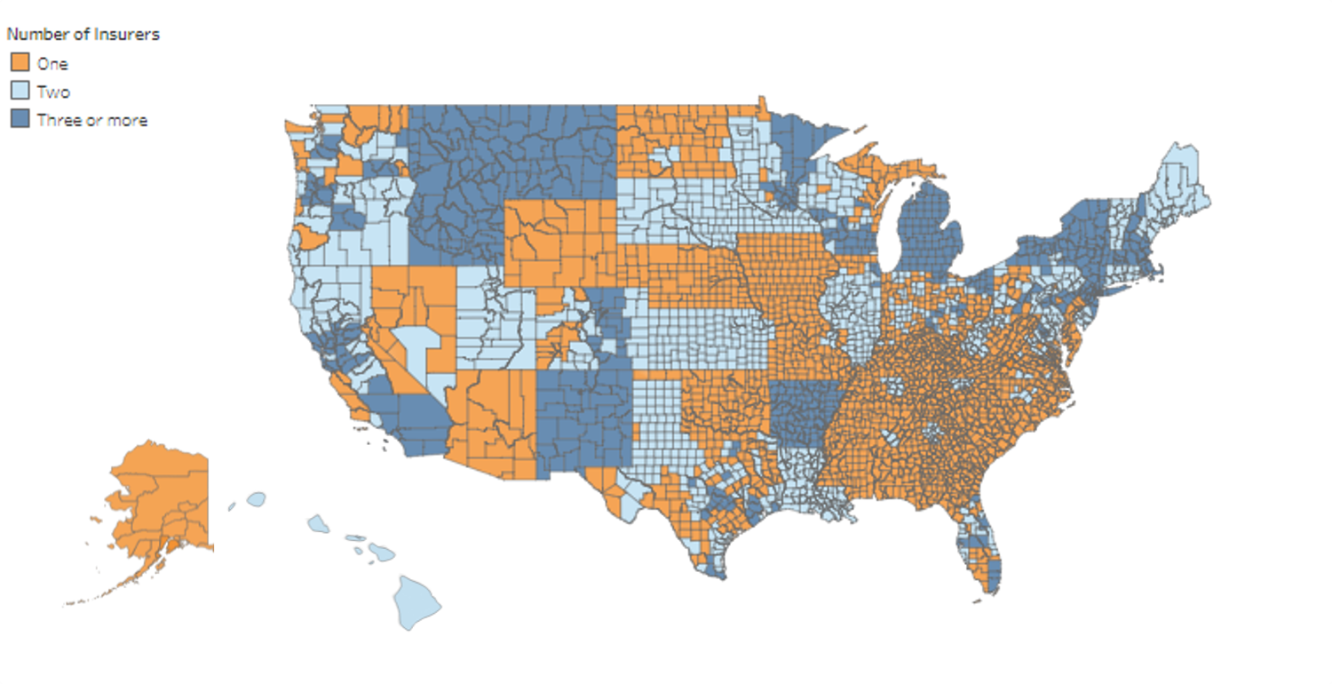
Insurer Participation by County in 2018
Source: Kaiser Family Foundation analysis of data from the 2018 QHP Landscape file released by healthcare.gov on October 25, 2017. Note: For states that do not use healthcare.gov in 2018, insurer participation is estimated based on information gathered from state rate filings. Enrollment is based on 2017 plan selections.
See the interactive map here: https://www.kff.org/health-reform/issue-brief/insurer-participation-on-aca-marketplaces/

