Slide 1
What Consumers in Kentucky, Tennessee, and Virginia
Need to Know about Open Enrollment
October 31, 2017
Jennifer Tolbert, Kaiser Family Foundation
Karen Pollitz, Kaiser Family Foundation
Kelli Cauley, Assister Program Supervisor, Kentuckiana Regional Planning & Development Agency (KIPDA)
Emilie Fauchet, Lead Navigator for the Hispanic Community (Middle TN), Family and Children's Service
Jill Hanken, Director, ENROLL! Virginia

Slide 2

Karen Pollitz
Senior Fellow

Slide 3

Jennifer Tolbert
Director of State Health Reform

Slide 4

Kelli Cauley
Assister Program Supervisor
Kentuckiana Regional Planning and Development Agency

Slide 5

Emilie Fauchet
Lead Navigator for the Hispanic Community (Middle TN)
Family and Children’s Service, Nashville

Slide 6

Jill Hanken
Director
ENROLL! Virginia

Slide 7
Events leading up to open enrollment added to uncertainty for insurers and confusion for consumers.
Debate over Affordable Care Act repeal ended with no legislation enacted
2018 Open Enrollment shortened to 6 weeks
Resources for outreach and consumer assistance have been reduced
  90% reduction in federal funding for advertising
  41% reduction in federal navigator grants; varying effects by states and programs
Cost-sharing reduction (CSR) payments to insurers have been terminated
  Bipartisan effort underway in Senate to restore CSR payments to insurers and federal funding for marketing and in-person assistance, though prospects are uncertain

Slide 8
Most are aware the individual mandate is still in effect, but four in ten uninsured are unaware or unsure.
As you may know, the health care law passed in 2010—known as the Affordable Care Act or Obamacare—required nearly all Americans to have health insurance, or else pay a fine. As far as you know, is this requirement still in effect, or not?
Total public
Uninsured ages 18-64
All non-group enrollees ages 18-64
Marketplace enrollees ages 18-64
NOTE: Refused responses not shown.
SOURCE: Kaiser Family Foundation Health Tracking Polls (pooled interviews from September and October 2017)

Slide 9
The Affordable Care Act is still the law.
The law has not been repealed or replaced
Individuals must have health insurance in 2018 or risk paying a tax penalty
  Penalty in 2018 is greater of:
    $695/adult ($347.50/child), up to $2,085/family; or
    2.5% of household income above the tax filing threshold, capped at the cost of national average bronze plan premium
  Exemptions for affordability (if lowest cost marketplace premium is more than 8.05% of income in 2018), poor adults in states not expanding Medicaid, hardship, others
To satisfy the individual mandate:
  Sign up for health coverage offered at work
  Apply for Medicaid/CHIP
    Over 300,000 in KY, TN, and VA are eligible for Medicaid/CHIP but not enrolled
  Apply for private, non-group health insurance on or off Marketplace
    Premium subsidies available in Marketplace for people with income 100%-400% FPL
Private non-group health insurance can only be purchased during open enrollment or special enrollment periods (SEP) following life change events

Slide 10
Most uninsured and large shares of non-group enrollees are unaware of the timing of open enrollment.
As you may know, under the health care law there are specific open enrollment periods each year when individuals can sign up for new insurance or change their current health insurance plans.
Do you happen to know when the next open enrollment period begins?
Do you happen to know when the next open enrollment period ends?
Uninsured
ages 18-64
All non-group enrollees
ages 18-64
Marketplace enrollees
ages 18-64
NOTE: Refused responses not shown.
SOURCE: Kaiser Family Foundation Health Tracking Polls (pooled interviews from September and October 2017)

Slide 11
Open enrollment for 2018 will be shorter in most states.
November 1 – December 15, 2017 in Healthcare.gov states
  Open enrollment period will be 6 weeks, compared to 12 weeks in prior years
State run marketplaces have option to extend dates, and many have
WA
VT
ME
MT
ND
MN
NH
OR
NY
MA
ID
SD
WI
MI
RI
WY
PA
CT
NE
IA
OH
NJ
NV
IL
IN
DE
UT
WV
MD
CA
CO
KS
MO
KY
VA
DC
TN
NC
AZ
NM
OK
AR
SC
MS
AL
GA
AK
TX
LA
FL
HI
Healthcare.gov State (39 States)
State-Based Marketplace (12 States including DC)

Slide 12
Nearly one-quarter of Marketplace enrollees auto-renewed in 2017.
Auto-renewal will still be an option in 2018, but active shopping is strongly recommended
Issuer exits means auto-renewal could assign consumers to new insurer with new provider network
Unlike prior years, consumers will not have the opportunity to change plans in January if they do not like the auto-renewal results
With 2018 premium changes, subsidy amounts could change substantially
Renewal notices with 2018 premium amounts that typically arrive in October will be late for many consumers

Slide 13
2018 Insurer participation changed in Kentucky, Tennessee, and Virginia.
State | Number of Marketplace Insurers |  | Detail
 | 2017 | 2018
Kentucky | 3 | 2 | Humana left Marketplace statewide Anthem reduced service area Caresource no change
Tennessee | 3 | 3 | Humana left Marketplace statewide BCBSTN expanded into areas left by Humana Oscar entered Marketplace (Nashville area) CIGNA no change
Virginia | 8 | 6 | Aetna left Marketplace statewide UnitedHealth left Marketplace statewide Anthem reduced service area Sentara (Optima) reduced service area CareFirst BCBS no change CIGNA no change Kaiser Permanente no change Piedmont no change

Slide 14
Most Marketplace enrollees worry rising deductibles, premiums will make their coverage unaffordable.
Percent who say they are “very” or “somewhat” worried that their…
…co-pays and deductibles will become so high that they won’t be able to afford to get the health care they need
…health insurance premiums will increase so much that they won’t be able to afford the plan they have now
SOURCE: Kaiser Family Foundation Health Tracking Polls (pooled interviews from September and October 2017)

Slide 15
Average medical deductibles in cost sharing reduction plans are much lower than in traditional Silver plans.
(200%-250% FPL)
(150%-200% FPL)
(100%-150% FPL)
Source: Kaiser Family Foundation analysis of Marketplace plans in the 39 states with Federally Facilitated or Partnership exchanges in 2017 (including Arkansas, Kentucky, New Mexico, Nevada, and Oregon). Data are from Healthcare.gov health plan information for individuals and families available here: https://www.healthcare.gov/health-plan-information-2017/

Slide 16
Though the President stopped reimbursement to insurers, insurers must still provide CSR to consumers.
Cost sharing reductions (CSR) are available to eligible individuals in the Marketplace with income 100%-250% FPL
  $12,060-$30,150 for individual in 2018
  $24,600 to $61,500 for family of four in 2018
Nationwide, 57% of marketplace enrollees were eligible for CSR in 2017
  51% in Kentucky; 59% in Tennessee; 60% in Virginia
CSR subsidies are delivered only through modified Silver plans.
  Silver plan deductibles, co-pays, and other cost sharing amounts are reduced; federal government reimburses insurers monthly for the value of added coverage
President Trump’s recent announcement ended CSR reimbursement to health insurers, but insurers are still required to offer CSR to eligible individuals
  Most important takeaway for consumers: Insurers are still required to provide reduced deductibles and copays for low-income marketplace enrollees
  Second most important takeaway for consumers: While insurers are increasing premiums to offset the loss of payments from the federal government, consumers will mostly be held harmless

Slide 17
Most insurers raised premiums to address the termination of CSR payments
Approach to applying CSR premium increases designed to protect consumers
  Tennessee: insurers applied premium increase just to silver plans
  Kentucky and Virginia: insurers applied the premium increase only on silver plans sold through the marketplace
As a result, the premiums for silver plans in most areas will increase much more than will premiums for bronze plans
That means the dollar value of premium tax credits will also increase substantially in 2018
Important for consumers to review plan prices during OE
  Consumers who continue to buy the benchmark Silver plan – or a cheaper plan – will be able to pay about the same monthly premium in 2018 or less
  After taking into account the tax credit, consumers may find the net premiums for bronze or gold plans in 2018 are more affordable than in 2017
  Consumers not eligible for tax credits will likely face higher premiums

Slide 18
2018 premiums in Kentucky are increasing, but subsidy-eligible consumers will pay the same or less.
Advance premium tax credit amounts and consumer share of premiums for 30-year old in Louisville, KY with income at 200% FPL ($24,120 in 2018)
$391
$332
$269
$247
$222
2017 Monthly Premiums
2018 Monthly Premiums
SOURCE: HealthCare.gov for 2017 and 2018 monthly premiums and premium tax credits.

Slide 19
2018 premiums in Tennessee are increasing, but subsidy-eligible consumers will pay the same or less.
Advance premium tax credit amounts and consumer share of premiums for 30-year old in Nashville, TN with income at 200% FPL ($24,120 in 2018)
$732
$519
$481
$372
$353
2017 Monthly Premiums
2018 Monthly Premiums
SOURCE: HealthCare.gov for 2017 and 2018 monthly premiums and premium tax credits.

Slide 20
2018 premiums in Virginia are increasing, but subsidy-eligible consumers will pay the same or less.
Advance premium tax credit amounts and consumer share of premiums for 30-year old in Virginia Beach, VA with income at 200% FPL ($24,120 in 2018)
$850
$589
$431
$425
$313
2017 Monthly Premiums
2018 Monthly Premiums
SOURCE: HealthCare.gov for 2017 and 2018 monthly premiums and premium tax credits.

Slide 21
New enrollment rules may add to confusion.
Failure to reconcile
  Consumers who received advanced premium tax credits (APTCs) in 2016 and who have not yet filed their 2016 federal income tax return with Form 8962 may be denied APTCs in 2018
  Marketplace eligibility determination notice won’t specify this reason
  Consumers can regain eligibility for APTC by filing 2016 federal return with Form 8962
Insurers can require repayment of 2017 unpaid premium debt
  Insurers can require payment of back due premiums from prior 12 months before issuing new coverage for 2018
  New rule, effective June 19, 2017, applies to premium debt after that date
  Prior notice required in 2017
  Appeals process not yet clearly defined
  Contact marketplace, state insurance regulator, in-person assister for help

Slide 22
Start early. Waiting to the last minute risks delays.
“Surge” signups as deadline approaches may increase with shorter Open Enrollment period
  Healthcare.gov slowdowns, call center waits are possible
  Unclear whether “in-line” enrollment will be permitted for those who are unable to complete their enrollment by Dec. 15 deadline
Planned maintenance on HealthCare.gov during Open Enrollment
Navigator funding reduced 41%, on average, in federal marketplace states
  Reductions vary by state: 16% in TN, 49% in VA (Navigators in KY are state-funded)
  Response to funding reductions will vary: Staff layoffs, reduced service areas, reduced service hours expected in some areas/programs*
Demand for in-person help can exceed capacity in final weeks of Open Enrollment
*Kaiser Family Foundation, “Data Note: Changes in 2017 Federal Navigator Funding,” October 2017, https://www.kff.org/health-reform/issue-brief/data-note-changes-in-2017-federal-navigator-funding/

Slide 23
KFF Resources on Open Enrollment
Health Reform Frequently Asked Questions https://www.kff.org/health-reform/faq/health-reform-frequently-asked-questions/
Marketplace Subsidy Calculator (2018 updates pending) https://www.kff.org/interactive/subsidy-calculator/
Penalty calculator (pending)
ACA and You Explainers https://www.kff.org/understanding-health-insurance/
State Health Facts https://www.kff.org/statedata

Slide 24


Slide 25
State-Based Marketplace – Federal Platform
Assister Program is required, but 100% State Funded
2 Insurance Issuers for Kentucky, but only 1 per County is available.
Anthem available in 59 Counties
CareSource available in 61 Counties
If you were enrolled in a 2017 plan,
You will be Auto-Enrolled into the closest
Cross-referenced Plan, even if a different
Issuer. #1 Concern – Is your Doctor in
Network

Slide 26
https://kynect.ky.gov/General/AgentOrKynector
To Find an Assister Near You for Assistance

Slide 27

https://healthbenefitexchange.ky.gov/SiteCollectionDocuments/November%20Events.pdf
To Find a Calendar of Events Throughout KY Where an Assister Is Available
Nov. 15th- 12:00-7:00 @ Sun Valley Community Center- 6505 Bethany Ln, Valley Station, KY 40272
Nov. 16th- 1:00-7:00 @ Meade County Extension Office- 1041 Old Ekron Rd, Brandenburg, KY 40108
Nov. 20th- 12:00-7:00 @ Awake Center- 701 Washington St, Shelbyville, KY 40065
Nov. 21st- 12:00-7:00 @ Hardin County Public Library- 100 Jim Owen Dr, Elizabethtown, KY 42701
Nov. 27th- Bullitt County@ Ridgeway Public Library – 127 N. Walnut St., Shepherdsville, KY 40165
Nov. 29th- 12:00-7:00 @ Marion County Career Center- 526 Workshop Lane, Lebanon, KY 40033
Nov. 30th- 12:00-7:00 @ South Central Library- 7300 Jefferson Blvd, Louisville, KY 40219
Dec. 1st- 12:00-5:00 @ Oldham County Public Library- 308 Yager Ave, La Grange, KY 40031 (may be extended to 7:00)
Dec. 4th- 2:00-7:00 @ Carroll County Library- 136 Court St, Carrollton, KY 41008
Dec. 5th- 12:00-7:00 @ Breckinridge County Extension Office- 1377 S Hwy 261. Hardinsburg, KY 40143
Dec. 6th- 12:00-7:00 @ St. Matthews Community Center- 310 Ten Pin Ln, Louisville, KY 40207
Dec. 8th- 12:00-5:00 @ Washington County Library- 333 W Main St, Springfield, KY 40069
Dec. 11th- Spencer County@ Spencer County Library – 168 Taylorsville Rd., Taylorsville, KY 40071
Dec. 12th- 12:00-5:00 @ Nelson County Library- 201 Cathedral Manor, Bardstown, KY 40004

Slide 28
Tennessee Carriers
Three carriers:
  BlueCross BlueShield (everywhere except Greater Nashville and Greater Memphis)
  Cigna (Tri-Cities area, Greater Nashville and Greater Memphis only)
  Oscar (Greater Nashville only)
All carriers submitted their plans assuming they would cover CSRs
  This did cause premium increases in order to stabilize the market
Consumers who have opted for auto-renewal will be automatically renewed into the plan that is the most similar to the plan that they had in 2017. Because of changes to plans and carriers, this may not be the plan that works best for them.
  All consumers can pick their own plan during Open Enrollment, even if they have been notified that they have been auto-renewed.

Slide 29
Tennessee Enrollment Assistance
Make an appointment with a Navigator anywhere in TN by calling 844-644-5443 or online at http://www.getcoveredtenn.org/
Navigators speak English, Spanish, Arabic, Kurdish, Amharic and language line services are available for other languages

Slide 30
Virginia OE5
Statewide Navigator Program
  www.enrollva.org
  Information
  Appointments
  Events Calendar
  1-888-392-5132
  Collaborate with
  CACs & other partners

Slide 31
Virginia Marketplace for 2018
Fewer carriers participating
  Seven Companies
Most areas have only one carrier
  But each offers multiple plans
2017 carriers may no longer serve the same areas
  New provider networks
  Different hospitals in network
  Different drug formularies
Average rate increases range from 34.5% - 81.8%
  Companies assumed loss of CSR payments
  Other federal uncertainty
Notes:
CareFirst, Cigna, Anthem Healthkeepers, Kaiser, Optima, Piedmont

Slide 32
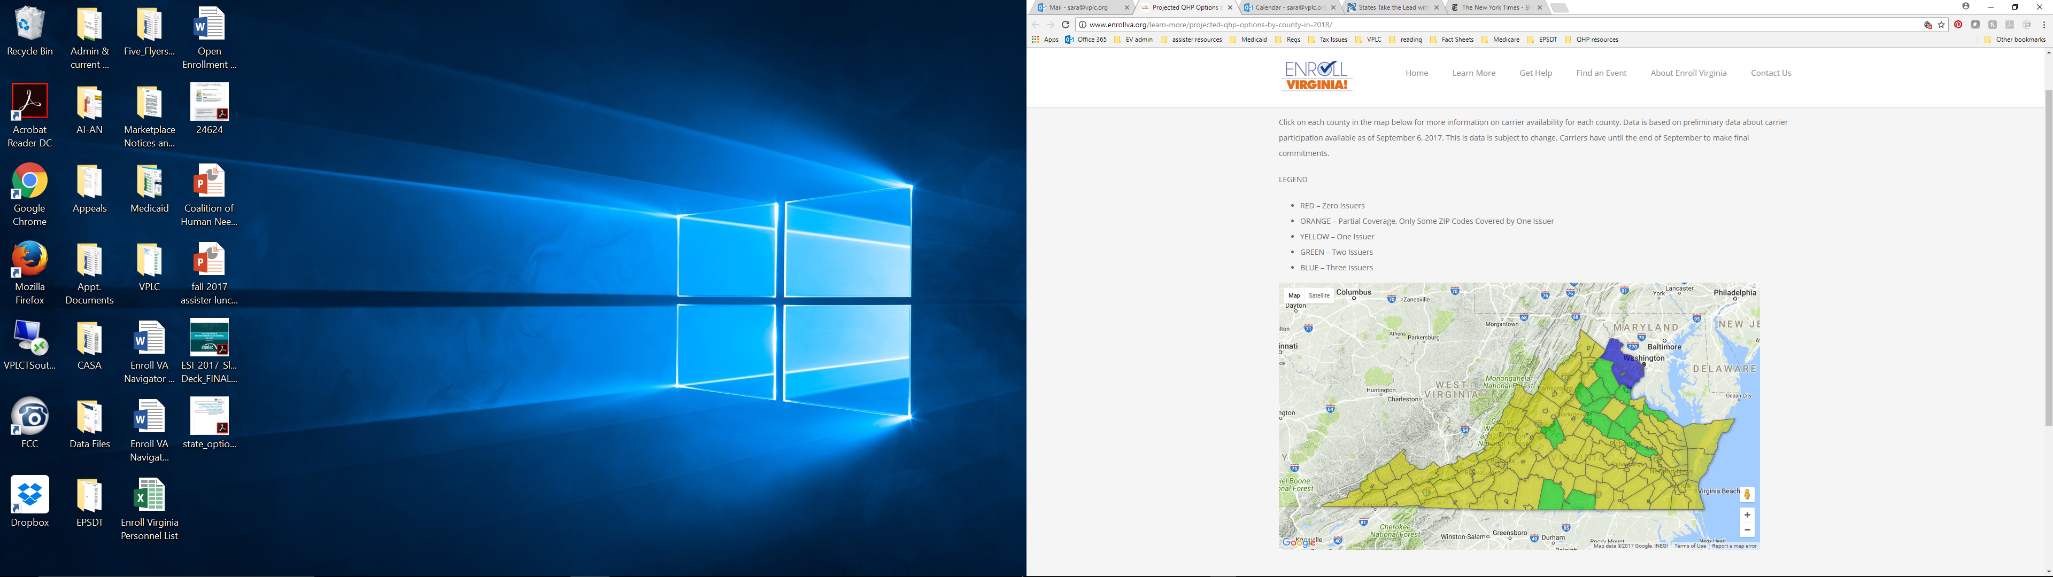
Number of Issuers by County
Yellow – One issuer
Green – Two issuers
Blue – Three issuers
Will there be adequate networks?

Slide 33
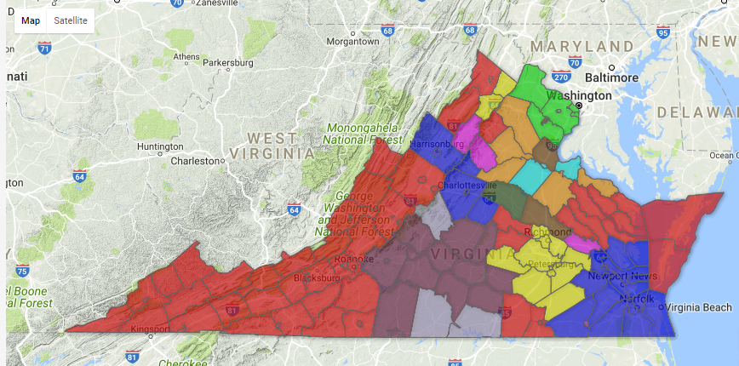
Issuer Options by County
Red – Anthem
Orange – Anthem & Kaiser
Pink – Anthem & Optima
Light Purple – Optima & Piedmont
Dark Purple – Piedmont
Yellow – Cigna
Light Green – CareFirst, Cigna & Kaiser
Dark Green – Optima & Kaiser
Brown – Cigna & Kaiser
Dark Blue – Optima
Light Blue - Kaiser

Slide 34
Tips for Consumers
Pay attention to mail from current insurance plan and Healthcare.gov
If authorized by consumer, letters will offer automatic renewal into same plan or most similar new plan
Consumer can still switch to another available plan – but only during open enrollment (unless SEP eligible)
  Check new networks – hospital, doctors
  Check new formularies

Slide 35
Tips for Consumers
If eligible, tax credits protect consumers from higher premiums.
  Income from 100%-400% FPL
Silver plans with cost sharing reductions (CSRs) will still be offered
  Household income under 250% FPL
  Lower deductibles, lower co-payments
Don’t wait to act! Open enrollment is only 6 weeks
  November 1 – December 15

Slide 36
Questions About Open Enrollment
Karen Pollitz, Senior Fellow,
Kaiser Family Foundation
Email: kpollitz@kff.org
Phone: (202) 347-5270
Jennifer Tolbert, Director of State Health Reform, Kaiser Family Foundation
Email: jtolbert@kff.org
Phone: (202) 347-5270
Kelli Cauley, Kentuckiana Regional Planning and Development Agency
  Online: https://kynect.ky.gov/General/AgentOrKynector
  Phone: (888) 737-3363
Emilie Fauchet, Family and Children’s Service, Nashville
  Online: http://www.getcoveredtenn.org
Phone: (844) 644-5443
Jill Hanken, ENROLL! Virginia
  Online: www.enrollva.org
Phone: (888) 392-5132

Slide 37
Contact Information
    Katie H. Smith, Communications Associate
    Kaiser Family Foundation
    Email: ksmith@kff.org
    Phone: (202) 347-5270
    Facebook: /KaiserFamilyFoundation
    Twitter: @KaiserFamFound
    Email alerts: kff.org/email

