Slide 1

Employer Health Benefits Survey 2017
Release Slides
September 19, 2017

Slide 2
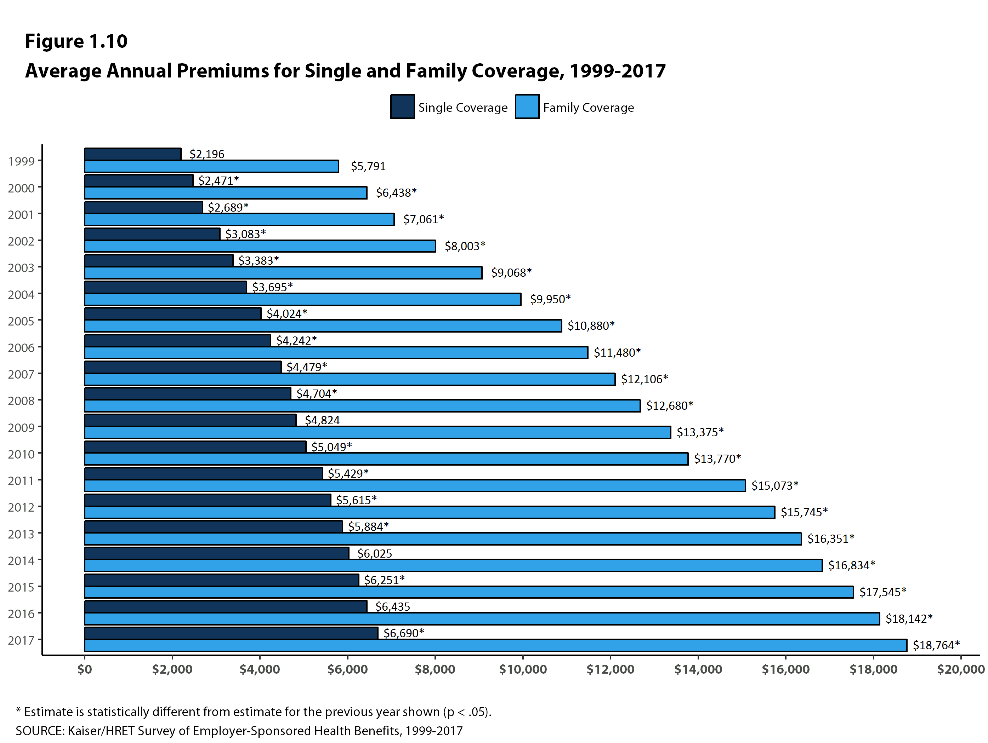
Figure 1

Slide 3
Figure 2

Slide 4
Figure 3
Average Annual Increases in Premiums for Family Coverage Compared to Other Indicators, 2000-2017
* Estimate is statistically different from estimate for the previous year shown (p < .05).
SOURCE: Kaiser/HRET Survey of Employer-Sponsored Health Benefits, 1999-2017. Bureau of Labor Statistics, Consumer Price Index, U.S. City Average of Annual Inflation (April to April), 1999-2017; Bureau of Labor Statistics, Seasonally Adjusted Data from the Current Employment Statistics Survey, 1999-2017 (April to April).

Slide 5
Figure 4

Slide 6
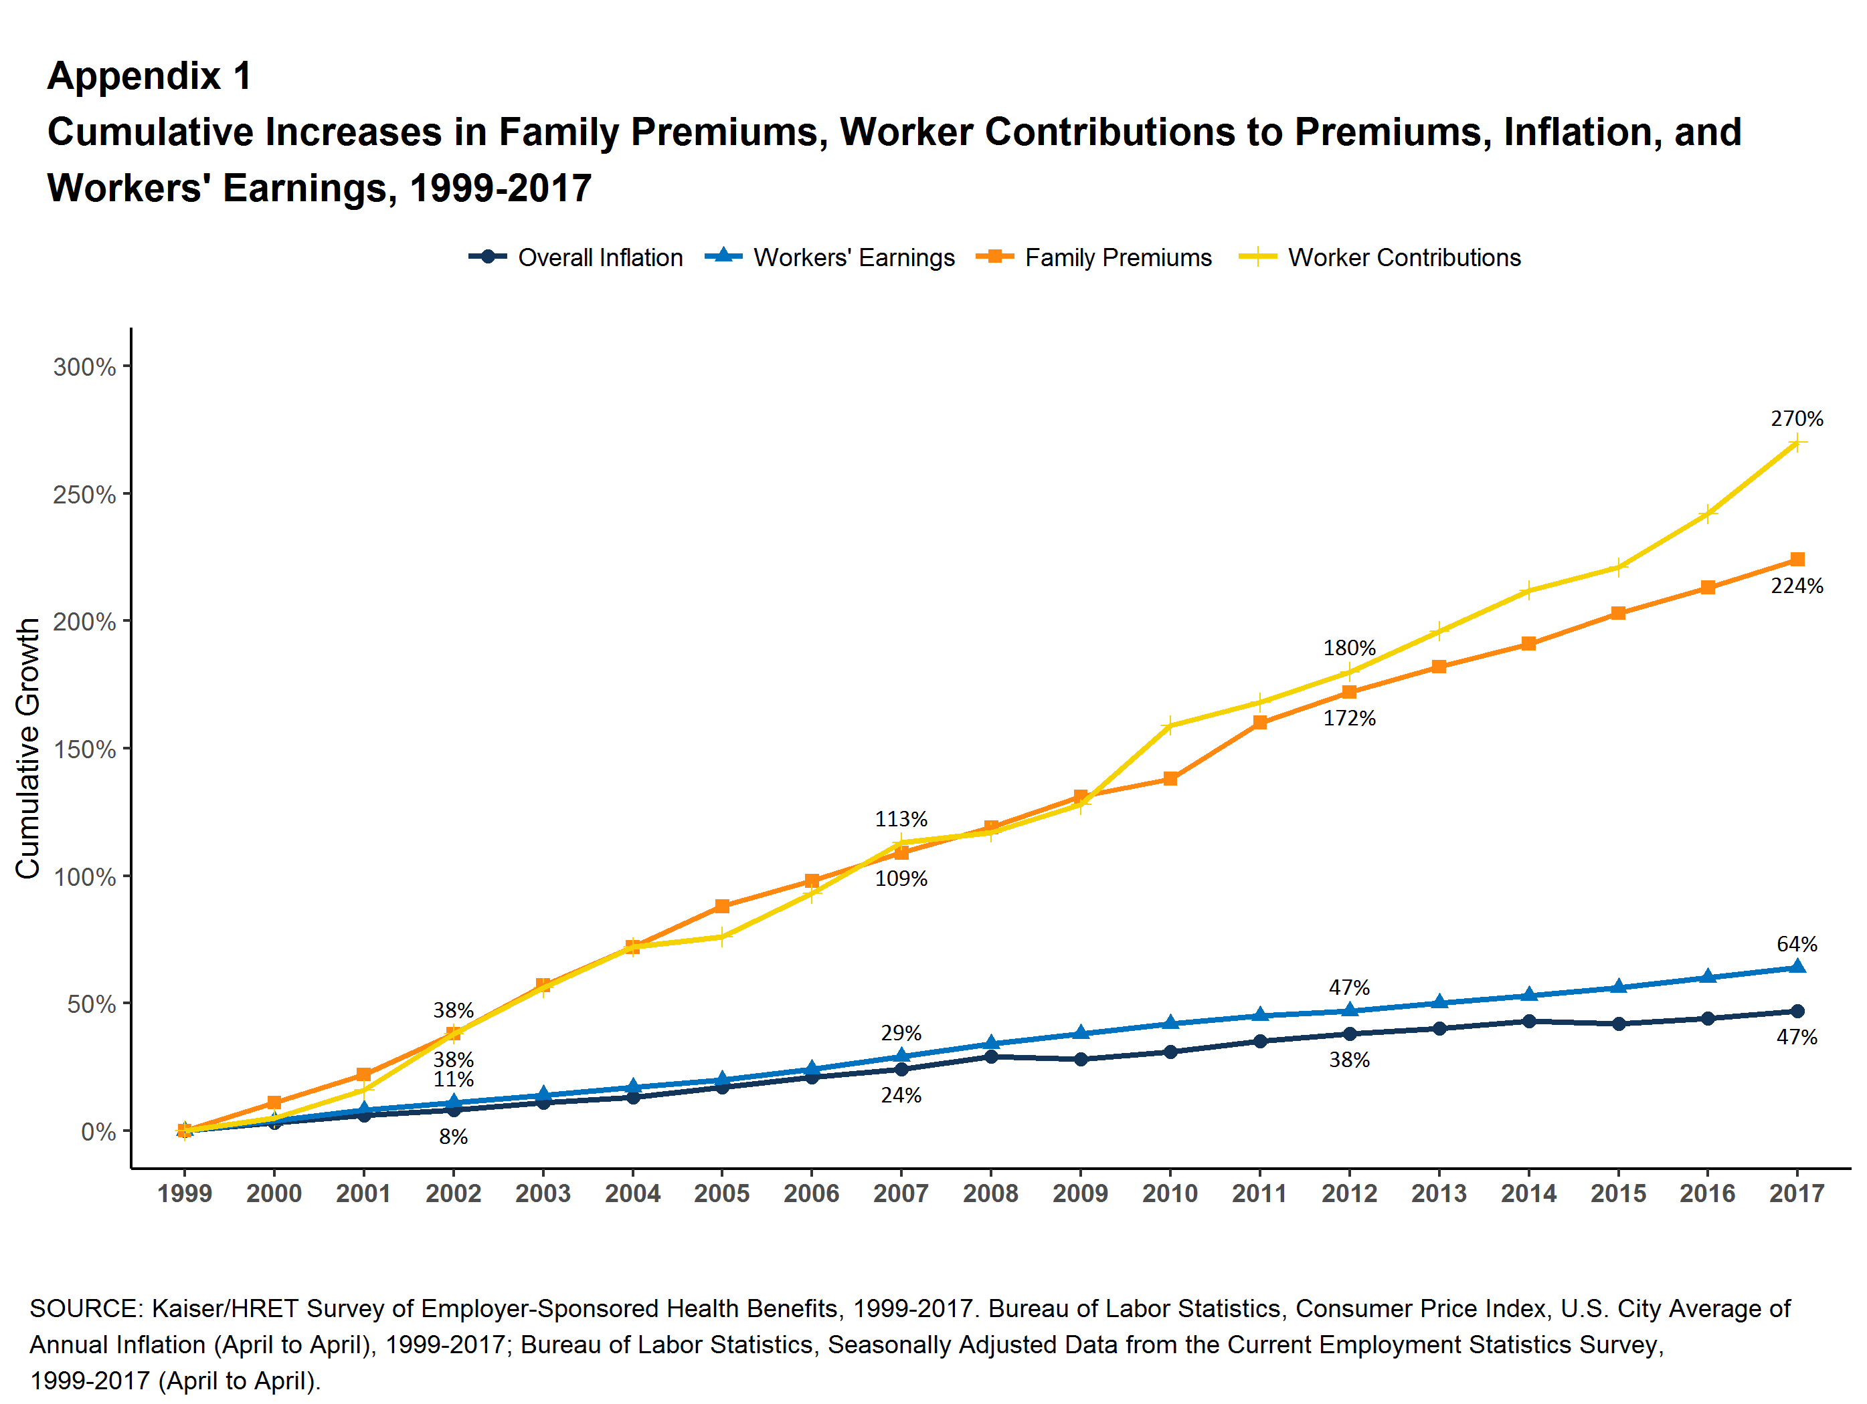
Figure 5

Slide 7
Figure 6

Slide 8
Figure 7

Slide 9
Figure 8

Slide 10
Figure 9

Slide 11
Figure 10

Slide 12
Figure 11

Slide 13
Figure 12
Percentage of All Workers Covered by Their Employer's Health Benefits, Both In Firms Offering and Not Offering Health Benefits, by Firm Size, 1999-2017
* Estimate is statistically different from estimate for the previous year shown (p < .05).
SOURCE: Kaiser/HRET Survey of Employer-Sponsored Health Benefits, 1999-2017.

Slide 14
Figure 13

Slide 15
Figure 14

Slide 16
Figure 15

Slide 17
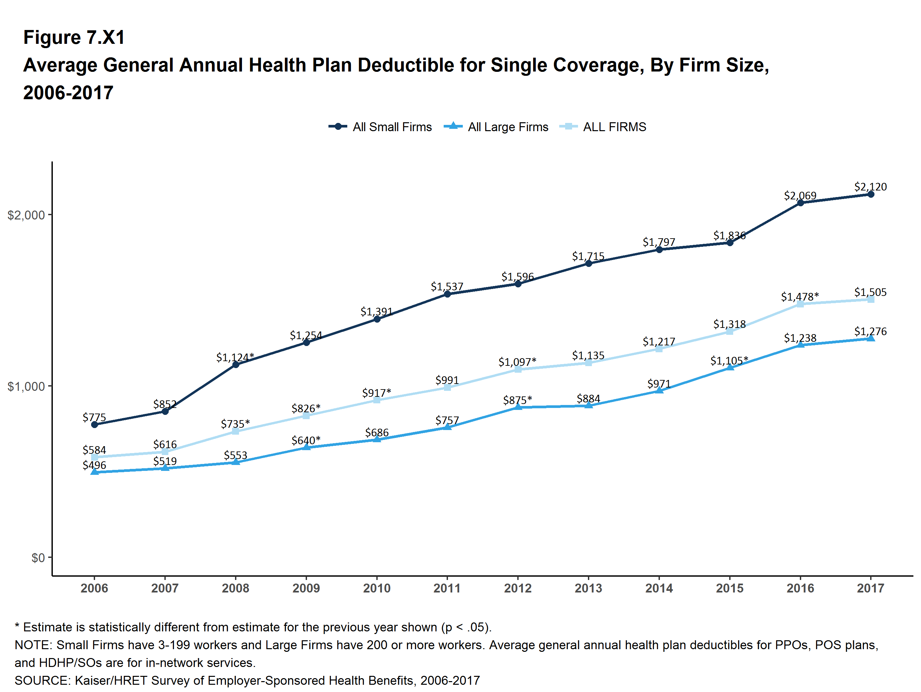
Figure 16

Slide 18
Figure 17

Slide 19
Figure 18
Percentage of Covered Workers Enrolled in a Plan with an Out-of-Pocket Maximum for Single Coverage, 2009-2017
* Estimate is statistically different from estimate for the previous year shown (p < .05).
NOTE: OOP refers to ‘out-of-pocket.’ Out-of-pocket maximums reported are for in-network services. Covered workers without an OOP maximum are considered to be exposed to at least the specified threshold. Some of these workers may be enrolled in plans whose cost-sharing structure has other limits that make it impossible to reach the specified threshold.
SOURCE: Kaiser/HRET Survey of Employer-Sponsored Health Benefits, 2009-2017.

Slide 20
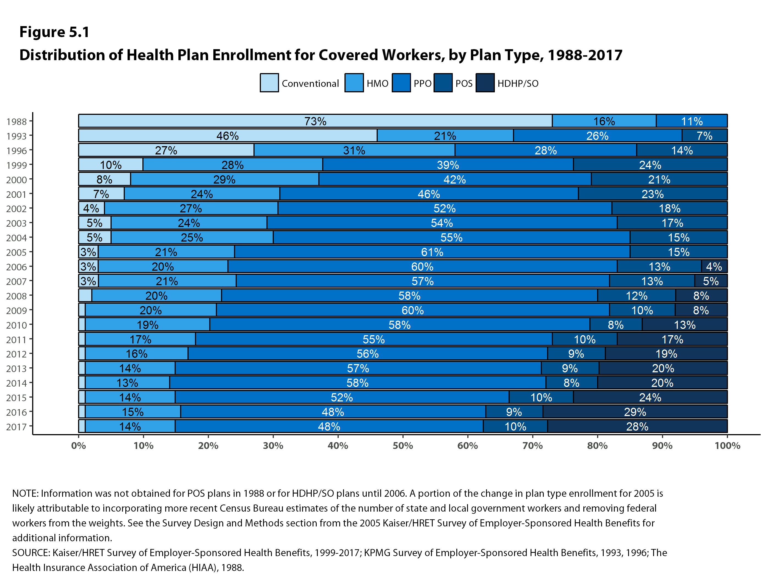
Figure 19

Slide 21
Figure 20

Slide 22
Figure 21

Slide 23
Figure 22

Slide 24
Exhibit 6:
Among Firms Offering Health Benefits, Percentage of Firms Offering Various Wellness and Health Promotion Activities and Incentives, by Firm Size, 2017
Figure 23
* Estimate is statistically different between All Small Firms and All Large Firms estimates (p < .05).
NOTE: 'Specific Wellness Programs' include 'Programs to Help Employees Stop Smoking', 'Programs to Help Employees Lose Weight', or 'Other Lifestyle or Behavioral Coaching'.
SOURCE: Kaiser Family Foundation and Health Research & Educational Trust, Employer Health Benefits Survey, 2017.

Slide 25
Figure 24

Slide 26
Figure 25

Slide 27
Figure 26

Slide 28


