Slide 1
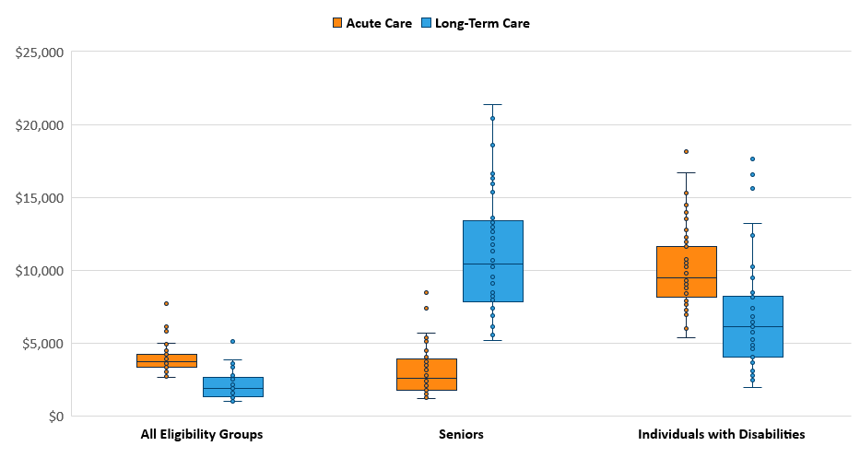
State Variation in Medicaid Acute and Long-Term Care Spending Per Enrollee, FY 2011
Note: Includes spending per enrollee for full and partial enrollees. Excludes spending for AZ, HI, MN for “All Eligibility Groups” and “Seniors”, TN, NM, and VT due to data reliability issues.
Source: Kaiser Family Foundation and Urban Institute estimates based on data from FY 2011 and CMS-64 reports. 2010 data were used for FL, KS, ME, MD, MT, NJ, OK, TX, and UT because 2011 data were unavailable.

