Slide 1
Medicaid’s role: what’s at stake under a block grant or per capita cap?

Slide 2



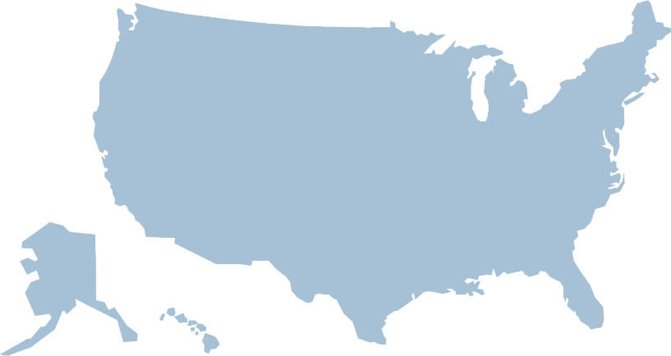

Under the current law, Medicaid provides a guarantee of coverage to people eligible for services and the federal government matches state Medicaid payments with no pre-set limit.
GUARANTEED
Who does Medicaid cover?
How are Medicaid funds spent?

Slide 3


























Medicaid covers several groups of people:
1 in 7 adults (age 18-65)
2 in 5 children
1 in 5 Medicare beneficiaries
3 in 5 nursing home residents
2 in 5 people with disabilities

Slide 4






Most people covered by Medicaid are children and adults.
Children and adults
Seniors and people
with disabilities

Slide 5
However, most Medicaid spending is for care provided to seniors and people with disabilities.
Children and adults
Seniors and people
with disabilities

Slide 6





Because seniors and people with disabilities have more complex needs, they have higher per-person costs.

Slide 7
In addition, seniors and people with disabilities rely on Medicaid for long-term care.
Long-term care

Slide 8
Per person spending also varies greatly across states
VT
ME
WA
NH
MT
ND
MN
OR
MA
SD
WI
NY
ID
MI
RI
WY
CT
IA
PA
NJ
NE
OH
DE
NV
IL
IN
MD
CA
UT
CO
WV
VA
DC
KS
MO
KY
NC
AZ
TN
NM
OK
AR
SC
MS
AL
GA
AK
TX
LA
FL
HI
$8,100 - $11,100
$6,800 - $8,100
$5,650 - $6,800
$4,000 - $5,650

Slide 9

Proposals to convert Medicaid to a block grant or per capita cap could reduce federal spending by limiting growth to a pre-set amount and increase state flexibility in determining eligibility and benefits.
Current law: Reflects increases in health care cost, changes in enrollment, and state policy choices
Current law
Federal Cap
Block grant: Does not account for changes in enrollment or changes in health care costs
Per capita cap: Does not account for changes in health care costs

Slide 10



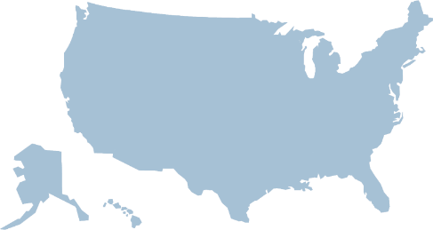














The impact of a block grant or per capita cap will depend on funding levels, but reducing federal Medicaid funds could:
Shift costs and risks to states, beneficiaries, and providers if states restrict eligibility, benefits, and provider payment
Lock in historic spending patterns
  If expansion funding is cut, the impact could be even greater for the 32 states that expanded Medicaid
Limit states’ ability to respond to rising health care costs, increases in enrollment due to a recession, or a public health emergency such as the opioid epidemic, HIV, Zika, etc.

Slide 11
For more information, visit www.kff.org/medicaid.

