Slide 1
Web Briefing for Journalists:
Repealing and Replacing Obamacare
Presented by the Kaiser Family Foundation
January 25, 2017

Slide 2



Diane Rowland
Larry Levitt
Usha Ranji
Senior Vice President for
Special Initiatives
Kaiser Family Foundation
Executive Vice President
Kaiser Family Foundation
Associate Director for Women’s Health Policy
Kaiser Family Foundation

Slide 3
The Coming Debate Over The Future of the Affordable Care Act
January 25, 2017
Kaiser Family Foundation Webinar
Larry Levitt
Senior Vice President, Kaiser Family Foundation
larryl@kff.org
@larry_levitt

Slide 4
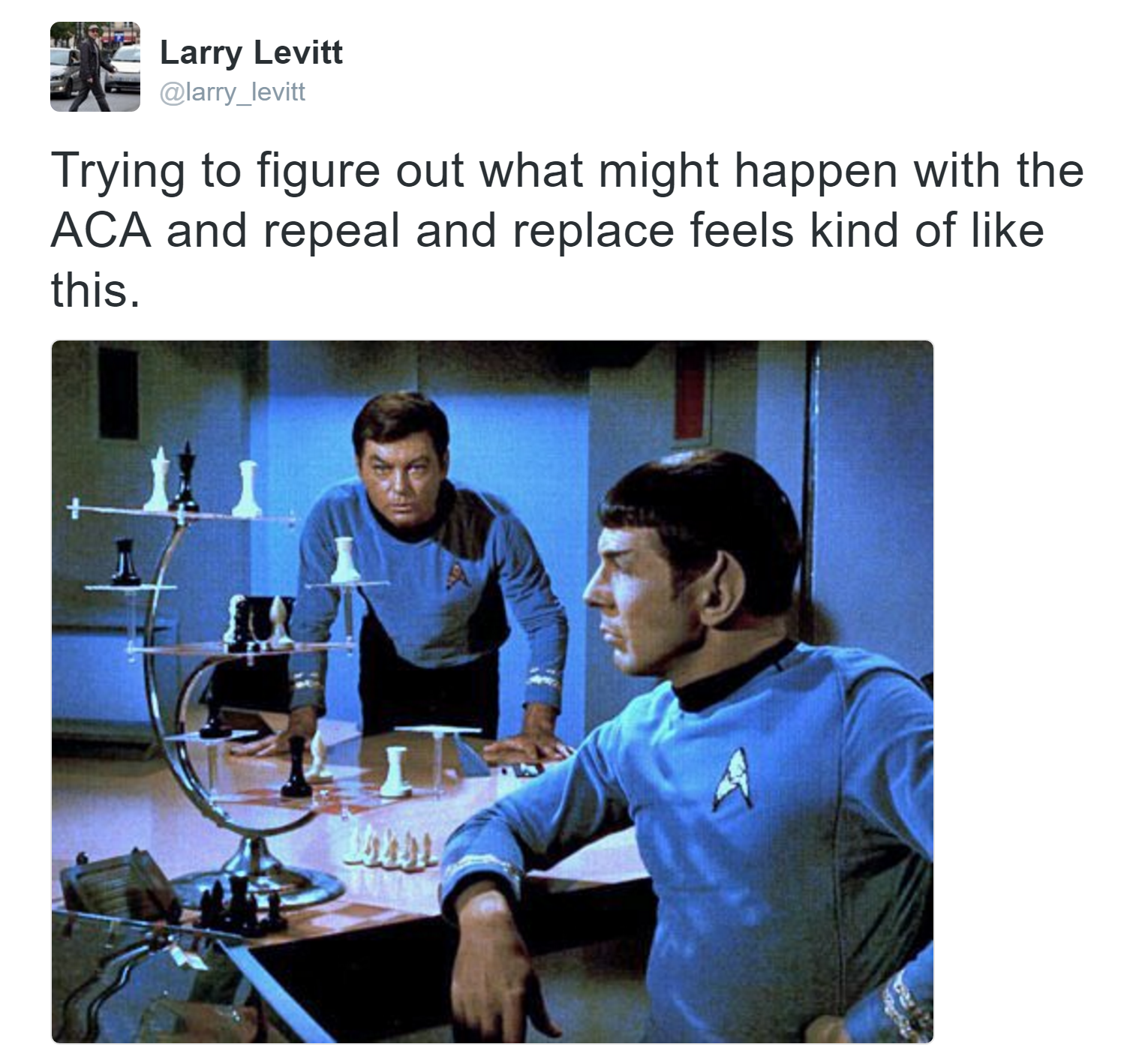

Slide 5
Possible avenues for repealing and replacing the ACA
A budget reconciliation measure allows for changes in taxes and spending with a 51 vote majority in the Senate, but it cannot make changes to federal law that have only incidental effects on the budget.
The House and Senate have passed budget resolutions paving the way for a reconciliation bill.
One model is HR 3762, passed by Congress in early 2016 and vetoed by the President.
  Repeal of ACA premium subsidies and Medicaid expansion, with a delayed effective date.
  Immediate repeal of the individual mandate and ACA tax increases.
  No change to the ACA’s insurance rules, including guaranteed access for people with pre-existing conditions.
Continuing discussion about whether replacement proposals will be introduced and debated alongside a repeal measure.
Potential executive actions by the Trump Administration (e.g., essential benefits, SEPs, grace periods, “grandmothered” plans, 1332 waivers).

Slide 6
President Trump’s executive order on the ACA
The order does not have any immediate effect or grant new powers to federal agencies. But, it may signal the approach the Administration intends to take.
  “waive, defer, grant exemptions from, or delay the implementation of any provision or requirement of the Act that would impose a fiscal burden on any State or a cost, fee, tax, penalty, or regulatory burden”
  “exercise all authority and discretion available to them to provide greater flexibility to States”
Some possible administrative actions:
  Waive the individual mandate penalty using “hardship” authority.
  Defer enforcement of the employer requirement.
  Provide greater flexibility for required benefits.
  Extend transitional “grandmothered” plans.
  Provide greater state flexibility through section 1332 ACA waivers and Medicaid waivers.

Slide 7
Consequences and risks of repeal and delay
With no replacement in place, health coverage could be at risk for up to 32 million people.
A replacement for the ACA would still likely require 60 votes in the Senate, which would need to be bipartisan based on the current partisan makeup.
Repeal of the ACA’s tax revenues would make development of a replacement more difficult, requiring scaled back benefits or new revenues or spending reductions.
There is significant risk of a “death spiral” and insurer exits in the individual insurance market in the short-term.
  Insurers would be required to guarantee coverage to people with pre-existing conditions, with no individual mandate to push healthy people to get covered.
  Insurers would also face uncertainty surrounding the future of the ACA, with an already fragile market in some states.
  Added risk: Potential for cost-sharing subsidies to end under House v. Burwell.
  Transitional relief could mitigate the risks.

Slide 8
ACA replacement proposals
Major proposals include:
  House GOP: A Better Way
  Representative Price: Empowering Patients First Act
  Senators Burr and Hatch, Representative Upton: Patient Choice, Affordability, Responsibility, and Empowerment Act
  Senators Cassidy and Collins: The Patient Freedom Act of 2017
  Senator Rand Paul: Obamacare Replacement Act
None of these proposals have been voted on or analyzed by the Congressional Budget Office, and some have not been turned into legislative language.
Details matter a lot!
President Trump has not yet provided much detail on his plans for replacing the ACA, though said recently that his plan would provide “insurance for everybody,” while being “much less expensive” and providing “much lower deductibles.”

Slide 9
Potential insurance market changes under ACA replacement proposals
Preservation of the ACA’s requirement for coverage of dependents up to age 26.
Less federal regulation of health plan benefits.
No individual or employer requirements.
More modest protections for people with pre-existing conditions in the individual insurance market.
  Guaranteed access only for those with continuous coverage.
  Premium surcharges or late enrollment penalties for people with coverage gaps.
  Federal grants for state high-risk pools.
More allowed variation in premiums based on age and gender.
Refundable tax credits that vary by age, but not necessarily by income or local premiums. Expanded use of Health Savings Accounts.
Sales of insurance across state lines.
Capping the tax exemption for employer-provided health benefits.
Greater state flexibility.

Slide 10
Some questions to consider under an ACA alternative
Consumers:
  What would be the impact on the number of people uninsured and on the adequacy of coverage people receive?
  Could low and middle income people afford health insurance and health care?
  How accessible is insurance for people with pre-existing conditions?
The federal budget:
  How is the plan paid for and what is the impact on the federal budget?
  Does the plan address rising health care costs?
States:
  Are there mechanisms and resources for states to go further if they wish?
Insurers:
  How is the transition managed and how quickly do changes take effect?
  What is the effect of continuous coverage requirements and late enrollment penalties vs. an individual mandate?
  Will medical underwriting be permitted in certain circumstances?

Slide 11
The Future of the ACA: What is at Stake for Medicaid?
January 25, 2017
Kaiser Family Foundation Webinar
Diane Rowland, Sc.D.
Executive Vice President, Kaiser Family Foundation

Slide 12
32 states expanded coverage for adults through the ACA expansion.
WA
VT
ME
MT*
ND
MN
NH*
OR
MA
SD
WI*
NY
ID
MI*
CT
RI
WY
PA
IA*
NJ
NE
OH
DE
NV
IL
IN*
MD
CA
UT
CO
WV
VA
KS
MO
KY
DC
NC
AZ*
TN
NM
OK
AR*
SC
MS
AL
GA
Democratic Governor
(14 States + DC)
AK
TX
LA
Republican Governor
(16 States)
FL
HI
Independent Governor
(1 State)
States not Implementing
Expansion (19 States)
NOTES: Coverage under the Medicaid expansion became effective January 1, 2014 in all but seven expansion states: Michigan (4/1/2014), New Hampshire (8/15/2014), Pennsylvania (1/1/2015), Indiana (2/1/2015), Alaska (9/1/2015), Montana (1/1/2016), and Louisiana (7/1/2016). Seven states that will have Republican governors as of January 2017 originally implemented expansion under Democratic governors (AR, IL, KY, MA, MD, NH, VT), and one state has a Democratic governor but originally implemented expansion under a Republican governor (PA). *AR, AZ, IA, IN, MI, MT, and NH have approved Section 1115 expansion waivers.

Slide 13
The uninsured rate in the United States has decreased, especially among Medicaid expansion states.
NOTE: Uninsured rates for 2016 are as of June 2016.
SOURCE: Emily P Zammitti, Robin A Cohen, and Michael E Martinez, Health Insurance Coverage: Early Release of Estimates from the National Health Interview Survey, January-June 2016, (Hyattsville, MD: National Center for Health Statistics, November 2016), https://www.cdc.gov/nchs/data/nhis/earlyrelease/insur201611.pdf.

Slide 14
The ACA Medicaid expansion increased eligibility for adults, but adult eligibility remains low in non-expansion states.
Median Medicaid Eligibility Levels for Adults as a Percent of the Federal Poverty Level, 2013 and 2017
Parents
Other Adults
Parents
Other Adults
States that Have Implemented the Medicaid Expansion as of Jan. 2017
(32 states, including DC)
States that Have Not Implemented the Medicaid Expansion as of Jan. 2017
(19 states)
NOTE: 2017 levels are based on state-reported eligibility levels as of January 2017. Eligibility levels are based on 2016 federal poverty levels (FPLs) for a family of three for children, pregnant women, and parents, and for an individual for childless adults. In 2016,the FPL was $20,160 for a family of three and $11,880 for an individual.
SOURCE: Based on results of a national survey conducted by the Kaiser Commission on Medicaid and the Uninsured and the Georgetown Center for Children and Families, 2013 and 2017 with data updates to reflect Medicaid expansion implementation.

Slide 15
Key Issues for ACA Repeal and Medicaid Expansion
14.4 million adults in 32 states covered by Medicaid expansion in Q1 2016, of which 11.2 million are newly eligible
100% federal financing match from Jan 2014 - September 2015 provided $93.3 billion to states; in 2017, match is 95% phasing down to 90% in 2020 and thereafter
How will repeal address the expansion?
  remove eligibility for adults without dependent children?
  remove federal funds for expansion?
  fold expansion into broader Medicaid block grants?
  make adjustments for non-expansion states?
What happens to other ACA provisions affecting all states?
Notes:
Some implications to note for non-expansion states: MAGI, enrollment & renewal processes, coordination with marketplaces

Slide 16
A block grant or per capita cap would be a fundamental change to Medicaid financing.
 | Current Medicaid Program | Block Grant | Per Capita Cap
Coverage | Guaranteed coverage, no waiting list or caps | No guarantee (can use wait lists or caps) | May be guaranteed for certain groups
Federal Funding | Guaranteed, no cap Responds to program needs (enrollment and health care costs) Can fluctuate | Capped Not based on enrollment, costs or program needs Fixed with pre-set growth | Capped per enrollee Not based on health care costs and needs Fixed with pre-set growth per enrollee
State Matching Payments | Required to draw down federal dollars Federal spending tied to state spending | Unclear Federal spending not tied to state spending beyond cap | Unclear Federal spending not tied to state spending beyond per enrollee cap
Core Federal Standards | Set in law with state flexibility to expand | Uncertain what the requirements would be to obtain federal funds

Slide 17
Medicaid is a major part of our health care system: covering 20% of people in the US in 2015.
Medicaid’s 74.4 million beneficiaries include:
1 in 2 low-income individuals
2 in 5 children
3 in 5 nursing home residents
2 in 5 people with disabilities
1 in 5 Medicare beneficiaries
SOURCE: Health insurance coverage: KCMU analysis of 2015 data from the 2016 ASEC Supplement to the CPS.

Slide 18
Medicaid is a major purchaser of health care.
Over three quarters of Medicaid enrollees are children and adults, but over half of spending is for seniors and people with disabilities.
$532.1B in FY 2015
*Fee-for-service
SOURCE: KFF estimates based on 2015 National Health Expenditure Accounts data from CMS, Office of the Actuary.
Office of the Actuary, CMS, 2015 Actuarial Report on the Financial Outlook for Medicaid, (Baltimore, MD: CMS), https://www.medicaid.gov/medicaid/financing-and-reimbursement/downloads/medicaid-actuarial-report-2015.pdf.

Slide 19
The budget resolution from March 2016 would have reduced federal Medicaid spending by 41% over the 2017-2026 period.
ACA Repeal: -$1,063 B
ACA Repeal: -$1,063 B
Total Cut: $2,091 B or 41%
Other Medicaid Cuts:
-$1,028
SOURCE: Kaiser Program on Medicaid and the Uninsured Estimates of the House Budget Committee Budget Resolution from March 2016 using the CBO January 2016 Baseline and Estimates from the Federal Subsidies for Health Insurance Coverage for People Under Age 65: 2016 to 2026 for the Medicaid ACA Estimates

Slide 20
A per capita cap could lock in historical state differences or redistribute federal funds across states.
Per capita spending by enrollment group
SOURCE: Kaiser Commission on Medicaid and the Uninsured and Urban Institute estimates based on data from FY 2011 MSIS and CMS-64 reports. Because 2011 MSIS data were unavailable, 2010 MSIS & CMS-64 data were used for Florida, Kansas, Maine, Maryland, Montana, New Mexico, New Jersey, Oklahoma, Texas, and Utah.

Slide 21




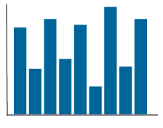
The impact of a block grant or per capita cap will depend on how it is structured and the funding levels, but could include:
Increases in the number of uninsured
Reduced access and service utilization, decreased provider revenues (to hospitals, nursing homes, etc.), and increased uncompensated care costs
Increased pressure on state budgets
Decreased economic activity
SOURCE: L. Antonisse, R. Garfield, R. Rudowitz, and S. Artiga, The Effects of Medicaid Expansion under the ACA: Findings from a Literature Review (Washington, DC: Kaiser Commission on Medicaid and the Uninsured, June 2016), http://kff.org/medicaid/issue-brief/the-effects-of-medicaid-expansion-under-the-aca-findings-from-a-literature-review/

Slide 22
What to Watch
What are options on the table?
  ACA Repeal / Replacement
  Financing Changes (Block Grant or Per Capita Cap)
  Waivers, administrative changes
What are key questions?
  What happens with expansion dollars?
  What is the base year for setting caps?
  What are allowable growth rates or spending targets?
  What new flexibility would be granted / core requirements maintained?
  What are the targeted reductions in federal funding?
What are the implications?
  Coverage / enrollees
  States (winners and losers)
  Providers
Notes:
2/21/14

Slide 23
The Future of the ACA: What is at Stake for Women’s Health?
January 25, 2017
Kaiser Family Foundation Webinar
Usha Ranji, M.S.
Associate Director, Women’s Health Policy
Kaiser Family Foundation

Slide 24
Changes in Women’s Insurance Coverage Since Passage of the ACA
Changes in health insurance coverage among women ages 18-64, 2010-2016
NOTES: *Data for 2016 do not include the full year, only January-June. Among women ages 18 to 64.
SOURCE: Health Insurance Coverage: Early Release of Estimates From the National Health Interview Survey, January-June 2016.

Slide 25
The ACA Made Many Insurance Reforms Affecting Women
ACA | At Risk Under Repeal
No pre-existing condition exclusions | At risk to be treated as pre-existing condition: Pregnancy (~ 4 million births per year) Prior C-section (1/3 births) Depression (1/10 women) History of domestic violence (1/3 women)
Gender rating banned | Individual plans may charge higher premiums to women for same coverage 1/3 of plans charged 25 and 40 year old women at least 30% more than men This practice costs women an estimated $1 billion more annually
Maternity care required in all plans | Individually purchased plans and small employer-based plans could exclude maternity care Included in only 12% of plans (2012) 7% of plans offered maternity riders (2012) Riders can cost more than $1000/month
Plans must offer dependent coverage up to age 26 | Women in their twenties had the highest uninsured rate before ACA 30% of women age 19-26 uninsured in 2009
SOURCES: Centers for Disease Control and Prevention (CDC), Births - Method of Delivery 2015, Depression in U.S. Household Population 2009-2012.
National Coalition Against Domestic Violence (NCADV), National Statistics, 2010.
National Women’s Law Center (NWLC), Turning to Fairness Report, 2012.
Kaiser Family Foundation/Urban Institute analysis of the March 2009 Current Population Survey, U.S. Bureau of the Census.

Slide 26
Preventive Services Covered by Private Plans Without Cost Sharing for Women
Cancer | Chronic Conditions | Vaccines | Healthy Behaviors | Pregnancy | Reproductive and Sexual Health
Breast Cancer Mammography for women 40+* Genetic (BRCA) screening and counseling Preventive medication Cervical Cancer Pap testing (women 21+ ) High-risk HPV DNA testing ♀ Colorectal Cancer One of following: fecal occult blood testing, colonoscopy, sigmoidoscopy Lung Cancer Adults 55-80 with history of smoking Skin Cancer Counseling for fair-skinned adults 10-24 | Cardiovascular health Hypertension screening Lipid disorders screenings Aspirin Type 2 Diabetes screening (adults w/ elevated blood pressure) Depression screening (adults, when follow up supports available) Osteoporosis screening (all women 65+, women 60+ at high risk) Obesity Screening (all adults) Counseling and behavioral interventions (obese adults) Hepatitis B, C screenings (adults at increased risk) | Td booster, Tdap MMR Meningococcal Hepatitis A, B Pneumococcal Zoster Influenza, Varicella HPV (women and men 19-26) | Alcohol misuse screening and counseling (all adults) Diet counseling (adults w/high cholesterol, CVD risk factors, diet-related chronic disease) Tobacco counseling and cessation interventions (all adults) Interpersonal and domestic violence screening and counseling (women 18-64)♀ Well-woman visits (women 18-64) ♀ Fall Prevention in Older Adults; physical therapy and vitamin D supplements | Tobacco and cessation interventions Alcohol misuse screening/counseling Rh incompatibility screening Gestational diabetes screenings♀ 24-28 weeks gestation First prenatal visit (women at high risk for diabetes) Screenings Hepatitis B Chlamydia (<24, hi risk) Gonorrhea HIV Syphilis Bacteriurea Folic acid supplements (women w/repro capacity) Iron deficiency anemia screening Breastfeeding supports, counseling , consultations and equipment rental♀ | STI and HIV counseling (adults at high risk; all sexually-active women) ♀ Screenings: Chlamydia (sexually active women <24y/o, older women at high risk) Gonorrhea (sexually active women at high risk) ♀ Syphilis (adults at high risk) HIV (adults at high risk; all sexually active women) Contraception (women w/repro capacity) ♀ All FDA approved methods as prescribed, Sterilization procedures Patient education and counseling
SOURCE: U.S. DHHS, “Recommended Preventive Services.” Available at http://www.healthcare.gov/center/regulations/prevention/recommendations.html.
More information about each of the services in this table, including details on periodicity, risk factors, and specific test and procedures are available at the following websites:
USPSTF: http://www.uspreventiveservicestaskforce.org/recommendations.htm
ACIP: http://www.cdc.gov/vaccines/pubs/ACIP-list.htm#comp HRSA Women’s Preventive Services♀: http://www.hrsa.gov/womensguidelines/

Slide 27
Plans Must Offer Coverage of at least one of each of 18 FDA Approved Contraceptive Methods
Contraceptive | Duration of Contraceptives
Surgical and Implant Sterilization | Permanent
Intrauterine devices – Copper and Progestin | 5-10 years
Implantable Rods | 3 years
Ella (emergency contraception) | Single use
Levonorgestrel (aka Plan B) | Single use
Injection (Depo-Provera) | Per injection (3 months each)
Oral Contraceptives (Combined, Progestin only, extended/continuous use) | Per month
Birth Control Patch | Per month
Vaginal Ring (NuvaRing) | Per month
Diaphragm | 2 years
Female Condom | Single use
Sponge | 3 time uses
Cervical Cap | 2 years
Spermicide | Per package
NOTE: A woman’s reproductive life spans approximately 30 years.
SOURCE: Planned Parenthood, Birth Control.

Slide 28
The Contraceptive Coverage Policy Has Had a Large Effect in a Short Amount of Time
Share of women reporting any out-of-pocket spending on oral contraceptives:
ACA Contraceptive Provision
NOTE: Share of women age 15-44 with health coverage from a large employer who have any out-of-pocket spending on oral contraceptive pills, 2004-2014.
SOURCE: Peterson-Kaiser Health System Tracker. Kaiser Family Foundation analysis of Truven Health Analytics MarketScan Commercial Claims and Encounters Database, 2004-2014.

Slide 29
What Will Happen to Contraceptive Coverage…? There are Options for Administrative Action without Full Repeal
HHS could drop requirement (Under President Trump, HRSA could have different recommendations)
Scale back the requirement (fewer methods, more medical management permitted)
Broaden the qualifications for exemption to all employers who object
  Hobby Lobby and Zubik SCOTUS cases - plaintiffs sought exemption
  Obama’s HHS : women workers & dependents entitled to contraception
  Trump’s HHS could give employers the right to be exempt if they object to contraception on moral or religious grounds

Slide 30
State Requirements for Contraceptive Coverage
28 states require insurance to cover prescription contraceptives to some extent, but only 4 include no cost-sharing and require all FDA-approved contraceptives
Do not apply to self-insured plans
VT
ME
WA
NH
MT
ND
MN
OR
MA
SD
WI
NY
ID
MI
CT
RI
WY
PA
NJ
NE
IA
OH
DE
NV
IL
IN
MD
CA
UT
CO
WV
VA
KS
MO
KY
DC
NC
AZ
TN
NM
OK
AR
SC
MS
AL
GA
TX
LA
AK
FL
HI
Contraceptive coverage required with no cost-sharing
Contraceptive coverage requirement
SOURCE: Guttmacher Institute, Insurance Coverage of Contraceptives, January 2017.

Slide 31
ACA Reforms Also Improved Availability of Maternity Care
Pregnancy no longer a pre-existing condition
Maternity and newborn care are essential health benefits
No cost prenatal visits and recommended screening services
Medicaid expansion provides pathway to coverage for mothers who previously may have lost coverage post partum
Breastfeeding supports for nursing mothers
  Breast pumps and lactation consultation now covered without cost-sharing
  Breaks and private area to express milk in workplace

Slide 32
ACA Repeal Will Place Additional Demands on the Family Planning Safety Net if Medicaid Expansion and Subsidies are Eliminated
SOURCE: Office of Population Affairs, Title X Family Planning Annual Report 2015 National Summary, August 2016.

Slide 33
Funding Threats to Planned Parenthood Could Eliminate Access to a Major Provider of Subsidized Family Planning Services to Women
Health centers make up a greater share of providers, but Planned Parenthood Clinics serve a disproportionate share of clients
SOURCE: Frost JJ, Zolna MR, & Frohwirth L. (2013). Contraceptive Needs and Services, 2010. New York: Guttmacher Institute, Table 3 on pg. 15.

Slide 34
Kaiser Family Foundation Resources
ACA Repeal
kff.org/tag/aca-repeal/
Medicaid’s Future
kff.org/tag/medicaids-future/
Reproductive Health
kff.org/tag/reproductive-health/
Interactive Maps: Estimates of Enrollment in ACA Marketplaces and Medicaid Expansion
http://kff.org/interactive/interactive-maps-estimates-of-enrollment-in-aca-marketplaces-and-medicaid-expansion/

Slide 35
Contact Information
    Amy Jeter, Communications Officer
    Kaiser Family Foundation | Washington, D.C.
    Email: AJeter@KFF.org
    Phone: (650) 854-9400
    Facebook: /KaiserFamilyFoundation
    Twitter: @KaiserFamFound
    Email alerts: kff.org/email

Slide 36
Today’s Web Briefing Will Be Recorded
The webcast will be available later today.
Slides are available for download.
kff.org/health-reform/event/web-briefing-for-journalists-repealing-and-replacing-obamacare/

