Slide 1
Who is Impacted by the Coverage Gap in States that Have Not Adopted the Medicaid Expansion?
Updated November 2016

Slide 2
An estimated 28.5 million nonelderly individuals were uninsured in 2015.
271.3 M Nonelderly
NOTES: Medicaid and other public coverage includes: CHIP, other state programs, Medicare and military related coverage. Data may not total 100% due to rounding.
SOURCE: Kaiser Family Foundation analysis of the 2016 ASEC Supplement to the CPS.

Slide 3
In 2015, the majority of the uninsured are low-income adults, and more than half are people of color.
Asian/Native Hawaiian or Pacific Islander
Other
Children
White non-Hispanic
Childless Adults
Hispanic
Parents
Black
Total = 28.5 Million Uninsured
NOTES: The U.S. Census Bureau's poverty threshold for a family with two adults and one child was $19,078 in 2015. Data may not total 100% due to rounding.
SOURCE: Kaiser Family Foundation analysis of the 2016 ASEC Supplement to the CPS.
Notes:
This color pattern also doesn’t seem to match the template.

Slide 4
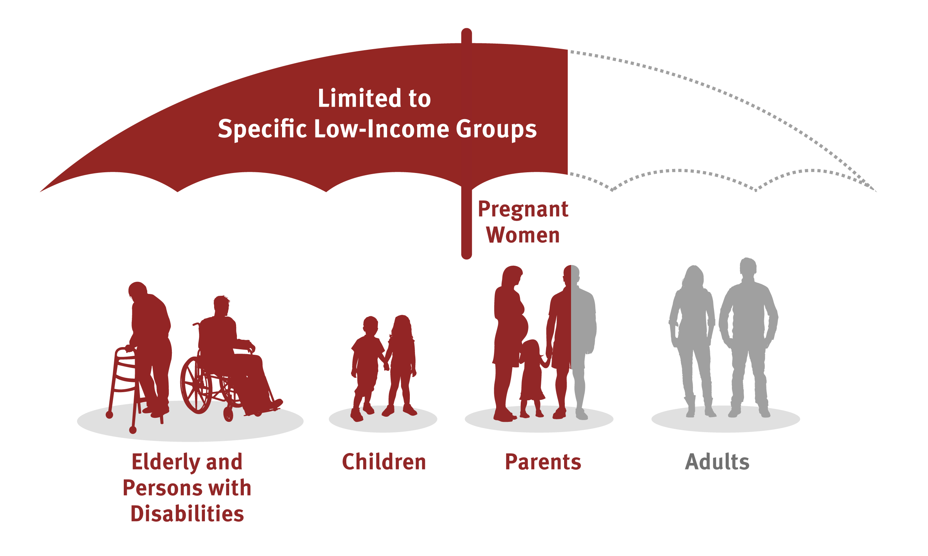
Prior to the ACA, Medicaid eligibility was limited to specific low-income groups.
Not Eligible

Slide 5
Expanding Medicaid to low-income adults is a core component of the ACA coverage expansions.
Universal Coverage
Medicaid Coverage For Low-Income Individuals
Marketplaces With Subsidies For Moderate Income Individuals
Individual
Mandate
Health Insurance Market Reforms
Employer-Sponsored Coverage

Slide 6
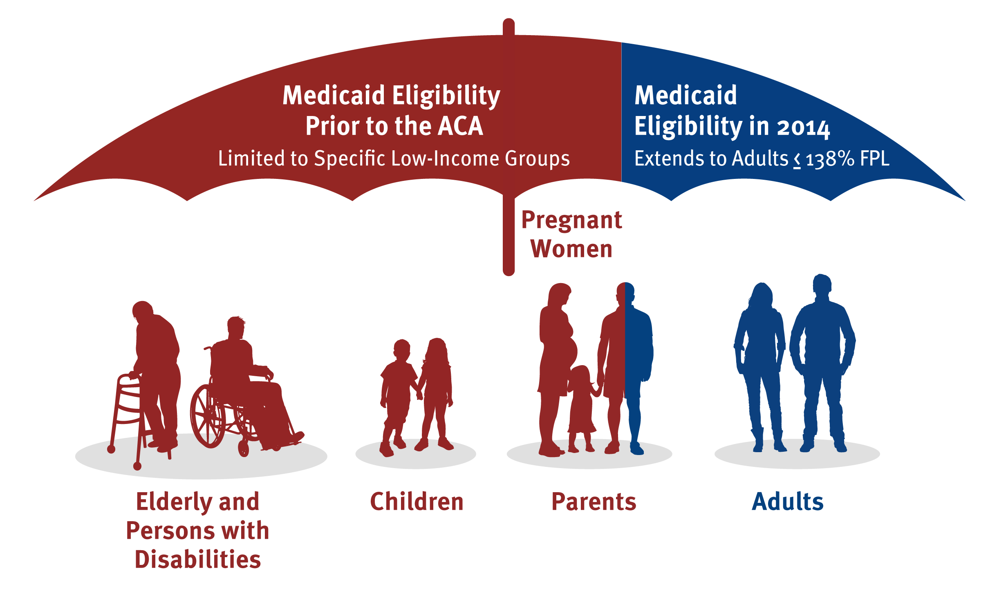
As enacted, the ACA Medicaid expansion would cover adults up to 138% FPL in all states, filling long-standing gaps in coverage.
NOTES: 138% FPL = $16,394 for an individual and $27,821 for a family of three in 2016.

Slide 7
But, the Supreme Court effectively made the Medicaid expansion a state option.
Status of Medicaid Expansion Decisions, October 14, 2016
WA
VT
ME
MT*
ND
MN
NH*
OR
MA
SD
WI*
NY
ID
MI*
CT
RI
WY
PA
NJ
NE
IA*
OH
DE
NV
IL
IN*
MD
CA
UT
CO
WV
VA
KS
MO
KY
DC
NC
TN
AZ*
NM
OK
AR*
SC
MS
AL
GA
AK
TX
LA
FL
HI
Adopted (32 States including DC)
Not Adopting At This Time (19 States)
NOTES: Current status for each state is based on KCMU tracking and analysis of state executive activity. *AR, AZ, IA, IN, MI, MT, and NH have approved Section 1115 waivers. WI covers adults up to 100% FPL in Medicaid, but did not adopt the ACA expansion.
SOURCE: “Status of State Action on the Medicaid Expansion Decision,” KFF State Health Facts, updated October 14, 2016.
http://kff.org/health-reform/state-indicator/state-activity-around-expanding-medicaid-under-the-affordable-care-act/

Slide 8
Medicaid eligibility for adults remains limited in states that have not adopted the Medicaid expansion.
NOTE: State-reported eligibility levels as of Jan. 1, 2016, updated to reflect Medicaid expansion adoption in Louisiana as of Jan. 12, 2016. Eligibility levels include the standard five percentage point of the federal poverty level (FPL) disregard. As of 2016, the FPL was $20,160 for a family of three and $11,880 for an individual.
SOURCE: Based on results from a national survey conducted by the Kaiser Commission on Medicaid and the Uninsured and the Georgetown University Center for Children and Families, 2016 with data updates based on new state decisions to expand Medicaid.

Slide 9
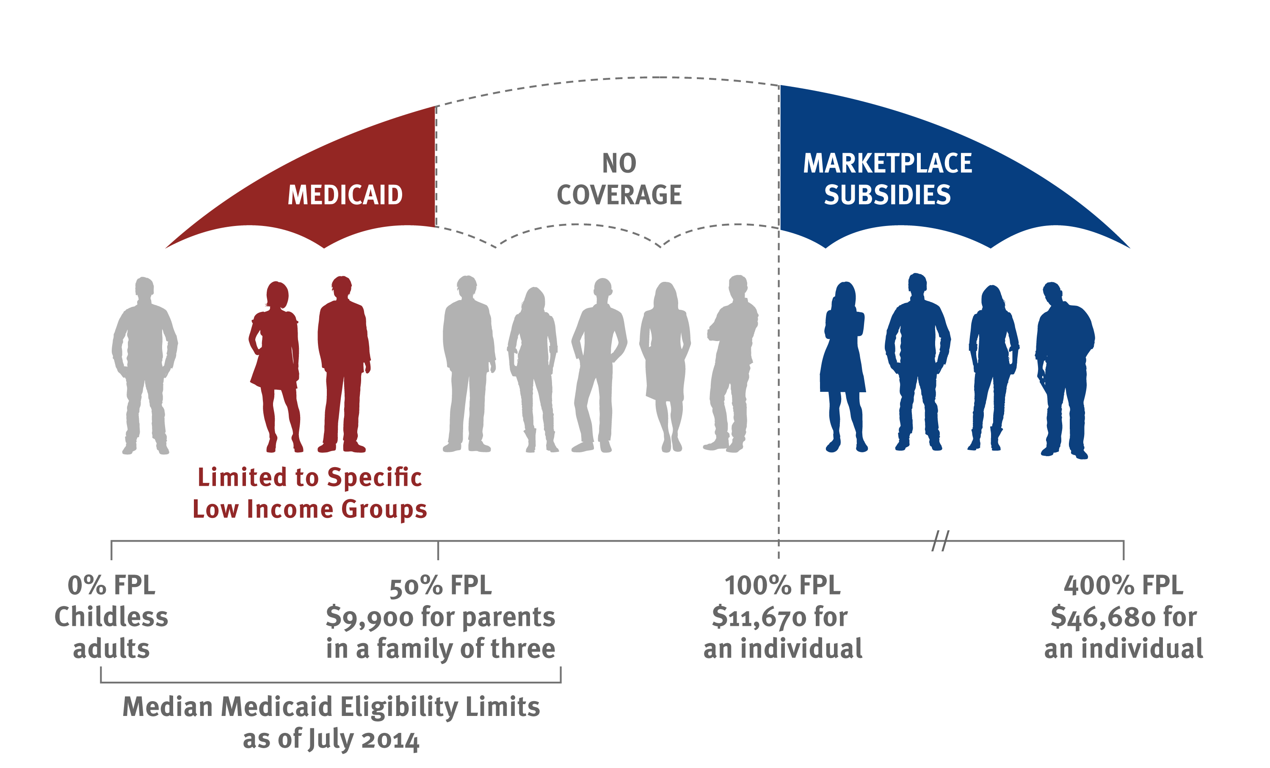
In states that have not adopted the Medicaid expansion, poor adults fall into a coverage gap, earning too much to qualify for Medicaid but too little for subsidies for Marketplace coverage.
44% FPL
$8,870 for parents
in a family of three
$11,880
for an individual
$47,520
for an individual
as of January 2016

Slide 10
In 2016, an estimated 2.6 million nonelderly adults fall into the coverage gap, most of whom reside in the South.
Distribution By State:
Distribution By Geographic Region:
Total = 2.6 Million in the Coverage Gap
Note: Totals may not sum to 100% due to rounding.
Source: Kaiser Family Foundation analysis based on 2016 Medicaid eligibility levels and 2016 Current Population Survey data.

Slide 11
More than half of adults in the coverage gap are adults of color. Adults in the coverage gap are of varying age and health status.
Distribution By Race/Ethnicity:
Distribution By Age:
Distribution By Health Status:
Total = 2.6 Million in the Coverage Gap
Note: Totals may not sum to 100% due to rounding.
Source: Kaiser Family Foundation analysis based on 2016 Medicaid eligibility levels and 2016 Current Population Survey data.

Slide 12
Nearly two-thirds of adults in the coverage gap are in a family with a worker, but most work in jobs that are unlikely to offer insurance.
Family work status :
Firm size and industry among those working:
Other
Manufacturing/Infrastructure
100+ employees
Education/ Health
Professional/ Public Admin
50-99 employees
<50 employees
Agriculture/ Service
Total = 2.6 Million in the Coverage Gap
Total = 1.4 Million Workers in the Coverage Gap
Notes: Industry classifications: Agriculture/Service includes agriculture, construction, leisure and hospitality services, wholesale and retail trade. Education/Health includes education and health services. Professional/Public Admin includes finance, professional and business services, information, and public administration. Manufacturing/Infrastructure includes mining, manufacturing, utilities, and transportation. Totals may not sum to 100% due to rounding.
Source: Kaiser Family Foundation analysis based on 2016 Medicaid eligibility levels and 2016 Current Population Survey data.

Slide 13
Uninsured Black adults are more likely to fall into the coverage gap than other racial/ethnic groups.
Share of Uninsured Adults Who Fall into the Coverage Gap, by Race/Ethnicity:
Total Uninsured Adults
23.2 M
10.5 M
3.5 M
7.5 M
1.7 M
12.7 M
Source: Kaiser Family Foundation analysis based on 2016 Medicaid eligibility levels and 2016 Current Population Survey data.

Slide 14
If all states adopted the Medicaid expansion, the coverage gap would be eliminated and 54% of the nonelderly uninsured would be eligible for financial assistance in 2016.
Ineligible due to Immigration Status
20%
Ineligible due to Immigration Status
20%
Unsubsidized Marketplace/ESI Offer
Unsubsidized Marketplace/ESI Offer
Tax-Credit Eligible
Tax-Credit Eligible
Eligible for Financial Assistance
43%
Eligible for Financial Assistance
54%
Medicaid-Eligible Child 10%
In the Coverage Gap
10%
Medicaid-Eligible Child 10%
Medicaid-Eligible Adult
Medicaid-Eligible Adult
14%
Based on Current Medicaid Expansion Decisions
If All States Expanded Medicaid
Total = 27.2 Million Nonelderly Uninsured
NOTES: Numbers may not sum to subtotals or 100% due to rounding. Tax-Credit Eligible share includes adults in MN and NY who are eligible for coverage through the Basic Health Plan.
SOURCE: Kaiser Family Foundation analysis based on 2016 Medicaid eligibility levels and 2016 Current Population Survey data.

