Slide 1

Web Briefing for Media: 2015 Kaiser/HRET Employer Health Benefits Survey
Tuesday, September 22, 2015
Presented by the Kaiser Family Foundation and
Health Research & Educational Trust (HRET)

Slide 2
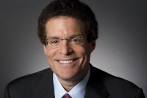
Drew Altman
President and CEO
Kaiser Family Foundation

Slide 3

Maulik S. Joshi
President
Health Research & Educational Trust (HRET)

Slide 4
Today’s Web Briefing Will Be Recorded
Read the report, and find a link to today’s presentation, at
kff.org/ehbs
A transcript will be available in the coming week.

Slide 5


Matthew Rae
Gary Claxton
Vice President and long-time study director
Kaiser Family Foundation
Senior Policy Analyst and study co-author
Kaiser Family Foundation

Slide 6
Average Annual Worker and Employer Contributions to Premiums and Total Premiums for Family Coverage, 1999-2015
$5,791
$6,438*
$7,061*
$8,003*
$9,068*
$9,950*
$10,880*
$11,480*
$12,106*
$12,680*
$13,375*
$13,770*
$15,073*
$15,745*
$16,351*
$16,834*
$17,545*
* Estimate is statistically different from estimate for the previous year shown (p<.05).
SOURCE: Kaiser/HRET Survey of Employer-Sponsored Health Benefits, 1999-2015.

Slide 7
Average Annual Premium Increases for Family Coverage, 1999-2015
SOURCE: Kaiser/HRET Survey of Employer-Sponsored Health Benefits, 1999-2015

Slide 8
Cumulative Increases in Health Insurance Premiums, Workers’ Contributions to Premiums, Inflation, and Workers’ Earnings, 1999-2015
SOURCE: Kaiser/HRET Survey of Employer-Sponsored Health Benefits, 1999-2015. Bureau of Labor Statistics, Consumer Price Index, U.S. City Average of Annual Inflation (April to April), 1999-2015; Bureau of Labor Statistics, Seasonally Adjusted Data from the Current Employment Statistics Survey, 1999-2015 (April to April).

Slide 9
Average Annual Worker and Employer Contributions to Premiums and Total Premiums for Single and Family Coverage, by Firm Size, 2015
Single Coverage
Family Coverage
$6,163
$6,289
$6,251
* Estimate is statistically different between All Large Firms and All Small Firms estimate (p<.05).
SOURCE: Kaiser/HRET Survey of Employer-Sponsored Health Benefits, 2015.

Slide 10
Average Annual Worker and Employer Contributions to Premiums and Total Premiums for Single and Family Coverage, by Firm Wage Level, 2015
Single Coverage
Family Coverage
$6,307*
$5,606*
$6,251
* Estimate is statistically different between All Large Firms and All Small Firms estimate (p<.05).
NOTE: Lower-wage level is $23,000 annually or less, the 25th percentile for workers earnings nationally.
SOURCE: Kaiser/HRET Survey of Employer-Sponsored Health Benefits, 2015.
Notes:
There

Slide 11
Percentage of Covered Workers With a General Annual Deductible for Single Coverage, 2006-2015
* Estimate is statistically different from estimate for the previous year shown (p<.05).
SOURCE: Kaiser/HRET Survey of Employer-Sponsored Health Benefits, 2006-2015.

Slide 12
Average General Annual Deductible for Covered Workers Enrolled in Single Coverage, 2006-2015
* Estimate is statistically different from estimate for the previous year shown (p<.05).
NOTES: Average general annual deductible is among all covered workers. Workers in plans without a general annual deductible for in-network services are assigned a value of zero.
SOURCE: Kaiser/HRET Survey of Employer-Sponsored Health Benefits, 2006-2015.

Slide 13
Cumulative Increases in Health Insurance Premiums, General Annual Deductibles, Inflation, and Workers’ Earnings, 2010-2015
NOTE: Average general annual deductible is among all covered workers. Workers in plans without a general annual deductible for in-network services are assigned a value of zero.
SOURCE: Kaiser/HRET Survey of Employer-Sponsored Health Benefits, 2010-2015. Bureau of Labor Statistics, Consumer Price Index, U.S. City Average of Annual Inflation (April to April), 2010-2015; Bureau of Labor Statistics, Seasonally Adjusted Data from the Current Employment Statistics Survey, 2010-2015 (April to April).

Slide 14
Percentage of Covered Workers Enrolled in a Plan with a General Annual Deductible of $1,000 or More for Single Coverage, By Firm Size, 2006-2015
* Estimate is statistically different from estimate for the previous year shown (p<.05).
NOTE: These estimates include workers enrolled in HDHP/SOs and other plan types. Average general annual health plan deductibles for PPOs, POS plans, and HDHP/SOs are for in-network services.
SOURCE: Kaiser/HRET Survey of Employer-Sponsored Health Benefits, 2006-2015.

Slide 15
Distribution of Health Plan Enrollment for Covered Workers, by
Plan Type, 1988-2015
NOTE: Information was not obtained for POS plans in 1988. A portion of the change in plan type enrollment for 2005 is likely attributable to incorporating more recent Census Bureau estimates of the number of state and local government workers and removing federal workers from the weights. See the Survey Design and Methods section from the 2005 Kaiser/HRET Survey of Employer-Sponsored Health Benefits for additional information.
SOURCE: Kaiser/HRET Survey of Employer-Sponsored Health Benefits, 1999-2015; KPMG Survey of Employer-Sponsored Health Benefits, 1993, 1996; The Health Insurance Association of America (HIAA), 1988.

Slide 16
Percentage of Firms Offering Health Benefits, by Firm Size, 1999-2015
*Estimate is statistically different from estimate for the previous year shown (p<.05).
NOTE: Estimates presented in this exhibit are based on the sample of both firms that completed the entire survey and those that answered just one question. For more information, see the Survey Methods Section.
SOURCE: Kaiser/HRET Survey of Employer-Sponsored Health Benefits, 1999-2015.

Slide 17
Eligibility, Take-Up Rate, and Coverage for Workers in Firms Offering Health Benefits, 1999-2015
* Estimate is statistically different from estimate for the previous year shown (p<.05).
SOURCE: Kaiser/HRET Survey of Employer-Sponsored Health Benefits, 1999-2014.

Slide 18
Among Firms with More Than 50 Employees and Who Offer Health Benefits, The Percentage of Firms Considering Offering Benefits Through a Private Exchange, 2015
^{ǂ} These questions were not asked of firms that already offer health benefits through a private exchange.
NOTE: A private exchange is one created by a consulting company, not by a state or federal government. Private exchanges allow employees to choose from several health benefit options offered on the exchange. A defined premium contribution is a set dollar amount offered to the employee. Employees may then select one of several plans and the employee pays the difference between the defined contribution and the cost of the health insurance option they choose.
SOURCE: Kaiser/HRET Survey of Employer-Sponsored Health Benefits, 2015.

Slide 19
Among Large Firms (200 or More Workers) Offering Health Benefits, Percentage of Firms Offering Incentives for Various Wellness and Health Promotion Activities, 2015
Health Risk Assessments
Biometric Screening
Wellness Programs
^{ǂ} Firms which offer either “Programs to Help Employees Stop Smoking”, “Programs to Help Employees Lose Weight”, or “Other Lifestyle or Behavioral Coaching“.
SOURCE: Kaiser/HRET Survey of Employer-Sponsored Health Benefits, 2015.

Slide 20
Among Firms Offering Health Benefits, Percentage of Firms Offering Specific Wellness Program to Their Employees, by Firm Size, 2015
* Estimate is statistically different between All Small Firms and All Large Firms (p<.05).
NOTE: “Other Lifestyle or Behavioral Coaching” can include health education classes, stress management, or substance abuse counseling.
SOURCE: Kaiser/HRET Survey of Employer-Sponsored Health Benefits, 2015.

Slide 21
Among Large Firms Offering Incentives for Workers Who Participate In or Complete Wellness Programs, Maximum Annual Value of the Reward for Wellness and Health Promotion Programs, Including Incentives for Health Risk Assessment and Biometric Screening, 2015
NOTE: Firms with at least one of the listed wellness programs were asked to report the maximum reward or penalty an employee could earn for all of the firm's health promotion activities combined. For some employers, the maximum incentive may include rewards or penalties for activities related to health risk assessments and biometric screening. Listed programs include: “Programs to Help Employees Stop Smoking”, “Programs to Help Employees Lose Weight”, or “Other Lifestyle or Behavioral Coaching”.
SOURCE: Kaiser/HRET Survey of Employer-Sponsored Health Benefits, 2015.

Slide 22
Among Firms Offering Health Benefits, Percentage of Firms Who Have Incorporated Various Features into Their Provider Networks, by Firm Size, 2015
Note: A high performance network is one that groups providers within the network based on quality, cost, and/or efficiency of care they deliver.
SOURCE: Kaiser/HRET Survey of Employer-Sponsored Health Benefits, 2015.

Slide 23
Among Firms Whose Plan with the Largest Enrollment Covers Specialty Drugs, Percentage of Firms Which Use the Following Strategies to Contain Specialty Drug Cost, by Firm Size, 2015
SOURCE: Kaiser/HRET Survey of Employer-Sponsored Health Benefits, 2015.

Slide 24
Among Firms Offering Health Benefits with 50 or More Full-Time-Equivalents^{ǂ}, Percentage of Firms That Took Various Actions, by Firm Size, 2015
ǂ Firms were asked if they took the relevant action in response to the Employer-Shared Responsibility Provisions. Firms with 50 or more full-time equivalents were asked these questions. A significant number of employers, mostly large employers did not know how many FTEs they employed. In these cases, firms with 50 or more workers were asked these questions.
Source: Kaiser/HRET Survey of Employer-Sponsored Health Benefits, 2015.

Slide 25
Among Firms Offering Health Benefits with 100 or More Full-Time-Equivalents^{ǂ}, Percentage of Firms That Took Various Actions, 2015
ǂ Response are among firms with 100 or more full-time equivalents. A significant number of employers, mostly large employers did not know how many FTEs they employed. In these cases, the responses for firms with 100 or more workers are included. Two percent of firms did not offer a health plan that meets minimum standards for value and affordability and three percent of firms did not know.
Source: Kaiser/HRET Survey of Employer-Sponsored Health Benefits, 2015.

Slide 26
Among Firms Offering Health Benefits, Percentage of Firms That Have Taken Various Actions in Anticipation of the Excise Tax on High-Cost Plans, by Firm Size, 2015
SOURCE: Kaiser/HRET Survey of Employer-Sponsored Health Benefits, 2015.

Slide 27
Among Large Firms (200 or More Workers) Offering Health Benefits Who Indicated That Have They Changed Their Plan or Switched Carriers In Anticipation of the Excise Tax on High-Cost Health Plans, Percentage of Firms Which Have Taken Various Actions, 2015
‡ Among firms who offer either an HSA-qualified plan or a high deductible plan paired with a health reimbursement arrangement.
Note: Sixteen percent of large firms offering health benefits report that they have changed their benefit plans or moved to lower cost plans in anticipation of the assessment
SOURCE: Kaiser/HRET Survey of Employer-Sponsored Health Benefits, 2015.

Slide 28
U.S. health care spending per capita has risen at historically low rates recently, but is expected to pick up
Average annual growth rate of health spending per capita for 1970’s – 1990’s;
Annual change in actual health spending per capita 2000 – 2013 and projected health spending per capita (2014 – 2024)
SOURCE: Kaiser Family Foundation analysis of National Health Expenditure (NHE) data from Centers for Medicare and Medicaid Services, Office of the Actuary, National Health Statistics Group.

Slide 29
Contact Information
    Craig Palosky, Communications Director
    Kaiser Family Foundation | Washington, D.C.
    Email: CPalosky@KFF.org
    Phone: 202-347-5270

Slide 30
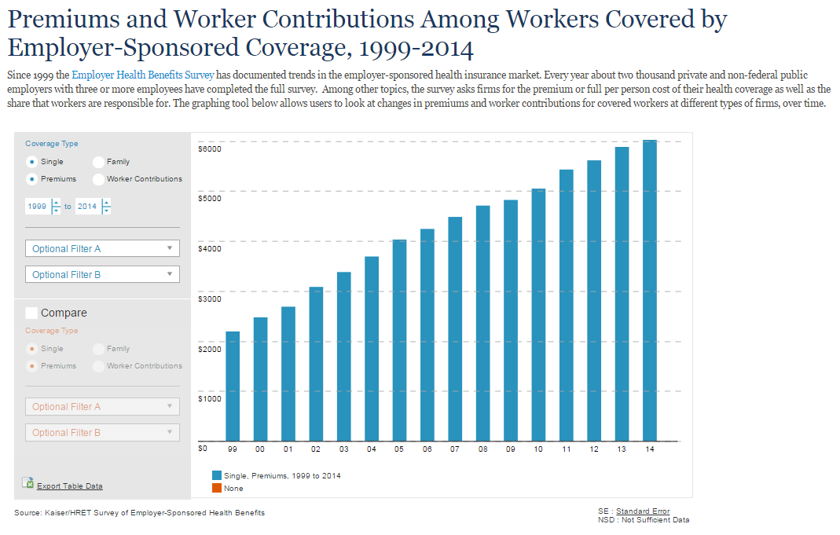
Updated and Embeddable Interactive on kff.org
kff.org/interactive/premiums-and-worker-contributions/

Slide 31


Also Released Today
New column from KFF CEO Drew Altman in Wall Street Journal Think Tank
blogs.wsj.com/washwire/tag/drew-altman/
New article in HealthAffairs
content.healthaffairs.org/lookup/doi/10.1377/hlthaff.2015.0885

Slide 32
Thank you!
Until next time, keep up with us online:
Twitter: @KaiserFamFound
Facebook: /KaiserFamilyFoundation
LinkedIn: /company/kaiser-family-foundation
Email Alerts: kff.org/email

