Slide 1
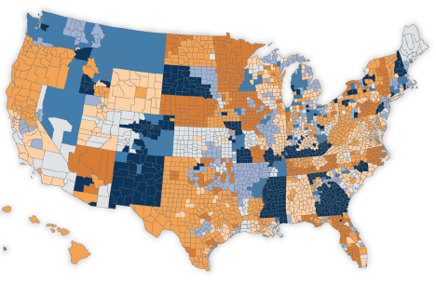
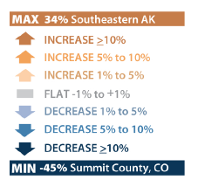
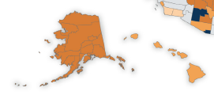
The difference in premiums Americans pay for the second-lowest cost silver plan from 2014 to 2015, before tax credits
Prior to the application of tax credits, changes in premiums for the benchmark silver plan vary dramatically from county to county across the nation
Notes: The premium changes shown are for the second-lowest cost silver (“benchmark”) plan available to a 40-year-old in a given county or region.
Source: Kaiser Family Foundation analysis of insurer rate filings to state regulators and premium data published by HealthCare.gov, available at https://www.healthcare.gov/health-plan-information-2015/

Slide 2
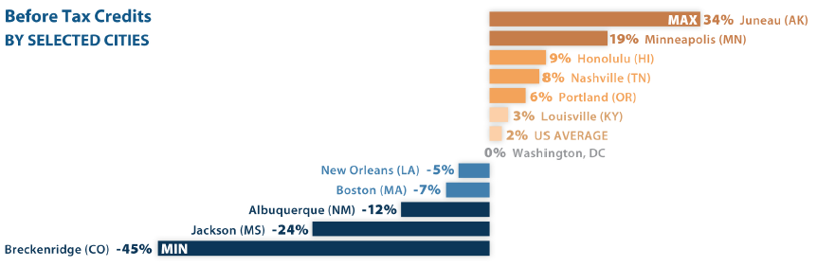

The difference in premiums Americans pay for the second-lowest cost silver plan from 2014 to 2015, before tax credits
Selected cities demonstrate variability among premium changes for the benchmark silver plan prior to the application of tax credits
Notes: The premium changes shown are for the second-lowest cost silver (“benchmark”) plan available to a 40-year-old in a given county or region.
Source: Kaiser Family Foundation analysis of insurer rate filings to state regulators and premium data published by HealthCare.gov, available at https://www.healthcare.gov/health-plan-information-2015/

Slide 3
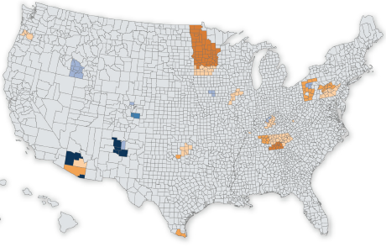
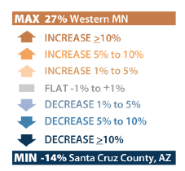

The difference in premiums Americans pay for the second-lowest cost silver plan from 2014 to 2015, after tax credits
Following the application of tax credits for a 40-year-old making $30,000 per year, premiums for the benchmark silver plan generally show little change
Notes: The premium changes shown are for the second-lowest cost silver (“benchmark”) plan available to a 40-year-old making $30,000 per year in a given county or region. A notable increase or decrease in the benchmark premium of a county from 2014 to 2015 can generally be attributed to premiums falling below the limit that the ACA sets for low- to moderate-income Americans as a percentage of income. Under the income and age scenario used in the map above, the 2015 benchmark premium is low enough in parts of Minnesota that a 40-year-old making $30,000 would not qualify for a tax credit.
Source: Kaiser Family Foundation analysis of insurer rate filings to state regulators and premium data published by HealthCare.gov, available at https://www.healthcare.gov/health-plan-information-2015/

Slide 4
The Affordable Care Act (ACA) sets limits on how much low- to moderate-income Americans pay for monthly premiums
The amount individuals and families earning up to 400% of the Federal Poverty Level (FPL) pay annually for health insurance premiums is capped as a percentage of income
Limits on what individuals pay for the benchmark silver plan in 2015
Income (% FPL) | Annual Salary (Individual) | Premium Cap (as % of income)
Under 100% | Less than $11,670 | No cap
100% -133% | $11,670 – $15,521 | 2.01%
133% -150% | $15,521 – $17,505 | 3.02% - 4.02%
150% -200% | $17,505 – $23,340 | 4.02% - 6.34%
200% -250% | $23,340 – $29,175 | 6.34% - 8.1%
250% -300% | $29,175 – $35,010 | 8.1% - 9.56%
300% -400% | $35,010 – $46,680 | 9.56%
Over 400% | More than $46,680 | No cap
Notes: Alaska and Hawaii have different poverty guidelines. Note that tax credits for the 2015 benefit year are calculated using 2014 federal poverty guidelines.
Notes: Under the ACA, individuals and families making up to 400% FPL may be eligible for subsidies in the form of premium tax credits. The amount of tax credit the enrollee receives varies with income such that the premium a person would have to pay for the second-lowest cost (“benchmark”) silver plan would not exceed a specified percentage of their income. The above table indicates the premium cap of an individual within different income brackets.
Source: Kaiser Family Foundation

