Slide 1
Web Briefing: The Medicaid Managed Care Market Tracker
Presented by the Kaiser Family Foundation
Thursday, December 11, 2014

Slide 2

Julia Paradise
Associate Director
Kaiser Commission on Medicaid and the Uninsured (KCMU)
Kaiser Family Foundation

Slide 3
39 states contract with comprehensive Medicaid MCOs – 19 provide MCO enrollment data on their websites.
As of September 2014
VT
ME
WA
MT
ND
NH
MN
OR
MA
SD
WI
NY
ID
MI
RI
WY
CT
IA
PA
NJ
NE
OH
DE
NV
IL
IN
MD
UT
CO
WV
VA
DC
CA
KS
MO
KY
NC
AZ
TN
NM
OK
AR
SC
MS
AL
GA
AK
TX
LA
FL
Reports MCO enrollment data (19 states)
HI
Does not report MCO enrollment data (20 states including DC)
SOURCE: KFF Medicaid Managed Care Market Tracker
No MCOs (12 states)

Slide 4
In most states that report their Medicaid MCO enrollment, at least 50% of beneficiaries are in MCOs.
As of September 2014
19 states reporting
VT
ME
WA
NH
MT
ND
MN
OR
NY
MA
ID
SD
WI
MI
RI
WY
CT
IA
PA
NJ
NE
OH
DE
Over 2/3 of Medicaid beneficiaries in the 19 reporting states are enrolled in MCOs.
NV
IL
IN
MD
CA
UT
CO
WV
VA
DC
KS
MO
KY
NC
AZ
TN
NM
OK
AR
SC
MS
AL
GA
AK
TX
LA
FL
Share of Medicaid beneficiaries in MCOs
HI
>75% (8 states)
50-75% (7 states)
1- <50% (4 states)
SOURCE: KFF Medicaid Managed Care Market Tracker
Data not reported (20 states)
No MCOs (12 states)

Slide 5
Payments to comprehensive MCOs account for more than one-quarter of total national Medicaid spending.
FY 2013
Total Medicaid Spending = $438.2 billion
Note: Excludes administrative spending, adjustments, and payments to the territories.
SOURCE: KFF Medicaid Managed Care Market Tracker

Slide 6
Local and national MCOs both play a large role in the Medicaid managed care market.
18 states reporting
Distribution of Medicaid MCO enrollment:
Parent firm-owned MCOs
44%
SOURCE: Medicaid Managed Care Market Tracker

Slide 7
The Medicaid Managed Care Market Tracker can be used for a multitude of descriptive and analytic purposes.
State-level data: Find out about Medicaid managed care in a particular state or states, compare or rank states on selected measures, and get a national overview of Medicaid managed care.
MCO-level data: Identify Medicaid MCOs, ascertain their current Medicaid enrollment, quality performance, and ownership by multi-state parent firms, and link to key information about their parent firms.
Firm-level data: Learn what other insurance markets parent firms are in, link to financial information about the firms, and find out which parent firms own Medicaid MCOs that have been sanctioned by states.

Slide 8
Enhancements to the Tracker are planned.
We will add MCO enrollment data for other states as states make the information available.
We will update data in the Tracker at regular intervals, and trend analysis will become possible over time.
We will add more indicators as we identify new data sources.
Watch for new functionality.

Slide 9
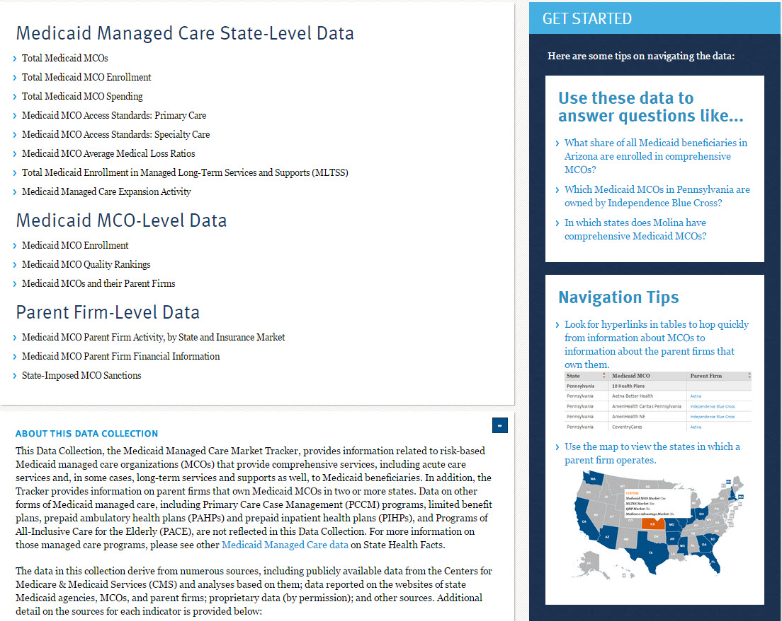
Find the Medicaid Managed Care Market Tracker at
kff.org/data-collection/medicaid-managed-care-market-tracker

Slide 10
Today’s Web Briefing Will Be Archived
Today’s web briefing and PowerPoint slides will be posted by or before tomorrow morning at
kff.org/medicaid/event/web-briefing-the-medicaid-managed-care-market-tracker/

Slide 11
Thank you!
Until next time, keep up with the Kaiser Family Foundation online:
Twitter: @KaiserFamFound
Facebook: /KaiserFamilyFoundation
LinkedIn: /company/kaiser-family-foundation
Email Alerts: kff.org/email

