Slide 1
Web Briefing for Journalists:
How the ACA’s Employer Requirements and Related Provisions Affect Businesses and Workers
Thursday, December 18, 2014
Presented by the Kaiser Family Foundation

Slide 2
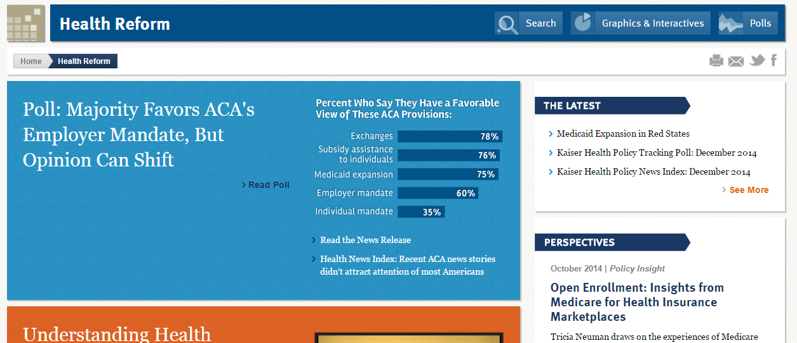
Released Today: December Kaiser Health Tracking Poll
View the poll findings at kff.org/health-reform.

Slide 3

Gary Claxton
Co-Executive Director
Program for the Study of Health Reform and Private Insurance
Kaiser Family Foundation

Slide 4
Percentage of Firms Offering Health Benefits and the Eligibility,
Take-Up, and Coverage Rates, by Firm Size, 2014
NOTES: Tests found no statistical differences between categories for 50 or more workers vs. 100 or more workers (p< .05). Eligibility refers to the percentage of workers offered benefits by their employer, take-up is the percent of eligible workers who enroll in that coverage, and the coverage rate is the percentage of workers who are covered by their employers’ health benefits.
SOURCE: Kaiser/HRET Survey of Employer-Sponsored Health Benefits, 2014.

Slide 5
Low-wage Firms are Less Likely to Offer and Have Lower Eligibility, Take-Up and Coverage Rates, 2014
Among Firms with 100 or more employees
* Estimates are statistically different for firms with a high share of low wage workers vs. firms with a low share of low wage workers by category (p<.05).
NOTES: Firms with a higher share of low wage workers refers to firms where 35% or more workers earn $23,000 a year or less. Firms with a lower share of low wage workers refers to firms where less than 35% of workers earn $23,000 a year or less.
SOURCE: Kaiser/HRET Survey of Employer-Sponsored Health Benefits, 2014.

Slide 6
Retail/Wholesale Firms have Similar Offer Rates but have Lower Eligibility, Take-Up and Coverage Rates, 2014
Among Firms with 100 or more employees
* Estimates are statistically different for Retail/Wholesale vs. Other Industries by category (p<.05).
SOURCE: Kaiser/HRET Survey of Employer-Sponsored Health Benefits, 2014.

Slide 7
Employer-Sponsored Insurance Availability Distribution, by Usual Hours Worked, 2010
NOTES: Workers are limited to nonelderly adults with non-varying hours at firms with 100 or more employees.
SOURCE: KFF analysis of the Survey of Income and Program Participation, April-July 2010.

Slide 8

Larry Levitt
Co-Executive Director
Program for the Study of Health Reform and Private Insurance
Kaiser Family Foundation
@larry_levitt

Slide 9
The penalty for not offering coverage (“a” penalty)
Applies to business with 100+ FTEs in 2015 and 50+ FTEs in 2016
Does the employer offer coverage to 70% [95% in 2016] of full-time employees (30+ hours) and dependent children?
YES
No penalty
NO
Did any one employee receive a marketplace tax credit?
NO
No penalty
YES
Penalty/month = # of FT employees – 80 [30 in 2016]
x
$2084 divided by 12
[indexed to premium growth]

Slide 10
The penalty for not offering coverage meeting minimum requirements (“b” penalty)
Applies to business with 100+ FTEs in 2015 and 50+ FTEs in 2016 that offer coverage
Does the employer offer coverage that meets minimum requirements:
Worker payment for single coverage is no more than 9.56% of wages
A 60% actuarial value
YES
No penalty
NO
Worker can apply for marketplace tax credits if otherwise eligible
Penalty/month = # of workers receiving tax credits
x
$3126 divided by 12
[indexed to premium growth]
Up to a maximum of the “a” penalty

Slide 11
How might employers respond?
Offer coverage that meets minimum requirements to avoid the “a” and “b” penalties.
Offer “skinny” coverage with little or no worker contribution to avoid the “a” penalty (hoping many workers will not apply for marketplace tax credits and trigger the “b” penalty).
Minimize exposure by reconfiguring hours for part-time workers.
Do not offer coverage and allow workers to apply for marketplace tax credits (though giving up the tax benefit for employer-sponsored health benefits).
Drop coverage for spouses, allowing them to apply for marketplace tax credits.

Slide 12
Potential effects on employer coverage and the federal budget
The Congressional Budget Office (CBO) projects 7 million fewer people with employer coverage in 2016 under the ACA (a 4% decline). Net effect of:
  Fewer employers offering coverage.
  More workers taking up employer coverage due to the individual mandate.
  Some people switching to other coverage.
CBO projects $139 billion in penalty payments by employers over the next 10 years.
CBO estimates that changing the threshold for full-time workers to 40 hours per week would increase the budget deficit by $57 billion over 10 years.

Slide 13
Related Resources
2014 Employer Health Benefits Survey
kff.org/ehbs
Flowchart: Employer Responsibility Under the ACA
kff.org/infographic/employer-responsibility-under- the-affordable-care-act/

Slide 14
Contact Information
    Rakesh Singh, Vice President of Communications
    Phone: 650-854-9400
    Email: RSingh@kff.org
    @raksingh
    Craig Palosky, Communications Director
    Phone: 202-347-5270
    Email: CPalosky@kff.org
    @CraigPalosky

Slide 15
Thank you!
Until next time, keep up with the Kaiser Family Foundation online:
Twitter: @KaiserFamFound
Facebook: /KaiserFamilyFoundation
LinkedIn: /company/kaiser-family-foundation
Email Alerts: kff.org/email

