Slide 1
Web Briefing for Journalists:
Consumer Issues Ahead of the ACA's Second Open Enrollment Season
Thursday, November 13, 2014
Presented by the Kaiser Family Foundation

Slide 2
During first open enrollment period, enrollment was slow to ramp up, but surged in final weeks.
Number of Individuals Selecting a Marketplace Plan
Number Enrolled and Paying Premium
NOTE: 85% of marketplace enrollees receive premium subsidies
SOURCE: ASPE, Health Insurance Marketplace: Summary Enrollment Report For the Annual Enrollment Period (May 1, 2014), http://aspe.hhs.gov/health/reports/2014/MarketPlaceEnrollment/Apr2014/ib_2014Apr_enrollment.pdf; ASPE enrollment report, November 10, 2014, http://aspe.hhs.gov/health/reports/2014/Targets/ib_Targets.pdf

Slide 3
Few states have made changes in Marketplace and Medicaid expansion decisions.
WA
VT
ME
MT
ND
MN
NH
OR*
MA
SD
WI
NY
ID
MI
CT
RI
WY
PA
NJ
NE
IA
OH
DE
NV*
CO
IL
IN
MD
CA
UT
WV
VA
DC
KS
MO
KY
NC
TN
AK
AZ
NM*
OK
AR
SC
MS
AL
GA
TX
LA
FL
HI
State-based Marketplace and Implementing the
Medicaid Expansion (16 States including DC)
Federally-facilitated or Partnership Marketplace and Implementing the Medicaid Expansion (12 States)
State-based Marketplace and Not Expanding
Medicaid (1 State)
Federally-facilitated Marketplace and Not Expanding
Medicaid (22 States)
* New Mexico, Nevada, and Oregon are Federally-supported State-based Marketplaces for 2015.
NOTES: In PA, coverage under the expansion will go into effect January 1, 2015.
SOURCE: “State Decisions on Health Insurance Marketplaces and the Medicaid Expansion,” KFF State Health Facts, as of August 28, 2014:
http://kff.org/health-reform/state-indicator/state-decisions-for-creating-health-insurance-exchanges-and-expanding-medicaid/.

Slide 4
Premium contribution amounts, out-of-pocket limits, and tax penalties are increasing in 2015.
2014 | 2015
Premium Contribution Amounts for those Receiving Subsidies
100% FPL: 2% of income 133% FPL: 3% of income 200% FPL: 6.3% of income 300-400% FPL: 9.5% of income | 100% FPL: 2.01% of income 133% FPL: 3.02% of income 200% FPL: 6.34% of income 300-400% FPL: 9.56% of income
Out-of-Pocket Maximum for Individual/Family
100-150% FPL: $2,250 / $4,500 150-200% FPL: $2,250 / $4,500 200-250% FPL: $5,200 / $10,400 Over 250% FPL: $6,350 / $12,700 | 100-150% FPL: $2,250 / $4,500 150-200% FPL: $2,250 / $4,500 200-250% FPL: $5,200 / $10,400 Over 250% FPL: $6,600 / $13,200
Penalty for Not Having Insurance
$95 or 1% of income above tax filing threshold | $325 or 2% of income above tax filing threshold

Slide 5
Overall, premium growth in most areas will be modest in 2015.
Second-lowest-cost silver plan before tax credits for selected cities
Source: Kaiser Family Foundation analysis of premium data from Healthcare.gov and insurer rate filings to state regulators.

Slide 6
Most people in the Marketplace received premium tax credits in 2014, lowering the cost of coverage.
Example: 40 year-old in Denver with income of $30,000 (261% FPL)
Silver Plan
Unsubsidized premium for benchmark silver plan = $3,000/year or $250/month
Individual contribution = $2,512/year (8.37% of income) or $209/month
Tax credit = $488/year or $41/month
Bronze Plan
Unsubsidized premium for lowest cost bronze plan = $2,232/year or $186/month
Tax credit = $488/year or $41/month
Individual contribution = $1,744/year or $145/month

Slide 7
After tax credits, benchmark premiums hold steady.
Silver plan premium change after tax credits for 40 year-old non-smoker making $30,000
Source: Kaiser Family Foundation analysis of premium data from Healthcare.gov and insurer rate filings to state regulators.

Slide 8
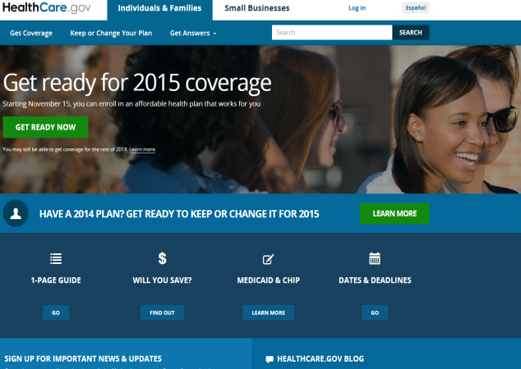
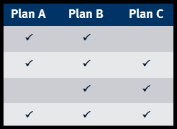
All Marketplace enrollees must renew coverage for 2015.
Non-group market plans on a calendar year. Even coverage purchased mid-year must be renewed for January 1, 2015
Renewal notices due before November 15
Plan/premium changes and renewal process explained
Shopping around to review new plan choices and premium changes
Automatic renewal is default option for most consumers
Health Insurance Renewal Notice
Please open!

Slide 9
Automatic renewal of coverage is the default option.
December 15, 2014 is key date
Consumers who don’t take action to renew/change coverage by this date will be automatically renewed for coverage beginning January 1, 2015
  In same plan if still offered
  In similar plan offered by same insurer if current plan discontinued
  No automatic re-enrollment if insurer exits nongroup market entirely
Consumers who are automatically re-enrolled in coverage for January 1 still have the remainder of Open Enrollment to change plans
  Plan selection by 15th of the month for coverage effective first day of following month
  Plan selection after 15th for coverage effective first day of second following month

Slide 10
Marketplace enrollees also must renew premium tax credit.
Premium tax credits apply on a calendar year. Must be renewed for January 1
2015 premium tax credit amounts may change due to changes in
  consumer’s age, income, family status, other characteristics
  tax credit formula
  cost of benchmark plan
To update 2015 APTC, consumers must update their application for financial assistance AND re-select health plan
December 15, 2014 is key date
Most consumers who don’t take action to update application for financial assistance by this date will have 2014 APTC amount automatically renewed for coverage beginning January 1, 2015, with some exceptions
  No automatic renewal for consumers who didn’t authorize Marketplace to check most recent tax return
  No automatic renewal for consumers who did authorize Marketplace to check and whose 2013 tax return shows income above 500% FPL

Slide 11
Consumers who auto-renew could face higher costs or receive an incorrect tax credit amount
2014
Second-lowest cost silver plan: Humana ($250/month for a 40 year-old)
Tax credit for enrollee making $30,000 = $41/month
Premium for 40-year-old enrollee making $30,000 = $209/month
2015
Humana premium for a 40 year-old = $249/month
Second-lowest cost silver plan: Colorado Health Insurance ($211/month for a 40 year-old)
Tax credit = $3/month
Premium to enroll in Colorado Health Insurance = $208
(-1% change from 2014)
Premium to enroll in Humana = $246
(18% change from 2014)

Slide 12
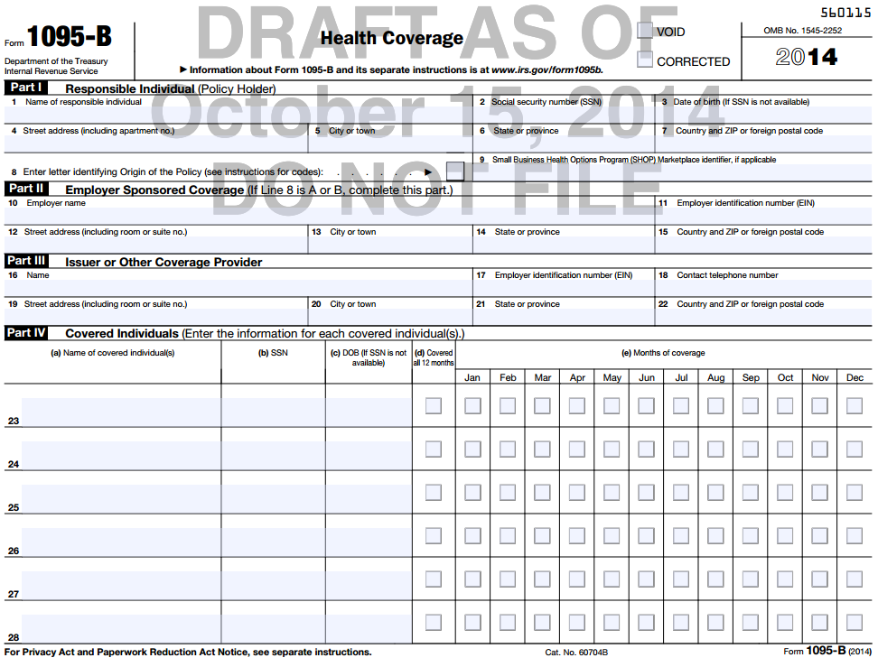
Consumers who did not have coverage in 2014 and who are not eligible for an exemption will face penalties.
In 2014, people must have minimum essential coverage or pay a penalty
Penalty = greater of $95 per adult or 1% of income above tax filing threshold
1/12 of penalty applies for each month uninsured
Health insurers, group health plans, other health programs will send form 1095-B by January 31, documenting 2014 coverage
Exemptions available
  Apply to Marketplace for certain exemptions (e.g., hardship)
  Others can be claimed on tax return (e.g., short coverage lapse)

Slide 13
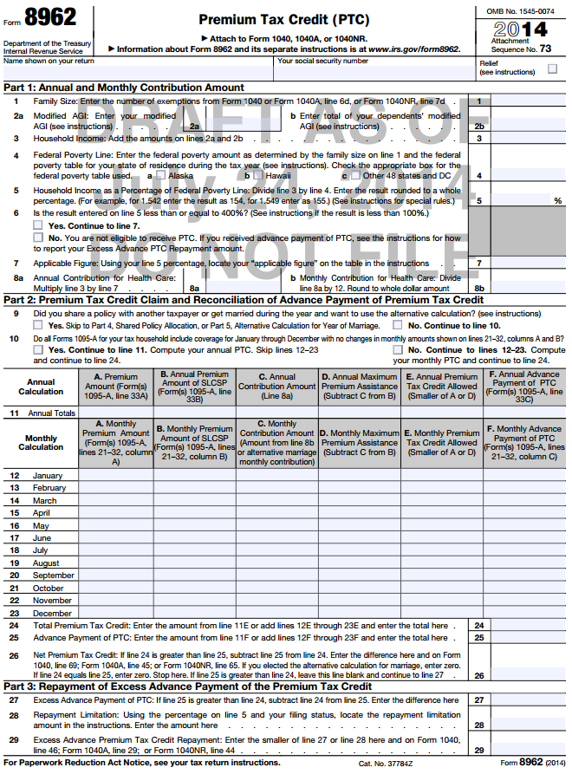
Consumers must reconcile any advance premium tax credit payments received in 2014 with final tax credit eligibility.
All consumers who received APTC during 2014 must file a 2014 federal tax return
Advanced premium tax credits (APTC) paid monthly during 2014 based on projected 2014 income, estimated at time of application
Final eligibility is based on actual 2014 income
By January 31, consumers who took APTC in 2014 will receive a form 1095-A from Marketplace
Tax filers must use Form 8962 to reconcile APTC with final premium tax credit eligibility
Consumers eligible for more tax credit receive difference as tax refund
Consumers who took too much APTC may be required to repay some or all of difference

Slide 14
Consumers who received tax credits that were too high will have to repay some or all of the difference.
Income as percentage of poverty line | Annual income for an individual | Repayment limit for single taxpayers | Annual income for a family of four | Repayment limit for married taxpayers filling jointly
Under 200% | Under $22,980 | $300 | Under $47,100 | $600
At least 200% but less than 300% | $22,980 - $34,470 | $750 | $47,100 - $70,650 | $1,500
At least 300% but less than 400% | $34,470 - $45,960 | $1,250 | $70,650 - $94,200 | $2,500
400% and above | $45,960 or more | Full amount | $94,200 or more | Full amount

Slide 15
As second open enrollment period approaches, significant challenges remain.
AMONG THE UNINSURED AGES 18-64: Percent of people who say they…
…do NOT know that open enrollment begins in November
…know “only a little” or “nothing at all” about the health insurance marketplace
…do NOT know that the health reform law provides financial help to low and moderate income Americans
SOURCE: Kaiser Family Foundation Health Tracking Poll (conducted October 8-October 14, 2014)

Slide 16
Key dates for consumers to keep in mind
November 15, 2014 | Second open enrollment period begins
December 15, 2014 | Consumers must select plan for coverage to begin by January 1, 2015. Currently enrolled consumers must renew coverage and application for financial assistance or current coverage and APTC will be automatically renewed for January 1 in most cases
February 15, 2015 | Last day of second open enrollment period. Consumers who select plan on this date will have new coverage take effect by March 1, 2015
April 15, 2015 | All individuals who file taxes must indicate coverage in 2014 or face a tax penalty; all individuals who received APTC in 2014 must file federal income tax return and reconcile tax credit amount

Slide 17
KFF Resources for Consumers
Find and share these resources at kff.org/aca
JUST RELEASED: Health Insurance Marketplace Calculator
UPDATED: Health Reform FAQs
NEW: Health Insurance Quiz
NEW VIDEO: “Health Insurance Explained – The YouToons Have It Covered”
  Spanish version to be released soon

Slide 18
KFF Resources on the Affordable Care Act
State Health Facts
  Marketplace Enrollment as a Share of the Potential Marketplace Population
  State Decisions on Health Insurance Marketplaces and the Medicaid Expansion
SURVEY: Health Insurance Marketplace Assister Programs
ANALYSIS: 2015 Premium Changes in the Affordable Care Act’s Health Insurance Marketplaces
POLL FINDINGS: Assessing Americans' Familiarity With Health Insurance Terms and Concepts

Slide 19
Q&A Discussion

Slide 20
Today’s Web Briefing Will Be Archived
Today’s web briefing and PowerPoint slides will be posted by or before tomorrow morning at
kff.org/newsroom

Slide 21
Contact Information
    Craig Palosky, Communications Director
    Phone: 202-347-5270
    Email: CPalosky@kff.org
    Rakesh Singh, Vice President of Communications
    Phone: 650-854-9400
    Email: RSingh@kff.org

Slide 22
Thank you!
Until next time, keep up with the Kaiser Family Foundation online:
Twitter: @KaiserFamFound
Facebook: /KaiserFamilyFoundation
LinkedIn: /company/kaiser-family-foundation
Email Alerts: kff.org/email

