Slide 1
TITLE

Slide 2
Key Facts
Ebola is:
  a virus first discovered in 1976
  spread through direct contact (through broken skin or mucous membranes) with infected blood and body fluids
  not spread through the air or by water
Individuals are only infectious when they have symptoms, which can appear up to 21 days after exposure
Ebola has been reported in 16 countries since first discovered
Most recent outbreak in 5 countries in West Africa, which previously have not had Ebola cases
Case fatality rate in current outbreak is about 50% as of September 2014
There is currently no vaccine or cure for Ebola; there has been limited use of experimental treatments in this outbreak
SOURCES: WHO Ebola Fact Sheet, http://www.who.int/mediacentre/factsheets/fs103/en/; WHO Ebola Virus Disease page, http://www.who.int/csr/disease/ebola/en/.

Slide 3
Ebola Cases in Current Outbreak as Share of All Ebola Cases Ever Reported
NOTES: Data as of September 13, 2014.
SOURCES: KFF analysis of data from: WHO Ebola Virus Disease page, http://www.who.int/csr/disease/ebola/en/; WHO Situation Reports: Ebola Response Roadmap, http://www.who.int/csr/disease/ebola/situation-reports/en/; and CDC Outbreaks Chronology, Ebola Hemorrhagic Fever, http://www.cdc.gov/vhf/ebola/resources/outbreak-table.html.

Slide 4
The U.S. Government Response: Key Agencies and Roles
USAID
  Office of Foreign Disaster Assistance: coordinates U.S. disaster response on the ground
  Bureau for Global Health: provides operational and personnel support
Department of Defense
  Provides technical and personnel support; conducts research on drug and vaccine development; will set up Joint Force Command to build clinics, provide training, and coordinate logistics
CDC
  Provides technical and personnel support, and activates Emergency Operations Center
NIH
  Conducts research on drug and vaccine development
HHS
  Funds drug and vaccine development through its Biomedical Advanced Research and Development Authority (BARDA)
FDA
  Regulates drug and vaccine development
State Department
  Coordinates diplomatic response and public education
NOTES: White House Ebola Fact Sheet, http://www.whitehouse.gov/the-press-office/2014/09/16/fact-sheet-us-response-ebola-epidemic-west-africa

Slide 5
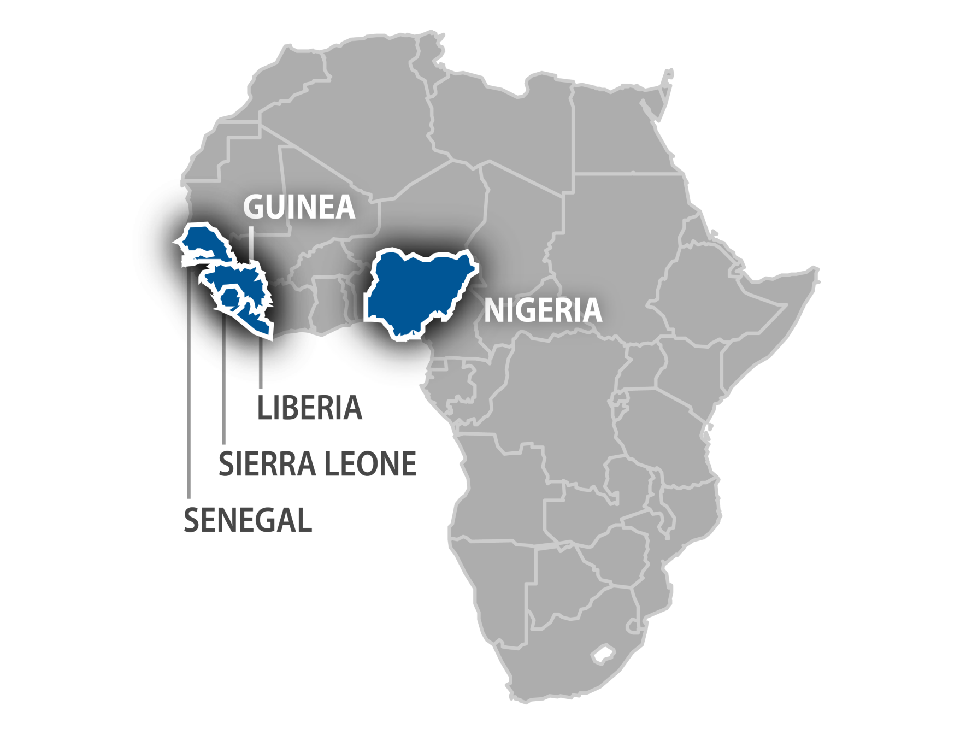
Map of Countries in West Africa Affected by Ebola
SOURCE: WHO Ebola Virus Disease page, http://www.who.int/csr/disease/ebola/en/

Slide 6
Ebola Cases in West Africa 2014 and U.S. Government Pledges of Assistance, by Month
SOURCES: KFF analysis of Ebola case data from: WHO Disease Outbreak News: Ebola Virus Disease, http://www.who.int/csr/don/archive/disease/ebola/en/; WHO Situation Reports: Ebola Response Roadmap http://www.who.int/csr/disease/ebola/situation-reports/en/; and Maia Majumder, MPH, Analysis of US funding data from: White House Ebola Fact Sheet, http://www.whitehouse.gov/the-press-office/2014/09/16/fact-sheet-us-response-ebola-epidemic-west-africa; USAID Testimony before the House Subcommittee on Africa, Global Health, Global Human Rights, and International Organizations, August 8, http://www.usaid.gov/news-information/congressional-testimony/aug-7-2014-dr-ariel-pablos-mendez-aa-global-health-hfac-combating-ebola-threat.

