Slide 1
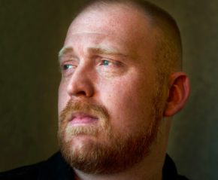



Many Report Worse Physical Or Emotional Health
After War
Thinking about your physical/mental and emotional health now compared to before your involvement in the Iraq and/or Afghanistan war(s) would you say your physical/mental and emotional health now is better, worse, or about the same?
NOTE: Don’t know/Refused responses not shown.
SOURCE: The Washington Post/Kaiser Family Foundation Survey of Iraq and Afghanistan Active Duty Soldiers and Veterans (conducted August 1 – December 15, 2013)

Slide 2

Widespread Awareness Of Suicide Attempts
And Homelessness
Do you personally know a service member or veteran from the Iraq or Afghanistan wars who has…
…attempted or died by suicide, or not?
…become homeless, or not?
SOURCE: The Washington Post/Kaiser Family Foundation Survey of Iraq and Afghanistan Active Duty Soldiers and Veterans (conducted August 1 – December 15, 2013)

Slide 3

Transitioning To Civilian Life
After your active duty military service/Thinking ahead to when you decide to leave the military, would you say your/do you think your re-adjustment to civilian life was/will be easy or difficult?
Overall, do you think the military is or is not doing enough to help veterans transition back to civilian life?
SOURCE: The Washington Post/Kaiser Family Foundation Survey of Iraq and Afghanistan Active Duty Soldiers and Veterans (conducted August 1 – December 15, 2013)

Slide 4
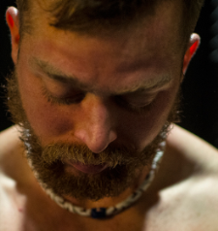
Majority Feel Disconnected, Not Understood
Now I am going to read to you things that some service members have experienced and others have not. For each, tell me how often, if at all, you personally have experienced the following as a result of your military service.
NOTE: Don’t know/Refused responses not shown.
SOURCE: The Washington Post/Kaiser Family Foundation Survey of Iraq and Afghanistan Active Duty Soldiers and Veterans (conducted August 1 – December 15, 2013)

Slide 5
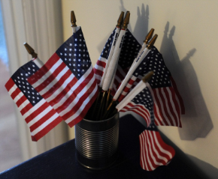
Attitudes Toward The Wars
All in all, considering the costs to the United States versus the benefits to the United States, do you think the war in Iraq was worth fighting/Afghanistan has been worth fighting, or not?
Afghanistan
Post-9/11 Service Members
General Public
Iraq
Post-9/11 Service Members
General Public
SOURCE: The Washington Post/Kaiser Family Foundation Survey of Iraq and Afghanistan Active Duty Soldiers and Veterans (conducted August 1 – December 15, 2013) and Kaiser Family Foundation Health Tracking Poll (conducted December 10-15, 2013)

Slide 6
Nine In Ten Say They Would Do It Again
Considering everything you now know about military service, if you had the chance to make the decision again, would you choose to join the military, or not?
SOURCE: The Washington Post/Kaiser Family Foundation Survey of Iraq and Afghanistan Active Duty Soldiers and Veterans (conducted August 1 – December 15, 2013)

