Slide 1
Web Briefing:
What Worked and What’s Next? Strategies from Four States Leading ACA Enrollment Efforts
Presented by the Henry J. Kaiser Family Foundation
Monday, July 28, 2014
1:00 p.m. ET

Slide 2


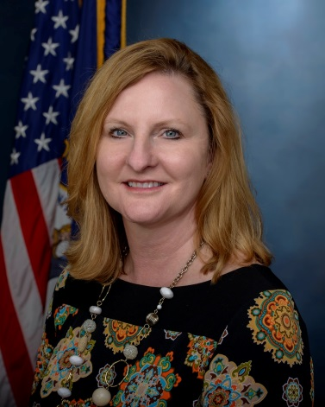
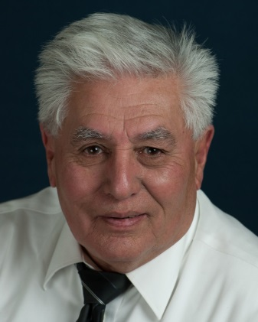
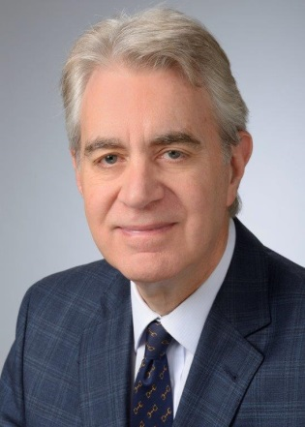
Today’s Speakers
Samantha Artiga
Kaiser Family Foundation
Lisa Lee
Kentucky Department of Medicaid Services
Taylor Roddy
Connect for Health Colorado
Rudy Vasquez
Sea Mar Community Health Centers (Tacoma, WA)
Kevin Counihan
Access Health CT

Slide 3
Today’s Web Briefing Will Be Archived
kff.org/uninsured/event/web-briefing-what-worked-and-whats-next-strategies-in-four-states-leading-aca-enrollment-efforts/
The full web briefing presentation and PowerPoint slides will be posted later today. You will receive an email from KFF via ReadyTalk once they are posted.
The transcript of today’s webinar will be posted in the coming week.

Slide 4
Q&A – Ask Questions At Any Time Via Chat
After the presentation, our experts will take questions from the audience via chat.
You can send your questions to us at any time during the presentation.

Slide 5
Samantha Artiga
Associate Director, Kaiser Commission on Medicaid and the Uninsured (KCMU)
Kaiser Family Foundation

Slide 6

Kevin Counihan
CEO
Access Health CT

Slide 7
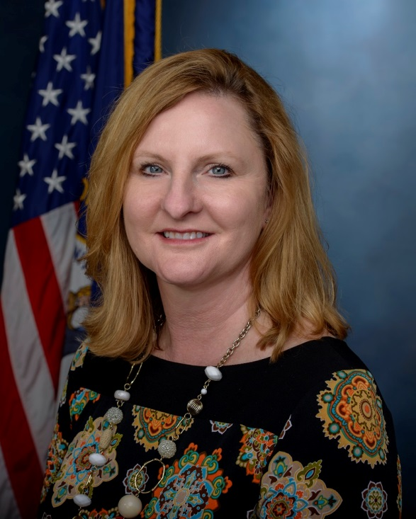
Lisa Lee
Deputy Commissioner
Department of Medicaid Services, Kentucky

Slide 8

Taylor Roddy
Marketing and Communications Manager
Connect for Health Colorado

Slide 9

Rudy Vasquez
Managed Care Operations Director
Sea Mar Community Health Centers of Washington

Slide 10
Study Overview
Identify key strategies contributing to success during previous open enrollment period and priorities looking forward
Four study states: Connecticut, Colorado, Kentucky and Washington
  Established a State-Based Marketplace
  Implemented Medicaid expansion
  Achieved success reaching and enrolling eligible individuals into coverage
In-person interviews conducted in May 2014
  Medicaid and Marketplace officials
  Enrollment assisters
  Consumer advocates
  Providers

Slide 11
What Worked?: Combination of Successful Strategies
Marketing and Branding | Outreach and Enrollment
Consumer Assistance | Systems and Operations
Leadership

Slide 12





What Worked?: Marketing and Branding
Branding the coverage expansions as state initiatives
Conducting statewide marketing across diverse channels
Adapting messaging over time
Providing consumer giveaways

Slide 13
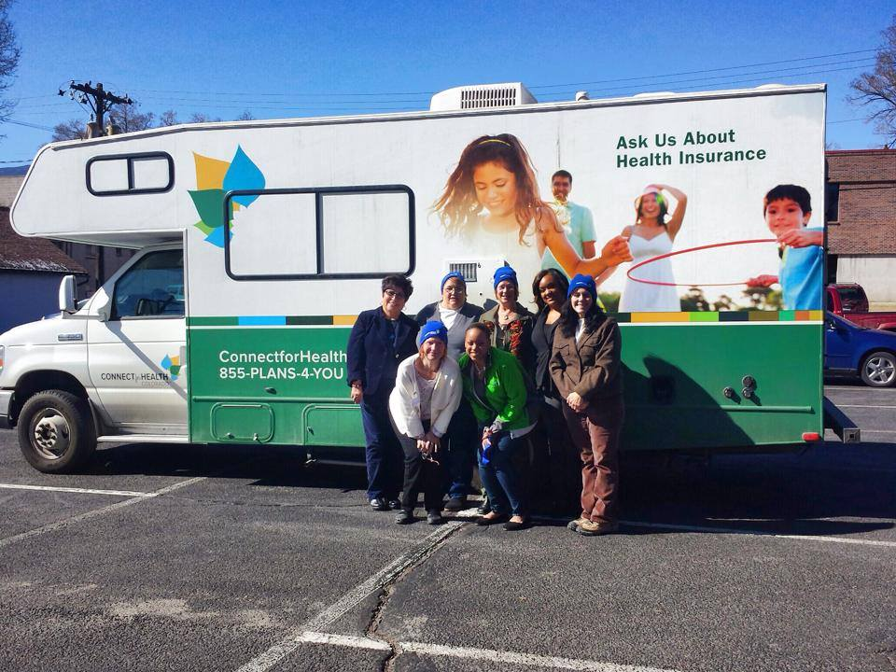
What Worked?: Outreach and Enrollment Initiatives
Conducting extensive outreach through numerous local avenues
Developing customized materials and resources
Reaching large groups through events and local media outlets
Going mobile with outreach
Establishing walk-in enrollment sites
Utilizing existing data to facilitate enrollment
Engaging providers in outreach and enrollment

Slide 14

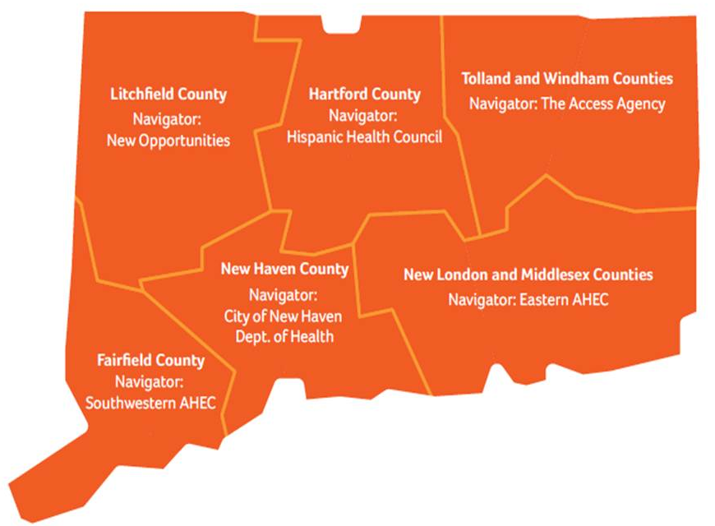
What Worked?: Consumer Assistance
Recognizing that enrollment requires time and education
Recruiting a diverse group of assisters with ties to local communities
Developing strong relationships between assisters and brokers
Coordinating assistance through a regional hub and spoke structure
Providing readily available support to assisters
Expanding call center capacity and creating tiered assistance levels

Slide 15
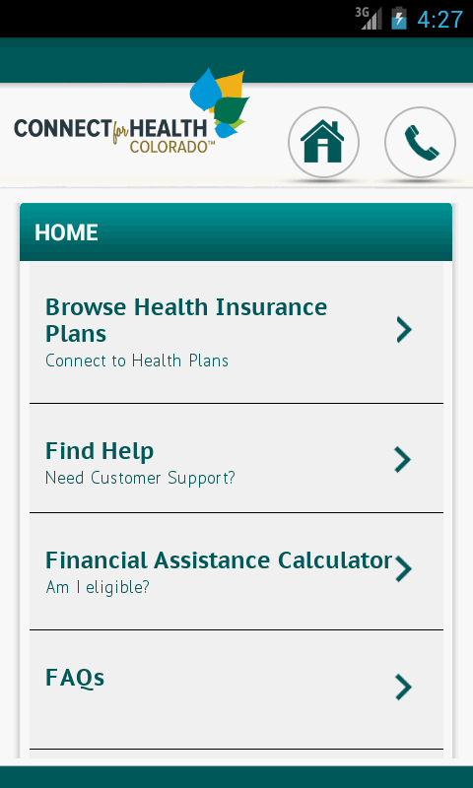

What Worked?: Systems and Operations
Building effective enrollment systems with consumer-friendly features
Implementing workarounds and incremental fixes
Using data and feedback loops to identify and respond to needs as they arose
Collaborating with stakeholders early and often
Promoting coverage efforts through strong leadership

Slide 16



What’s Next?: Current and Future Priorities
Enrollment and Renewal
  Educating about continued Medicaid enrollment and special enrollment periods
  Reaching remaining eligible but uninsured
  Supporting continuity of coverage
  Continuing enrollment system upgrades
Consumer Assistance
  Enhancing training and support for assisters
  Ensuring adequate consumer assistance
Access and Utilization of Care
  Increasing health insurance and health care literacy
  Supporting access to care for the newly uninsured
  Maintaining safety-net provider capacity

Slide 17
Time for Q&A – Ask Questions At Any Time Via Chat
We will now take questions via chat (see bottom left hand corner of your screen).
You can type and send us your questions via chat at any time.
A transcript will be available after the briefing.

Slide 18
Today’s Web Briefing Will Be Archived
kff.org/uninsured/event/web-briefing-what-worked-and-whats-next-strategies-in-four-states-leading-aca-enrollment-efforts/
The full web briefing presentation and PowerPoint slides will be posted later today. You will receive an email from KFF via ReadyTalk once they are posted.
The transcript of today’s webinar will be posted in the coming week.

Slide 19
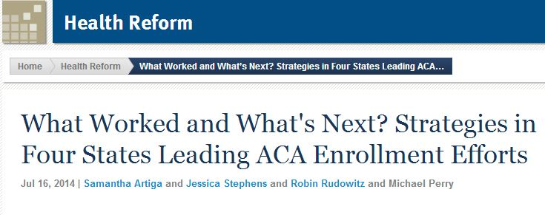





Learn More About Each State’s Enrollment Experiences
kff.org/health-reform/issue-brief/what-worked-and-whats-next-strategies-in-four-states-leading-aca-enrollment-efforts/

Slide 20
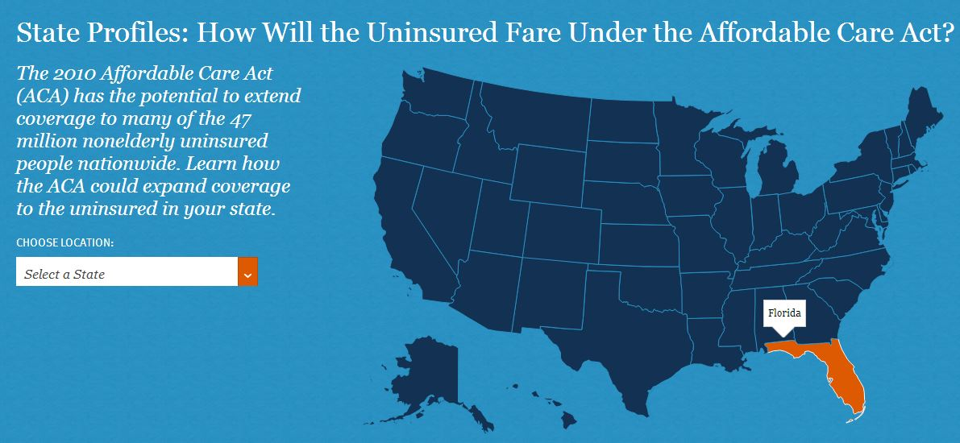
How Will the Uninsured Fare Under the Affordable Care Act?
Learn how the Affordable Care Act could expand coverage to the uninsured in your state: kff.org/state-profiles-uninsured-under-aca/

Slide 21
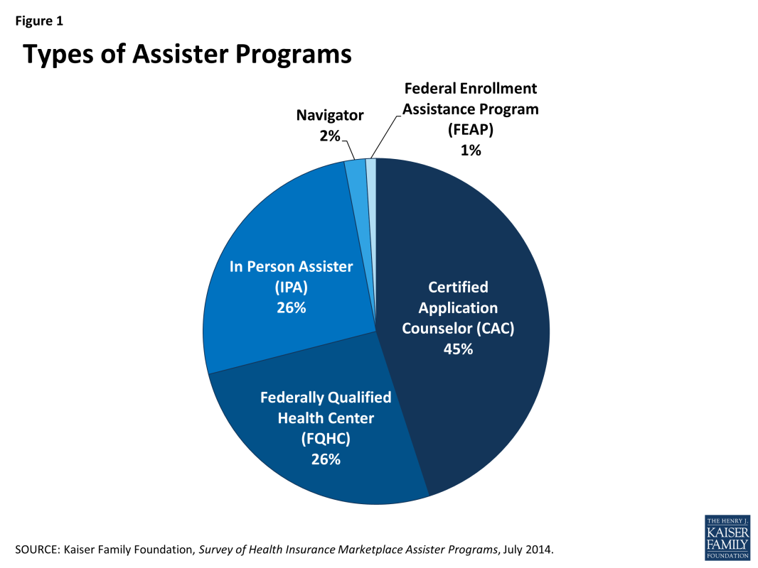
Survey of Health Insurance Marketplace Assister Programs
First nationwide assessment of the number and type of Assister Programs, and the number of people they helped
Examines nature of help consumers needed, both pre- and post-enrollment, and if Assister Programs could meet consumer needs
Discusses key factors that impacted effectiveness of Assister Programs and outlook for consumer assistance in the future
kff.org/health-reform/report/survey-of-health-insurance-marketplace-assister-programs/

Slide 22
Contact Information
    Chris Lee, Communications Officer
    Kaiser Family Foundation| Washington, D.C.
    Email: CLee@KFF.org
    Tiffany Ford Fields, Communications Associate
    Kaiser Family Foundation | Washington, D.C.
    Email: TFordFields@kff.org

Slide 23
Thank you!
Until the next event, keep up with the Kaiser Family Foundation online:
Facebook: /KaiserFamilyFoundation
Twitter: @KaiserFamFound
LinkedIn: /company/kaiser-family-foundation
Email Alerts: kff.org/email

