Slide 1
Web Briefing for Media:
Key Stories Ahead of the 2014 International AIDS Conference
Presented by the Kaiser Family Foundation
Friday, July 11, 2014
12:00 p.m. ET to 1:00 p.m. ET

Slide 2
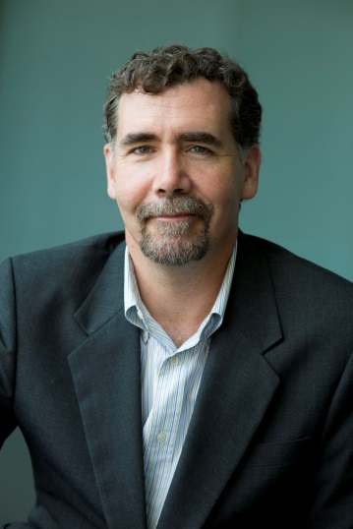
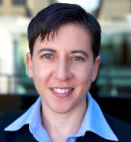

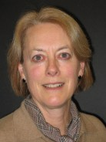
Today’s Speakers
Dr. Jennifer Kates
Vice President and Director of Global Health and HIV Policy
Kaiser Family Foundation
Dr. Chris Beyrer
President-elect, International AIDS Society
Director, Johns Hopkins HIV Training Program in Epidemiology and Prevention Science
Dr. Tony Fauci
Director, National Institute of Allergy and Infectious Diseases (NIAID)
National Institutes of Health (NIH)
Penny Duckham
Executive Director, Kaiser Media Fellowships Program
Kaiser Family Foundation

Slide 3
Penny Duckham
Executive Director, Kaiser Media Fellowships Program
Kaiser Family Foundation

Slide 4
Jennifer Kates, PhD
Vice President
Director of Global Health and HIV Policy
Kaiser Family Foundation

Slide 5

Chris Beyrer, MD, MPH
President-elect
International AIDS Society
Director
Johns Hopkins HIV Training Program in Epidemiology and Prevention Science

Slide 6
Anthony S. Fauci, MD
Director, National Institute of Allergy and Infectious Diseases (NIAID)
National Institutes of Health (NIH)

Slide 7
Time for Q&A – Ask Questions At Any Time Via Chat
We will now take questions via chat (see bottom left hand corner of your screen).
You can type your questions via chat at any time.
A transcript will be available after the briefing.

Slide 8
Today’s Web Briefing Will Be Archived
  kff.org/hivaids/event/july-11-web-briefing-for-media-key-stories-ahead-of-the-2014-international-aids-conference/
The full web briefing presentation and PowerPoint slides will be posted by or before tomorrow morning.
The transcript of today’s web briefing will be posted in the coming week.

Slide 9
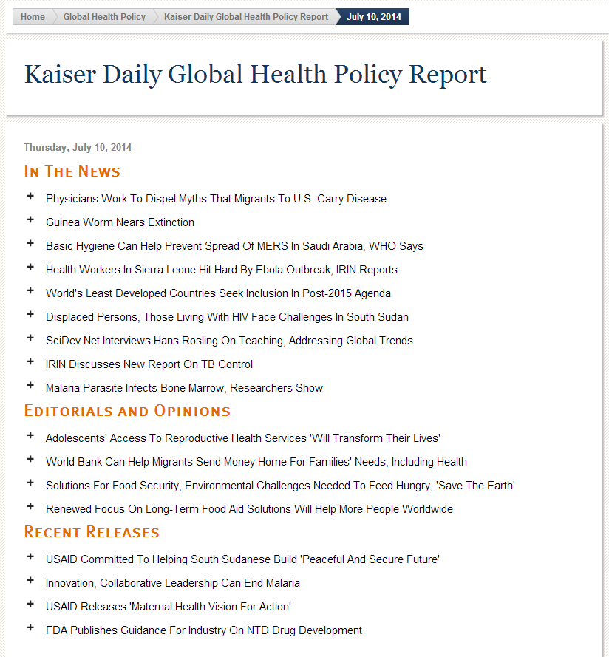

Sign up for a daily digest of global health headlines via KFF
Visit kff.org/email, enter your email address, and choose “Kaiser Daily Global Health Report.”

Slide 10


Slide 11


Find more information at www.aids2014.org

Slide 12
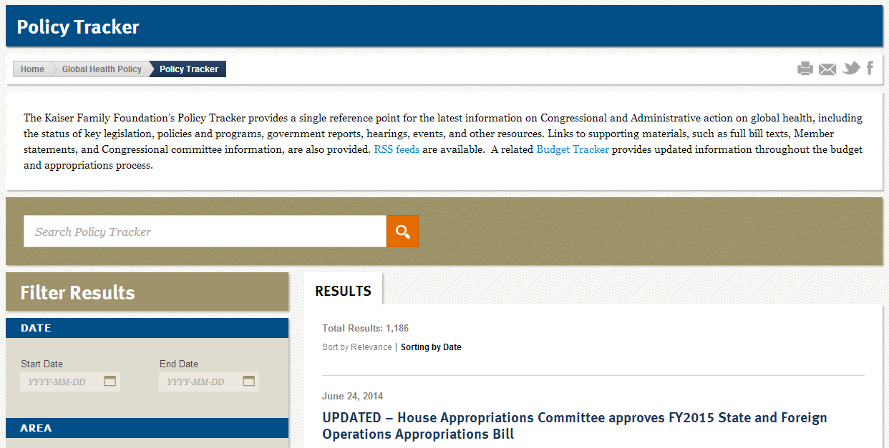
Find the latest info on Congressional and Administrative action on global health at kff.org/policy-tracker/search

Slide 13
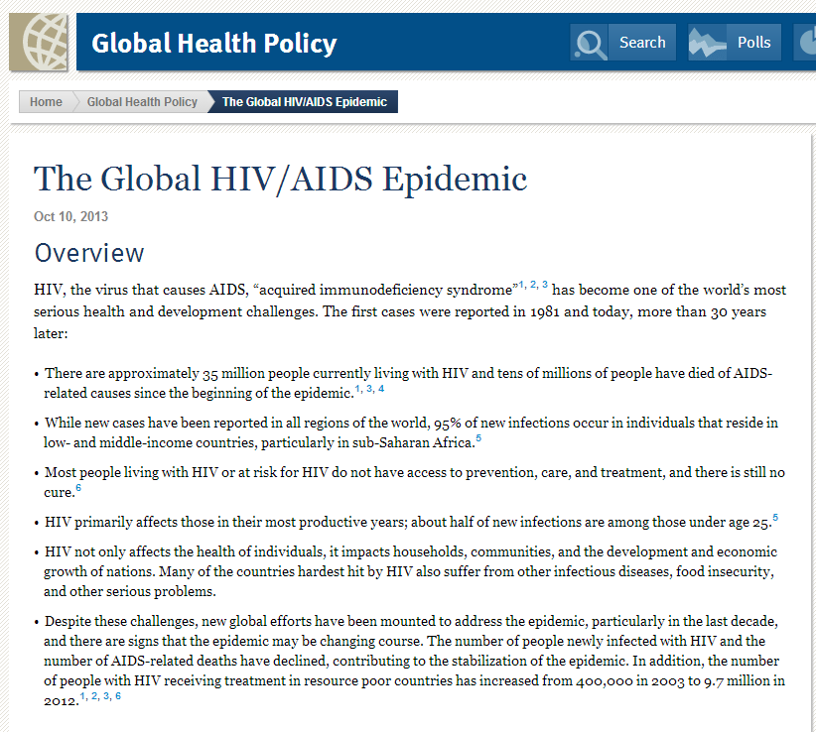
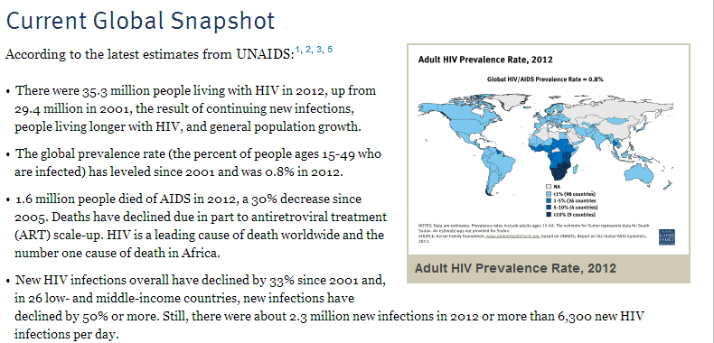
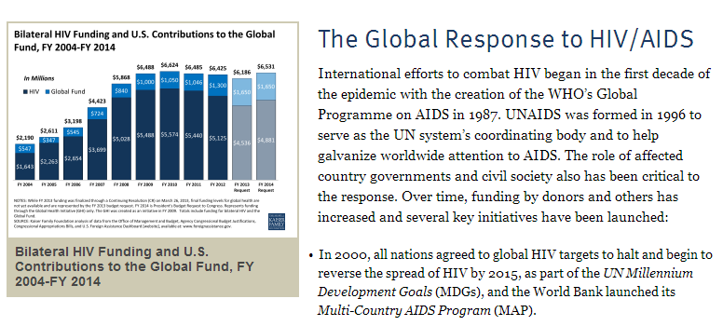
KFF Fact Sheet: The Global HIV/AIDS Epidemic
Available now at kff.org/global-health-policy/fact-sheet/the-global-hivaids-epidemic/

Slide 14

Coming soon from KFF and UNAIDS
KFF and UNAIDS will release a new report on Friday, July 18, 2014 at the AIDS 2014 conference:
Financing the Response to AIDS in Low- and Middle-Income Countries: International Assistance from Donor Governments in 2013
Look for it next week at kff.org/global-health-policy

Slide 15

Contact Information for Speakers (while at IAS conference)
    Jen Kates, PhD
    Kaiser Family Foundation
    Email: JenniferK@KFF.org
    Mobile: US + 202-210-2506
    Chris Beyrer, MD, MPH
    International AIDS Society
    Media Inquiries: Nick Thomson
    Phone: US + 61 (0) 409 690 256 // Local: 409 690 256
    Email: cbeyrer@jhu.edu // Phone: US + 443-807-0412
    Dr. Anthony Fauci
    NIAID at NIH
    Contact: Johanna McDonough
    Email: Johanna.mcdonough@altum.com
    Mobile: US + 202-329-7357

Slide 16
Thank you!
Until the next event, keep up with the Kaiser Family Foundation online:
Facebook: /KaiserFamilyFoundation
Twitter: @KaiserFamFound
LinkedIn: /company/kaiser-family-foundation
Email alerts: kff.org/email

