Slide 1
The ACA sets caps on the amount that eligible exchange enrollees must spend on premiums
Maximum monthly premium an eligible individual would pay for a benchmark silver plan under the ACA
Income (% Federal Poverty Level) | Annual Salary (household of one) | Premium cap (as % of income)
0% - 100% | $0 - $11,490 | No Cap
100% - 133% | $11,490 - $15,282 | 2%
133% - 150% | $15,282 - $17,235 | 3% - 4%
150% - 200% | $17,235 - $22,980 | 4% - 6.3%
200% - 250% | $22,980 - $28,725 | 6.3% - 8.05%
250% - 300% | $28,725 - $34,470 | 8.05% - 9.5%
300% - 400% | $34,470 - $45,960 | 9.5%
>400% | >$45,960 | No Cap
Note: The Federal Poverty Level (FPL) was $11,490 for an individual and $23,550 for a family of four through 2013. For more information, please see the Department of Human and Health Services Poverty Guidelines, available at http://aspe.hhs.gov/poverty/13poverty.cfm
Notes: Under the ACA, individuals making up to 400% FPL may be eligible for subsidies in the form of premium tax credits. The amount of tax credit the enrollee receives varies with income such that the premium a person would have to pay for the second-lowest cost (“benchmark”) silver plan would not exceed a specified percentage of their income. The above table indicates the premium cap of an individual within different income brackets.
Source: Kaiser Family Foundation Subsidy Calculator, available at http://kff.org/interactive/subsidy-calculator/.

Slide 2
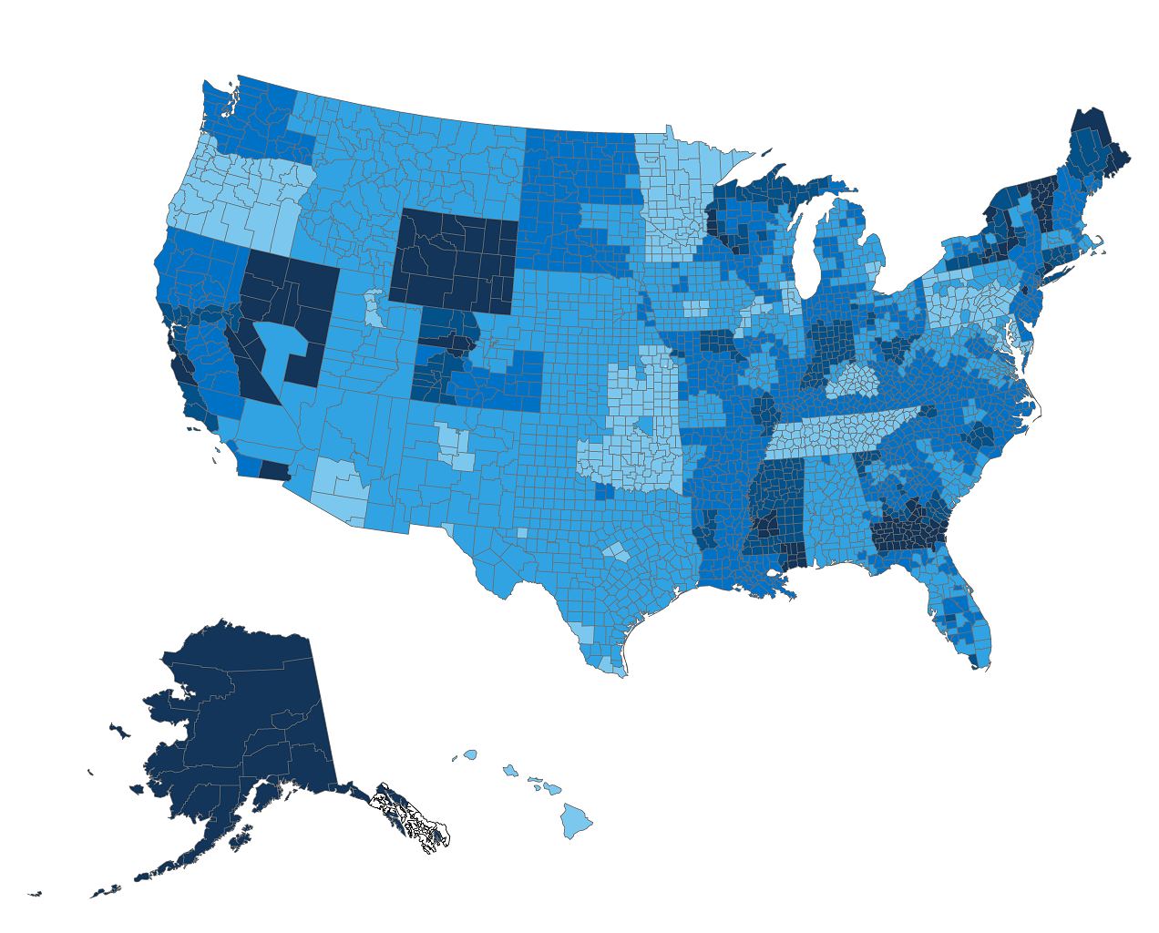
What Americans pay for a silver plan on the exchanges
40-year-old making $51,705 per year (450% of Poverty), with no financial assistance
Monthly Premium
Notes: Premiums indicate the amount a 40-year-old would need to spend on the second-lowest cost silver plan in a given county or region.
Source: Premiums for state-based exchanges were obtained through a Kaiser Family Foundation review of insurer rate filings to state regulators. Premiums for federally-facilitated and partnership exchanges were obtained from data published by HealthCare.gov, as of January 22, 2014, available at https://www.healthcare.gov/health-plan-information/.

Slide 3
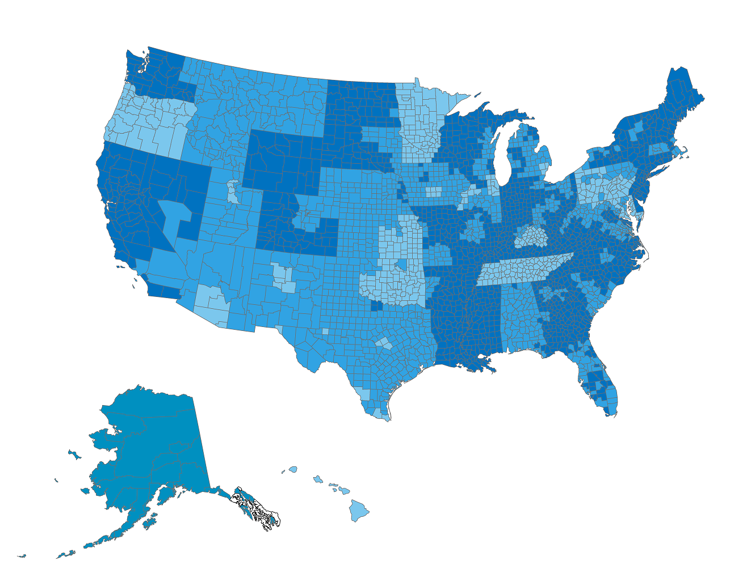
What Americans pay for a silver plan on the exchanges
40-year-old making $40,215 per year (350% of Poverty), with moderate financial assistance
Notes: Premiums indicate the amount a 40-year-old would need to spend on the second-lowest cost silver plan in a given county or region.
Source: Premiums for state-based exchanges were obtained through a Kaiser Family Foundation review of insurer rate filings to state regulators. Premiums for federally-facilitated and partnership exchanges were obtained from data published by HealthCare.gov, as of January 22, 2014, available at https://www.healthcare.gov/health-plan-information/.

Slide 4
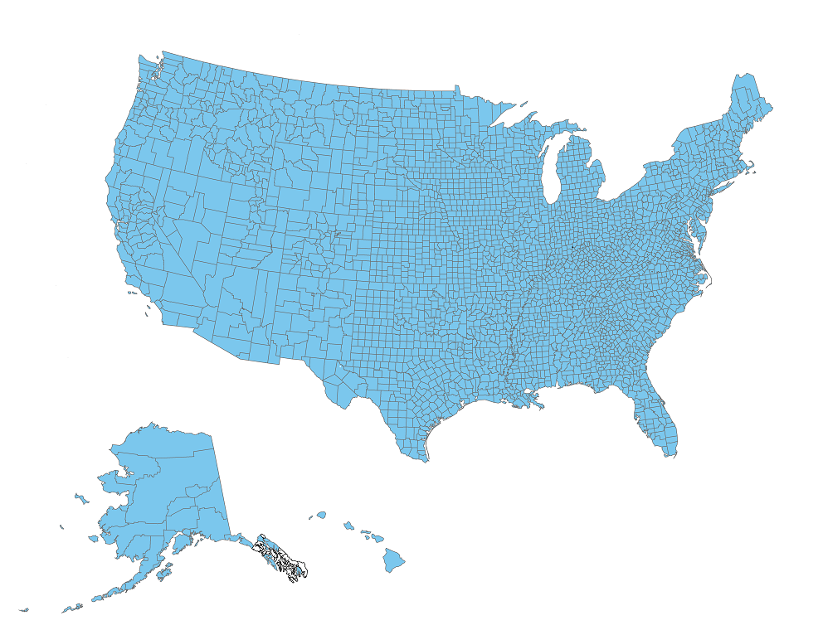
What Americans pay for a silver plan on the exchanges
40-year-old making $28,725 per year (250% of Poverty), with significant financial assistance
Notes: Premiums indicate the amount a 40-year-old would need to spend on the second-lowest cost silver plan in a given county or region.
Source: Premiums for state-based exchanges were obtained through a Kaiser Family Foundation review of insurer rate filings to state regulators. Premiums for federally-facilitated and partnership exchanges were obtained from data published by HealthCare.gov, as of January 22, 2014, available at https://www.healthcare.gov/health-plan-information/.

Slide 5

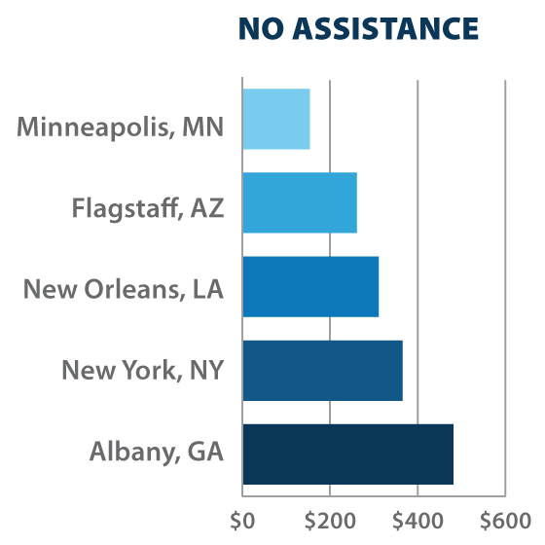
What Americans pay for a silver plan on the exchanges
40-year-old making $51,705 per year (450% of Poverty), with no financial assistance
$154
At 450% FPL, an enrollee would not be eligible for premium tax credits
$261
$311
$365
$481
Notes: Premiums indicate the amount a 40-year-old would need to spend on the second-lowest cost silver plan in a given county or region.
Source: Premiums for state-based exchanges were obtained through a Kaiser Family Foundation review of insurer rate filings to state regulators. Premiums for federally-facilitated and partnership exchanges were obtained from data published by HealthCare.gov, as of January 22, 2014, available at https://www.healthcare.gov/health-plan-information/.

Slide 6
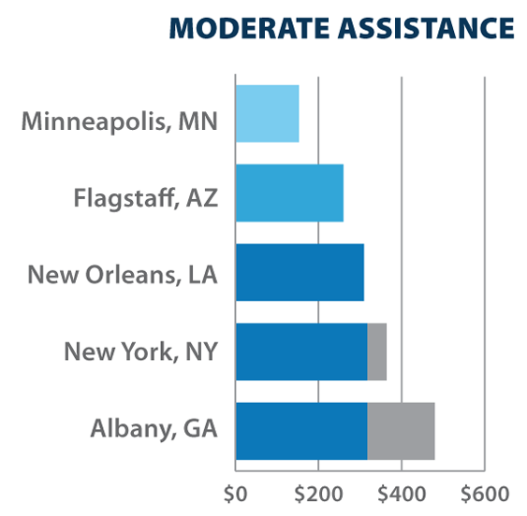
What Americans pay for a silver plan on the exchanges
40-year-old making $40,215 per year (350% of Poverty), with moderate financial assistance
$154
At 350% FPL, eligible enrollees would have to pay a maximum of 9.5% of their income on premiums for a benchmark silver plan
$261
$311
$318
$47
$318
$163
Notes: Premiums indicate the amount a 40-year-old would need to spend on the second-lowest cost silver plan in a given county or region.
Source: Premiums for state-based exchanges were obtained through a Kaiser Family Foundation review of insurer rate filings to state regulators. Premiums for federally-facilitated and partnership exchanges were obtained from data published by HealthCare.gov, as of January 22, 2014, available at https://www.healthcare.gov/health-plan-information/.

Slide 7
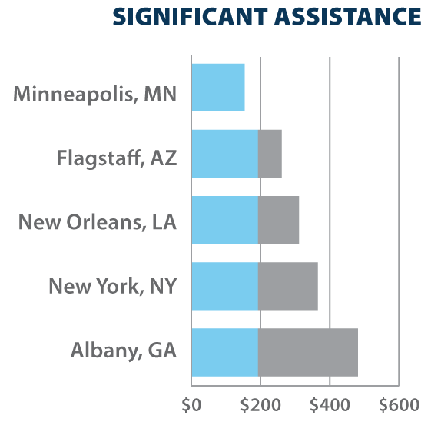
What Americans pay for a silver plan on the exchanges
40-year-old making $28,725 per year (250% of Poverty), with significant financial assistance
$154
At 250% FPL, eligible enrollees would have to pay a maximum of 8.05% of their income on premiums for a benchmark silver plan
$193
$69
$193
$118
$193
$173
$193
$289
Notes: Premiums indicate the amount a 40-year-old would need to spend on the second-lowest cost silver plan in a given county or region.
Source: Premiums for state-based exchanges were obtained through a Kaiser Family Foundation review of insurer rate filings to state regulators. Premiums for federally-facilitated and partnership exchanges were obtained from data published by HealthCare.gov, as of January 22, 2014, available at https://www.healthcare.gov/health-plan-information/.

