Slide 1
The President’s FY15 Budget Request and Funding for Global Health Programs
Presented by Jen Kates and Adam Wexler of the Kaiser Family Foundation
kff.org/global-health-policy
Wednesday, March 19, 2014
12:30 p.m. ET – 1:15 p.m. ET

Slide 2


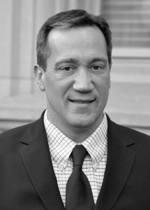

Today’s Speakers from the Kaiser Family Foundation
Adam Wexler
Director, Global Health Budget Project
Jen Kates
Vice President and Director of Global Health & HIV Policy
Penny Duckham
Executive Director, Media Fellowships Program
Tony Fratto
Partner, Hamilton Place Strategies
Former Deputy Press Secretary to U.S. President George W. Bush

Slide 3
U.S. Global Health Budget:
Introduction & Context

Slide 4
What is the U.S. “Global Health Budget”
Discretionary funding (must be appropriated by Congress annually) for a range of health programs carried out in low- and middle-income countries
Includes both bilateral and multilateral funding
Major program areas include:
  HIV
  Tuberculosis
  Malaria
  The Global Fund to Fight AIDS, Tuberculosis and Malaria (Global Fund)
  Maternal & Child Health (MCH)
  Nutrition
  Family Planning & Reproductive Health (FP/RH)
  Neglected Tropical Diseases (NTDs)
  Pandemic Influenza & Other Emerging Threats

Slide 5
Public Overestimates Share Of Budget Going To Foreign Aid
Just your best guess, what percentage of the federal budget is spent on foreign aid?
Average answer = 28% of the federal budget is spent on foreign aid
Foreign Aid ≈ 1%
of Federal Budget
SOURCE: Kaiser Family Foundation 2013 Survey of Americans on the U.S. Role in Global Health (conducted August 6-20, 2013)

Slide 6
Global Health Funding Represents Small Share of U.S. Federal Budget
FY 2015
Budget Request
Federal Budget
$4.0 trillion
Global Health
$9.4 billion
<1%
NOTES: Total federal budget figure is an estimate only. Global Health represents total known amounts; some additional global health funding provided through USAID and DoD is not yet known.
SOURCE: Kaiser Family Foundation analysis of data from the Office of Management and Budget, Congressional Budget Office, Agency Congressional Budget Justifications, Congressional Appropriations Bills, and U.S. Foreign Assistance Dashboard [website], available at: www.foreignassistance.gov.

Slide 7
U.S. Largest Donor of International Health Assistance, 2010
Total = $18.4 billion
NOTES: Represents gross US$ disbursements of Official Development Assistance (ODA) as reported to the Organisation for Economic Co-operation and Development (OECD). Health ODA combines data from three OECD CRS sub-sectors: (1) Health; (2) Population Policies/Programs and Reproductive Health (includes HIV/AIDS & STDs); and (3) Other Social Infrastructure and Services - Social Mitigation of HIV/AIDS.
SOURCE: Analysis of data obtained via online query of the OECD Development Assistance Committee (DAC) Database and Creditor Reporting System (CRS); November 7, 2012.

Slide 8
Top 10 Donor Governments by Health Assistance as a Percentage of Total Assistance, 2010
NOTES: Represents gross US$ disbursements of Official Development Assistance (ODA) as reported to the Organisation for Economic Co-operation and Development (OECD). Health ODA combines data from three OECD CRS sub-sectors: (1) Health; (2) Population Policies/Programs and Reproductive Health (includes HIV/AIDS & STDs); and (3) Other Social Infrastructure and Services - Social Mitigation of HIV/AIDS.
SOURCE: Analysis of data obtained via online query of the OECD Development Assistance Committee (DAC) Database and Creditor Reporting System (CRS); November 7, 2012.

Slide 9
U.S. Global Health Budget:
Where We Are – Budget Request & Trends

Slide 10
Global Health Funding, FY 2013-FY 2015
In Billions
NOTES: Represents total known U.S. global health funding; some additional global health funding provided through USAID and DoD is not yet known. The FY15 Budget Request includes an additional $300 million in potential funding for the Global Fund that would be made available through the new “Opportunity, Growth, and Security Initiative” (if approved by Congress), but is dependent on additional pledges from other donors. FY 2013 funding levels include the effects of sequestration.
SOURCE: Kaiser Family Foundation analysis of data from the Office of Management and Budget, Agency Congressional Budget Justifications, Congressional Appropriations Bills, and U.S. Foreign Assistance Dashboard [website].

Slide 11
Funding for Global Health in Broader Federal Budget Context
NOTES: Global Health represents total known funding amounts; some additional global health funding provided through USAID and DoD is not yet known. The FY15 Budget Request includes an additional $300 million in potential funding for the Global Fund that would be made available through the new “Opportunity, Growth, and Security Initiative” (if approved by Congress), but is dependent on additional pledges from other donors. International Affairs does not include funding for Overseas Contingency Operations (OCO). Discretionary Budget amounts are rounded totals. FY 2013 funding levels include the effects of sequestration.
SOURCE: Kaiser Family Foundation analysis of data from the Office of Management and Budget, Agency Congressional Budget Justifications, Congressional Appropriations Bills, and U.S. Foreign Assistance Dashboard [website].

Slide 12
Trends in Global Health Funding, FY 2001-FY 2015
In Billions
NOTES: Represents funding through the Global Health Programs (GHP) account only. FY 2013 funding levels include the effects of sequestration.
SOURCE: Kaiser Family Foundation analysis of data from the Office of Management and Budget, Agency Congressional Budget Justifications, Congressional Appropriations Bills, and U.S. Foreign Assistance Dashboard [website].

Slide 13
Global Health Funding By Sector, FY 2015 Budget Request
In Millions
Total = $8.1 billion
NOTES: Represents funding through the Global Health Programs (GHP) account only.
SOURCE: Kaiser Family Foundation analysis of data from the Office of Management and Budget, Agency Congressional Budget Justifications, Congressional Appropriations Bills, and U.S. Foreign Assistance Dashboard [website].

Slide 14
Change in Global Health Funding by Sector, FY 2014–FY 2015
In Millions
Global
Fund*
TB
Pandemic
Preparedness
Nutrition
NTDs
MCH
Vulnerable
Children
Additional $300 million may be available through new “Opportunity, Growth, and Security Initiative” (see note).
NOTES: Represents funding through the Global Health Programs (GHP) account only. The FY15 Budget Request includes an additional $300 million in potential funding for the Global Fund that would be made available through the new “Opportunity, Growth, and Security Initiative” (if approved by Congress), but is dependent on additional pledges from other donors.
SOURCE: Kaiser Family Foundation analysis of data from the President’s FY 2015 Budget Request, the “Consolidated Appropriations Act, 2014” (H.R. 3547) and accompanying report (#113-32), the Office of Management and Budget, and U.S. Foreign Assistance Dashboard [website].

Slide 15
Key Take-Aways: FY15 Budget Request
Compared to FY13, global health funding remained essentially flat while International Affairs funding and Non-Defense Discretionary spending both increased
Compared to FY14, all program areas declined with the exception of HIV, which remained flat, and malaria and FP/RH, which increased slightly
FY15 Budget Request includes $45 million in new funding to support the recently announced “Global Health Security Initiative”
Additional funding (for the Global Fund & MCH) could be made available, but is dependent on Congressional approval of new “Opportunity, Growth, & Security Initiative”
In both FY13 and FY14, Congress approved higher global health funding than the Budget Request
NOTES: International Affairs does not include funding for Overseas Contingency Operations (OCO).

Slide 16
U.S. Global Health Budget:
Looking Ahead

Slide 17
Key Dates Looking Forward
March: House & Senate committees hold budget hearings
April 15: Congress passes a House/Senate Budget Resolution
  Unlikely due to passage of Murray/Ryan Agreement
May through September: Appropriations Committees draft and enact appropriations bills
October 1: New federal fiscal year begins
  Continuing Resolution: If appropriations laws are not enacted by October 1, Congress typically enacts temporary “band-aid” measures (called Continuing Resolutions) to keep programs operating until the laws are enacted

Slide 18
The presenters’ slides conclude here.
The following slides feature additional resources that may be of interest to people interested in this health policy topic.

Slide 19
Global Health Resources on kff.org/global-health-policy
Global Health Policy Tracker
-Tracks the latest Congressional and Administrative actions on global health
A Reporter’s Guide to U.S. Global Health Policy
The U.S. Government Engagement in Global Health: A Primer
2013 Survey of Americans on the U.S. Role in Global Health
Kaiser Daily Global Health Policy report

Slide 20
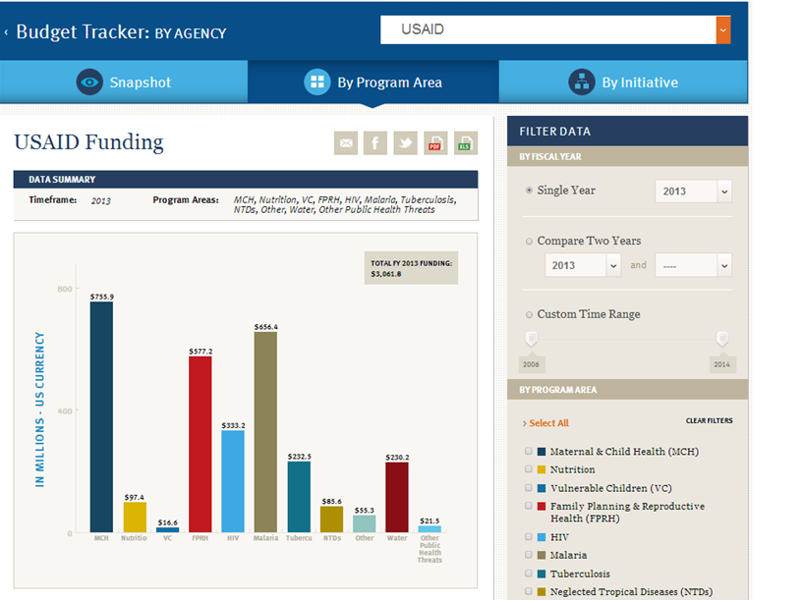
Coming Soon: Interactive Global Health Budget Tracker

Slide 21
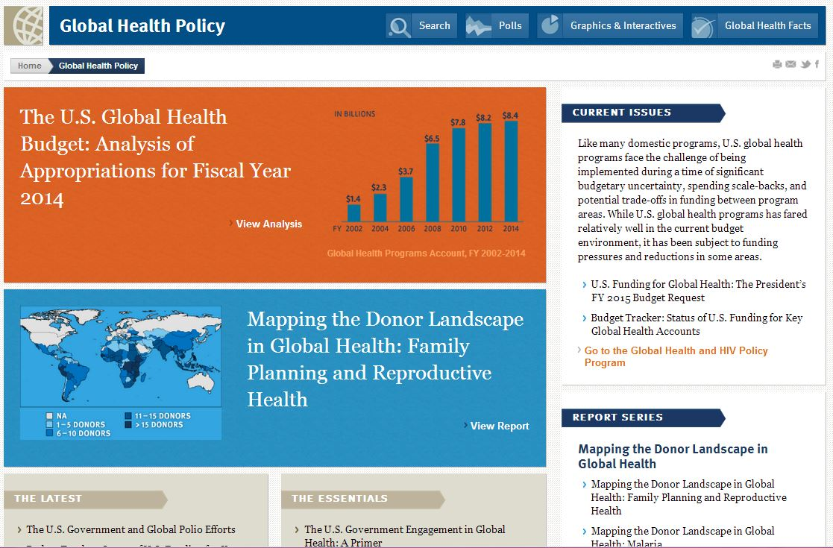
Find more resources at kff.org/global-health-policy

Slide 22
Keep in touch with KFF online!
Facebook: /KaiserFamilyFoundation
Twitter: @KaiserFamFound
LinkedIn: /company/kaiser-family-foundation
Emails: kff.org/email

