Slide 1
The ACA and What It Means for Black Americans
Presented by the Kaiser Family Foundation
Tuesday, February 25, 2014
12:30 p.m. ET – 1:30 p.m. ET

Slide 2




Today’s Speakers from the Kaiser Family Foundation
Samantha Artiga
Director, Disparities Policy Project
Jennifer Tolbert
Director of State Health Reform
Penny Duckham
Executive Director, Media Fellowships Program
Jessica Stephens
Senior Policy Analyst, Disparities Policy Project

Slide 3
Jennifer Tolbert
Director of State Health Reform
Kaiser Family Foundation

Slide 4
Promoting Health Coverage through the ACA
Universal Coverage
Medicaid Coverage For Low-Income Individuals
Marketplaces With Subsidies for Moderate Income Individuals
Individual
Mandate
Health Insurance Market Reforms
Employer-Sponsored Coverage

Slide 5

Most uninsured individuals are at income levels that qualify for Medicaid expansion or marketplace subsidies.
Health Insurance Coverage of the Nonelderly, 2012
Income
≤138% FPL
(51%)
139-399% FPL
(39%)
≥400% FPL
(10%)
Employer-Sponsored
Coverage
Uninsured
Medicaid*
Private Non-Group
266.9 Million Nonelderly
47.3 Million Uninsured
*Medicaid also includes other public programs: CHIP, other state programs, Medicare and military-related coverage. The federal poverty level for a family of three in 2012 was $19,090.
Numbers may not add to 100% due to rounding.
SOURCE: KCMU/Urban Institute analysis of 2013 ASEC Supplement to the CPS.

Slide 6
Marketplace enrollment surpassed 3 million in January.
Number of Individuals Who Have Selected a QHP
PA
TX
FL
Total Number of Individuals = 3.3 million
Source: Health Insurance Marketplace: February Enrollment Report, Department of Health and Human Services, February 12, 2014.

Slide 7
State-based Marketplaces are more successfully enrolling people into coverage, with a few notable exceptions.
Marketplace Enrollment as a Share of the Potential Marketplace Population
State-based Marketplace
Federally-Facilitated Marketplace
SOURCE: Based on data from Health Insurance Marketplace: January Enrollment Report, Department of Health and Human Services, January 13, 2014 and State-by-State Estimates of the Number of People Eligible for Premium Tax Credits Under the Affordable Care Act, Kaiser Family Foundation, November 5, 2013.

Slide 8
Eight of the ten states with the largest increase in Marketplace enrollment from December to January are in the South.
SOURCE: Based on data from Health Insurance Marketplace: February Enrollment Report, Department of Health and Human Services, February 12, 2014 and Health Insurance Marketplace: January Enrollment Report, Department of Health and Human Services, January 13, 2014.

Slide 9
Samantha Artiga
Director, Disparities Policy Project
Associate Director, Kaiser Commission on Medicaid and the Uninsured
Kaiser Family Foundation

Slide 10





The ACA Medicaid expansion fills current gaps in coverage.
Medicaid Eligibility Today
Medicaid Eligibility
in 2014
Limited to Specific Low-Income Groups
Extends to Adults ≤138% FPL*
Pregnant
Women
Extends to Adults
≤138% FPL*
Elderly &
Persons with Disabilities
Children
Parents
Adults
*138% FPL = $15,856 for an individual and $26,951 for a family of three in 2013.

Slide 11





All states must streamline enrollment processes regardless of whether they expand Medicaid.
HEALTH
INSURANCE
$
Data
Hub
Dear ______,
You are
eligible for…
Medicaid
CHIP
Marketplace
#
Multiple Ways to Enroll
Single Application
for Multiple Programs
Use of Electronic
Data to Verify Eligibility
Real-Time Eligibility Determinations

Slide 12
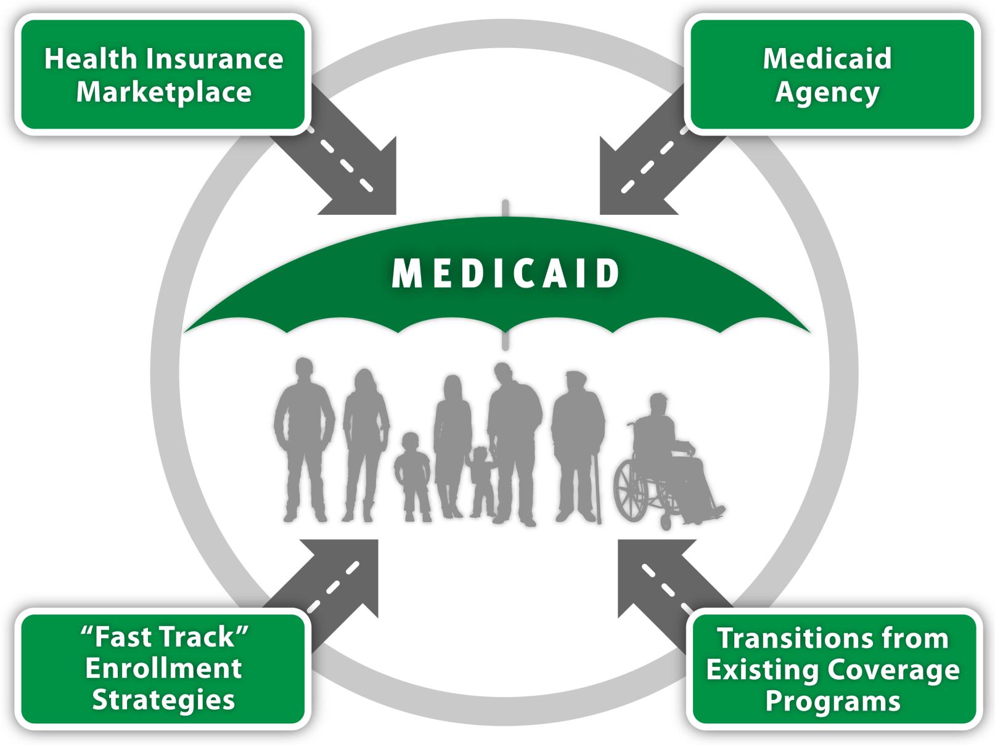
Individuals are connecting to Medicaid through multiple pathways today.

Slide 13
The ACA will lead to increased Medicaid enrollment in a number of ways.
Changes in Medicaid
under the ACA
Expected Impacts on Medicaid Enrollment
Simplified Enrollment and Renewal in All States
Previously Eligible but Not Enrolled in All States
“No Wrong Door” Enrollment in All States
Medicaid Coverage
Newly Eligible in States that Implement the Expansion
Expands Eligibility in States that Implement Expansion
Uninsured
Stability and Continuity of Coverage in All States
Increased Outreach and Enrollment

Slide 14
Experiences to Date
States continuing to implement new eligibility and enrollment processes and coordinate enrollment in Medicaid with the Marketplaces.
CMS has begun reporting new timely eligibility and enrollment data.
  Data are new and subject to gaps and limitations.
  Quality and completeness will improve over time.
Early data show a jump in Medicaid and CHIP eligibility determinations since open enrollment for the Marketplaces began in October 2013.
  Between October-December 2013, state Medicaid and CHIP agencies and state-based Marketplaces made over 6.3 million Medicaid and CHIP determinations.
  As of February 1, 2014, 3.2 million individuals determined or assessed eligible for Medicaid or CHIP by the Marketplaces (1.2 million by FFM in 36 states; 2 million by SBMs in 15 states).
Some states have efficiently enrolled large numbers of eligible people through facilitated enrollment options and transitions from early expansion programs.
In the long run, key measures of impact will be changes in number of uninsured and the experiences of individuals who gain coverage.

Slide 15
Jessica Stephens
Senior Policy Analyst, Disparities Policy Project and Kaiser Commission on Medicaid and the Uninsured
Kaiser Family Foundation

Slide 16
However, not all states are moving forward with the Medicaid expansion.
VT
ME
WA
NH
MT
ND
MN
OR
MA
SD
WI*
NY
ID
MI*
CT
RI
WY
PA*
NJ
NE
IA*
OH
DE
NV
IL
IN*
MD
CA
UT
CO
WV
VA
KS
MO
KY
DC
NC
AZ
TN
NM
OK
AR*
SC
MS
AL
GA
AK
TX
LA
FL
HI
Implementing Expansion in 2014 (26 States including DC)
Open Debate (6 States)
Not Moving Forward at this Time (19 States)
NOTES: Data are as of January 28, 2014. *AR and IA have approved waivers for Medicaid expansion; MI has an approved waiver for expansion and plans to implement in Apr. 2014; IN and PA have pending waivers for alternative Medicaid expansions; WI amended its Medicaid state plan and existing waiver to cover adults up to 100% FPL, but did not adopt the expansion.
SOURCES: States implementing in 2014 and not moving forward at this time are based on data from CMS here States noted as “Open Debate” are based on KCMU analysis of State of the State Addresses, recent public statements made by the Governor, issuance of waiver proposals or passage of a Medicaid expansion bill in at least one chamber of the legislature.

Slide 17
Adult eligibility will increase in states expanding Medicaid, but remain low in states that are not expanding.
Median Medicaid/CHIP Eligibility Thresholds as a Percent of the Federal Poverty Level, January 2014
Moving
Forward With Expansion
(26 states)
Not Moving Forward With Expansion
(25 states)
Moving
Forward
With Expansion
(26 States)
Not Moving Forward With Expansion
(25 States)
Pregnant
Women
Children
Parents
Childless Adults
NOTE: Includes the five percentage point of income disregard.
SOURCE: Based on data from the Centers for Medicare and Medicaid Services, available at: http://medicaid.gov/AffordableCareAct/Medicaid-Moving-Forward-2014/Medicaid-and-CHIP-Eligibility-Levels/medicaid-chip-eligibility-levels.html as of November 15, 2013.

Slide 18
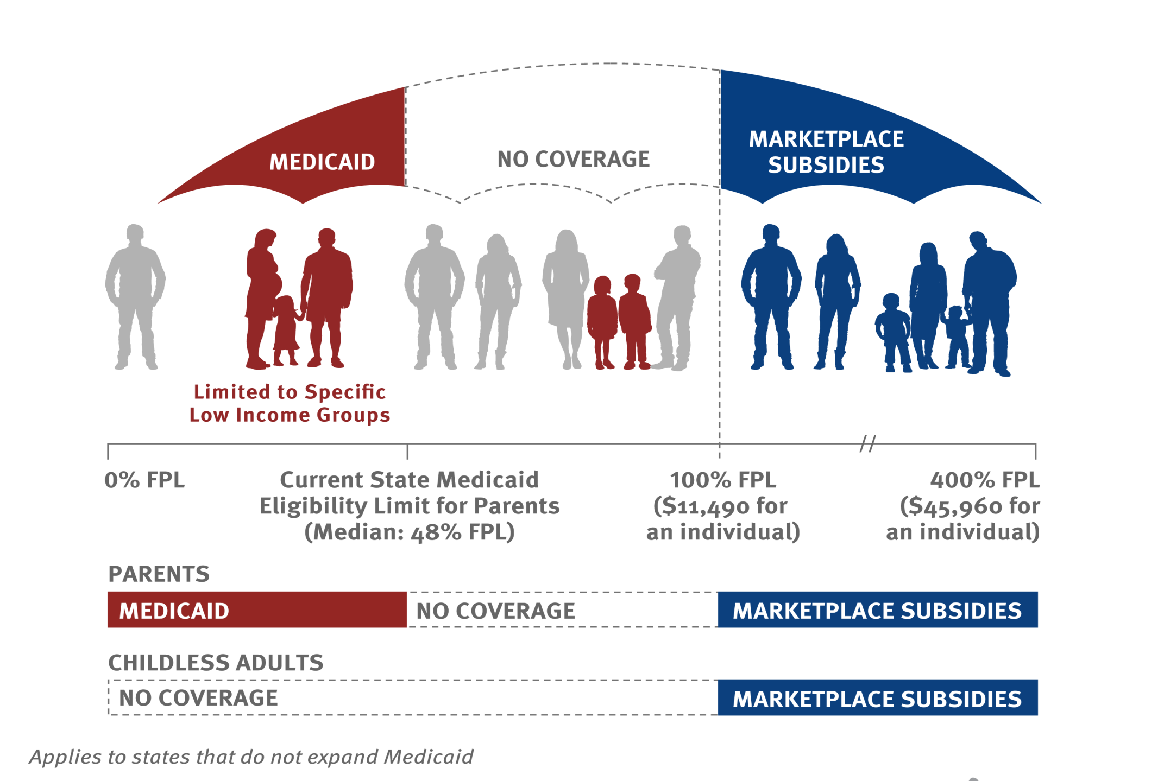
Millions of poor adults will be left without a coverage option in states that do not expand Medicaid under the ACA.
4.8 Million Adults
0% FPL
Childless Adults
47% FPL
Parents
Median Medicaid Eligibility Limits as of Jan. 2014
NOTE: Applies to states that do not expand Medicaid. In most states not moving forward with the expansion, adults without children are ineligible for Medicaid. Based on state Medicaid expansion decisions as of 2014.

Slide 19
The impact of the coverage gap varies widely by race/ethnicity.
Share of Nonelderly Uninsured Adults <138% FPL in the Coverage Gap by Race/Ethnicity:
4.8 M
2.2 M
1.3 M
1.0 M
0.3 M
2.6 M
NOTES: Excludes legal immigrants who have been in the country for five years or less and undocumented immigrants. The poverty level is $19,530 for a family of three and $11,490 for an individual in 2013.
SOURCE: Kaiser Family Foundation analysis based on 2014 Medicaid eligibility levels and 2012-2013 Current Population Survey.

Slide 20
Continued coverage gaps will likely lead to widening racial and ethnic disparities in health coverage.
161.6 M
14.7 M
33.5 M
1.9 M
49.2 M
SOURCE: KCMU/ Urban Institute analysis of 2012 ASEC Supplement to the CPS.

Slide 21
The presenters’ slides conclude here.
The following slides feature additional resources that may be of interest to people interested in this health policy topic.

Slide 22
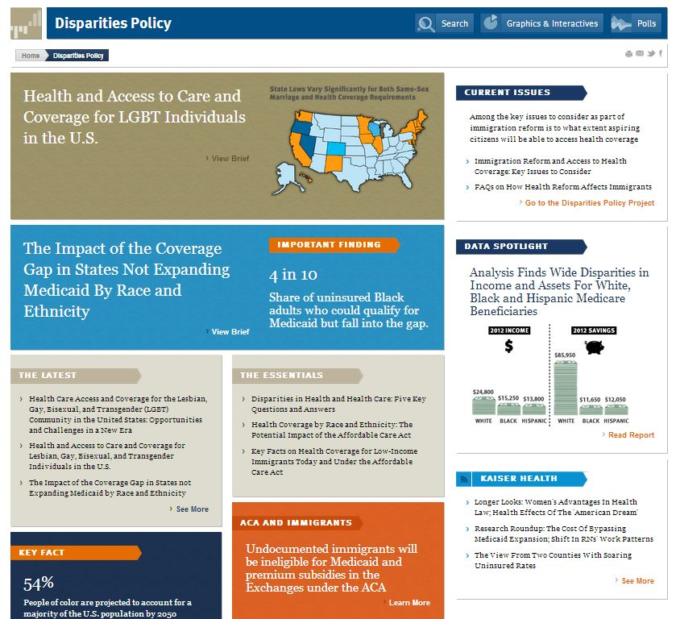
Find more resources at kff.org/disparities-policy

Slide 23
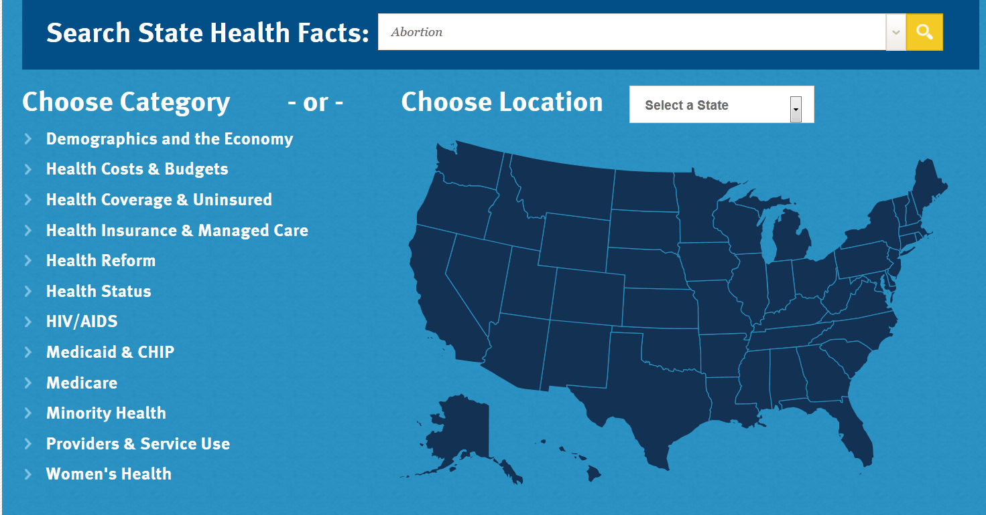
State-by-State Data on Minority Health
www.kff.org/statedata/

Slide 24


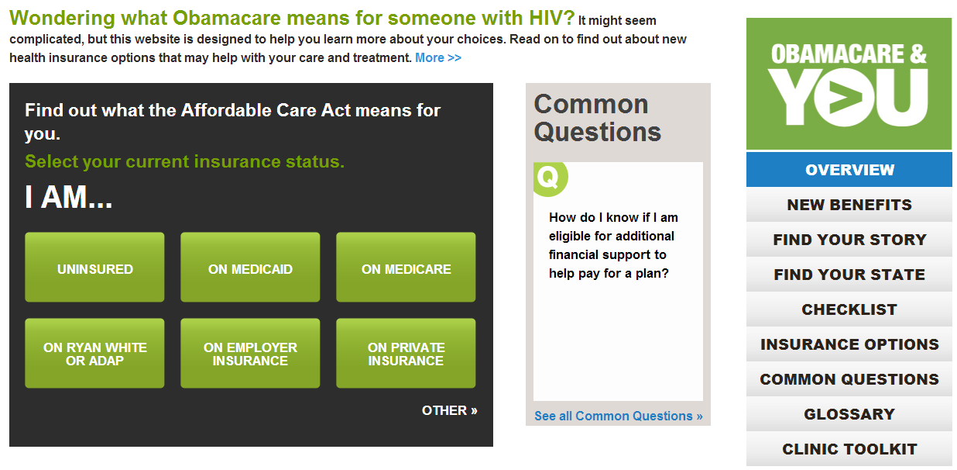
Obamacare & You: Resources For People with HIV
http://greaterthan.org/campaign/obamacare/

Slide 25


GREATER THAN AIDS: EMPOWERED
ALICIA KEYS
IN CONVERSATION
WITH FIVE INSPIRING WOMEN LIVING WITH HIV
http://greaterthan.org/empowered/

Slide 26
KFF Resources on Health Coverage Among Black Americans
The Coverage Gap: Uninsured Poor Adults in States that Do Not Expand Medicaid
The Impact of the Coverage Gap in States Not Expanding Medicaid by Race and Ethnicity
Health Coverage for the Black Populations Today and Under the ACA
kff.org/disparities-policy/

Slide 27
KFF Resources on Insurance Coverage for Women
Health Reform: Implications for Women’s Access to Coverage and Care
Fact Sheet: Women’s Health Insurance Coverage
Health Insurance Coverage of Women, State Estimates
Medicaid’s Role for Women Across the Lifespan: Current Issues and the Impact of the Affordable Care Act
Preventive Services Covered by Private Health Plans under the Affordable Care Act
Search for “women’s health” on kff.org

Slide 28
KFF Resources on Contraception and Abortion
A Guide to the Supreme Court’s Review of the Contraceptive Coverage Requirement
Coverage for Abortion Services and the ACA
Fact Sheet: Emergency Contraception
State Health Facts: Abortion Statistics and Policies
Search for “contraceptive” or “abortion” on kff.org

Slide 29
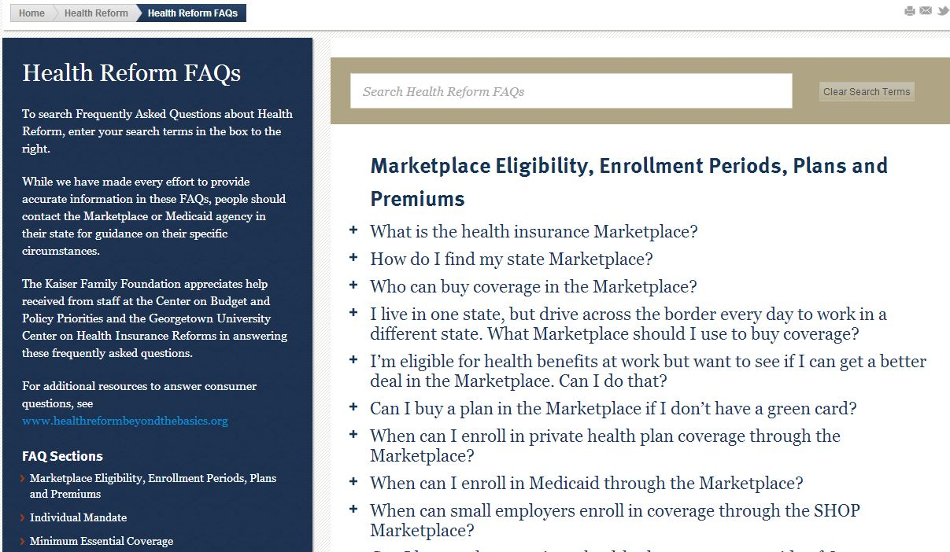
Frequently Asked Questions (FAQs) on Health Reform
Search Q&A by adding a search term or clicking on a section heading
kff.org/health-reform/faq/health-reform-frequently-asked-questions/

Slide 30
KFF Resources on Exchanges / Marketplaces
(NEW) Marketplace Enrollment as a Share of the Potential Marketplace Population
State Marketplace Statistics
Explaining Health Care Reform: Questions About Health Insurance Exchanges
State Decisions For Creating Health Insurance Exchanges
Search for “marketplaces” on kff.org

Slide 31
KFF Resources on Tax Credits & Premiums
Quantifying Tax Credits for People Now Buying Insurance on Their Own
Explaining Health Care Reform: Questions About Health Insurance Subsidies
Why Premiums Will Change for People Who Now Have Nongroup Insurance
Search for “tax credit” on kff.org

Slide 32
KFF Resources on Insurance Market Reforms
The “Health Insurance Market Reforms” series covers:
      Pre-Existing Condition Exclusions
      Guaranteed Issue
      Rate Restrictions
      Rate Review
Search for “Health Insurance Market Reforms” at kff.org

Slide 33

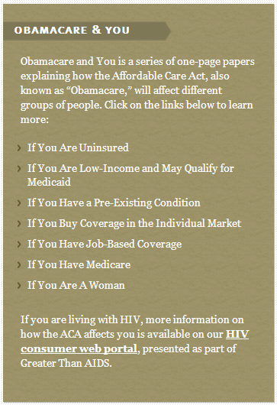
KFF Resources for Consumers on the ACA
kff.org/aca-consumer-resources

Slide 34



KFF Resources in Spanish
"Los YouToons Se Preparan Para Obamacare“ (Video)
Obamacare y Usted
  Seven fact sheets on how the ACA affects people if they:
    Have Medicare
    Qualify for Medicaid
    Have coverage through their employers
    Are uninsured
    Have pre-existing conditions
    Are a woman
    Buy coverage in the individual market
Calculadora de subsidios
kff.org/cuidado-de-salud-recursos-para-los-consumidores/

Slide 35
Keep in touch with KFF online!
Facebook: /KaiserFamilyFoundation
Twitter: @KaiserFamFound
LinkedIn: /company/kaiser-family-foundation
Email Alerts: kff.org/email

