Slide 1
Women’s Health under the Affordable Care Act
The Covering Health Reform Webinar Series For Journalists
Presented by the Kaiser Family Foundation
Thursday, February 6, 2014
12:30 p.m. ET – 1:30 p.m. ET

Slide 2



Today’s Speakers from the Kaiser Family Foundation
Alina Salganicoff
Vice President and Director of Women’s Health Policy
Laurie Sobel
Senior Policy Analyst
Penny Duckham
Executive Director, Media Fellowships Program

Slide 3












Women Were a Critical Part of the ACA Debate
The White House Blog
Health Insurance Reform as a Women's Issue:
The First Lady's Take
Comprehensive Health Care Reform:
An Essential Prescription for Women
A Report by the Joint Economic Committee
Representative Carolyn B. Maloney, Chair
Senator Charles E. Schumer, Vice Chair
March of Dimes Calls for Health Coverage
for Women of Childbearing Age and Children
Join YWCA to tell Congress that now is the time to pass comprehensive healthcare reform.
AMA president says pregnant women are barred from buying individual health policies
AARP on What Health Reform Means for Women
Health Care: A Basic Right
Healthcare Reform in America - You can make a difference!

Slide 4
Costs Are a Barrier to Care for Many Women
Percentage of men and women who say they or a family member have done each of the following in the past year because of COST:
Put off or postponed getting needed health care
Skipped a recommended medical test or treatment
Didn’t fill a prescription
Cut pills or skipped doses of medicine
Had problems getting mental health care
Source: Kaiser Family Foundation Health Tracking Poll (conducted September 12-18, 2013) http://kff.org/health-reform/poll-finding/kaiser-health-tracking-poll-september-2013/

Slide 5
Millions of Uninsured Women Could Gain Access to Affordable Coverage, but Many Are in the Gap
Insurance Coverage of Women in the U.S., 2011-2012
Eligibility for Coverage
2.6 million
6.8 million
Tax Credit Eligible - 37%
4.4 million
Medicaid Eligible - 24%
Coverage Gap - 13%
(income below 100% FPL in a state not expanding Medicaid)
2.4 million
2.5 million
Undocumented - 13%
96.3 Million Women
Ages 19 - 64
18.7 Million Uninsured Women
NOTE: Undocumented refers to those who are not legally authorized in the U.S. Medicaid Eligible includes women eligible for Medicaid in all states. Percentage may not add up to 100% due to rounding.
SOURCE: Kaiser Family Foundation analysis based on 2014 Medicaid eligibility levels and 2012-2013 Current Population Survey, U.S. Bureau of the Census.

Slide 6
Impact of the Supreme Court Ruling:
Half of states will not be expanding Medicaid in 2014
VT
ME
WA
NH
MT
ND
MN
OR
MA
SD
WI*
NY
ID
MI*
CT
RI
WY
PA*
NJ
NE
IA*
OH
DE
NV
IL
IN*
MD
CA
UT
CO
WV
VA
KS
MO
KY
DC
NC
AZ
TN
NM
OK
AR*
SC
MS
AL
GA
AK
TX
LA
FL
HI
Implementing Expansion in 2014 (26 States including DC)
Seeking to Move Forward with Expansion post-2014 (2 States)
Not Moving Forward at this Time (23 States)
SOURCES: State decisions on the Medicaid expansion as of December 11, 2013. Based on data from CMS, available at: http://medicaid.gov/AffordableCareAct/Medicaid-Moving-Forward-2014/Medicaid-and-CHIP-Eligibility-Levels/medicaid-chip-eligibility-levels.html. Data have been updated to reflect more recent activity.

Slide 7
The ACA Makes Many Insurance Reforms Affecting Women
Before ACA | After ACA
No uniform national policy regarding dependent coverage age limits | Dependent coverage extended to age 26, Uninsured rate for women 19-25 fell from 30% in 2009 to 25% in 2012
Pregnancy and history of domestic violence could be considered pre-existing conditions | No pre-existing condition exclusions
Individual insurance plans could charge higher premiums to women. Many did. | Plans are no longer permitted to use gender to determine premiums: gender-rating banned
Individual insurance plans typically excluded maternity care, considered pregnancy a “pre-ex”, or required costly riders for coverage. Only employer plans required to cover maternity care. | Individually purchased plans and employer-based plans include maternity care
Plans were not required to cover preventive services without cost sharing. | ALL new plans must cover recommended preventive services without cost-sharing.
Source: Kaiser Family Foundation, Health Reform: Implications for Women’s Access to Coverage and Care, 2013.

Slide 8
ACA requires all “new” private plans to cover preventive services
Includes:
  Self-insured employer plans (ERISA plans)
  Individual insurance plans (plans purchased by individuals)
  Small and Large group plans (plans employers buy for workers)
  Plans that are “grandfathered” are exempt
Requirement also applies to plans that are available in the state Marketplaces because preventive services are considered an Essential Health Benefit

Slide 9
Adult Preventive Services to be Covered by Private Plans Without Cost Sharing
Cancer | Chronic Conditions | Vaccines | Healthy Behaviors | Pregnancy | Reproductive and Sexual Health
Breast Cancer Mammography for women 40+* Genetic (BRCA) screening and counseling Preventive medication Cervical Cancer Pap testing (women 21+ ) High-risk HPV DNA testing ♀ Colorectal Cancer One of following: fecal occult blood testing, colonoscopy, sigmoidoscopy | Cardiovascular health Hypertension screening Lipid disorders screenings Aspirin Type 2 Diabetes screening (adults w/ elevated blood pressure) Depression screening (adults, when follow up supports available) Osteoporosis screening (all women 65+, women 60+ at high risk) Obesity Screening (all adults) Counseling and behavioral interventions (obese adults) | Td booster, Tdap MMR Meningococcal Hepatitis A, B Pneumococcal Zoster Influenza, Varicella HPV (women and men 19-26) | Alcohol misuse screening and counseling (all adults) Diet counseling (adults w/high cholesterol, CVD risk factors, diet-related chronic disease) Tobacco counseling and cessation interventions (all adults) Interpersonal and domestic violence screening and counseling (women 18-64)♀ Well-woman visits (women 18-64) ♀ | Tobacco and cessation interventions Alcohol misuse screening/counseling Rh incompatibility screening Gestational diabetes screenings♀ 24-28 weeks gestation First prenatal visit (women at high risk for diabetes) Screenings Hepatitis B Chlamydia (<24, hi risk) Gonorrhea Syphilis Bacteriurea Folic acid supplements (women w/repro capacity) Iron deficiency anemia screening Breastfeeding supports, counseling , consultations and equipment rental♀ | STI and HIV counseling (adults at high risk; all sexually-active women♀) Screenings: Chlamydia (sexually active women <24y/o, older women at high risk) Gonorrhea (sexually active women at high risk) Syphilis (adults at high risk) HIV (adults at high risk; all sexually active women♀) Contraception (women w/repro capacity) ♀ All FDA approved methods as prescribed, Sterilization procedures Patient education and counseling
SOURCE: U.S. DHHS, “Recommended Preventive Services.” Available at http://www.healthcare.gov/center/regulations/prevention/recommendations.html.
More information about each of the services in this table, including details on periodicity, risk factors, and specific test and procedures are available at the following websites:
USPSTF: http://www.uspreventiveservicestaskforce.org/recommendations.htm
ACIP: http://www.cdc.gov/vaccines/pubs/ACIP-list.htm#comp HRSA Women’s Preventive Services: http://www.hrsa.gov/womensguidelines/

Slide 10
Why does this matter? Insurance coverage facilitates use of preventive care
Percent of women reporting they have received screening test in past two years:
*
*
*
*
NOTE: Colon cancer screening among women ages 50 and older; *Significantly different from private, p<.05.
SOURCE: Kaiser Family Foundation, 2013 Kaiser Women’s Health Survey.

Slide 11
ACA makes important reforms to improve availability of maternity care
Pregnancy no longer a pre-existing condition
Maternity and newborn care are essential health benefits
Prenatal care and recommended screening services, breastfeeding support now covered without cost-sharing
Medicaid – Pays for nearly half of U.S. births
    Mandatory coverage of tobacco cessation programs for pregnant women
    Optional coverage for freestanding birth centers
    Medicaid coverage for all newborns who lack acceptable coverage
Workplace breastfeeding protections for nursing mothers
  Breaks and private area to express milk

Slide 12
ACA’s mental health coverage benefit helps women who have historically lacked coverage for many conditions
NOTE: *Substance Disorders includes nicotine addiction.
SOURCE: Comorbidity Survey Replication, updated 2012. Journal of the American Academy of Child and Adolescent Psychiatry, March 2009.

Slide 13
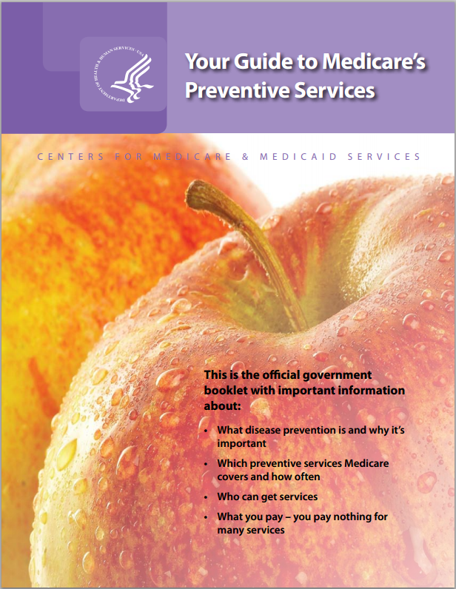
ACA expands the preventive services that Medicare Part B will cover without cost-sharing
“Welcome to Medicare” preventive visit Yearly "Wellness" visit Abdominal aortic aneurysm screening Alcohol misuse screenings & counseling Bone mass measurements (bone density) Cardiovascular disease screenings Cardiovascular disease (behavioral therapy) Cervical & vaginal cancer screening Colorectal cancer screenings Depression screenings | Diabetes screenings and self-management training Glaucoma tests HIV screening Mammograms (screening) Nutrition therapy services Obesity screenings & counseling Sexually transmitted infections screening & counseling Vaccinations: Flu, Hepatitis B, Pneumococcal Tobacco use cessation counseling
Source: http://www.medicare.gov/coverage/preventive-and-screening-services.html

Slide 14
  Focus on Coverage of Contraception and Abortion

Slide 15
Contraceptive Coverage: What does it include?
ACA requires coverage of FDA-approved contraceptive methods “as prescribed” for women with no cost sharing.
Includes counseling and insertion as well as services related to follow-up and management of side effects, counseling for continued adherence, and device removal
All new plans and for-profit employers must cover contraceptives
Exemptions and accommodations for certain religious and affiliated nonprofits

Slide 16












FDA Approved Contraceptive Services and Supplies - Covered without Cost-Sharing
Contraceptive |  | Costs
Barrier Methods | Diaphragm | $15-$75
 | Sponge | $9-15
 | Cervical Cap | $60-$75
 | Spermicide | $8
 | Female Condom | $4
Hormonal Methods | Oral Contraceptives (Pills) | $15-$50
 | Birth Control Patch (Ortho Evra) | $15-$80
 | Birth Control Ring (NuvaRing) | $15-$80
 | Birth Control Shot (Depo-Provera) | $35-$100
Emergency Contraception | Plan B – One Step, Next Choice, Levonorgesterol | $35-$60
 | ella | $55
Implanted Devices | Intrauterine device – ParaGard, Hormonal IUD- Mirena, Skyla | $500-$1000
 | Implantable Rods | $400-$800
Sterilization for Women | Procedure | $1500 - $6000
NOTE: A woman’s reproductive life spans approximately 30 years.
SOURCE: Planned Parenthood, Birth Control, http://www.plannedparenthood.org/health-topics/birth-control-4211.htm.

Slide 17
Contraceptive Coverage: Exemptions and Accommodations
Exempt
Mandatory
Nonprofit Houses of Worship
For Profit Employers:
No Exemptions or Accommodations
Nonprofit Employers
Secular
Religiously Affiliated
No religious objection to contraception
Employer objects to contraceptives on religious grounds
Accommodation
Employer is not required to cover contraceptives; Employees/Dependents do not have guaranteed contraceptive coverage.
Self-Certify and notify insurer or third party administrator (TPA)
Employer must include contraceptive coverage or face a penalty
Employer not obligated to purchase contraceptive coverage: Insurer or TPA must pay for
coverage for workers/dependents.
NOTE: This requirement applies to employers with fifty or more employees unless they are offering coverage through a grandfathered plan. Small employers (less than fifty employees) are not penalized for not offering health insurance to their workers. However, if a small employer does provide health insurance it must cover preventive services, including contraceptives for women.

Slide 18


Do for-profit corporations have religious rights?
Supreme Court - Oral Argument 3/25/14
Case | Plaintiff | Claim
Hobby Lobby, Inc. v. Sebelius | Green family, Protestants of Oklahoma, own Hobby Lobby, a national chain of craft stores with over 500 stores in over 41 states and over 13,000 employees | Greens object to providing health insurance coverage for Ella, Plan B, and IUDs because it is against their religious beliefs and the requirement violates the Religious Freedom Restoration Act (RFRA) and the First Amendment
Conestoga Wood Specialties Corp. v. Sebelius | Hahn family, Mennonites of Pennsylvania, own Conestoga Woods Specialties which manufactures wood cabinets and has 950 full time employees. | Hahns object to providing health insurance coverage for Plan B and Ella because it is against their religious beliefs and the requirement violates RFRA and the First Amendment
SOURCE: Kaiser Family Foundation, A Guide to the Supreme Court’s Review of the Contraceptive Coverage Requirement, Dec. 2013

Slide 19
Religious Freedom Restoration Act of 1993
The Religious Freedom Restoration Act of 1993 (RFRA) provides that the government “shall not substantially burden a person’s exercise of religion” unless that burden is the least restrictive means to further a compelling governmental interest.
http://www.law.cornell.edu/uscode/text/42/chapter-21B

Slide 20
What the Supreme Court Must Consider
Is the for-profit employer a “person” capable of religious belief?
Does the requirement to provide health insurance for contraceptives substantially burden the employer?
Does the government have a compelling interest to provide health insurance coverage for preventive care including contraceptives?
Is the government meeting the compelling interest in the least restrictive way?
Burden on Employer
Burden on Government
1.
2.
3.
4.
YES
YES
YES
NO
NO
NO
YES
NO
Does not violate RFRA
Violates RFRA
SOURCE: Kaiser Family Foundation, A Guide to the Supreme Court’s Review of the Contraceptive Coverage Requirement, Dec. 2013

Slide 21
Broader Ramifications of the Decision Beyond Health Care:
A decision in favor of granting for profit corporations religious rights could have far-reaching consequences:
Some business owners may have religious beliefs that conflict with various aspects of health care, including: blood transfusions, vaccinations, infertility treatments, psychiatry treatment and drugs, and health insurance all together.
Employers could ask to “opt out” of civil rights laws including:
  Laws meant to protect people from employment and housing discrimination based on race, gender, religion, national origin, or pregnancy.
SOURCE: Kaiser Family Foundation, A Guide to the Supreme Court’s Review of the Contraceptive Coverage Requirement, Dec. 2013

Slide 22
ACA and Abortion Coverage
  Abortion explicitly banned as an essential health benefit
  State policy also shapes coverage
    Medicaid:
      The Hyde Amendment limits the use of federal funds (including tax credits and subsidies) to abortion coverage only in the cases of rape, incest, life endangerment
    State Marketplaces and Private Insurance:
      States can ban abortion coverage in Marketplaces; 24 states have done so
      9 states have either banned or restricted abortion coverage in plans sold by private insurers in the state (beyond the State Marketplace)
SOURCE: Patient Protection and Affordable Care Act , Section 1334.

Slide 23
State Policies on Abortion Coverage in Medicaid and Private Insurance
WA
VT
ME
MT
ND
MN
NH
OR
WI
NY
MA
ID
SD
MI
RI
WY
PA
CT
IA
NJ
NV
NE
OH
DE
UT
CO
IL
IN
MD
CA
WV
VA
DC
KS
MO
KY
NC
OK
TN
AZ
AR
SC
NM
MS
AL
GA
AK
LA
TX
FL
HI
State abortion coverage restriction:
state Medicaid programs
state Marketplace plans
private insurance
3 Restrictions (9 states)
2 Restrictions (14 states)
1 Restriction (11 states and DC)
No Restrictions (16 states)
SOURCE: Kaiser Family Foundation, Coverage for Abortion Services and the ACA, January 2014. http://kff.org/womens-health-policy/issue-brief/coverage-for-abortion-services-and-the-aca/

Slide 24
Availability of Abortion Coverage for Women Uninsured Prior to 2014
(3.9 Million Women)
NOTE: Total excludes women who are not legally authorized in the U.S. *Includes women qualifying for Medicaid in states that limit abortion coverage to Hyde; or are eligible for subsidies in states that ban abortion in their state Marketplace; or with incomes 400+% FPL in states that ban abortion in private plans.
**Includes women with incomes below the federal poverty level but who live in state not expanding Medicaid and do not qualify for subsidies.
SOURCE: Kaiser Family Foundation, Coverage for Abortion Services and the ACA, January 2014.
http://kff.org/womens-health-policy/issue-brief/coverage-for-abortion-services-and-the-aca/

Slide 25
Women’s Health and ACA: Key Issues and Dates
Enrollment:
  Women comprise 54% of early Marketplace enrollees. Women’s role in promoting enrollment to families and young adults is key
Coverage Gap
  2.4 million women in coverage gap
Preventive Services
  Implementation will be key
Reproductive Services
  Contraceptive coverage: Supreme Court oral arguments on Hobby Lobby and Conestoga Wood Specialties will be on March 25th, 2014, with an expected decision in June 2014
  Abortion coverage rules still in play in state and federal arena

Slide 26
Women’s Health Resources from The Kaiser Family Foundation
The Kaiser Family Foundation, Women’s Health Policy
FAQ’s about Women’s Health and the ACA
A Guide to the Supreme Court’s Review of the Contraceptive Coverage Requirement
Coverage for Abortion Services and the ACA
Health Reform: Implications for Women’s Access to Coverage and Care
Fact Sheet: Women’s Health Insurance Coverage
Medicaid’s Role for Women Across the Lifespan: Current Issues and the Impact of the Affordable Care Act

Slide 27
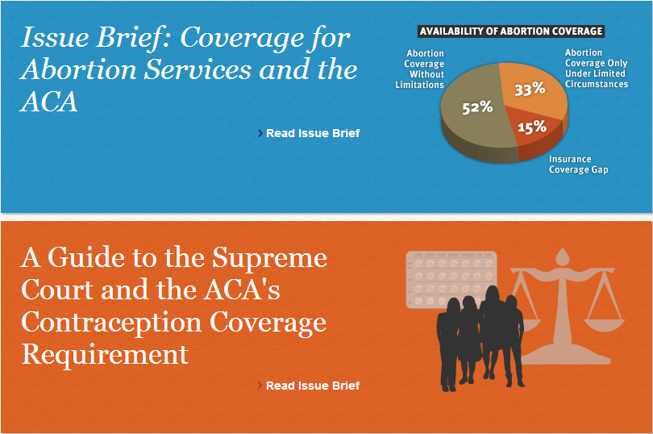
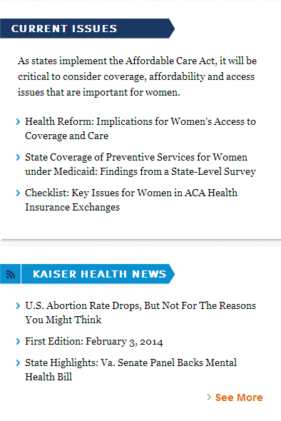
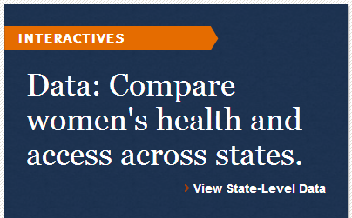

Women’s Health on kff.org
kff.org/womens-health-policy/

Slide 28
KFF Resources on Insurance Coverage for Women
Health Reform: Implications for Women’s Access to Coverage and Care
Fact Sheet: Women’s Health Insurance Coverage
Health Insurance Coverage of Women, State Estimates
Medicaid’s Role for Women Across the Lifespan: Current Issues and the Impact of the Affordable Care Act
Preventive Services Covered by Private Health Plans under the Affordable Care Act
Search for “women’s health” on kff.org

Slide 29
KFF Resources on Contraception and Abortion
A Guide to the Supreme Court’s Review of the Contraceptive Coverage Requirement
Coverage for Abortion Services and the ACA
Fact Sheet: Emergency Contraception
State Health Facts: Abortion Statistics and Policies
Search for “contraceptive” or “abortion” on kff.org

Slide 30
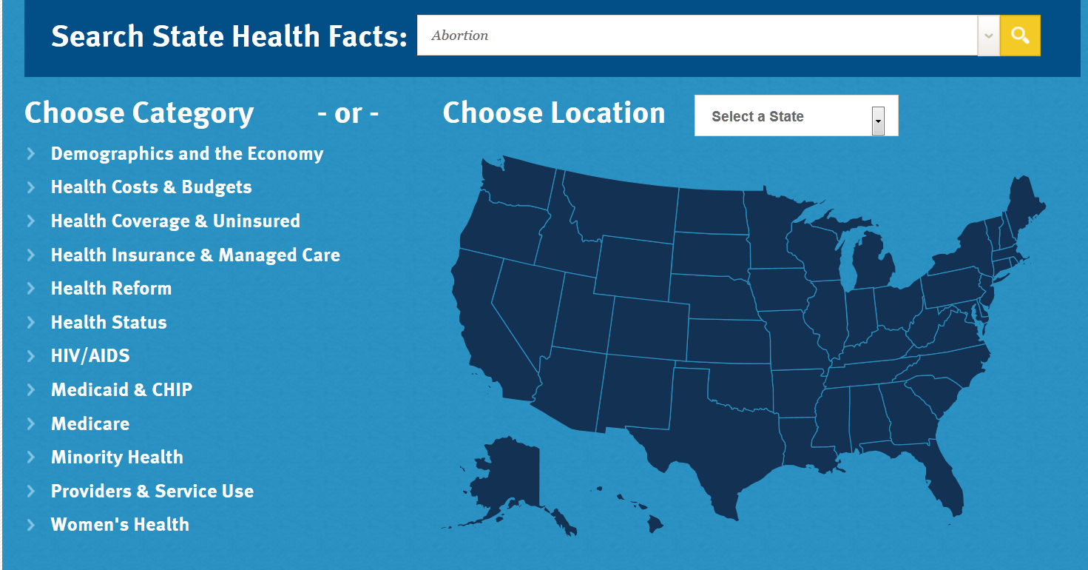
State-by-State Data on Women’s Health
www.kff.org/statedata/

Slide 31
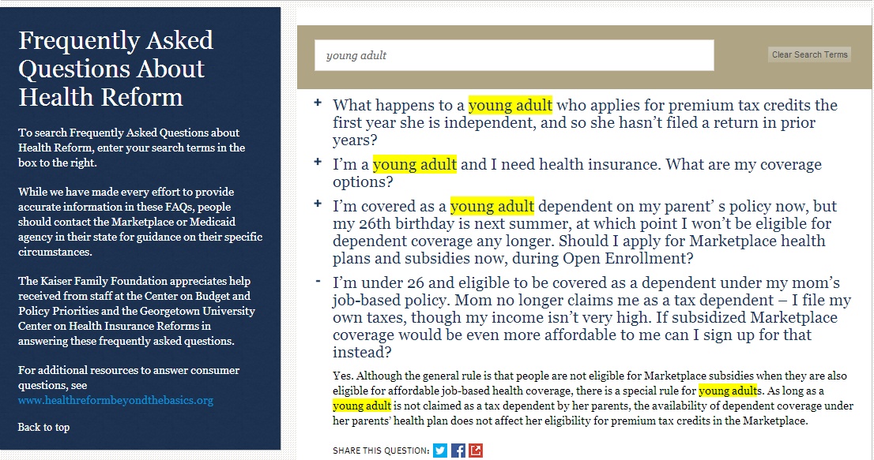
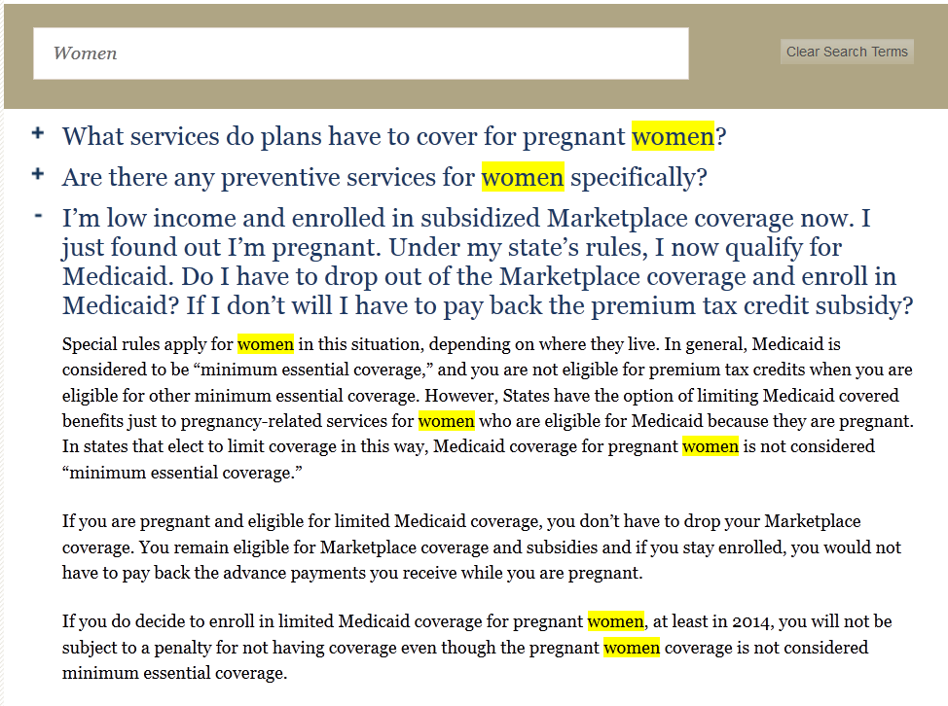
KFF’s Frequently Asked Questions (FAQs) on the ACA
Search FAQs by typing a search term or click on a section heading (not pictured)
Feature women’s health FAQs instead: http://kff.org/health-reform/faq/health-reform-frequently-asked-questions/#section-womens-health
kff.org/health-reform/faq/health-reform-frequently-asked-questions/

Slide 32
KFF Resources on ACA and Low- to Moderate-Income Adults
The Coverage Gap: Uninsured Poor Adults in States that Do Not Expand Medicaid
State Estimates for People Eligible for Tax Credits In Marketplace
kff.org/health-reform/

Slide 33
KFF Resources on Exchanges / Marketplaces
(NEW) Marketplace Enrollment as a Share of the Marketplace Eligible Population
State Marketplace Statistics
Explaining Health Care Reform: Questions About Health Insurance Exchanges
State Decisions For Creating Health Insurance Exchanges
Search for “marketplaces” on kff.org

Slide 34
KFF Resources on Tax Credits & Premiums
Quantifying Tax Credits for People Now Buying Insurance on Their Own
Explaining Health Care Reform: Questions About Health Insurance Subsidies
Why Premiums Will Change for People Who Now Have Nongroup Insurance
Search for “tax credit” on kff.org

Slide 35
KFF Resources on Insurance Market Reforms
The “Health Insurance Market Reforms” series covers:
      Pre-Existing Condition Exclusions
      Guaranteed Issue
      Rate Restrictions
      Rate Review
Search for “Health Insurance Market Reforms” at kff.org

Slide 36
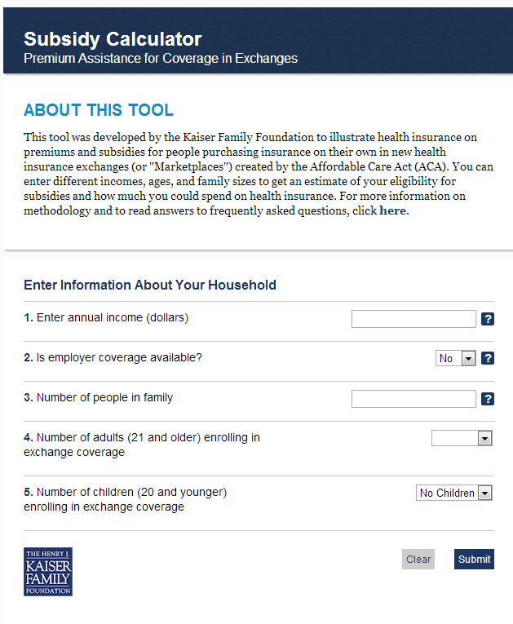

Feature Our Resources on Your Site For Free
Health Reform Subsidy Calculator
Animated Video
kff.org/interactive/subsidy-calculator
kff.org/youtoons-obamacare-video
kff.org/aca-consumer-resources

Slide 37

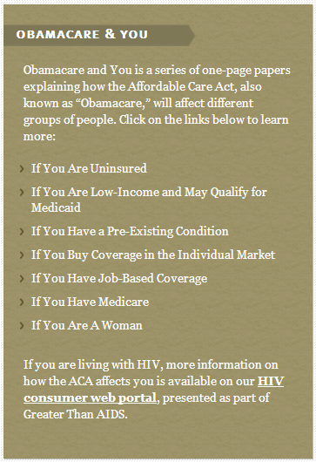
KFF Resources for Consumers on the ACA
kff.org/aca-consumer-resources

Slide 38



KFF Resources in Spanish
"Los YouToons Se Preparan Para Obamacare“ (Video)
Obamacare y Usted
  Seven fact sheets on how the ACA affects people if they:
    Have Medicare
    Qualify for Medicaid
    Have coverage through their employers
    Are uninsured
    Have pre-existing conditions
    Are a woman
    Buy coverage in the individual market
Calculadora de subsidios
kff.org/cuidado-de-salud-recursos-para-los-consumidores/

Slide 39
Contact Information
    Rakesh Singh, Vice President of Communications
    Kaiser Family Foundation | Menlo Park, Calif.
    Email: RSingh@KFF.org
    Victoria Chao, Communications Associate
    Kaiser Family Foundation| Menlo Park, Calif.
    Email: VChao@KFF.org

Slide 40
Keep in touch with KFF online!
Facebook: /KaiserFamilyFoundation
Twitter: @KaiserFamFound
LinkedIn: /company/kaiser-family-foundation
Emails: kff.org/email

