Slide 1
A Year-End Update on the ACA Rollout and Looking Ahead to 2014
The Covering Health Reform Webinar Series For Journalists
Presented by the Kaiser Family Foundation
Tuesday, December 17, 2013
12:30 p.m. ET – 1:30 p.m. ET

Slide 2


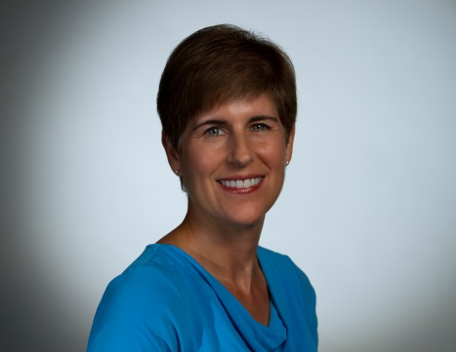
Today’s Speakers from the Kaiser Family Foundation
Jen Tolbert
Director of State Health Reform
Larry Levitt
Co-Director of the Program for the Study of Health Reform and Private Insurance
Senior Vice President
Penny Duckham
Executive Director, Media Fellowships Program

Slide 3
Penny Duckham
Executive Director, Media Fellowships Program
Kaiser Family Foundation

Slide 4
Today’s Webinar Will Be Archived
  kff.org/health-reform/event/webinar-a-year-end-update-on-the-aca-rollout-looking-ahead-to-2014
The full webinar presentation and PowerPoint slides will be posted by or before tomorrow morning.
The transcript of today’s webinar will be posted in the coming week.

Slide 5
Jen Tolbert
Director, State Health Reform
Kaiser Family Foundation

Slide 6
State Decisions for Establishing Health Insurance Marketplaces and Expanding Medicaid
VT
ME
WA
NH
MT
ND
MN
OR
MA
SD
WI
NY
ID
MI
CT
RI
WY
PA
NJ
NE
IA
OH
DE
NV
IL
IN
MD
CA
UT
CO
WV
VA
KS
MO
KY
DC
NC
AK
AZ
TN
NM
OK
AR
SC
MS
AL
GA
TX
LA
FL
HI
State-based Marketplace and Moving Forward
with the Medicaid expansion (16 States including DC)
Federally-Facilitated or Partnership Marketplace and Moving Forward with the Medicaid Expansion (10 States)
State-based Marketplace and Not Moving Forward
with the Medicaid expansion (1 State)
Federally-Facilitated or Partnership Marketplace and Not Moving Forward with the Medicaid Expansion (24 States)
SOURCE: State Decisions on Health Insurance Marketplaces and the Medicaid Expansion, as of November 22, 2013, KFF State Health Facts,
http://www.kff.org/health-reform/state-indicator/state-decisions-for-creating-health-insurance-exchanges-and-expanding-medicaid/#

Slide 7
Number of Individuals Who Have Selected a Qualified Health Plan, as of November 30, 2013
Total Number of Individuals Selecting a QHP = 364,682
* State-based Marketplaces
Source: Health Insurance Marketplace: December Enrollment Report, Department of Health and Human Services, December 11, 2013.

Slide 8
Number of Individuals Who Have Selected a QHP as a Share of those Eligible to Enroll in the Marketplace for States with the Largest Marketplace Enrollment
Kentucky
(20,951 enrollees)
New York
(45,513 enrollees)
Washington
(17,770 enrollees)
California
(107,087 enrollees)
Florida
(17,908 enrollees)
State-based Marketplace
State utilizes Federal Marketplace portal
Texas
(14,038 enrollees)
SOURCE: Based on data from “Health Insurance Marketplace: December Enrollment Report,” Department of Health and Human Services, December 11, 2013 and “State-by-State Estimates of the Number of People Eligible for Premium Tax Credits Under the Affordable Care Act,” Kaiser Family Foundation, November 5, 2013.

Slide 9
Number of Individuals Determined or Assessed Eligible for Medicaid through State and Federal Websites
(as of November 30, 2013)
Total Number of Individuals = 803,077
* State-based Marketplaces
Source: Health Insurance Marketplace: December Enrollment Report, Department of Health and Human Services, December 11, 2013.

Slide 10
What Do We Know About Marketplace Activity So Far?
Of the roughly 3 million total applicants, three out of four are eligible to enroll in the Marketplace versus Medicaid
  Higher proportion of Marketplace applicants determined eligible for Medicaid/CHIP in State-based Marketplaces (40%) compared to states with a Federally-facilitated Marketplace (15%)
  Integrated eligibility systems in State-based Marketplaces, coupled with decisions to expand Medicaid, likely contributing to higher Medicaid eligibility determinations
Overall, about 40% of those eligible to enroll in the Marketplace are eligible for financial assistance
Critical step of selecting a plan has been completed by less than 16% of those determined eligible to enroll in the Marketplace plan
  In State-based Marketplaces, nearly 30% have selected a plan compared to only 9% across states with a Federally-facilitated Marketplace
  Website problems may be one reason for low enrollment
Initial reports indicate enrollment in December is surging

Slide 11
Larry Levitt
Senior Vice President
Kaiser Family Foundation

Slide 12
Warning: Math and actuarial terms to follow. Proceed at your own risk.

Slide 13
What is Risk Pooling?
People are part of a risk pool if their premiums are based on their collective health care use.
Pre-ACA, there were risk pools galore in the individual market:
  Each insurer had its own risk pools.
  Within an insurer, risk pools were often segregated by “block of business.”
Under the ACA:
  Each insurer must set premiums for all of its individual market business in a state as a single risk pool.
  This means plans sold inside and outside of exchanges/marketplaces are in the same risk pool.
  Risk is further pooled ACROSS insurers within a state through risk adjustment.
  Grandfathered and “early renewal” plans are NOT part of the ACA risk pool.
Premiums can still vary by a number of factors: age, tobacco use, geography, level of patient cost-sharing, and provider network.

Slide 14
Why Does Risk Pooling Matter?
Who is in the pool in a state affects the average cost in the market.
  For 2014, since premiums are already set, the effect is on insurer profitability.
  For 2015 and beyond, the effect is on premiums.
Potential threats to the risk pool:
  The tendency for older/sicker people to be more likely to sign up than younger/healthier people (“adverse selection”).
  Continuation of policies under the “old” rules.
What will we know and what won’t we know:
  We’ll know the age distribution of exchange/marketplace enrollees, but not of enrollees in the outside market.
  We likely won’t know anything about health status for quite a while.

Slide 15
Relative Premiums Under Unlimited Age Rating vs. 3:1 Limit
Older adults pay less than their average cost
Young adults pay more than their average cost
Source: Kaiser Family Foundation analysis. Unlimited age rates are based on an average of several pre-ACA age curves. Rates under a 3:1 limit are based on the standard age factors established by the CCIIO. Both curves have been normalized based on an estimated average age factor.

Slide 16
Distribution of Potential Individual Market Enrollees by Age
The Potential Market
Uninsured without an employer offer
Current individual market purchasers
Legal residents
Under 18
55 or older
18-34
35-54
Source: Kaiser Family Foundation analysis of the Survey of Income and Program Participation.

Slide 17
Enrollment in Exchanges Plans So Far Among 18-34 Year-Olds
State | % of Enrollees, Age 18-34
California | 22%
Colorado | 17%
Connecticut | 19%
Kentucky | 20%
Maryland | 27%
Minnesota | 10%
Massachusetts | 37%
Rhode Island | 20%
Washington | 18%
Source: New York Times, nytimes.com/interactive/2013/12/14/us/tracking-the-ages-of-health-care-enrollees.html

Slide 18
What if Young Adults Stay Away?
If there is lower-than-expected enrollment among young adults, then there will be insufficient premium revenue from people paying more than they cost on average to subsidize people who pay less than they cost on average.
But, the effect isn’t as big as conventional wisdom suggests.
If 18-34 year-olds are 25% less likely to enroll:
  They would represent 33% of enrollees vs. 40% in the potential market.
  Premiums would have to rise by 1.1%.
If 18-34 year-olds are 50% less likely to enroll:
  They would represent 25% of enrollees vs. 40% in the potential market.
  Premiums would have to rise by 2.4%.

Slide 19
Is a “Death Spiral” Likely?
A “death spiral” is when sicker people end up in the risk pool, causing premiums to rise, in turn causing healthy people to drop out, in turn causing premiums to go up even more.
Because premiums still vary substantially by age, a “death spiral” is highly unlikely in response to low enrollment among young adults.
Skewed enrollment by health status would have greater consequences, but there are “shock absorbers” built into the system.
  Risk corridors and reinsurance.
  Tax credits that mean many people do not pay the full cost of insurance.
  Phase-in of higher penalties under the individual mandate.
  The desire among insurers to attract healthy people in 2015.

Slide 20
Other Things to Keep an Eye on in the Coming Weeks
Have the back-end issues been worked out so that people who thought they were enrolled actually are enrolled?
Are people who signed up for plans paying their premiums?
Is outreach ramping up now that the enrollment systems are functioning more smoothly?
Are consumer assistance resources sufficient to provide help to people who need it in applying for coverage and picking a plan?
What is the share of enrollment among people eligible for tax credits?
How do consumers perceive their coverage as they start to use it?

Slide 21
Q&A – You can Ask Questions Via Chat or Phone
We will now take questions via chat and via phone.
You can type your questions via chat at any time during the webinar.
To ask a question via phone, please dial:
1-800-741-5804

Slide 22
How to Ask a Question via Phone
Be sure to dial into the call: 1-800-741-5804
TO ASK A QUESTION: Please press the number 1 followed by the number 4 to ask a question.
  Your phone line will be unmuted when it is your turn to ask a question, and the operator will announce your first name, last name and media outlet to the group.
TO WITHDRAW A QUESTION: If your question has been answered, press 1 followed by the number 3 to withdraw your question.
  You will no longer be in line to ask a question via phone if you press 1 then 3.

Slide 23
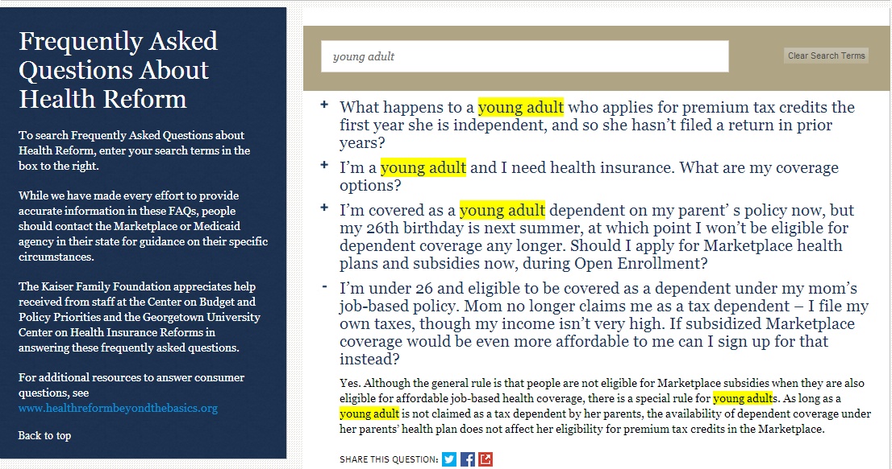
FREQUENTLY ASKED QUESTIONS ABOUT HEALTH REFORM
Search Q&A by adding a search term or clicking on a section heading
kff.org/health-reform/faq/health-reform-frequently-asked-questions/

Slide 24
THE ACA AND LOW- TO MODERATE-INCOME ADULTS
The Coverage Gap: Uninsured Poor Adults in States that Do Not Expand Medicaid
State Estimates for People Eligible for Tax Credits In Marketplace
kff.org/health-reform/

Slide 25
EXCHANGES/MARKETPLACES
State Marketplace Statistics
Explaining Health Care Reform: Questions About Health Insurance Exchanges
State Decisions For Creating Health Insurance Exchanges
Search for “marketplaces” on kff.org

Slide 26
TAX CREDITS & PREMIUMS
Quantifying Tax Credits for People Now Buying Insurance on Their Own
Explaining Health Care Reform: Questions About Health Insurance Subsidies
Why Premiums Will Change for People Who Now Have Nongroup Insurance
Search for “tax credit” on kff.org

Slide 27
INSURANCE MARKET REFORMS
The “Health Insurance Market Reforms” series covers:
      Pre-Existing Condition Exclusions
      Guaranteed Issue
      Rate Restrictions
      Rate Review
Search for “Health Insurance Market Reforms” at kff.org

Slide 28
BENEFITS IN THE NEW MARKETPLACES
Preventive Services Covered by Private Health Plans under the Affordable Care Act
Quick Take: Essential Health Benefits: What Have States Decided for Their Benchmark?
The Flip Side of Higher Premiums: Better Coverage
Health Reform: Implications for Women’s Access to Coverage and Care
Search for “marketplaces” on kff.org

Slide 29
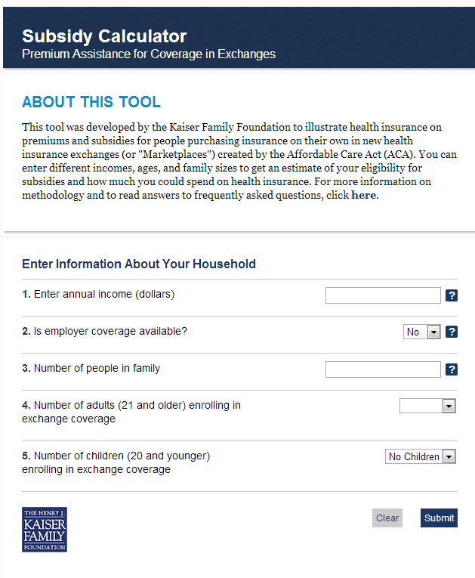

FEATURE OUR RESOURCES ON YOUR SITE FOR FREE
Health Reform Subsidy Calculator
Animated Video
kff.org/interactive/subsidy-calculator
kff.org/youtoons-obamacare-video
kff.org/aca-consumer-resources

Slide 30


RESOURCES FOR CONSUMERS
kff.org/aca-consumer-resources

Slide 31



SPANISH LANGUAGE RESOURCES
"Los YouToons Se Preparan Para Obamacare“ (Video)
Obamacare y Usted
  Una serie de materiales que explican cómo la Ley de Cuidado de Salud a Bajo Precio afecta a diferentes grupos de personas
Calculadora de subsidios
kff.org/cuidado-de-salud-recursos-para-los-consumidores/

Slide 32
Contact Information
    Rakesh Singh, Vice President of Communications
    Kaiser Family Foundation | Menlo Park, Calif.
    Email: RSingh@KFF.org
    Craig Palosky, Director of Communications
    Kaiser Family Foundation| Washington, D.C.
    Email: CPalosky@KFF.org

Slide 33
Keep in touch with us online
Facebook: /KaiserFamilyFoundation
Twitter: @KaiserFamFound
LinkedIn: /company/kaiser-family-foundation
Emails: kff.org/email

