Slide 1
How the Affordable Care Act Affects Baby Boomers and Medicare Beneficiaries
The Covering Health Reform Webinar Series For Journalists
Presented by the Kaiser Family Foundation
Thursday, November 21, 2013
12:30 p.m. ET – 1:30 p.m. ET

Slide 2



Today’s Speakers from the Kaiser Family Foundation
Karen Pollitz
Senior Fellow, Health Reform and Private Insurance
Juliette Cubanski
Associate Director of the Program on Medicare Policy
Rakesh Singh
Vice President of Communications

Slide 3
Rakesh Singh
Vice President of Communications
Kaiser Family Foundation

Slide 4
Today’s Webinar Will Be Archived
  kff.org/health-reform/event/how-the-affordable-care-act-affects-baby-boomers-and-medicare-beneficiaries
The full webinar presentation and PowerPoint slides will be posted by or before tomorrow morning.
The transcript of today’s webinar will be posted in the coming week.

Slide 5

Karen Pollitz
Senior Fellow, Health Reform and Private Insurance
Kaiser Family Foundation

Slide 6
U.S. Population Demographics by Age
SOURCE: US Census, 2012.

Slide 7
Labor Force Participation and Health Status, by Age
Percent of Civilians Not in Labor Force, 2012
Self-Reported Health Status of Non-Elderly Adults, 2010
Health Status
SOURCE: US Census, 2010 &2012

Slide 8
Among All Large Firms (> 200 Workers) Offering Health Benefits to Active Workers, Percentage of Firms Offering Retiree Health Benefits, 1988-2013
NOTE: Tests found no statistical difference from estimate for the previous year shown (p<.05). No statistical tests are conducted for years prior to 1999.
SOURCE: Kaiser/HRET Survey of Employer-Sponsored Health Benefits, 1999-2013; KPMG Survey of Employer-Sponsored Health Benefits, 1991, 1993, 1995, 1998; The Health Insurance Association of America (HIAA), 1988.

Slide 9
“Boomers” Rely Disproportionately on Non-Group Coverage
Market is medically underwritten;
  Applicants with pre-existing conditions can be turned down or charged more
  Premiums tend to increase over time as health status declines
Age rating means older participants pay 4-6x premium for young adults
Plans can exclude or limit coverage for key benefits
  Mental health care
  Prescription drugs
  Rehab services
Cost sharing can be high
Coverage is unsubsidized

Slide 10
Key Changes to Non-group Market in 2014
Prohibit medical underwriting
  pre-existing condition exclusions
  eligibility and premiums based on health status
Limit age rating to 3:1
Require plans to cover essential health benefits
Limit cost sharing for essential health benefits in network
Premium tax credit subsidies for incomes 100% to 400% FPL

Slide 11
Premiums as a Percent of Income, Benchmark Silver Plan
SINGLE INDIVIDUALS
MARRIED COUPLES
$15,211
$11,307
$7,606
$5,653
$6,480
$4,366
$4,366
$5,894
$5,894
$5,894
$5,070
$5,070
$3,240
$3,240
$2,535
$2,535
SOURCE: KFF Subsidy Calculator. Premium reflect national average rates. Red indicates unsubsidized premiums.

Slide 12
Juliette Cubanski
Associate Director of the Program on Medicare Policy
Kaiser Family Foundation

Slide 13
How Does the ACA Affect People on Medicare?
Do people with Medicare need to sign up for Marketplace plans?
  No. People with Medicare can and should keep it; insurers are not allowed to sell Marketplace plans to people they know have Medicare
Will the tax penalty apply to people on Medicare?
  No, because Medicare counts as “minimum essential coverage”
Are people on Medicare eligible for premium tax credits?
  No. These tax credits can only be used to purchase Marketplace plans

Slide 14
More Answers to Key Questions about Medicare and the New Marketplaces
Are Medicare Advantage, Part D, and Medigap plans sold through the Marketplaces?
  No. People on Medicare should still enroll at www.Medicare.gov,
  1-800-MEDICARE, or directly through a Medicare or Medigap plan
Has Medicare’s open enrollment period changed?
  No. Medicare’s enrollment period runs from Oct 15-Dec 7

Slide 15


The ACA Gradually Closes the Medicare Part D “Donut Hole”
EXHIBIT 15
What is the “donut hole”?
  The gap in the Medicare prescription drug benefit where enrollees were responsible for 100% of their drug costs until they reached catastrophic coverage
What did the ACA do?
  Closes the Medicare Part D coverage gap by gradually reducing cost sharing to
  25% of drug costs in the gap in 2020
  In 2014, enrollees pay 47.5% of brand drug costs and 72% of generic drug costs in the gap
  In 2014, the gap begins after total drug costs reach $2,850 and ends after an enrollee has spent a total of $4,550 out of pocket ($6,691 in total drug costs)

Slide 16
The ACA Included Other Medicare Benefit Improvements and Delivery System Reforms
EXHIBIT 15
Improvements in benefits
  Provides new annual wellness visit with personalized prevention plan
  Eliminates cost sharing for preventive services
Delivery system reforms
  Establishes the Center for Medicare and Medicaid Innovation to test, evaluate, and expand different payment models to reduce program spending while maintaining or improving quality of care
  Establishes the Coordinated Health Care Office to improve care coordination for people dually eligible for both Medicare and Medicaid
  Authorizes numerous programs, pilots, demonstrations to improve quality of care and efficiency while reducing program spending

Slide 17
The ACA Included New Revenues and Medicare Savings that Helped Improve the Program’s Financial Outlook
EXHIBIT 15
New revenues
  Income-related premiums for higher-income people on Medicare ($85,000/individual; $170,000/couple)
  Increases the Medicare payroll tax by 0.9% (from 1.45% to 2.35%) for higher-income taxpayers on earnings over $200,000/individual; $250,000/couple
Medicare savings
  Gradually reduces payments to Medicare Advantage plans to align more closely with costs under traditional Medicare; provides new quality-based bonus payments to plans with higher star ratings
  Reduces payments for hospitals and other medical providers (not physicians)
  Authorizes a 15-member Independent Payment Advisory Board to propose Medicare spending reductions if spending exceeds target growth rates

Slide 18
Projected Medicare spending has declined since the enactment of the ACA
Medicare Spending
(in $ billions)
Average annual growth rate, 2010-2019:
Projected spending before ACA: 6.8 percent
Projected spending after ACA: 4.8 percent
Projected Medicare spending before ACA
Projected Medicare spending after ACA
NOTE: Estimates do not take into account future changes to the Sustainable Growth Rate formula to prevent reduction in fees.
SOURCE: Kaiser Family Foundation analysis of CBO data; Medicare Baseline Spending before reform from CBO, March 2009 Baseline: MEDICARE; after reform from CBO, May 2013 Baseline: MEDICARE.

Slide 19
Q&A – You can Ask Questions Via Chat or Phone
We will now take questions via chat and via phone.
You can type your questions via chat at any time during the webinar.
To ask a question via phone, please dial:
1-800-931-6361

Slide 20
How to Ask a Question via Phone
Be sure to dial into the call: 1-800-931-6361
TO ASK A QUESTION: Please press the number 1 followed by the number 4 to ask a question.
  Your phone line will be unmuted when it is your turn to ask a question, and the operator will announce your first name, last name and media outlet to the group.
TO WITHDRAW A QUESTION: If your question has been answered, press 1 followed by the number 3 to withdraw your question.
  You will no longer be in line to ask a question via phone if you press 1 then 3.

Slide 21
Contact Our Communication Staff With Follow-Up Questions
    Rakesh Singh, Vice President of Communications
    Kaiser Family Foundation | Menlo Park, Calif.
    Email: RSingh@KFF.org
    Craig Palosky, Director of Communications
    Kaiser Family Foundation| Washington, D.C.
    Email: CPalosky@KFF.org

Slide 22
Medicare Beneficiaries and Prescription Drugs
To Switch or Not to Switch: Are Medicare Beneficiaries Switching Drug Plans To Save Money?
Medicare Part D: A First Look at Plan Offerings in 2014
Interactive: State and Local Data on Medicare Health and Prescription Drug Plans
kff.org/topic/medicare

Slide 23
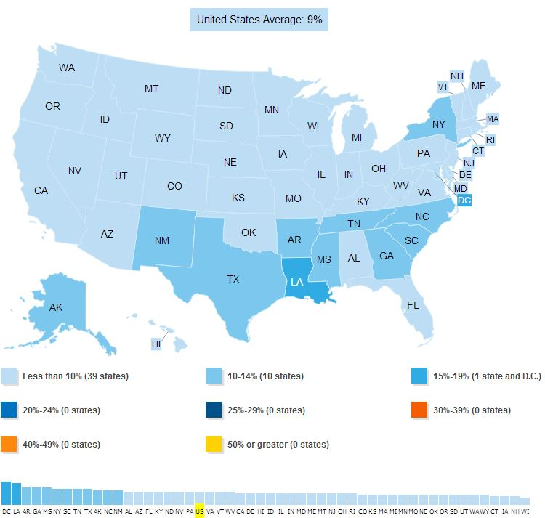
Compare Poverty Rates under the Official Census Poverty Measure and the Supplemental Poverty Measure
kff.org/interactive/seniors-in-poverty

Slide 24
The Future of Medicare
Medicare and the Federal Budget: Comparison of Medicare Provisions in Recent Federal Debt and Deficit Reduction Proposals
Policy Options to Sustain Medicare for the Future
Public Opinion Polling on Raising the Age of Medicare Eligibility: Historic Trends and Current Nuances
Wide Disparities in the Income and Assets of People on Medicare by Race and Ethnicity: Now and in the Future
kff.org/medicare

Slide 25
FAQs on Medicare and the Affordable Care Act
Find the answers to questions like:
I am covered by Medicare. Can I keep my Medicare coverage even though these marketplace plans are available, or do I need to make a change?
I am about to turn 65 and go on Medicare, and my income is $100,000. I know that people with higher incomes are required to pay higher premiums for Medicare Part B and Part D. To avoid paying these higher Medicare premiums, can I sign up for health insurance from a marketplace plan instead of enrolling in Medicare when I turn 65?
My husband and I are retired. He just turned 65 and is now covered by Medicare, but I am 62 and I don’t have health insurance. Can I enroll in Medicare as his spouse?
kff.org/health-reform/faq/health-reform-frequently-asked-questions/#section-medicare

Slide 26
Resources for Consumers
“Obamacare and You” fact sheets (in English and Spanish)
  Includes specific fact sheet on Medicare beneficiaries
Consumer Resource Center in English: kff.org/aca-consumer-resources
Consumer Resource Center in Spanish: kff.org/cuidado-de-salud-recursos-para-los-consumidores
Subsidy Calculator (in English and Spanish)
[Video] The Story of Medicare: A Timeline

Slide 27
Keep in touch with us online
Facebook: /KaiserFamilyFoundation
Twitter: @KaiserFamFound
LinkedIn: /company/kaiser-family-foundation
Emails: http://profile.kff.org

