Slide 1
Medicaid and the ACA: The Impact of State Decisions
The Covering Health Reform Webinar Series For Journalists
Presented by the Kaiser Family Foundation
Thursday, October 24, 2013
12:30 p.m. ET – 1:30 p.m. ET

Slide 2



Today’s Speakers from the Kaiser Family Foundation
Robin Rudowitz
Associate Director, Kaiser Commission on Medicaid and the Uninsured
Rachel Garfield
Senior Researcher, Kaiser Commission on Medicaid and the Uninsured
Penny Duckham
Executive Director, Media Fellowships Program

Slide 3
The goal of the ACA is to make coverage more available, more reliable, and more affordable.
Universal Coverage
Medicaid Coverage For Low-Income Individuals
Exchanges With Subsidies For Moderate Income Individuals
Individual
Mandate
Health Insurance Market Reforms
Employer-Sponsored Coverage
Notes:
Kaiser Slide – Health Reform set

Slide 4





The ACA Medicaid expansion fills current gaps in coverage.
Medicaid Eligibility Today
Medicaid Eligibility
in 2014
Limited to Specific Low-Income Groups
Extends to Adults ≤138% FPL*
Pregnant
Women
Extends to Adults
≤138% FPL*
Elderly &
Persons with Disabilities
Children
Parents
Adults
*138% FPL = $15,856 for an individual and $26,951 for a family of three in 2013.

Slide 5





The ACA streamlines enrollment processes to make it easier to obtain coverage, regardless of whether states expand.
HEALTH
INSURANCE
$
Data
Hub
Dear ______,
You are
eligible for…
Medicaid
CHIP
Marketplace
#
Multiple Ways to Enroll
Single Application
for Multiple Programs
Use of Electronic
Data to Verify Eligibility
Real-Time Eligibility Determinations
Notes:
Kaiser Slide – Health Reform set

Slide 6


Decisions to implement the Medicaid expansion have many coverage and fiscal implications for states.
Reduction in the Number
of Uninsured
Increased Provider Revenue
+
Increased State Savings
Federal + State Funds
↓ Uncompensated Care Costs
↓ State-funded health programs (e.g. Mental health)
Increased State Economic Activity
↑ Jobs and Revenues

Slide 7
Not all states are expanding Medicaid
(Status as of October 22, 2013)
VT
ME
WA
NH²
MT
ND
MN
OR
MA
SD
WI
NY
ID
MI¹
CT
RI
WY
PA
NJ
NE
IA¹
OH
DE
NV
IL
IN
MD
CA
UT
CO
WV
VA
KS
MO
KY
DC
NC
AZ
TN¹
NM
OK
AR¹
SC
MS
AL
GA
AK
TX
LA
FL
HI
Moving Forward at this Time (26 States including DC)
Not Moving Forward at this Time (25 States)
NOTES: 1 - Exploring an approach to Medicaid expansion likely to require waiver approval. 2- Discussion of a special session being called on the Medicaid expansion.
SOURCES: State decisions on the Medicaid expansion as of October 22, 2013. Based on data from the Centers for Medicare and Medicaid Services, available at: http://medicaid.gov/AffordableCareAct/Medicaid-Moving-Forward-2014/Medicaid-and-CHIP-Eligibility-Levels/medicaid-chip-eligibility-levels.html. Data has been updated to reflect more recent activity.
Notes:
Updated 9/30/13 LS

Slide 8
States moving forward with the Medicaid expansion are expected to see higher enrollment and spending growth in FY 2014 due to more coverage and federal funds.
NOTE: States decisions about the Medicaid expansion as of September 30, 2013. Based on data from the Centers for Medicare and Medicaid Services, available at: http://medicaid.gov/AffordableCareAct/Medicaid-Moving-Forward-2014/Medicaid-and-CHIP-Eligibility-Levels/medicaid-chip-eligibility-levels.html.
SOURCE: KCMU survey of Medicaid officials in 50 states and DC conducted by Health Management Associates, October 2013.

Slide 9
Medicaid eligibility for adults will increase in states moving forward with the expansion but will remain very limited in other states.
Median Medicaid Eligibility Limits for Adults as a Percent of the FPL, January 2013 and January 2014
Parents
Other Adults
Parents
Other Adults
(In a family of 3)
(for an individual)
(In a family of 3)
(for an individual)
States Moving Forward with the Medicaid Expansion at this Time
(25 states & DC)
States NOT Moving Forward with the Medicaid Expansion at this Time
(25 states)
NOTE: 138% FPL = $15,856 for an individual and $26,951 for a family of three in 2013.
SOURCE: Eligibility data for January 2013 based on the results of a national survey conducted by the KCMU and the Georgetown University Center for Children and Families, 2013. Status of Medicaid expansion decisions and 2014 eligibility levels based on data from the Centers for Medicare and Medicaid Services.

Slide 10
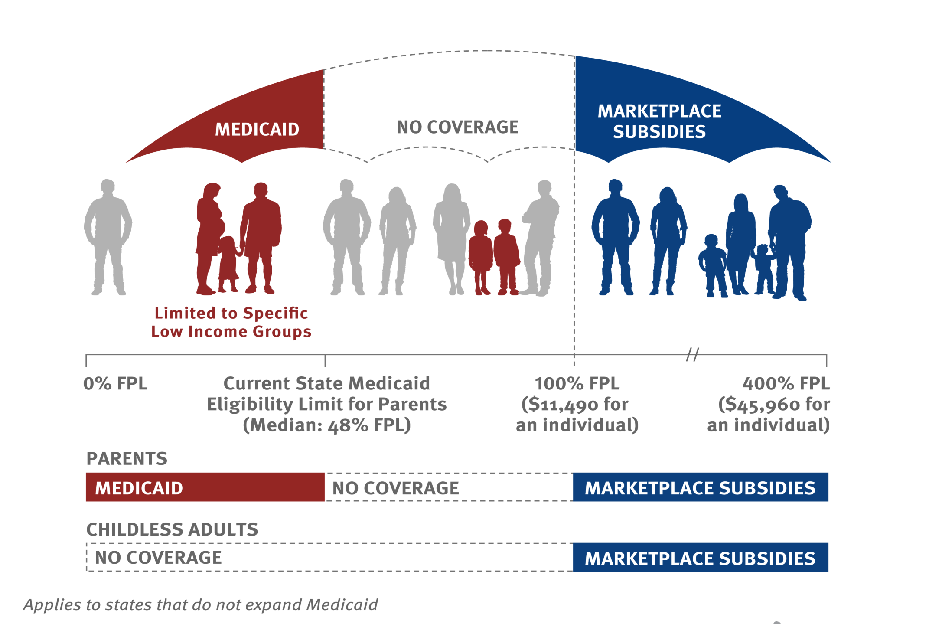
In states that do not expand Medicaid under the ACA, there will be large gaps in coverage available for adults.
0% FPL
Childless Adults
47% FPL
Parents
Median Medicaid Eligibility Limits as of Jan. 2014
NOTE: Applies to states that do not expand Medicaid. In most states not moving forward with the expansion, adults without children are ineligible for Medicaid .

Slide 11
Without Medicaid expansion, 4.8 million uninsured nonelderly adults below poverty may fall into the coverage gap.
NOTES: Excludes legal immigrants who have been in the country for five years or less and immigrants who are not lawfully present. The poverty level for a family of three in 2013 is $19,530.
SOURCE: Kaiser Family Foundation analysis based on 2014 Medicaid eligibility levels and 2012-2013 Current Population Survey.

Slide 12
The majority of poor uninsured nonelderly adults in states not expanding Medicaid fall in the coverage gap.
In the coverage gap
Share who are:
Eligible for Medicaid in 2014*
* Based on current Medicaid eligibility rules converted to MAGI. Applies only to MAGI populations.
NOTES: Excludes legal immigrants who have been in the country for five years or less and immigrants who are not lawfully present. SOURCE: Kaiser Family Foundation analysis based on 2014 Medicaid eligibility levels and 2012-2013 Current Population Survey.

Slide 13
What to look for going forward:
How will the status of state decisions regarding the Medicaid expansion change leading up to January 1 and beyond?
How will new enrollment systems work and how will systems be coordinated across health programs?
How will the ACA effect Medicaid enrollment and the uninsured?
What effect will the ACA have on state revenue and fiscal conditions?
How will increased Medicaid coverage affect access to health care and services— and ultimately health outcomes?
How will individuals in the coverage gap fare and will they be able to access needed health care?
How will the safety net of community clinics and public hospitals care for the newly-insured and remaining uninsured?

Slide 14
Q&A
Throughout the Q&A discussion, we will show slides featuring relevant resources that can be found on our website at kff.org.
All slides will be available online by or before tomorrow morning.

Slide 15
Q&A
In the interest of time, please try to only ask one question via the call queue.
If you have additional questions, ask them via the chat function in the Q&A tab or you can contact us via email at acawebinars@kff.org.

Slide 16
How to Ask a Question
TO ASK: Please press the number 1 followed by the number 4 to ask a question. Your line will be unmuted when it is your turn.
TO WITHDRAW: If your question has been answered, you may press 1 followed by the number 3 to withdraw your question.

Slide 17
Today’s Webinar Will Be Archived
kff.org/health-reform/event/webinar-for-journalists-medicaid-aca-state-decisions
The full webinar presentation and PowerPoint slides will be posted by tomorrow morning.
The transcript of today’s webinar will be posted in the coming week.

Slide 18
Find More Health Reform Resources Online
    Health Reform Resources from KFF:
    kff.org/health-reform
    Medicaid Resources from KFF:
    kff.org/medicaid
    Consumer Resources Center:
    kff.org/aca-consumer-resources

Slide 19
Contact Information
    Rakesh Singh, VP of Communications
    Kaiser Family Foundation | Menlo Park, Calif.
    Email: RSingh@KFF.org
    Chris Lee, Communications Officer
    Kaiser Family Foundation | Washington, D.C.
    Email: CLee@KFF.org

Slide 20
KFF Resources on Medicaid Expansion
Search for these titles on kff.org.
The Coverage Gap: Uninsured Poor Adults in States that Do Not Expand Medicaid
Status of State Action on the Medicaid Expansion Decision, as of October 22, 2013 (table and map)
The Uninsured: A Primer – Key Facts about Health Insurance on the Eve of Coverage Expansions

Slide 21
KFF Resources on Enrollment and Eligibility
Search for these titles on kff.org.
Helping Hands: A Look at State Consumer Assistance Programs under the Affordable Care Act
Getting into Gear for 2014: Insights from Three States Leading the Way in Preparing for Outreach and Enrollment in the Affordable Care Act
Medicaid in a Historic Time of Transformation: Results from a 50-State Medicaid Budget Survey for State Fiscal Years 2013 and 2014

Slide 22
KFF Resources for Consumers
YouToons Videos in English and Spanish
kff.org/health-reform/video/youtoons-obamacare-video
kff.org/health-reform/video/los-youtoons-se-preparan-para-obamacare
“Obamacare and You” Fact Sheets
kff.org/health-reform/fact-sheet/obamacare-and-you
“For Consumers: Understanding Health Reform” resource center
kff.org/aca-consumer-resources

Slide 23
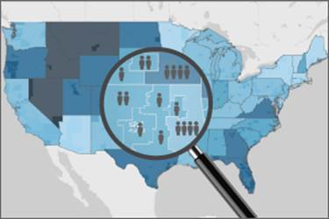
Zooming In on Health Reform – Interactive Tool
Use our interactive “Zooming In” tool to examine a local area (via zip code, county, or city).
See how the number and composition of individuals enrolled in Medicaid - or people without insurance coverage - could change if your state expands Medicaid.
kff.org/interactive/zooming-in-health-reform-medicaid-uninsured-local-level

Slide 24
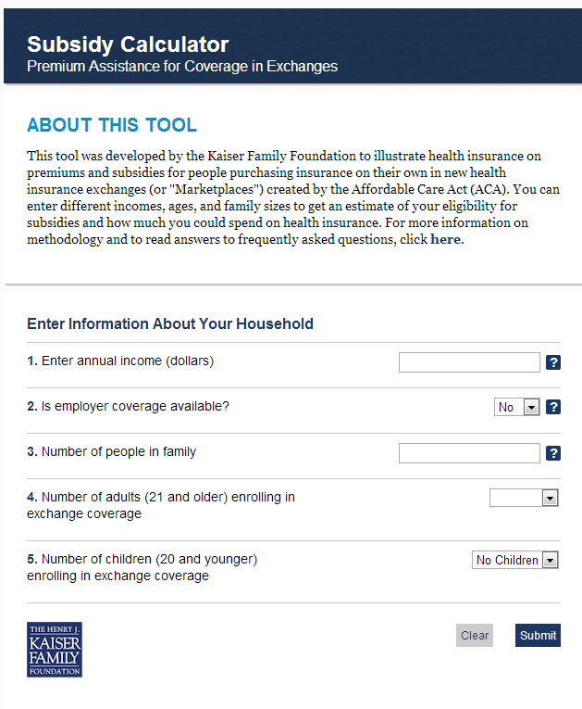

Embed our resources on your website for free.
Health Reform Subsidy Calculator
Animated Video
kff.org/interactive/subsidy-calculator
kff.org/youtoons-obamacare-video
Examples of these embedded resources:
My Fox NY: http://www.myfoxny.com/category/270456/do-i-qualify-for-health-care-subsidies
CNN Money: http://economy.money.cnn.com/2013/07/18/obamacare

Slide 25


Spanish-Language Resources for Consumers
Now Available
“Los YouToons Se Preparan Para Obamacare” (Animated Video)
Coming Soon!
“Obamacare Y Usted” Fact Sheets
  Explains ACA as it relates to Medicare, Medicaid, Uninsured, Individual Market, Employer-Based Coverage, Pre-Existing Conditions
Spanish-language version of the KFF Subsidy Calculator
  Will include all 50 states
  Embeddable

Slide 26
Keep in touch with the Kaiser Family Foundation
Sign up for our emails
  profile.kff.org
    Enter your email address, then select your health policy interests and contact information.
Social media
  Facebook: /KaiserFamilyFoundation
  Twitter: @KaiserFamFound
  LinkedIn: Kaiser Family Foundation

