Slide 1
Understanding Insurance Premiums Under The Affordable Care Act
The Covering Health Reform Webinar Series For Journalists
Presented by the Kaiser Family Foundation
Tuesday, September 10, 2013
12:30 p.m. ET – 1:30 p.m. ET

Slide 2



Today’s Speakers from the Kaiser Family Foundation
Larry Levitt
Senior Vice President for Special Initiatives
Co-Executive Director, Program for the Study of Health Reform and Private Insurance
Gary Claxton
Vice President
Co-Director, Program for the Study of Health Reform and Private Insurance
Penny Duckham
Executive Director, Media Fellowships Program

Slide 3
Insurance Market Rules in the Individual Insurance Market Starting in 2014
Insurers must accept all comers, regardless of health.
Premiums cannot vary by health status or gender, and variations due to age are limited to 3-1.
All plans must meet certain new standards, including:
  Coverage of “essential benefits,” including preventive care with no patient cost-sharing and coverage for mental health services.
  No annual or lifetime limits on coverage.
  Coverage must be offered in one of several tiers of patient cost-sharing: catastrophic (primarily for young people), bronze, silver, gold, and platinum.
These rules apply to coverage sold to individuals inside of exchanges/marketplaces and outside.
Tax credits and cost-sharing subsidies available to low and middle income people buying coverage in exchanges/marketplaces.

Slide 4
Examples of Coverage Options for Individuals and Small Businesses
Plan Type | “Actuarial Value” | Typical Deductible | Coinsurance | Maximum Out-of-Pocket Cost
Bronze | 60% | $5,000 | 30% | $6,350
Silver | 70% | $2,000 | 20% | $6,350
Gold | 80% | $0 | 20% | $6,350
Platinum | 90% | $0 | 10% | $6,350
Catastrophic (up to age 30) | NA | $6,350 | 0% | $6,350
All figures are for single coverage. Amounts for families would be double.
All plans have to cover a wide range of benefits.
Lower-income enrollees in exchanges are eligible for reduced cost-sharing.

Slide 5
How the Premium Tax Credit Works
Example: 40 year old in Seattle with income at 250% of the poverty level ($28,725).
Silver Plan
Unsubsidized premium for second lowest cost silver plan = $3,396 per year
Individual contribution = $2,312 (8.05% of income)
Tax credit = $1,084
Bronze Plan
Unsubsidized premium for lowest cost bronze plan = $2,556
Tax credit = $1,084
Individual contribution = $1,472

Slide 6
Timeline and Process
Open enrollment for individual market coverage (inside and outside of exchanges/marketplaces) begins October 1 and runs through March 31, 2014.
State insurance departments generally review rate filings from insurers.
Approved rates are then submitted to the appropriate federal or state exchange/marketplaces (for insurers participating).
As of August 30, 17 states and DC had publicly released comprehensive information about rates in exchanges/marketplaces.
Rate information for all states is expected to be available by October 1.

Slide 7
The Second Lowest Cost Silver Premium for a 40 Year-Old in Selected Cities, Before Tax Credits
CBO Projection = $320
Source: Kaiser Family Foundation Analysis

Slide 8
The Second Lowest Cost Silver Premium for a 40 Year-Old at 250% of Poverty ($29k), After Tax Credits
Federal Tax Credit
Source: Kaiser Family Foundation Analysis

Slide 9
The Lowest Cost Bronze Premium for a 40 Year-Old at 250% of Poverty ($29k), After Tax Credits
Federal Tax Credit
Source: Kaiser Family Foundation Analysis

Slide 10
Number of Insurers Participating in Exchange/Marketplace by Rating Area
Source: Kaiser Family Foundation Analysis. Actual figures for IN and WA may be higher due to incomplete information.

Slide 11
Why Premiums Change Under the ACA
↑ as people with pre-existing conditions get insurance (potentially offset by greater enrollment among young and healthy people).
↑ because coverage will get better for some.
↑ and↓ due to limits on age rating and prohibition of health and gender rating.
↓ as a result of federal reinsurance.
↓ with rate review and the 80/20 medical loss ratio threshold.
↓ through price competition.
↓ for most purchasers due to federal premium subsidies.

Slide 12
TODAY’S WEBINAR WILL BE ARCHIVED
  kff.org/health-reform/event/understanding-insurance-premiums-under-the-affordable-care-act
The full webinar presentation and PowerPoint slides will be posted by tomorrow morning.
The transcript of today’s webinar will be posted in the coming week.

Slide 13
CONTACT US
    Rakesh Singh, VP of Communications
    Kaiser Family Foundation | Menlo Park, Calif.
    Email: RSingh@KFF.org
MORE HEALTH REFORM RESOURCES
    kff.org/health-reform
    kff.org/aca-consumer-resources

Slide 14
TAX CREDITS & PREMIUMS
Subsidy Calculator
NEW: An Early Look at Premiums and Insurer Participation in Health Insurance Marketplaces, 2014
Quantifying Tax Credits for People Now Buying Insurance on Their Own
Explaining Health Care Reform: Questions About Health Insurance Subsidies
Why Premiums Will Change for People Who Now Have Nongroup Insurance
kff.org/tag/subsidies

Slide 15
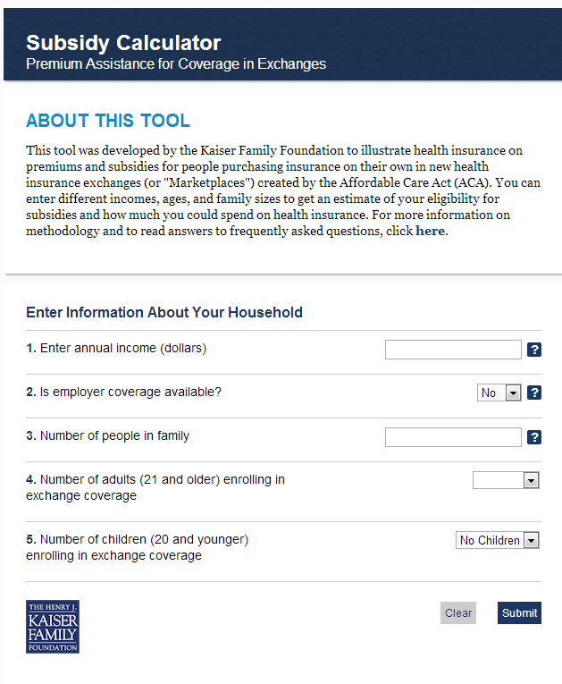

FEATURE OUR RESOURCES ON YOUR SITE FOR FREE
Health Reform Subsidy Calculator
Animated Video
kff.org/interactive/subsidy-calculator
kff.org/youtoons-obamacare-video
Examples of these embedded resources:
My Fox NY: http://www.myfoxny.com/category/270456/do-i-qualify-for-health-care-subsidies
CNN Money: http://economy.money.cnn.com/2013/07/18/obamacare

Slide 16



SPANISH LANGUAGE RESOURCES
Now Available
La Reforma del Cuidado de la Salud
Llega al Publico (Video)
Coming Soon!
Spanish language versions of:
  “The YouToons Get Ready for Obamacare” – released in July 2013
  Health Reform Subsidy Calculator

Slide 17
EXCHANGES/MARKETPLACES
State Decisions For Creating Health Insurance Exchanges
Explaining Health Care Reform: Questions About Health Insurance Exchanges
State Health Insurance Marketplace Profiles
kff.org/statedata

Slide 18
INSURANCE MARKET REFORMS
The “Health Insurance Market Reforms” series covers:
      Pre-Existing Condition Exclusions
      Guaranteed Issue
      Rate Restrictions
      Rate Review
Search for “Health Insurance Market Reforms” at kff.org

Slide 19
BENEFITS IN THE NEW MARKETPLACES
Preventive Services Covered by Private Health Plans under the Affordable Care Act
Quick Take: Essential Health Benefits: What Have States Decided for Their Benchmark?
The Flip Side of Higher Premiums: Better Coverage
Health Reform: Implications for Women’s Access to Coverage and Care
kff.org/tag/marketplaces

