Slide 1
The Affordable Care Act: What Do Consumers Need To Know About Health Reform’s Changes?
Part of the Foundation’s Covering Health Reform Webinar Series
August 28, 2013
12:30 p.m. ET

Slide 2



Today’s Speakers from the Kaiser Family Foundation
Jennifer Tolbert
Director of State Health Reform
Karen Pollitz
Senior Fellow, Health Reform and Private Insurance
Rakesh Singh
Vice President of Communications

Slide 3
Promoting Health Coverage through the ACA
Universal Coverage
Medicaid Coverage For Low-Income Individuals
Marketplaces With Subsidies for Moderate Income Individuals
Individual
Mandate
Health Insurance Market Reforms
Employer-Sponsored Coverage
Notes:
Kaiser Slide – Health Reform set

Slide 4

Many Uninsured Will Be Newly Eligible for Coverage
Health Insurance Coverage of the Nonelderly, 2011
Income
≤138% FPL
Medicaid (51%)
139-399% FPL
Subsidies (39%)
≥400% FPL
(10%)
Employer-Sponsored
Coverage
Uninsured
Medicaid*
Private Non-Group
266.4 Million Nonelderly
47.9 Million Uninsured
*Medicaid also includes other public programs: CHIP, other state programs, Medicare and military-related coverage. The federal poverty level for a family of three in 2011 was $18,530.
Numbers may not add to 100% due to rounding.
SOURCE: KCMU/Urban Institute analysis of 2012 ASEC Supplement to the CPS.

Slide 5





ACA Medicaid Expansion Fills Current Gaps in Coverage
Medicaid Eligibility Today
Medicaid Eligibility
in 2014
Limited to Specific Low-Income Groups
Extends to Adults ≤138% FPL*
Pregnant
Women
Extends to Adults
≤138% FPL*
Elderly &
Persons with Disabilities
Children
Parents
Adults
*138% FPL = $15,856 for an individual and $26,951 for a family of three in 2013.

Slide 6
Current Status of the Medicaid Expansion Decision, as of August 28, 2013
VT
ME
WA
NH
MT
ND
MN
OR
MA
SD
WI
NY
ID
MI*
CT
RI
WY
PA
NJ
NE
IA*
OH
DE
NV
IL
IN*
MD
CA
UT
CO
WV
VA
KS
MO
KY
DC
NC
AZ
TN*
NM
OK
AR*
SC
MS
AL
GA
AK
TX
LA
FL
HI
Moving Forward at this Time (25 States including DC)
Debate Ongoing (5 States)
Not Moving Forward at this Time (21 States)
* These states are exploring an approach to the Medicaid expansion that is likely to require waiver approval.

Slide 7
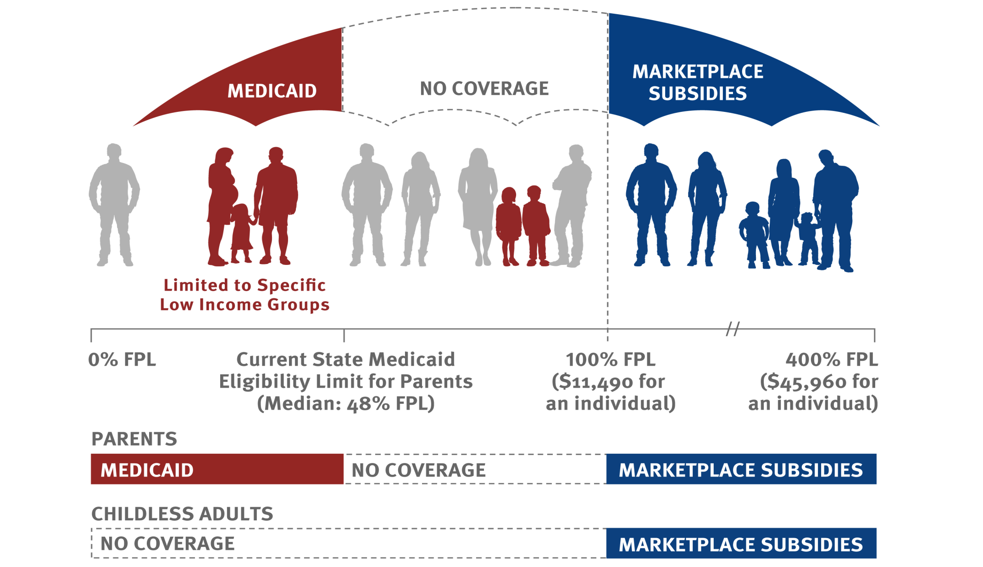
In States That Do Not Expand Medicaid, There Will Be Large Gaps in Coverage for Low-Income Adults
Eligibility for Medicaid and Subsidies as of 2014 in 21 States Not Expanding Medicaid at this Time:
Current Medicaid Eligibility Limit for Parents
Median of 21 States Not Expanding:
48% FPL

Slide 8




Health Insurance Marketplaces Will Facilitate Enrollment into Coverage by Individuals and Small Employers
Medicaid/CHIP
Plan A | Plan B | Plan C
 | 
 |  | 
 |  | 
 |  | 
John Doe
123 Main Street
12345
Premium Tax
Credits
Unsubsidized
Exchange Coverage
Eligibility for Multiple Programs Determined in
Real Time
Information Provided
on Available Plans
for Comparison
Enrollment Into Selected Plan
Notes:
Created by JS (3/8/2013)
Kaiser Slide – Health Reform set

Slide 9
State Have Made Their Decisions For Creating Health Insurance Marketplaces
WA
VT
ME
MT
ND
NH
OR
MN
MA
ID**
SD
WI
NY
MI
RI
WY
PA
CT
IA
NJ
NV
NE
IN
OH
DE
UT*
CO
IL
MD
CA
WV
VA
DC
KS
MO
KY
NC
OK
TN
AZ
NM**
AR
SC
MS
AL
GA
AK
TX
LA
FL
HI
State-based Marketplace (17 states including DC)
Partnership Marketplace (7 states)
Federally-facilitated Marketplace (27 states)
* In Utah, the federal government will operate the individual exchange while the state will run the SHOP exchange.
** Idaho and New Mexico received approval to operate state-based marketplaces; however, due to time constraints, the states will rely on the federal government for the IT infrastructure, but will perform most other functions.
Notes:
As of March 7, 2013:
Declared state-based exchange: KY, RI, CO, CT, WA, DC, HI, ID, VT, CA, MD, MA, UT, MN, NV, NM, NY, OR
Planning for partnership exchange: NH, MI, IA, IL, DE, WV, AR
Default to federal exchange:
Kaiser Slide – Health Reform set

Slide 10
ACA Includes New Rules for Coverage in the Non-group Market
Pre-ACA
Policies are medically underwritten
Post-ACA
Insurers are prohibited from discriminating based on health status
Policies must cover the essential health benefits
Consumer out-of-pocket spending is limited
Premium and cost-sharing subsidies are available
Policies typically have high cost sharing
Many policies exclude benefits such as prescription drugs and maternity care
Premiums are unsubsidized leaving them unaffordable for many

Slide 11
Plans Sold through Marketplaces Will Be Easier to Compare
Plan Type | “Actuarial Value” | Typical Deductible | Typical Coinsurance | Maximum Out-of-Pocket Cost
Bronze | 60% | $5,000 | 30% | $6,350
Silver | 70% | $2,000 | 20% | $6,350
Gold | 80% | $0 | 20% | $6,350
Platinum | 90% | $0 | 10% | $6,350
Catastrophic (up to age 30) | NA | $6,350 | 0% | $6,350
All figures are for single coverage. Amounts for families would be double.
All plans must cover essential benefits: hospitalization, outpatient medical, emergency care, Rx drugs, maternity, mental health, rehab, lab tests, preventive services, pediatric dental & vision.

Slide 12
Most Consumers in Marketplaces Will Be Eligible for Subsidies to Lower the Cost of Coverage
% FPL | % of income | Occupation | Annual salary | 2nd lowest cost silver Unsubsidized: $3,018 age 24 $3,857 age 40 $9,054 age 64 |  |  | Bronze Unsubsidized: $2,501 age 24 $3,197 age 40 $7,505 age 64
 |  |  |  | 24 | 40 | 64 | 24 | 40 | 64
<133% | 2% | Fast food worker | $14,500 | $290 | $290 | $290 | $0 | $0 | $0
133-150% | 3% - 4% | Retail clerk | $17,000 | $660 | $660 | $660 | $143 | $0 | $0
150-200% | 4% - 6.3% | Dishwasher | $18,930 | $886 | $886 | $886 | $369 | $225 | $0
200-250% | 6.3% - 8.05% | Home health aide | $24,320 | $1,631 | $1,631 | $1,631 | $1,115 | $971 | $82
250-300% | 8.05% - 9.5% | Pre-school teacher | $30,750 | $2,633 | $2,633 | $2,633 | $2,116 | $1,972 | $1,083
300-350% | 9.5% | Construction worker | $38,380 | $3,018 | $3,646 | $3,646 | $2,501 | $2,986 | $2,096
350-400% | 9.5% | Reporter | $45,120 | $3,018 | $3,857 | $4,286 | $2,501 | $3,197 | $2,737
KFF Subsidy Calculator, http://www.kff.org/interactive/subsidy-calculator/

Slide 13
Coming Changes to Employer-Sponsored Insurance
Large employer requirement to offer coverage or pay a penalty. Delayed to 2015
Maximum limit on annual out-of-pocket cost sharing for essential benefits limited to $6,350/person or $12,700/family. Partially delayed to 2015
No annual dollar limits on covered benefits
Small group, fully insured plans must cover essential health benefits
Already in effect: No lifetime limits on covered benefits, dependent coverage to age 26, 100% coverage for preventive services

Slide 14
Key Implementation Dates
October 1, 2013 – March 31, 2014
  Initial open enrollment period
    People can enroll after March 31st if they have a qualifying event
    Those eligible for Medicaid can enroll at any time
January 1, 2014
  Coverage through Marketplaces and expanded Medicaid coverage begins
  Insurance market rules go into effect
  Requirement to have insurance coverage takes effect
October 15, 2014 – December 15, 2014
  Marketplace open enrollment period
January 1, 2015
  Large employer requirement to offer coverage takes effect

Slide 15
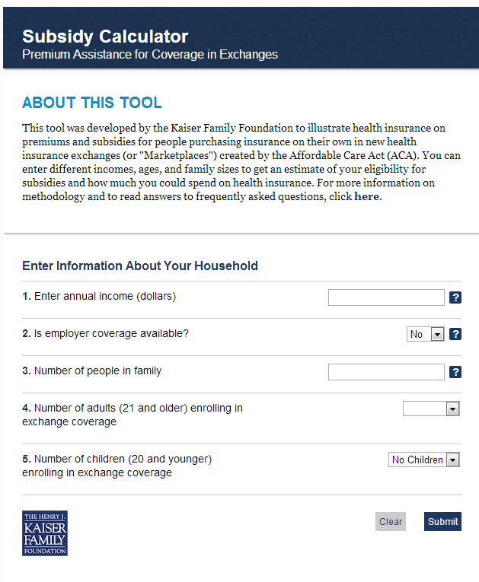

Feature KFF’s Health Reform Resources On Your Site
Health Reform Subsidy Calculator
Animated Video
http://www.kff.org/interactive/subsidy-calculator/
http://kff.org/youtoons-obamacare-video
Examples of these embedded resources:
Kera.org: http://breakthroughs.kera.org/obamacare-101-how-the-texas-health-insurance-marketplace-will-work
CNNMoney: http://economy.money.cnn.com/2013/07/18/obamacare/

Slide 16
Q&A
TO ASK: Please press the number 1 followed by the number 4 to ask a question. Your line will be unmuted when it is your turn.
TO WITHDRAW: If your question has been answered, you may press 1 followed by the number 3 to withdraw your question.
In the interest of time, please try to only ask one question. If you have any follow-up questions, you can use the chat function in the Q&A tab or you can contact us via email at acawebinars@kff.org.

Slide 17
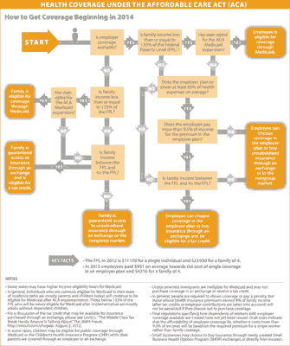
Individual Mandate
Infographic: Visualizing Health Policy – Health Coverage Under the Affordable Care Act
  kff.org/infographic/visualizing-health-policy-health-coverage-under-the-affordable-care-act-aca

Slide 18
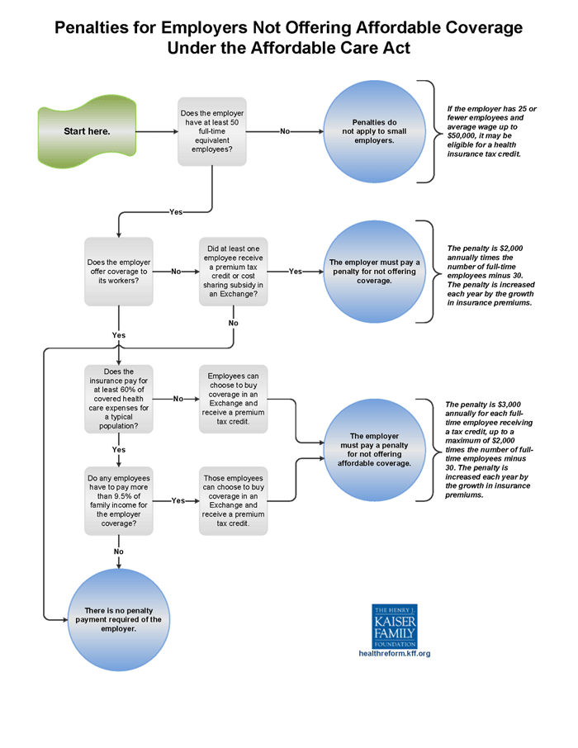
Employer Mandate
Infographic: Employer Responsibility Under the Affordable Care Act
2013 Annual Employer Health Benefits Survey

Slide 19
Medicaid Expansion
Issue Brief: What is Medicaid’s Impact on Access to Care, Health Outcomes, and Quality of Care? Setting the Record Straight on Evidence
Issue Brief: Analyzing the Impact of State Medicaid Expansion Decisions
Report: State and Local Coverage Changes Under Full Implementation of the Affordable Care Act
Report: The Cost of Not Expanding Medicaid
Issue Brief: The Impact of Current State Medicaid Expansion Decisions on Coverage by Race and Ethnicity
Issue Brief: Key Lessons from Medicaid and CHIP for Outreach and Enrollment Under the Affordable Care Act
Fact Sheet: Medicaid and Its Role in State/Federal Budgets and Health Reform
http://www.kff.org/medicaid/

Slide 20
Exchanges/Marketplaces
State Health Insurance Marketplace Profiles: kff.org/state-health-exchange-profiles
Table/Map: Status of State Action on the Medicaid Expansion Decision
Issue Brief: Quantifying Tax Credits for People Now Buying Insurance on Their Own
Issue Brief: Ensuring the Health Care Needs of Women: A Checklist for Health Exchanges
Issue Brief: Navigator and In-Person Assistance Programs: A Snapshot of State Programs
Brief: Explaining Health Care Reform: Questions About Health Insurance Exchanges
http://www.kff.org/tag/marketplaces/

Slide 21
Interactive Resources: Quizzes, Infographics & More
Quizzes on Women’s Health, Health Reform/ACA, Uninsured, Medicaid, Medicare
  Each quiz has 10 questions; includes explanations & related resources with results
Health Reform Implementation Timeline
  Shows how & when provisions of the health reform law will be implemented
Health Poll Question Finder
  Search our archive of poll questions on health issues by topic or keyword
Zooming In On Health Reform Tool
  See how the number & composition of individuals enrolled in Medicaid (or who are uninsured) could change in local areas and at the state level if your state expands Medicaid
Infographic: Medicaid Spending & Enrollment
  Click through to see who is covered & what the program spends on their care
http://www.kff.org/graphics/search/

Slide 22
Spanish Language Resources
Video: La Reforma del Cuidado de la Salud Llega al Publico
  kff.org/health-reform/video/video-la-reforma-del-cuidado-de-la-salud-llega-al-publico
  Released with the first animated YouToons video by KFF, “Health Reform Hits Main Street” – released in 2010
Coming Soon!
  The companion video to the second animated YouToons video by KFF, “The YouToons Get Ready for Obamacare: Health Insurance Changes Coming Your Way Under the Affordable Care Act” – released in July 2013
    English video: kff.org/health-reform/video/youtoons-obamacare-video

Slide 23
For more information
Contact: Rakesh Singh, VP of Communications, Kaiser Family Foundation
  Based in Menlo Park, California headquarters
  Email: RSingh@KFF.org
More Health Reform Resources:
  www.kff.org/health-reform
  www.kff.org/aca-consumer-resources

Slide 24
Today’s Webinar Will Be Archived
  kff.org/health-reform/event/what-do-consumers-need-to-know-about-health-reforms-changes
The full webinar presentation and PowerPoint slides will be posted by tomorrow morning.
The transcript of today’s webinar will be posted in the coming week.

