Slide 1

Characteristics of the Medicare Population
Percent of total Medicare population:
Per Capita Annual Income below $22,000
Per Capita Savings below $53,000
3+ Chronic Conditions
Fair/Poor Health
Cognitive/Mental Impairment
Under-65 Disabled
2+ ADL Limitations
Age 85+
Long-term Care Facility Resident
NOTE: ADL is activity of daily living.
SOURCES: Income and savings data from Urban Institute/Kaiser Family Foundation analysis, 2011. All other data from Kaiser Family Foundation analysis of the Centers for Medicare & Medicaid Services Medicare Current Beneficiary 2009 Cost and Use file.
Notes:
1

Slide 2
Distribution of Traditional Medicare Beneficiaries and Medicare Spending, 2009
Average per capita Traditional Medicare spending: $9,702
Average per capita Traditional Medicare spending among
top 10%: $55,763
Average per capita Traditional Medicare spending among
bottom 90%: $4,584
Total Number of Traditional Medicare Beneficiaries: 35.4 million
Total Traditional Medicare
Spending: $343 billion
NOTES: Excludes Medicare Advantage enrollees. Includes noninstitutionalized and institutionalized beneficiaries.
SOURCE: Kaiser Family Foundation analysis of the CMS Medicare Current Beneficiary Survey Cost and Use File, 2009.

Slide 3
Medicare Beneficiaries’ Utilization of Selected Medical and Long-Term Care Services, 2009
Percent of total Medicare population:
Physician Office Visit
Emergency Room Visit
Inpatient Hospital Stay
Home Health Visit
Skilled Nursing Facility Stay
Hospice Visits
SOURCES: Kaiser Family Foundation analysis of the Centers for Medicare & Medicaid Services Medicare Current Beneficiary 2009 Cost and Use file.
Notes:
3

Slide 4
Medicare Benefit Payments By Type of Service, 2012
Part A
Part B
Part A and B
Part C
Part D
11%
26%
22%
6%
13%
14%
6%
4%
Total Benefit Payments = $556 billion
NOTE: Does not sum to 100% due to rounding. Excludes administrative expenses and is net of recoveries. *Includes hospice, durable medical equipment, Part B drugs, outpatient dialysis, ambulance, lab services, and other services.
SOURCE: Congressional Budget Office, Medicare Baseline, March 2012.
Notes:
4

Slide 5
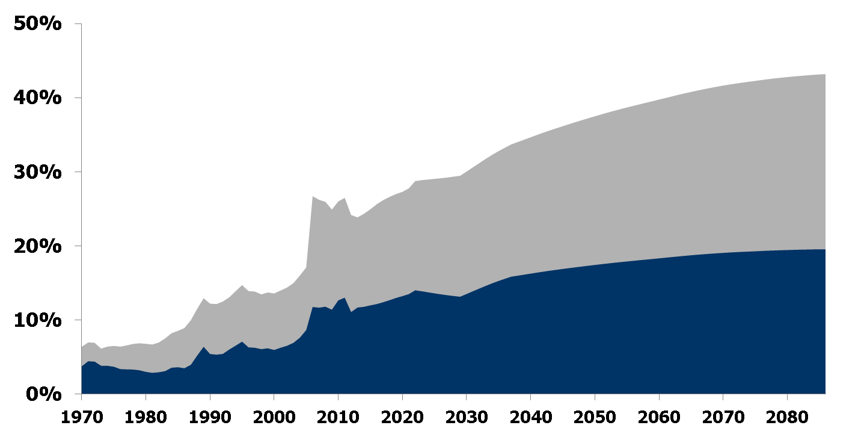
Part B and Part D Out-of-Pocket Spending as a Share of Average Social Security Benefit
 | 2000 | 2010 | 2020
Average Monthly Social Security benefit payment | $1,001 | $1,151 | $1,242
Average monthly out-of-pocket spending on Part B and Part D | $136 | $299 | $339
Total SMI
out-of-pocket spending
Average
out-of-pocket spending on
SMI cost sharing
2020: 27%
2010: 26%
2000: 14%
Average
out-of-pocket spending on
SMI premiums
NOTE: SMI is Supplementary Medical Insurance. Out-of-pocket spending includes SMI (Part B and Part D) premiums and out-of-pocket cost-sharing expenses for SMI covered services.
SOURCE: Kaiser Family Foundation analysis based on data from 2012 Annual Report of the Boards of Trustees of the Federal Hospital Insurance and Federal Supplementary Medical Insurance Trust Funds.

Slide 6
Medicare as a Share of the Federal Budget, 1980 - 2020
Medicare as a share of the federal budget
5.8% | 8.5% | 12.1% | 15.1% | 18.0%
SOURCE: Historical spending for 1980 – 2010 from Congressional Budget Office (CBO) Budget and Economic Outlook: Historical Budget Data (January 2011); projected spending for 2020 from CBO Update to the Budget and Economic Outlook: Fiscal Years 2012 to 2022 (August 2012).

Slide 7
Average Annual Growth in Medicare Spending Compared with Economic Benchmarks, 2011 – 2020
NOTE: SGR is sustainable growth rate; GDP is gross domestic product; CPI is consumer price index.
SOURCES: Kaiser Family Foundation analysis of data from Medicare Trustees, Office of Management and Budget, Congressional Budget Office,
Centers for Medicare & Medicaid Services, U.S. Census Bureau.
Notes:
7

Slide 8
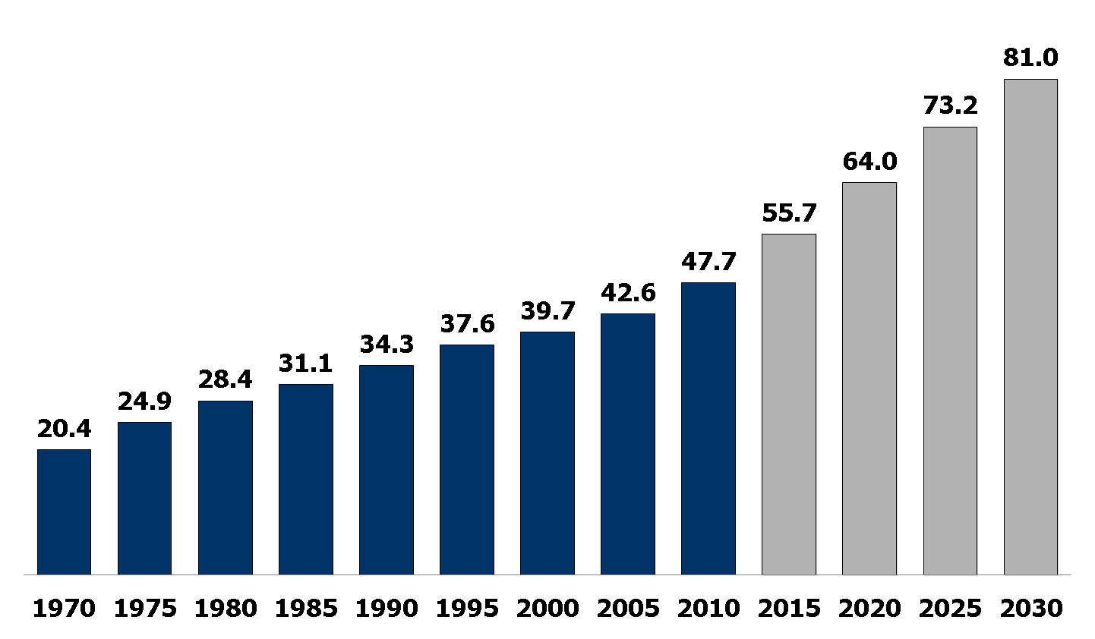
Medicare Enrollment, 1970 - 2030
Number in millions:
Historical Projected
SOURCE: 2012 Annual Report of the Boards of Trustees of the Federal Hospital Insurance and Federal Supplementary Medical Insurance Trust Funds.

Slide 9
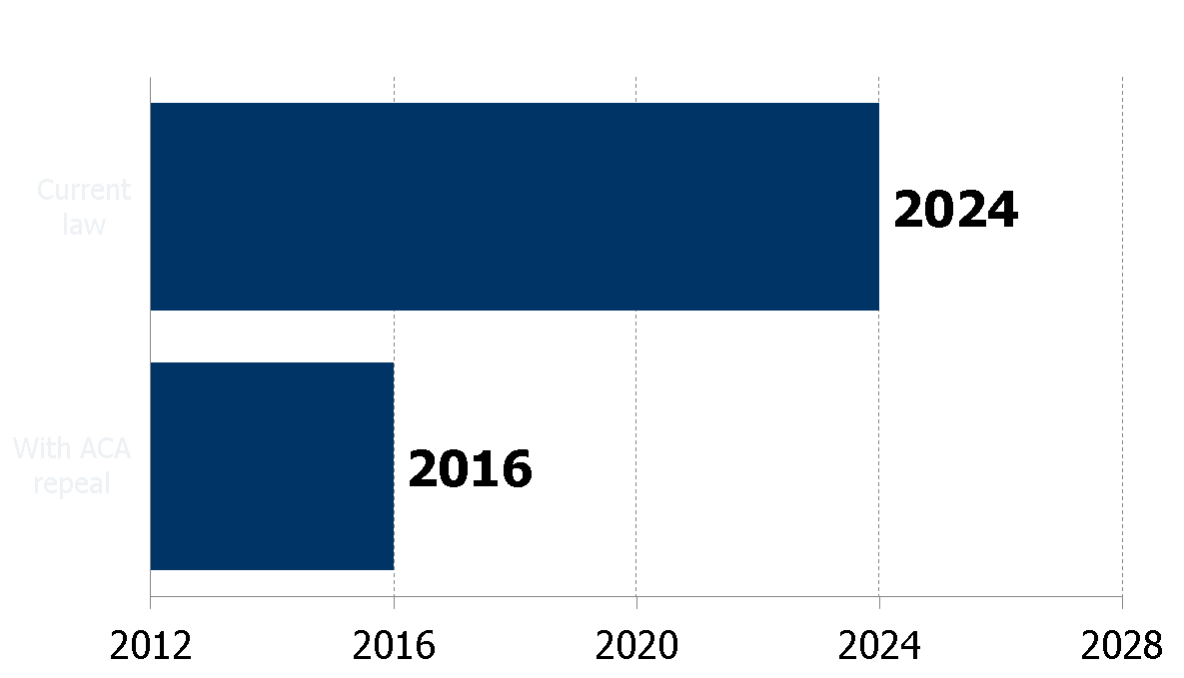
Solvency Projections of the Medicare Part A Trust Fund under current law and with repeal of health reform law
Solvency projections of the Part A trust fund:
Current law
With ACA repeal
Year
Source: Part A solvency projection for current law from 2012 Annual Report of the Boards of Trustees of the Federal Hospital Insurance and Federal Supplementary Medical Insurance Trust Funds; solvency projection with ACA repeal from Centers for Medicare and Medicaid Services (CMS) Press Release, “Medicare Stable, but Requires Strengthening,” released April 23, 2012.

