Slide 1

Median Medicaid/CHIP Eligibility Thresholds, January 2013
Minimum Medicaid Eligibility under Health Reform - 138% FPL
($24,344 for a family of 3 in 2012)
SOURCE: Based on the results of a national survey conducted by the Kaiser Commission on Medicaid and the Uninsured and the Georgetown University Center for Children and Families, 2013.

Slide 2
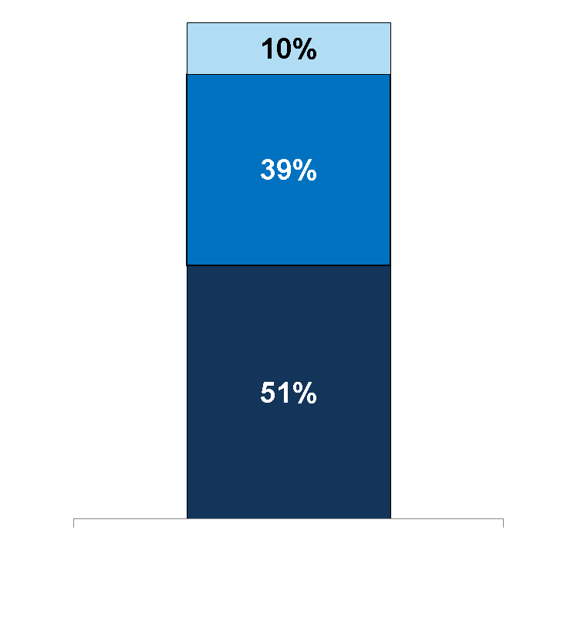
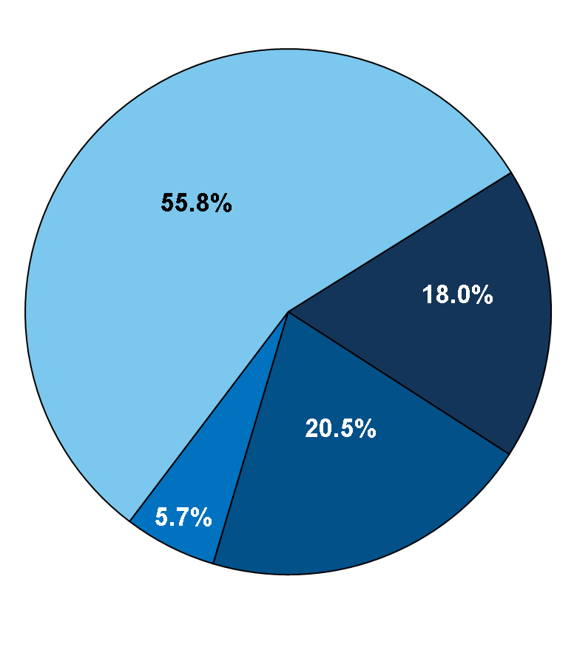
Health Insurance Coverage of the Nonelderly, 2011
Federal Poverty Level
≥400% FPL
139-399% FPL
(Subsidies)
Employer-Sponsored
Coverage
Uninsured
<139% FPL
(Medicaid)
Medicaid/ Other Public
Private Non-Group
266.4 Million Nonelderly
47.9 Million Uninsured
*Medicaid also includes other public programs: CHIP, other state programs, Medicare and military-related coverage. The federal poverty level for a family of four in 2011 was $22,350.
Numbers may not add to 100 due to rounding.
SOURCE: KCMU/Urban Institute analysis of 2012 ASEC Supplement to the CPS.

Slide 3
Share of Nonelderly Uninsured ≤138% FPL by State, 2010-2011
WA
VT
ME
MT
ND
NH
OR
MN
MA
ID
SD
WI
NY
MI
CT
RI
WY
IA
PA
NJ
NV
NE
IN
OH
DE
UT
CO
IL
MD
CA
WV
VA
DC
KS
MO
KY
NC
OK
TN
AZ
NM
AR
SC
MS
AL
GA
AK
TX
LA
FL
HI
26% – 47% (17 states, including DC)
United States:
51% Uninsured ≤ 138% FPL
48% – 52% (18 states)
53% - 61% (16 states)
SOURCE: Urban Institute and Kaiser Commission on Medicaid and the Uninsured estimates based on the Census Bureau's March 2011 and 2012 Current Population Survey (CPS: Annual Social and Economic Supplements).

Slide 4
States continue to weigh the Medicaid expansion decision.
Executive Activity on the Medicaid Expansion Decision:
WA
VT
ME
MT
ND
NH
OR
MN
MA
ID
SD
WI
NY
MI
CT
RI
WY
IA
PA
NJ
NV
NE
IN
OH
DE
UT
CO
IL
MD
CA
WV
VA
DC
KS
MO
KY
NC
OK
TN
AZ
NM
AR
SC
MS
AL
GA
TX
LA
AK
FL
HI
Governor’s Position on the Medicaid Expansion, as of Mar. 5, 2013
Supports Expansion (27 states, including DC)
Opposes Expansion (17 states)
Weighing Options (7 states)
SOURCE: Based on a review of State of the State Addresses, Budgets Proposed by Governors, as well as other public statements made by the Governor.

Slide 5
New State and Federal Medicaid Expenditures Under ACA, with All States Expanding Medicaid, 2013-2022
Total: $1,028 Billion
SOURCE: Urban Institute estimates prepared for the Kaiser Commission on Medicaid and the Uninsured, October 2012.

Slide 6
Enrollment Increases Under the ACA With All States Expanding Medicaid, 2016 and 2022
New Eligibles
Current Eligibles
12.0 M
5.9 M
14.3 M
7.0 M
Total: 17.9 Million
Total: 21.3 Million
SOURCE: HIPSM 2012.

