Slide 1

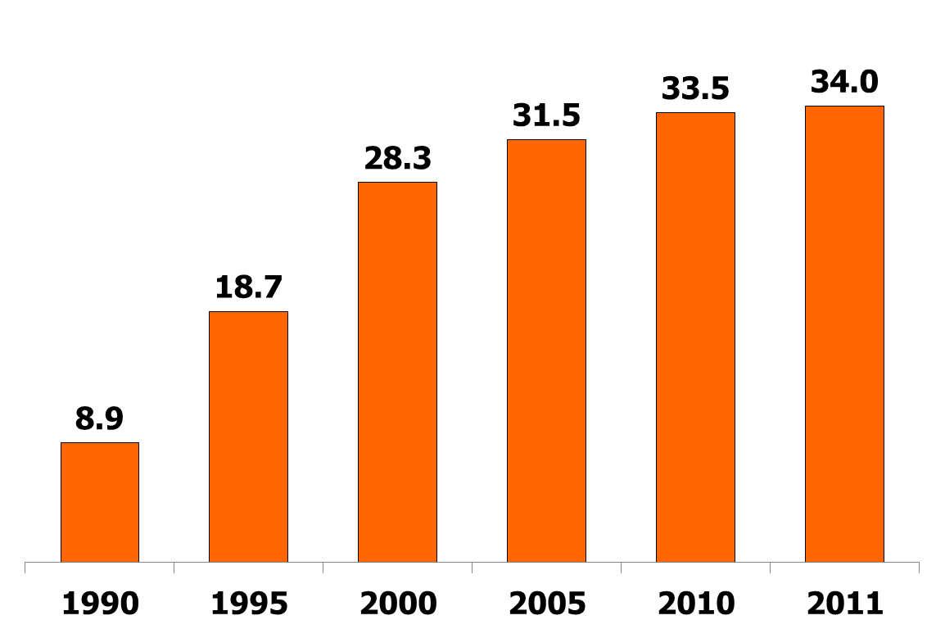
Global Estimates of People Living with HIV/AIDS 1990-2011
In Millions
SOURCE: UNAIDS, Report on the Global AIDS Epidemic, 2012.

Slide 2
International AIDS Assistance: Donor Governments as Share of Total Donor Government Disbursements, 2011
In Billions
$7.6 billion
Total Disbursements
Sources: UNAIDS and Kaiser Family Foundation analysis, July 2012; Global Fund to Fight AIDS, Tuberculosis and Malaria online data query, January 2012; UNITAID Annual Report, 2011; UNITAID Audited Financial Report for the period 2010-2011; OECD CRS online data queries.

Slide 3
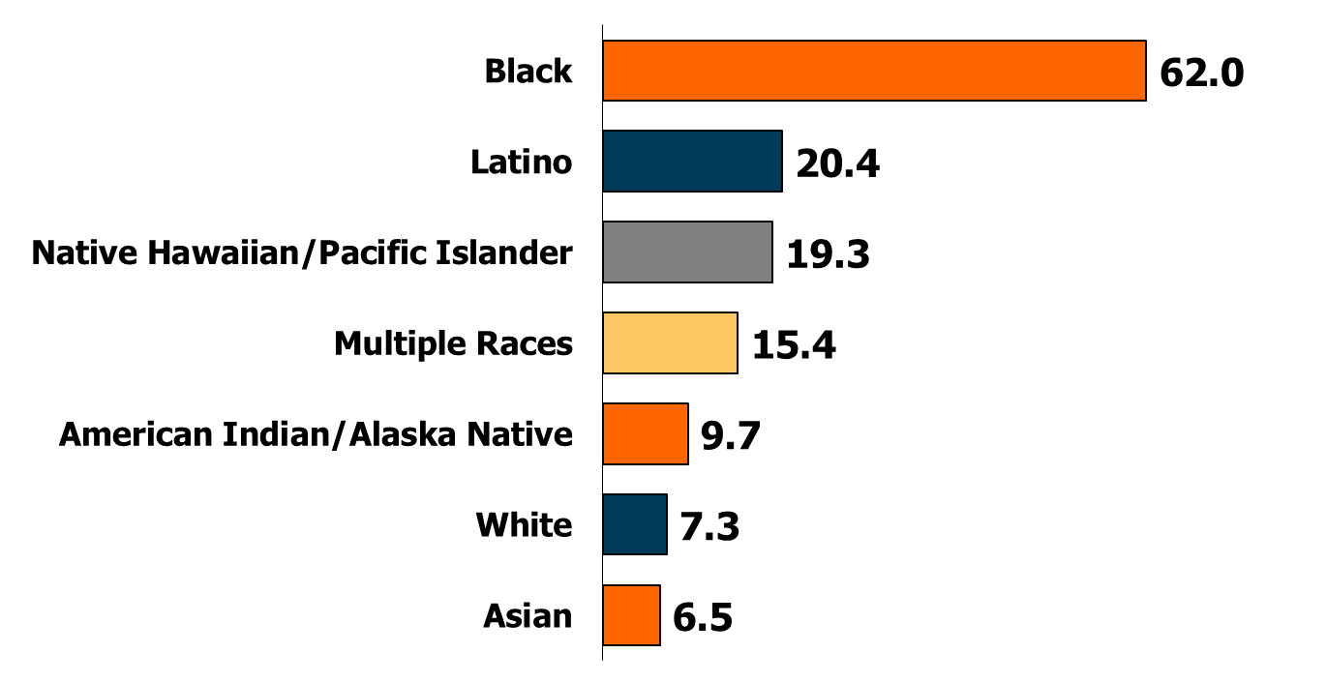
Rates of New HIV Diagnoses per 100,000,
by Race/Ethnicity, U.S., 2010
NOTE: Data do not include cases from the U.S. dependencies, possessions, and associated nations, and cases of unknown residence.
SOURCE: Kaiser Family Foundation, based on CDC, HIV Surveillance Report, Vol. 22, 2012.

Slide 4
The Continuing HIV/AIDS Epidemic in the U.S.
~1.2 Million
~50%
~18%
~50,000
Annual New
HIV Infections
People Living
People with
HIV/AIDS Not
In Regular Care*
People with HIV Who
Don't Know
They Are Infected
with HIV/AIDS
*Of those who are aware of their infection.
NOTES: Data are estimates; estimated number of people living with HIV/AIDS based on CDC’s supplemental report (below) and Kaiser Family Foundation projections through 2011.
SOURCES: Prejean, J et al. “Estimated HIV Incidence in the United States, 2006-2009”. PLoS ONE 6(8); 2011; CDC, MMWR, Vol. 60, No. 47; 2011; CDC, HIV Surveillance Supplemental Report 2012; Vol. 17, No. 3 (Part A); 2012.

Slide 5
Trend in Share Naming HIV/AIDS as Most Urgent Health Problem for the U.S. and the World
Percent of the public naming HIV/AIDS as the most urgent health problem facing the nation and the world in open-ended questions
Source: Kaiser Family Foundation Surveys.

