Slide 1

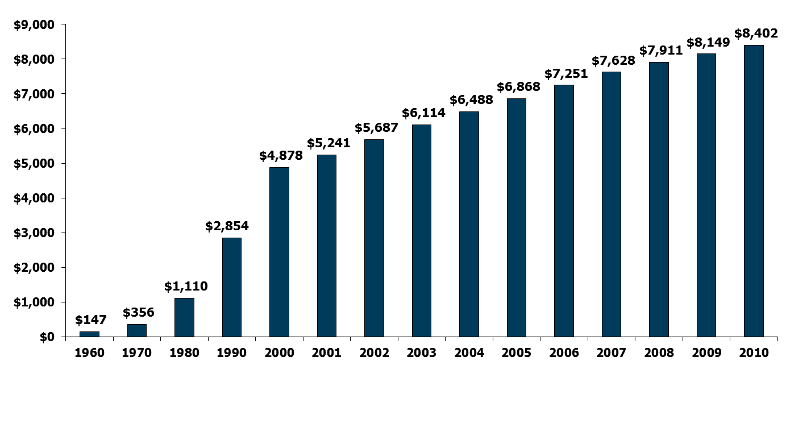
National Health Expenditures per Capita, 1960-2010
NHE as a Share of GDP
5.2% 7.2% 9.2% 12.5% 13.8% 14.5% 15.4% 15.9% 16.0% 16.1% 16.2% 16.4% 16.8% 17.9% 17.9%
Notes: According to CMS, population is the U.S. Bureau of the Census resident-based population, less armed forces overseas.
Source: Centers for Medicare and Medicaid Services, Office of the Actuary, National Health Statistics Group, at http://www.cms.hhs.gov/NationalHealthExpendData/ (see Historical; NHE summary including share of GDP, CY 1960-2010; file nhegdp10.zip).

Slide 2
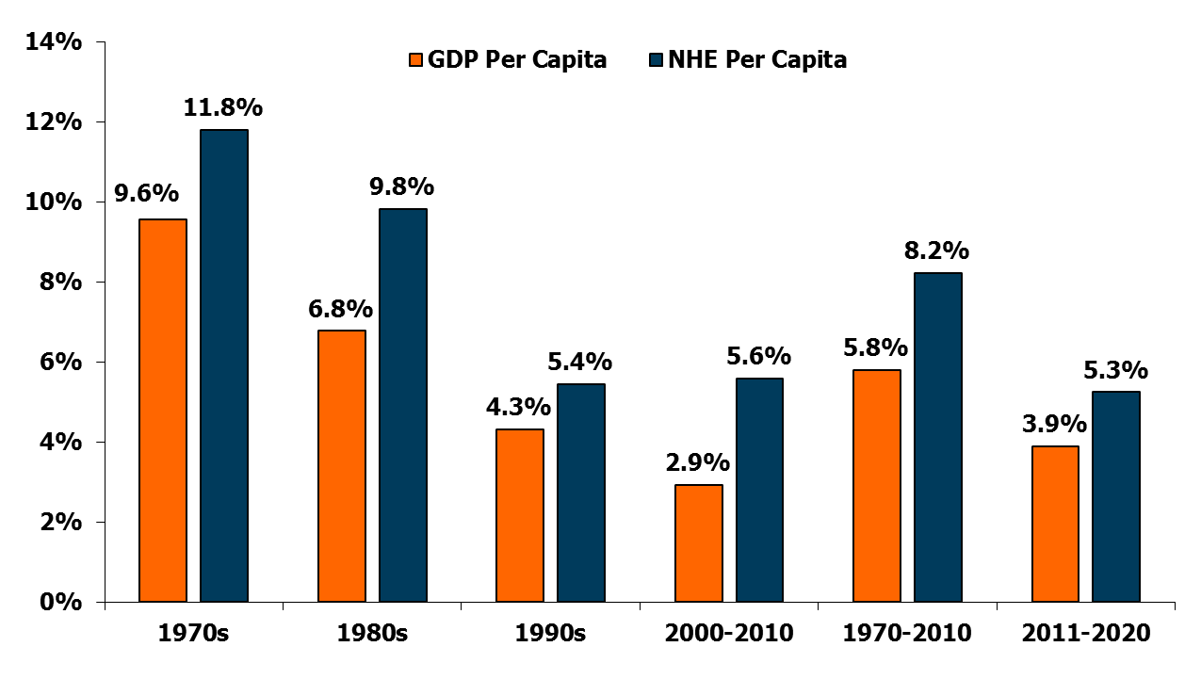
Average Annual Growth Rates for NHE and GDP, Per Capita, for Selected Time Periods
Projected
Source: Historical data from Centers for Medicare and Medicaid Services, Office of the Actuary, National Health Statistics Group, January 2012, at http://www.cms.hhs.gov/NationalHealthExpendData/ (see Historical; NHE summary including share of GDP, CY 1960-2010; file nhegdp10.zip). Projections from Centers for Medicare and Medicaid Services, Office of the Actuary, National Health Statistics Group, July 2011, “National Health Expenditures 2010-2020,” Table 1, https://www.cms.gov/NationalHealthExpendData/downloads/proj2010.pdf.

Slide 3
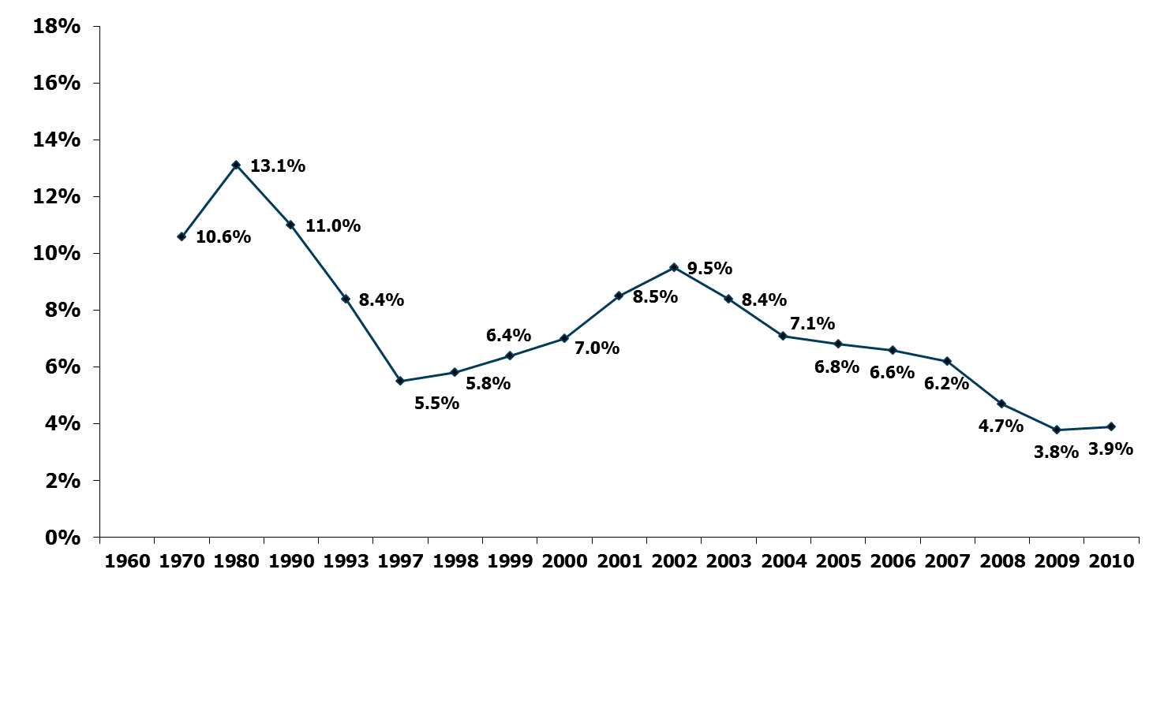
Average Annual Percent Change in National Health Expenditures, 1960-2010
Source: Kaiser Family Foundation calculations using NHE data from Centers for Medicare and Medicaid Services, Office of the Actuary, National Health Statistics Group, at http://www.cms.hhs.gov/NationalHealthExpendData/ (see Historical; National Health Expenditures by type of service and source of funds, CY 1960-2010; file nhe2010.zip).

Slide 4
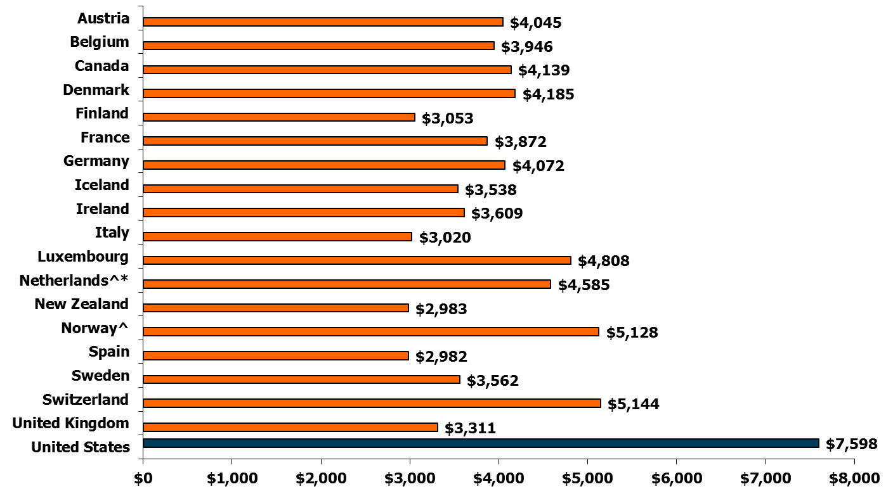
Per Capita Total Current Health Care Expenditures, U.S. and Selected Countries, 2009
^OECD estimate.
*Break in series.
Notes: Amounts in U.S.$ Purchasing Power Parity, see http://www.oecd.org/std/ppp; includes only countries over $2,500. OECD defines Total Current Expenditures on Health as the sum of expenditures on personal health care, preventive and public health services, and health administration and health insurance; it excludes investment.
Source: Organisation for Economic Co-operation and Development. “OECD Health Data: Health Expenditures and Financing”, OECD Health Statistics Data from internet subscription database. http://www.oecd-ilibrary.org, data accessed on 01/10/12.

Slide 5
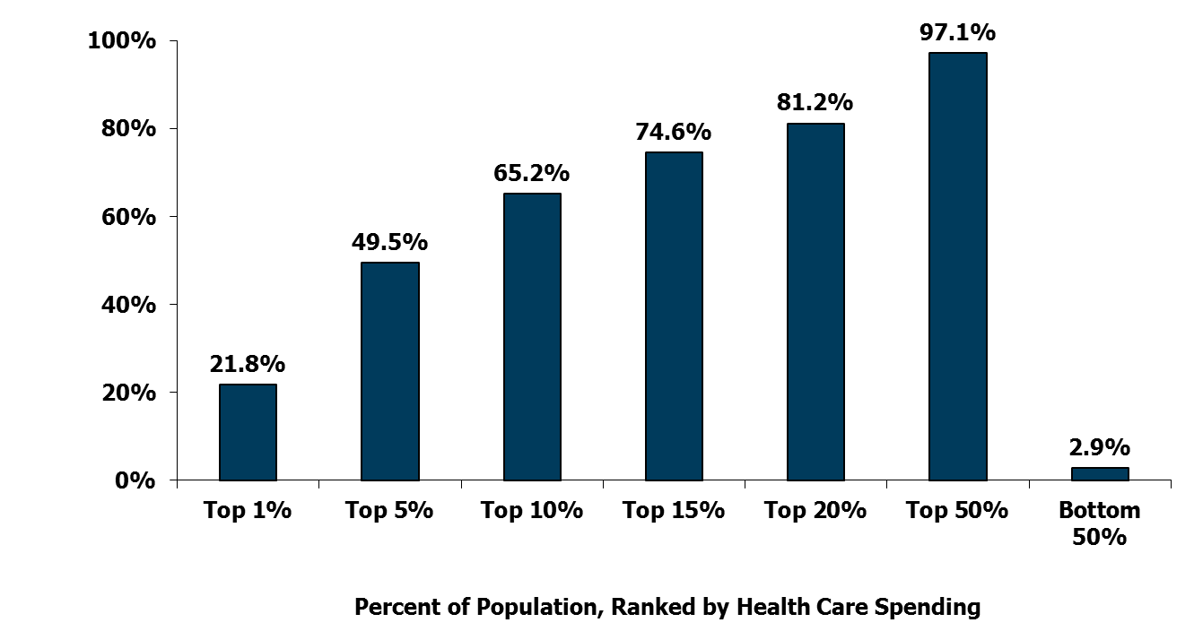
Concentration of Health Care Spending in the U.S. Population, 2009
Percent of Total Health Care Spending
(≥$51,951)
(≥$17,402)
(≥$9,570)
(≥$6,343)
(≥$4,586)
(≥$851)
(<$851)
Note: Dollar amounts in parentheses are the annual expenses per person in each percentile. Population is the civilian noninstitutionalized population, including those without any health care spending. Health care spending is total payments from all sources (including direct payments from individuals and families, private insurance, Medicare, Medicaid, and miscellaneous other sources) to hospitals, physicians, other providers (including dental care), and pharmacies; health insurance premiums are not included.
Source: Kaiser Family Foundation calculations using data from U.S. Department of Health and Human Services, Agency for Healthcare Research and Quality, Medical Expenditure Panel Survey (MEPS), Household Component, 2009.
Notes:
A small proportion of the U.S. population accounts for half of all U.S. health care spending. The 5% of the population with higher health care expenses (≥$16,336 annually) was responsible for nearly half (47.5%) of total health care spending, while the 50% of the population with the lowest expenses (<$825) accounted for only 3.1% of total spending.

Slide 6
Distribution of Average Spending Per Person, 2009
 | Average Spending Per Person
Age (in years)
<5 | $2,468
5-17 | 1,695
18-24 | 1,834
25-44 | 2,739
45-64 | 5,511
65 or Older | 9,744
Sex
Male | $3,559
Female | 4,635
Note: Population is the civilian noninstitutionalized population, including those without any health care spending. Health care spending is total payments from all sources (including direct payments from individuals and families, private insurance, Medicare, Medicaid, and miscellaneous other sources) to hospitals, physicians, other providers (including dental care), and pharmacies; health insurance premiums are not included.
Source: Kaiser Family Foundation calculations using data from U.S. Department of Health and Human Services, Agency for Healthcare Research and Quality, Medical Expenditure Panel Survey (MEPS), 2009.

Slide 7
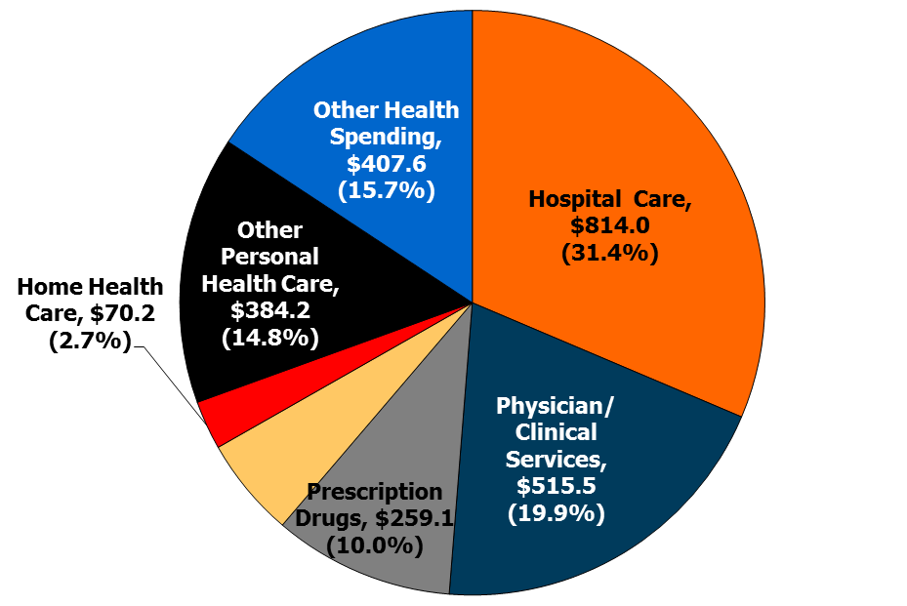
Distribution of National Health Expenditures, by Type of Service (in Billions), 2010
Nursing Care Facilities & Continuing Care Retirement Communities, $143.1 (5.5%)
NHE Total Expenditures: $2,593.6 billion
Note: Other Personal Health Care includes, for example, dental and other professional health services, durable medical equipment, etc. Other Health Spending includes, for example, administration and net cost of private health insurance, public health activity, research, and structures and equipment, etc.
Source: Kaiser Family Foundation calculations using NHE data from Centers for Medicare and Medicaid Services, Office of the Actuary, National Health Statistics Group, at http://www.cms.hhs.gov/NationalHealthExpendData/ (see Historical; National Health Expenditures by type of service and source of funds, CY 1960-2010; file nhe2010.zip).

Slide 8
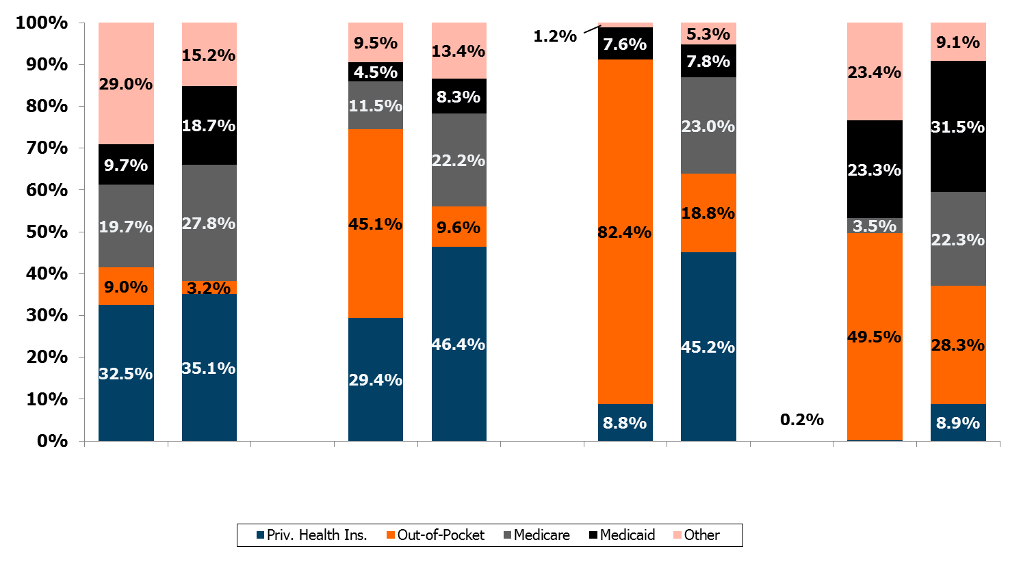
Percent Distribution of Source of Funds for Selected Personal Health Care Services, 1970 and 2010
1970 2010
1970 2010
1970 2010
1970 2010
Hospital Care
Physician & Clinical Services
Retail Prescription Drugs
Nursing Care Facilities & Continuing Care Retirement Communities
Notes: Medicare and Medicaid were enacted in 1965; by January 1970, all states but two were participating in Medicaid. “Out-of-Pocket” includes direct spending by consumers for all health care goods and services not covered by insurance, except for health care premiums. “Priv. Health Ins.” includes premiums paid to health insurance plans and the net cost of private health insurance (administrative costs, reserves, taxes, and profits or losses). “Other” includes Other Public Health Insurance Programs (CHIP, Depts. of Defense and of Veterans Affairs) and Other Third Party Payers (e.g., worksite health care, other private revenues, workers’ compensation, maternal/child health, other state and local programs, etc.).
Source: Centers for Medicare and Medicaid Services, Office of the Actuary, National Health Statistics Group at https://www.cms.gov/NationalHealthExpendData/ (see Historical; NHE Web tables, Tables 7, 8, 11, 12).

Slide 9
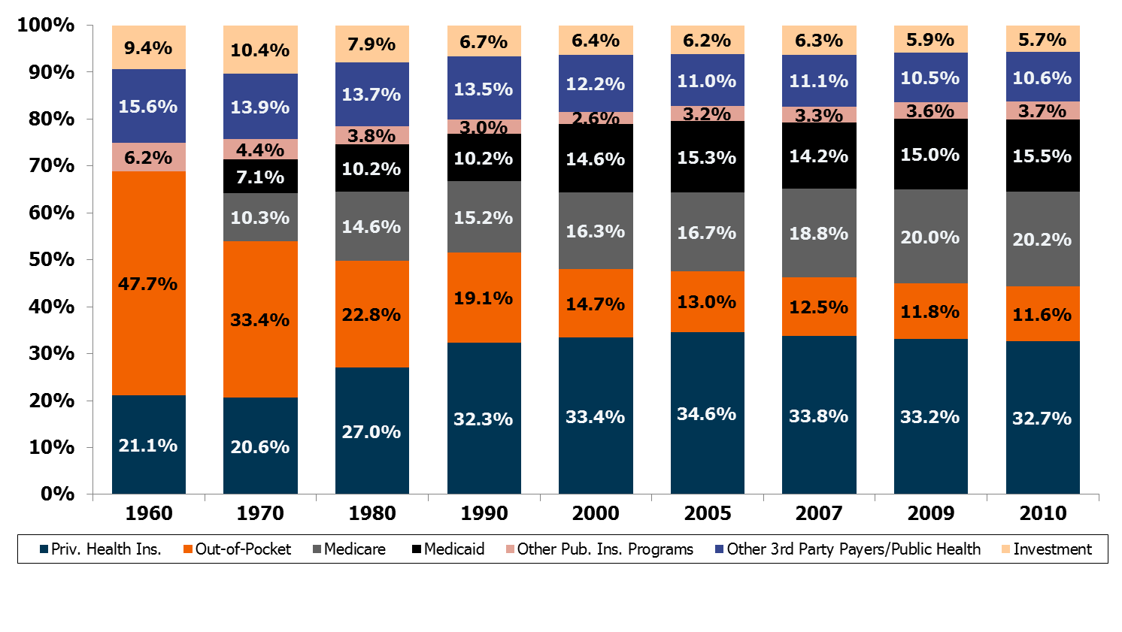
Percent Distribution of National Health Expenditures, by Source of Funds, 1960-2010
Notes: Medicare and Medicaid were enacted in 1965; by January 1970, all states but two were participating in Medicaid. Starting with 2009 NHE data, CMS revised the “Source of Funds” measure from a classification that was either public or private to one that is more program-based. CMS’s rational was that “financing arrangements have become more complex and the lines between public and private payers have become blurred as a single program may have federal, state, local, and private funding.” As a result, the category “Other Third Party Payers” includes both public and private programs and also some programs that receive funds from both public and private sources, such as Workers’ Compensation, Worksite Health Care, and School Health. “Other Pub. Ins. Programs” includes CHIP, the Department of Defense, and the Department of Veterans Affairs.
Source: Kaiser Family Foundation calculations using NHE data from Centers for Medicare and Medicaid Services, Office of the Actuary, National Health Statistics Group, at http://www.cms.hhs.gov/NationalHealthExpendData/ (see Historical; National Health Expenditures by type of service and source of funds, CY 1960-2010; file nhe2010.zip).

Slide 10
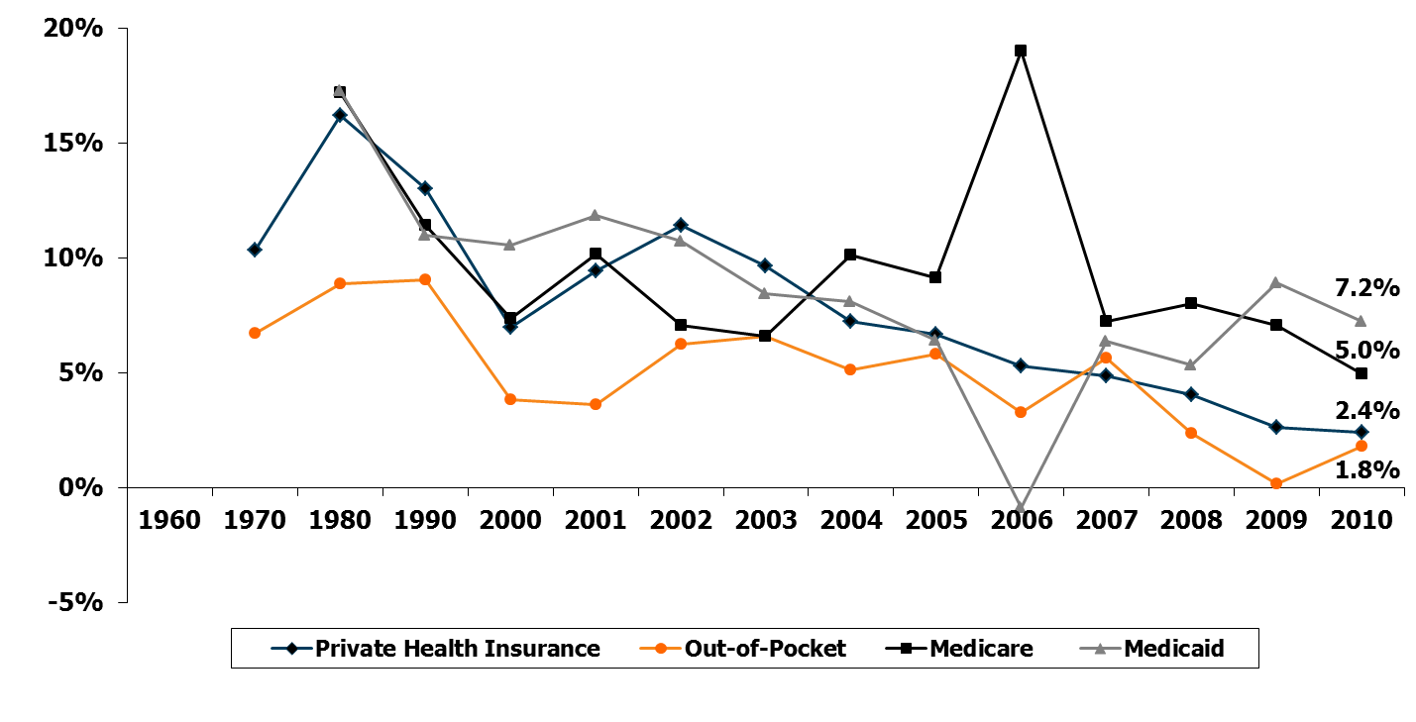
Annual Percent Change in National Health Expenditures, by Selected Sources of Funds, 1960-2010
Notes: This figure omits national health spending that belongs in the categories of Other Public Insurance Programs, Other Third Party Payers and Programs, Public Health Activity, and Investment, which together represented about 20% of total national health spending in 2010. Medicare and Medicaid were enacted in 1965; by January 1970, all states but two were participating in Medicaid. Implementation of the Medicare Part D prescription drug benefit was the major cause of the 2006 increase in Medicare spending and decrease in Medicaid spending (Medicare replaced Medicaid drug coverage for dual eligibles).
Source: Kaiser Family Foundation calculations using NHE data from Centers for Medicare and Medicaid Services, Office of the Actuary, National Health Statistics Group, at http://www.cms.hhs.gov/NationalHealthExpendData/ (see Historical; National Health Expenditures by type of service and source of funds, CY 1960-2010; file nhe2010.zip).

Slide 11
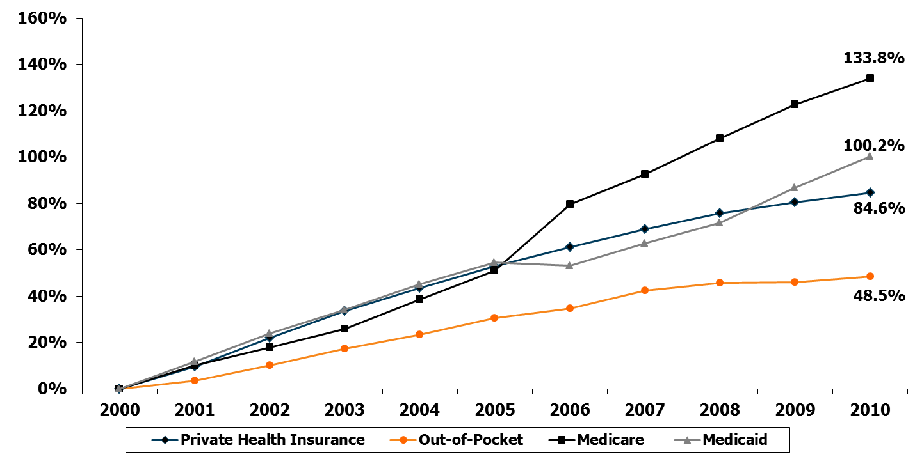
Cumulative Percent Change in National Health Expenditures, by Selected Sources of Funds, 2000-2010
Notes: This figure omits national health spending that belongs in the categories of Other Public Insurance Programs, Other Third Party Payers and Programs, Public Health Activity, and Investment, which together represent about 20% of total national health spending in 2010. Medicare and Medicaid were enacted in 1965; by January 1970, all states but two were participating in Medicaid.
Source: Kaiser Family Foundation calculations using NHE data from Centers for Medicare and Medicaid Services, Office of the Actuary, National Health Statistics Group, at http://www.cms.hhs.gov/NationalHealthExpendData/ (see Historical; National Health Expenditures by type of service and source of funds, CY 1960-2010; file nhe2010.zip).

Slide 12
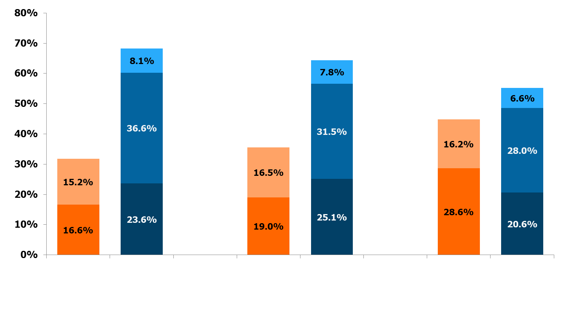
Percent Distribution of National Health Expenditures, by Type of Sponsor, 1987, 2000, 2010
Federal Private Business
State & Local Household
Other Private Revenues
68.2%
64.5%
55.1%
44.9%
35.5%
31.8%
Government Private
Government Private
Government Private
1987 (Total = $519.1 billion)
2000 (Total = $1,377.2 billion)
2011 (Total = $2,700.7 billion)
Notes: Starting with the 2009 NHE data, CMS expanded their focus on spending by Type of Sponsor, which provides estimates of the individual, business, or tax source that is behind each Source of Funds category and is responsible for financing or sponsoring the payments. “Federal” and “State & Local” includes government contributions to private health insurance premiums and to the Medicare Hospital Insurance Trust Fund through payroll taxes, Medicaid program expenditures including buy-in premiums for Medicare, and other state & local government programs. “Private Business” includes employer contributions to private health insurance, the Medicare Hospital Insurance Trust Fund through payroll taxes, workers’ compensation insurance, temporary disability insurance, worksite health care. “Household” includes contributions to health insurance premiums for private health insurance, Medicare Part A or Part B, out-of-pocket costs. “Other Private Revenues” includes philanthropy, structure & equipment, non-patient revenues.
Source: Centers for Medicare and Medicaid Services, Office of the Actuary, National Health Statistics Group at
https://www.cms.gov/NationalHealthExpendData/ (see Historical; NHE Web tables, Table 5).

Slide 13
Annual Percent Change in National Health Expenditures, by Type of Sponsor, 1988-2010
¹
²
³
⁴
⁵
¹ Excludes Medicare Retiree Drug Subsidy payments to private plans beginning in 2006.
² Excludes subsidized COBRA payments in 2009 and 2010.
³ Includes one-half of self-employment contribution to Medicare Hospital Insurance Trust Fund and taxation of Social Security benefits.
⁴ Excludes Medicaid buy-in premiums for Medicare. Includes Retiree Drug Subsidy payments to private and state and local plans beginning in 2006.
⁵ Includes Medicaid buy-in premiums for Medicare.
Source: Centers for Medicare and Medicaid Services, Office of the Actuary, National Health Statistics Group, “National Health Expenditures 2010: Sponsor Highlights,” Table 2, https://www.cms.gov/NationalHealthExpendData/downloads/sponsors.pdf.

Slide 14
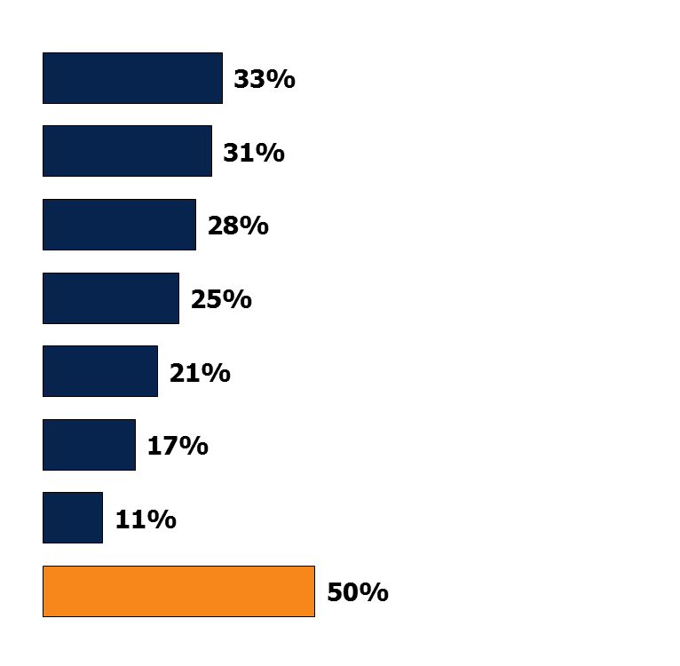
Putting Off Care Because of Cost
Percent who say they or another family member living in their household have done each of the following in the past 12 months because of the cost:
Relied on home remedies or over-the-counter drugs instead of going to see a doctor
Skipped dental care or checkups
Put off or postponed getting health care needed
Not filled a prescription for a medicine
Skipped a recommended medical test or treatment
Cut pills in half or skipped doses of medicine
Had problems getting mental health care
‘Yes’ to any of the above
Source: Kaiser Family Foundation Health Tracking Poll (conducted August 10-15, 2011).

Slide 15
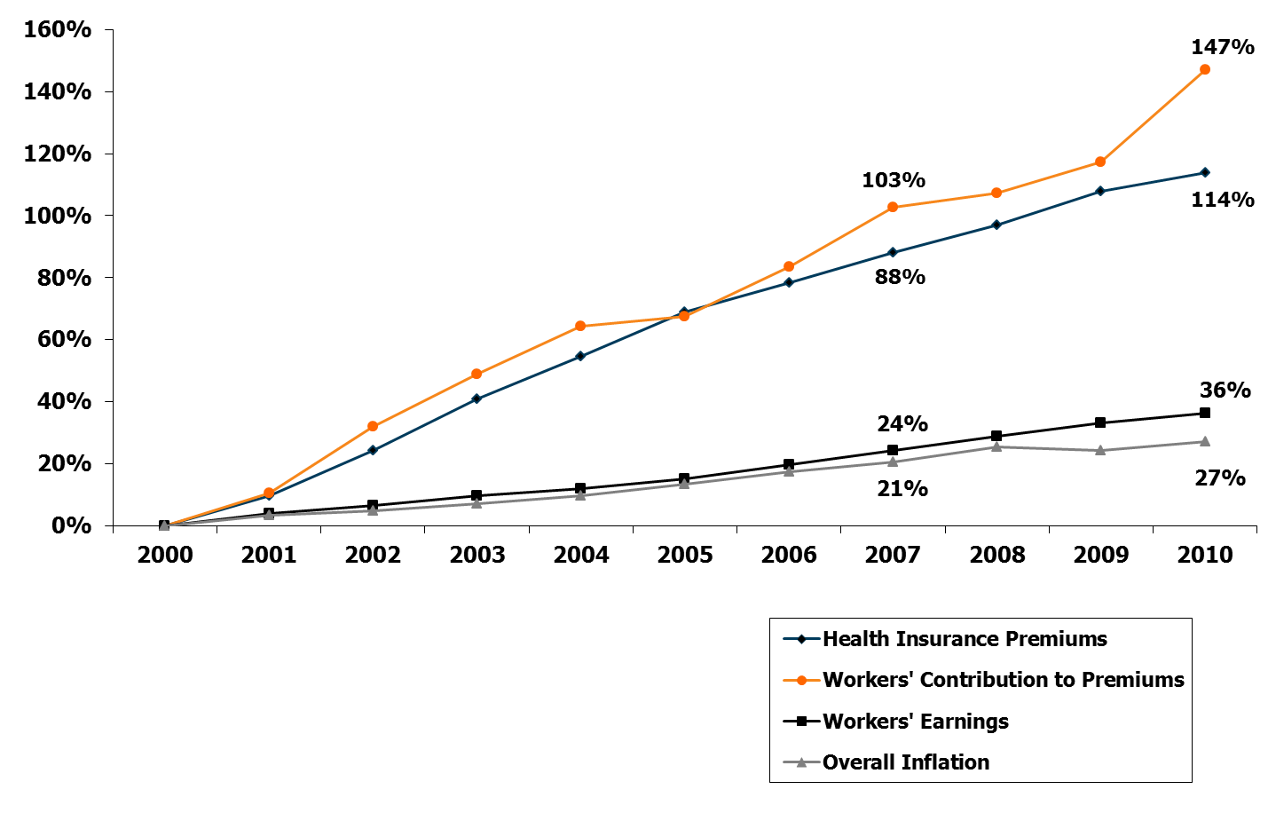
Cumulative Increases in Health Insurance Premiums, Workers’ Contributions to Premiums, Inflation, and Workers’ Earnings, 2000-2010
Notes: Health insurance premiums and worker contributions are for family premiums based on a family of four.
Source: Kaiser/HRET Survey of Employer-Sponsored Health Benefits, 1999-2011. Bureau of Labor Statistics, Consumer Price Index, U.S. City Average of Annual Inflation (April to April), 1999-2011. Bureau of Labor Statistics, Seasonally Adjusted Data from the Current Employment Statistics Survey, 1999-2011 (April to April).

Slide 16
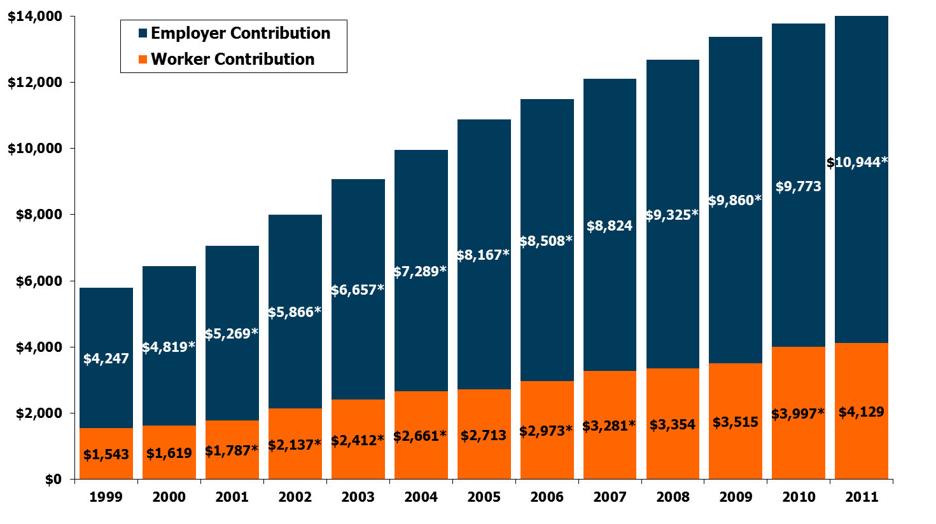
Average Annual Worker and Employer Contributions to Premiums and Total Premiums for Family Coverage,
1999-2011
$13,770*
$15,073*
$13,375*
$12,680*
$12,106*
$11,480*
$10,880*
$9,950*
$9,068*
$8,003*
$7,061*
$6,438*
$5,791
* Estimate is statistically different from estimate for the previous year shown (p<.05).
Source: Kaiser/HRET Survey of Employer-Sponsored Health Benefits, 1999-2011.

Slide 17
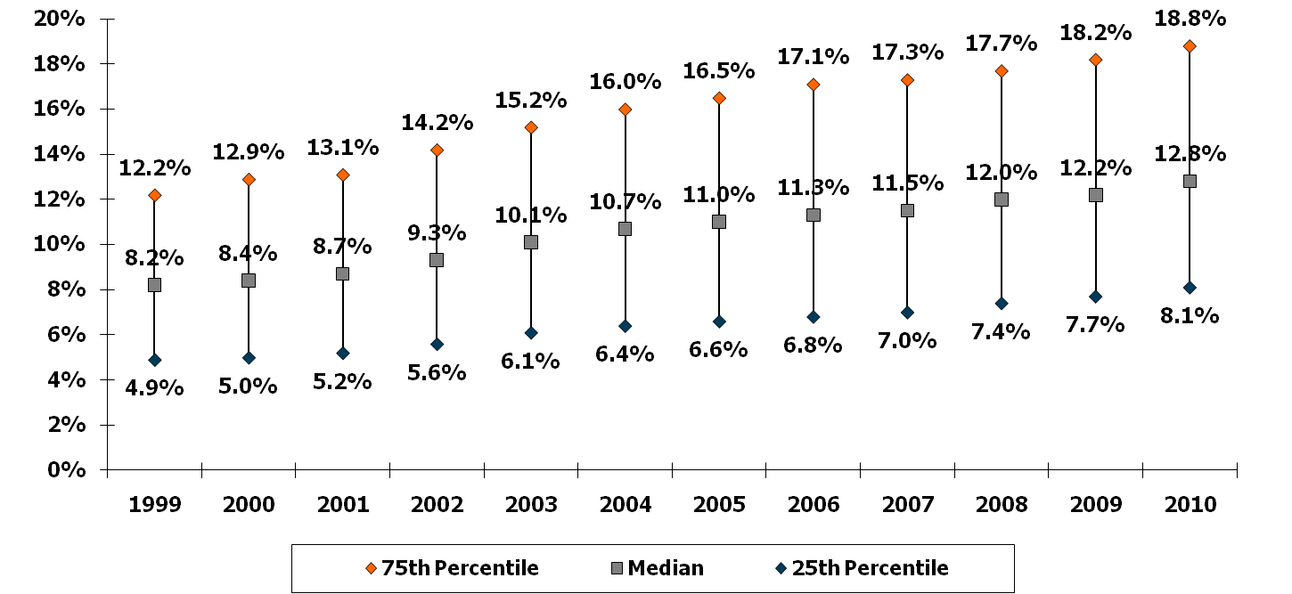
Distribution of Health Coverage Costs as a Percentage of Payroll for Employees with Access to Coverage, 1999-2010
Source: Kaiser Family Foundation calculations based on data from the National Compensation Survey, 1999-2010, conducted by the Bureau of Labor Statistics.

Slide 18
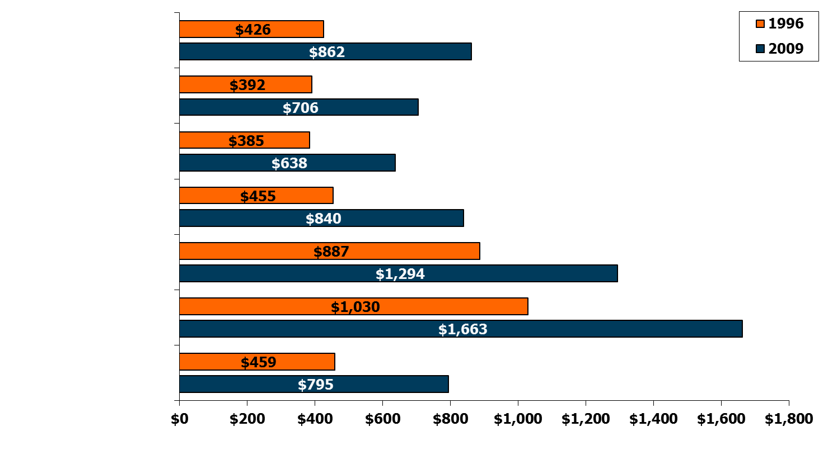
Average Out-of-Pocket Health Services Expenses and Percent Increases, 1996 and 2009
Nonelderly Uninsured
102%
Nonelderly with Private Insurance
80%
Below the Federal Poverty Line
66%
Poverty Line Through 125% of Poverty
85%
Age 65 and Older
46%
Perceived Poor
Health Status
61%
Total
73%
Note: Percents are the percent increase from 1996 to 2009. Dollar amounts and percentages do not include health insurance premiums.
Source: Agency for Healthcare Research and Quality, Medical Expenditure Panel Survey, Table 1.1, Total Health Services Median and Mean Expenses per Person with Expense and Mean Expenses by Source of Payment, 1996 and 2009, http://meps.ahrq.gov/mepsweb/data_stats/quick_tables_results.jsp?component=1&subcomponent=0&tableSeries=1&year=-1&SearchMethod=1&Action=Search.

Slide 19
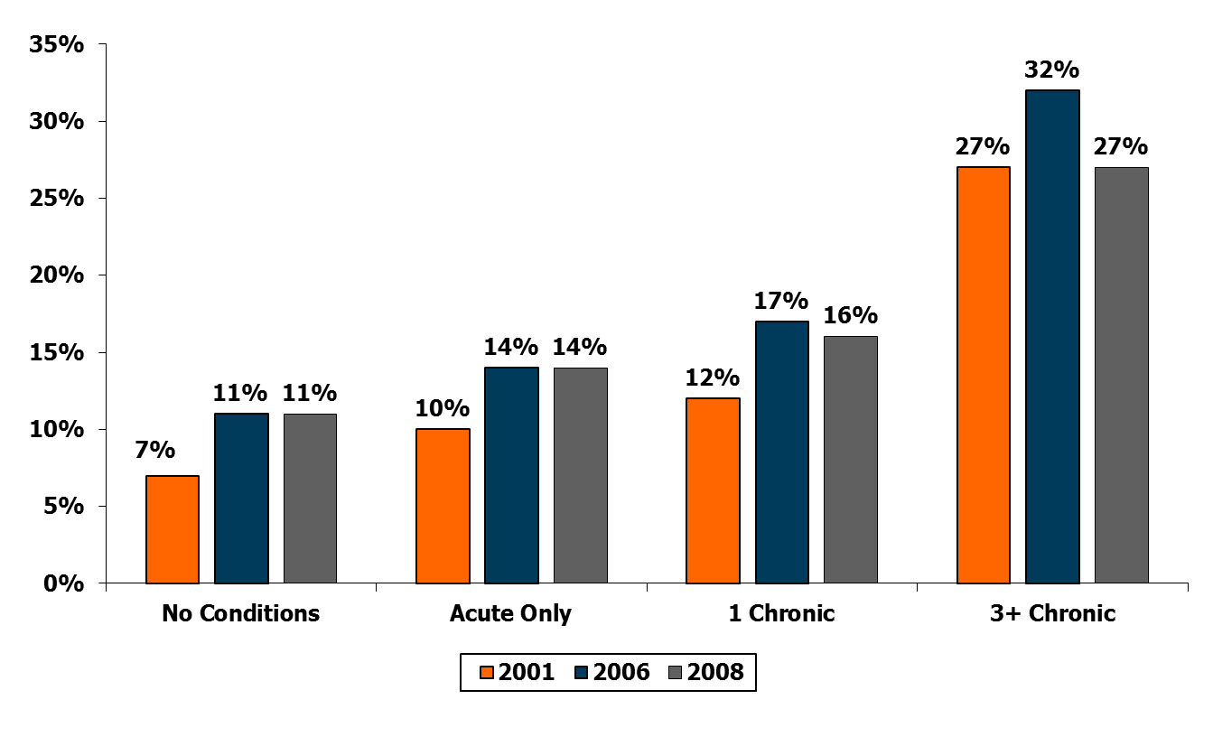
Prevalence of High Out-of-Pocket Burdens Among the Nonelderly, by Chronic Condition Status, 2001, 2006, and 2008
Percent with Total Burden > 10% of Income
Note: Percentages include health insurance premiums.
Source: Peter J. Cunningham, Center for Studying Health Systems Change, calculations using 2001, 2006, and 2008 Medical Expenditure Panel Surveys, presented at The National Academies Workshop on Measuring Medical Care Economic Risk, September 8, 2011.

Slide 20
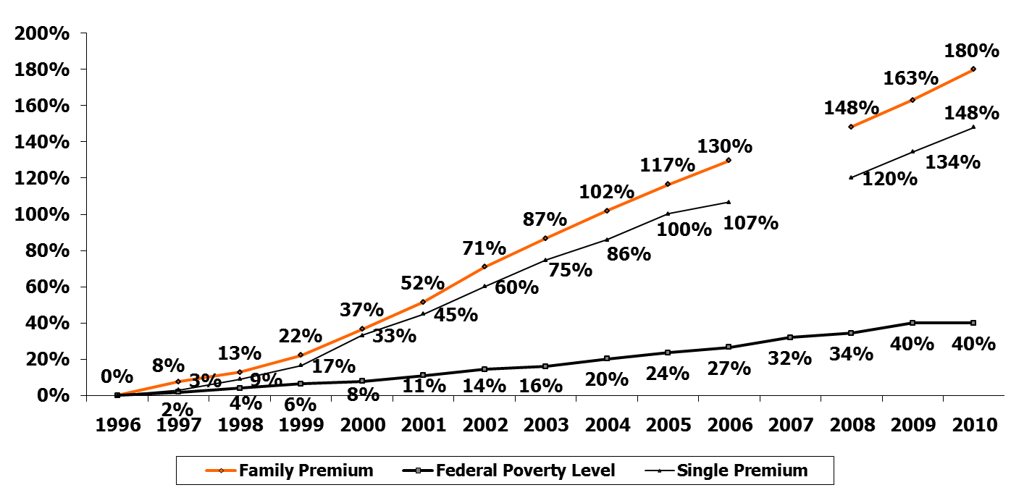
Cumulative Change in Single and Family Health Insurance Premiums and Federal Poverty Level, 1996-2010
*
*
*No data are available for 2007 due to MEPS transition from retrospective to current data collection.
Note: Family premium percentages were calculated based on a family of four. In 2009 and 2010, the federal poverty level for a family of four was $22,050.
Source: Premium data from Agency for Healthcare Research and Quality, Medical Expenditure Panel Survey, private sector data from Insurance Component, 1996-2010, at http://meps.ahrq.gov/mepsweb/. Federal Poverty Level based on HHS Federal Poverty Guidelines (1996 through 2010) at http://aspe.hhs.gov/poverty/figures-fed-reg.shtml; rate of growth based on change for one person (change for a four-person family would be 41.3% rather than 39.9% over the period).

