Slide 1

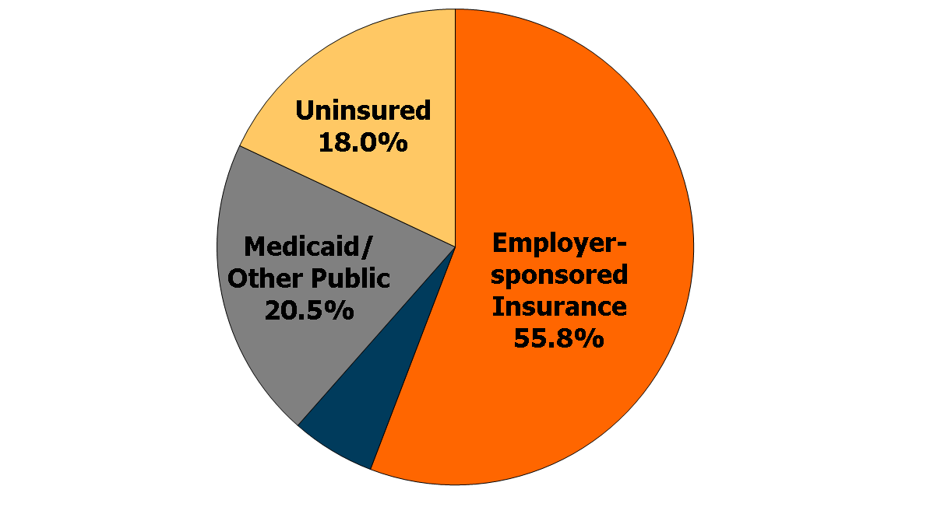
Health Insurance Coverage of the Nonelderly Population, 2011
Private Non-group 5.7%
266.4 Million
SOURCE: KCMU/Urban Institute analysis of 2012 ASEC Supplement to the CPS.

Slide 2
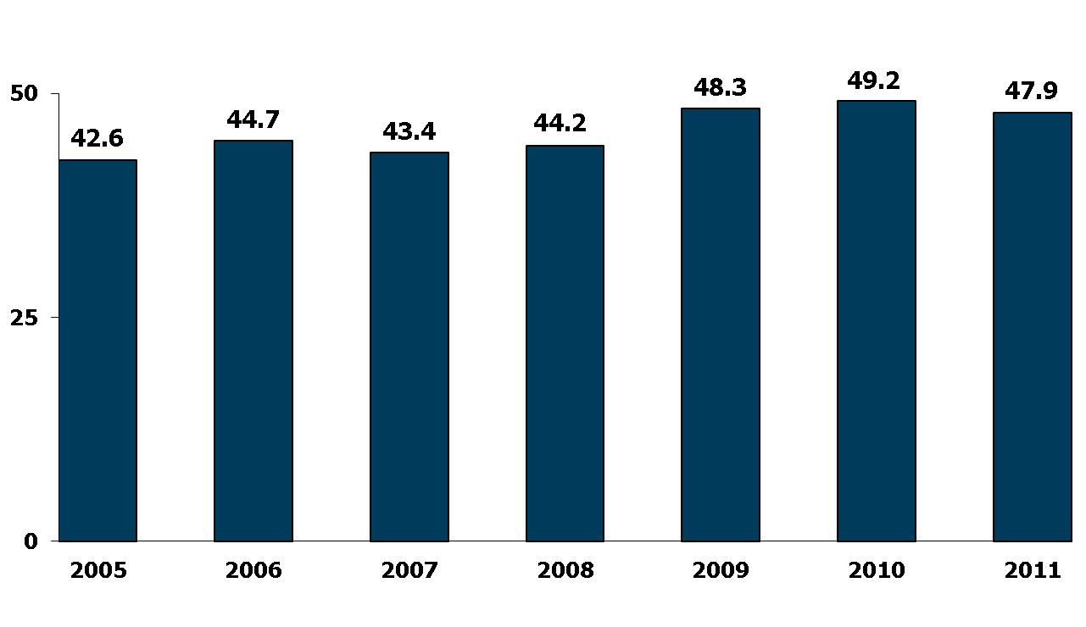
Number of Nonelderly Uninsured Americans,
2005 – 2011
SOURCE: DeNavas-Walt C, Proctor B, and Smith J. “Income, Poverty, and Health Insurance Coverage in the United States: 2011”. United States Census Bureau. Issued September 2012.

Slide 3
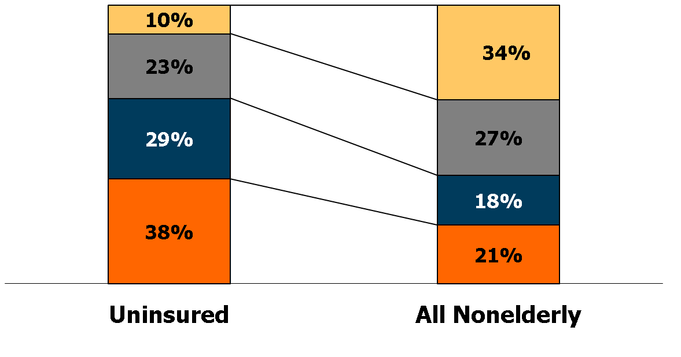
Uninsured Nonelderly vs. All Nonelderly, by Family Poverty Level, 2011
400% +
200% - 399%
100% - 199%
Under 100%
47.9 Million
266.4 Million
NOTES: Data may not total 100% due to rounding. The Federal Poverty Level for a family of four in 2011 was $22,350 (according to the HHS poverty guidelines).
SOURCE: KCMU/Urban Institute analysis of 2012 ASEC Supplement to the CPS.

Slide 4
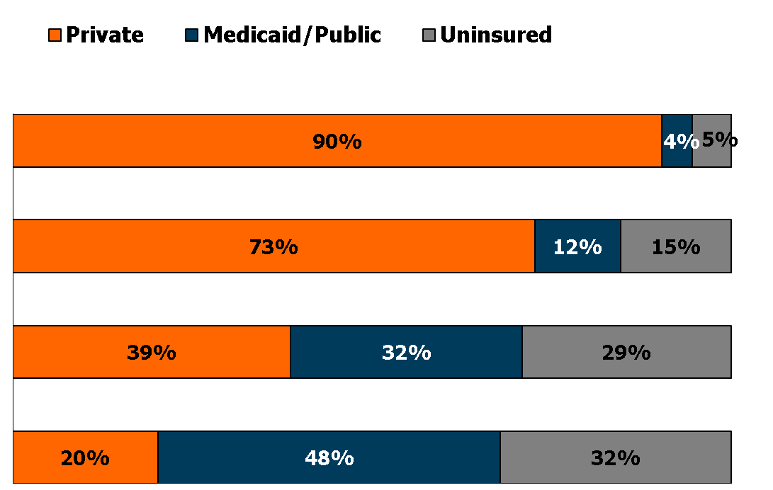
Nonelderly Health Insurance Coverage by Family Poverty Level, 2011
Number
400% +
90.5 M
200% - 399%
72.1 M
100% - 199%
47.4 M
Under 100%
56.3 M
NOTES: Data may not total 100% due to rounding. The Federal Poverty Level for a family of four in 2011 was $22,350 (according to the HHS poverty guidelines).
SOURCE: KCMU/Urban Institute analysis of 2012 ASEC Supplement to the CPS.

Slide 5
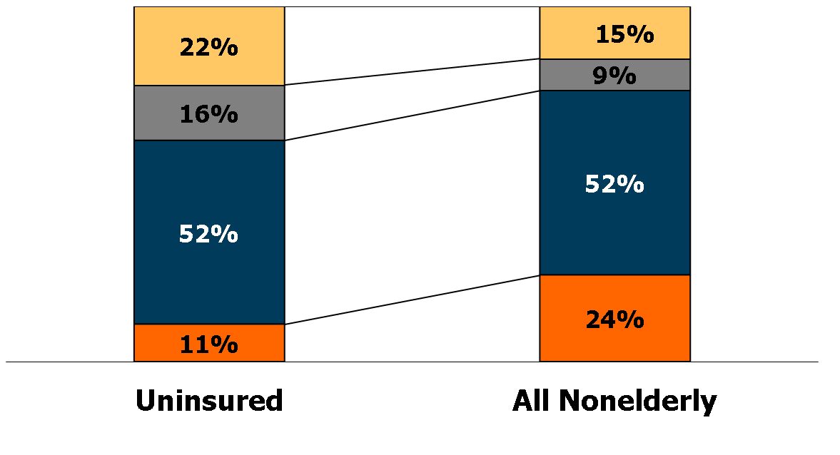
Uninsured Nonelderly vs. All Nonelderly, by Family Work Status, 2011
No workers
Only part-time
One full-time worker
Two full-time workers
47.9 Million
266.4 Million
NOTES: Data may not total 100% due to rounding.
SOURCE: KCMU/Urban Institute analysis of 2012 ASEC Supplement to the CPS.

Slide 6
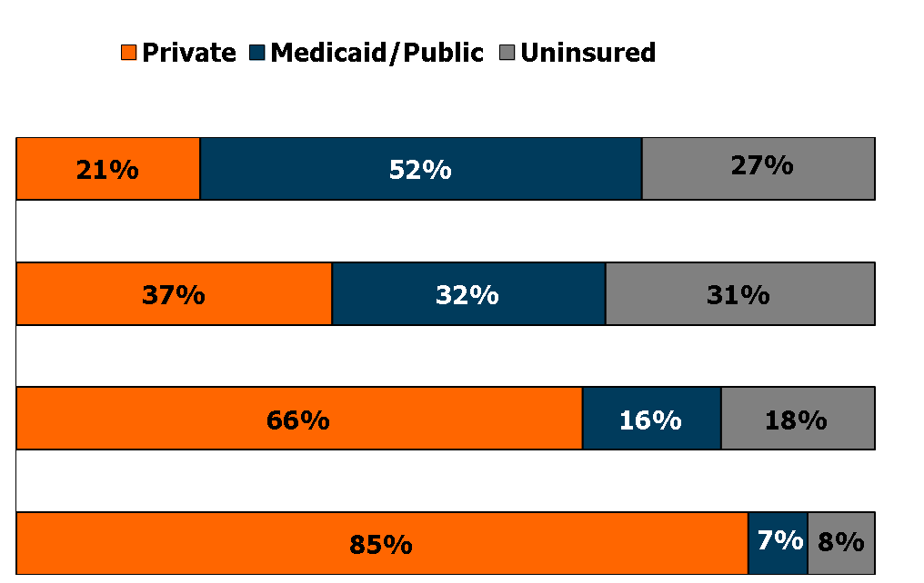
Nonelderly’s Health Insurance Coverage by Family Work Status, 2011
Number
No workers
39.3 M
Only part-time
23.7 M
One full-time
worker
138.4 M
Two full-time
workers
65.0 M
NOTES: Data may not total 100% due to rounding.
SOURCE: KCMU/Urban Institute analysis of 2012 ASEC Supplement to the CPS.

Slide 7
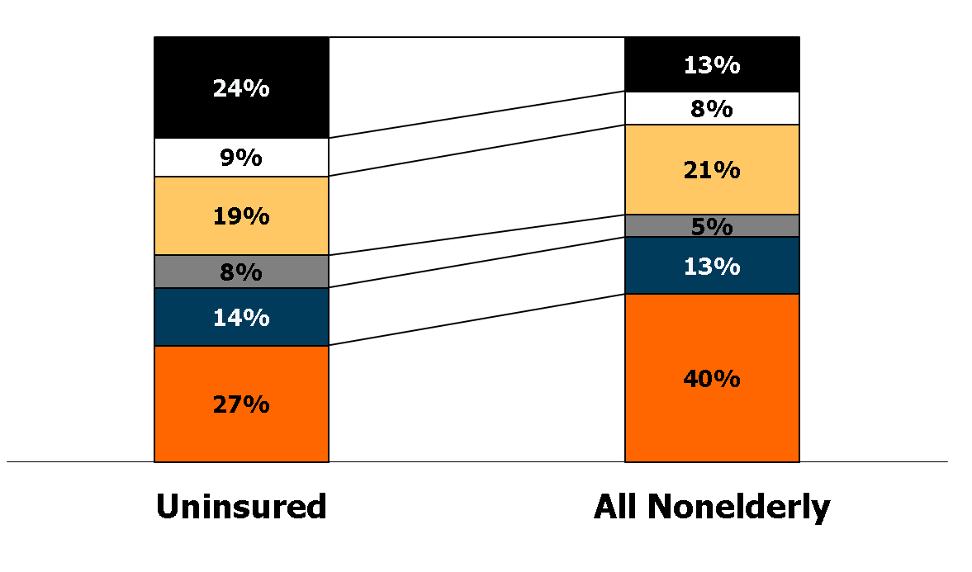
Uninsured Nonelderly vs. All Nonelderly, by Household Type, 2011
Adults, living together
Adults, living alone
Married, no children
Other with children
1 parent with children
2 parents
with children
47.9 Million
266.4 Million
NOTES: Data may not total 100% due to rounding. Other households with children include families with at least three generations in a household, plus families in which adults are caring for children other than their own (e.g., a niece living with her aunt).
SOURCE: KCMU/Urban Institute analysis of 2012 ASEC Supplement to the CPS.

Slide 8
Nonelderly Health Insurance Coverage by Household Type, 2011
Number
Adults, living together
34.0 M
Adults, living alone
20.7 M
Married, no children
56.5 M
Other with children
14.2 M
1 parent with children
35.7 M
2 parents with children
105.4 M
NOTES: Other households with children include families with at least three generations in a household, plus families in which adults are caring for children other than their own (e.g., a niece living with her aunt). Data may not total 100% due to rounding.
SOURCE: KCMU/Urban Institute analysis of 2012 ASEC Supplement to the CPS.

Slide 9
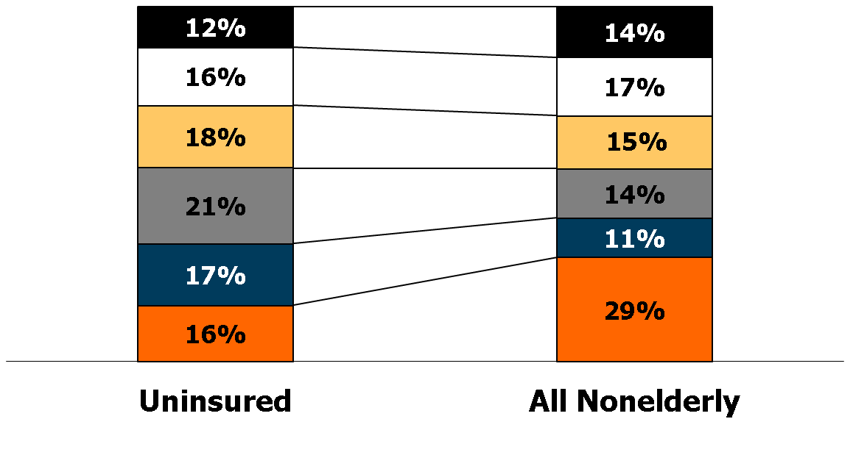
Uninsured Nonelderly vs. All Nonelderly, by Age Group, 2011
55 - 64
45 - 54
35 - 44
26 - 34
19 - 25
Under 19
47.9 Million
266.4 Million
NOTES: Data may not total 100% due to rounding.
SOURCE: KCMU/Urban Institute analysis of 2012 ASEC Supplement to the CPS.

Slide 10
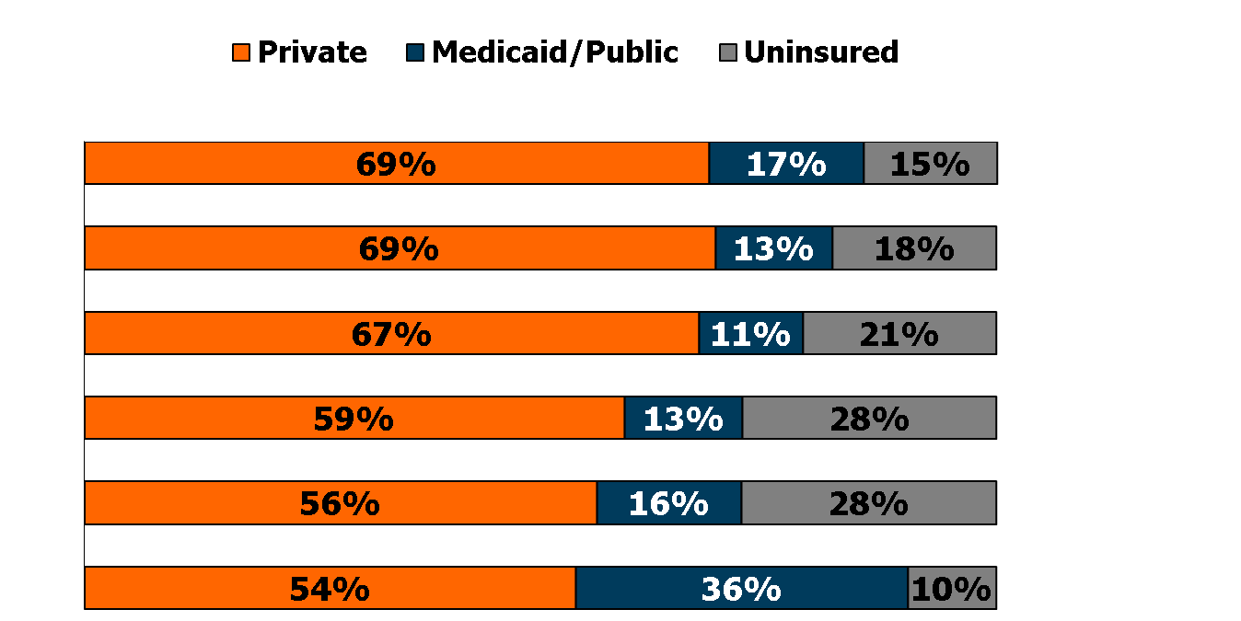
Nonelderly Health Insurance Coverage by Age Group, 2011
Number
55 - 64
38.0M
45 - 54
43.9 M
35 - 44
39.7 M
26 - 34
36.8 M
19 - 25
29.7 M
Under 19
78.4 M
NOTES: Data may not total 100% due to rounding.
SOURCE: KCMU/Urban Institute analysis of 2012 ASEC Supplement to the CPS.

Slide 11
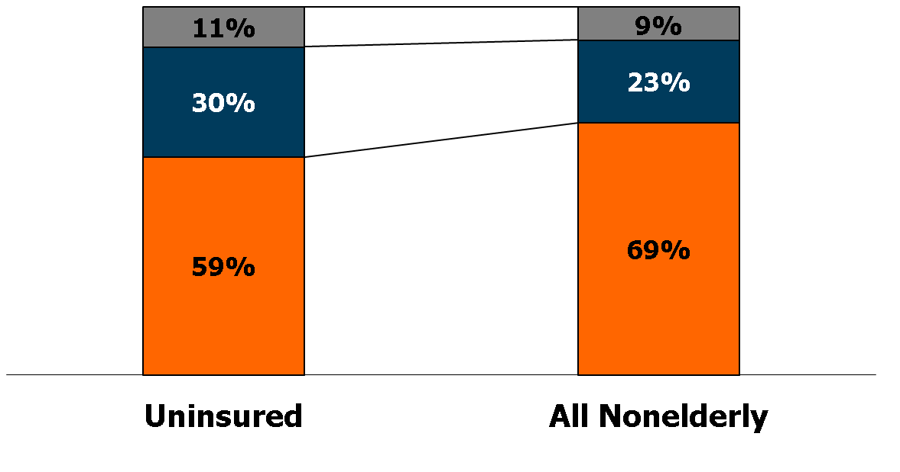
Uninsured Nonelderly vs. All Nonelderly, by Health Status, 2011
Fair or Poor
Good
Excellent or
very good
47.9 Million
266.4 Million
NOTES: Data may not total 100% due to rounding.
SOURCE: KCMU/Urban Institute analysis of 2012 ASEC Supplement to the CPS.

Slide 12
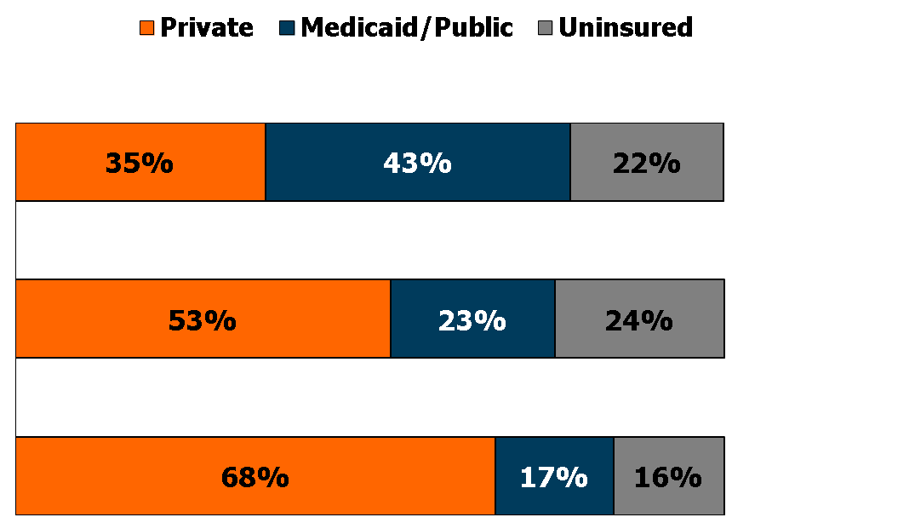
Nonelderly Health Insurance Coverage by Health Status, 2011
Number
Fair or poor
24.0 M
Good
60.0 M
Excellent or
very good
182.4 M
NOTES: Data may not total 100% due to rounding.
SOURCE: KCMU/Urban Institute analysis of 2012 ASEC Supplement to the CPS.

Slide 13
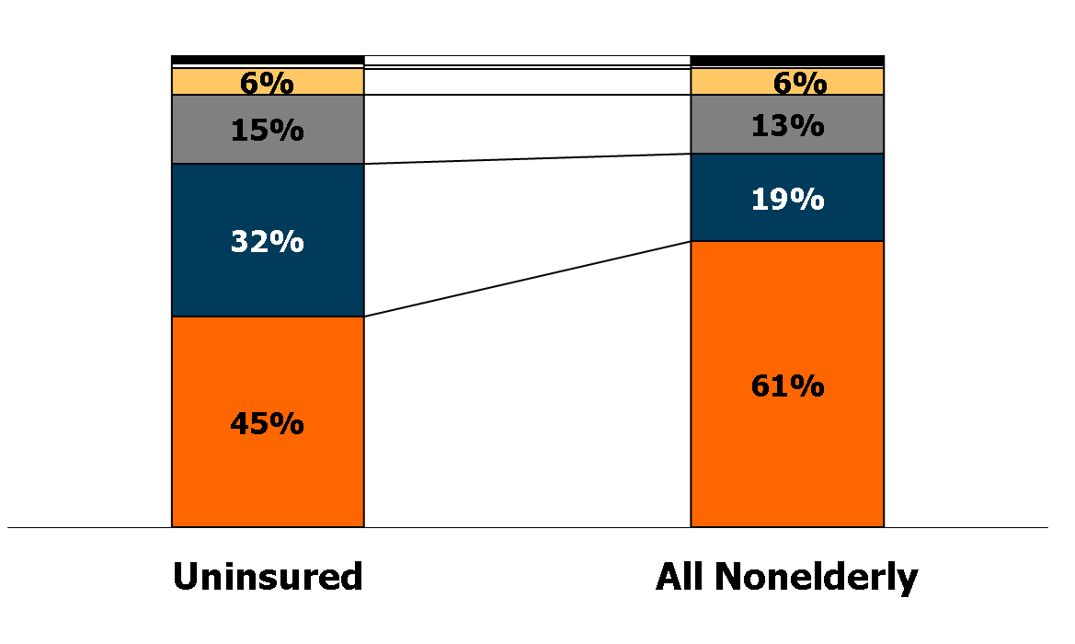
Uninsured Nonelderly vs. All Nonelderly, by Race and Ethnicity, 2011
Multiracial (2%)
American Indian (1%)
2%
Asian
1%
Black
Hispanic
White
47.9 Million
266.4 Million
NOTES: Data may not total 100% due to rounding. American Indian category includes Aleutian Eskimos. Asian includes South Pacific Islander.
SOURCE: KCMU/Urban Institute analysis of 2012 ASEC Supplement to the CPS.

Slide 14
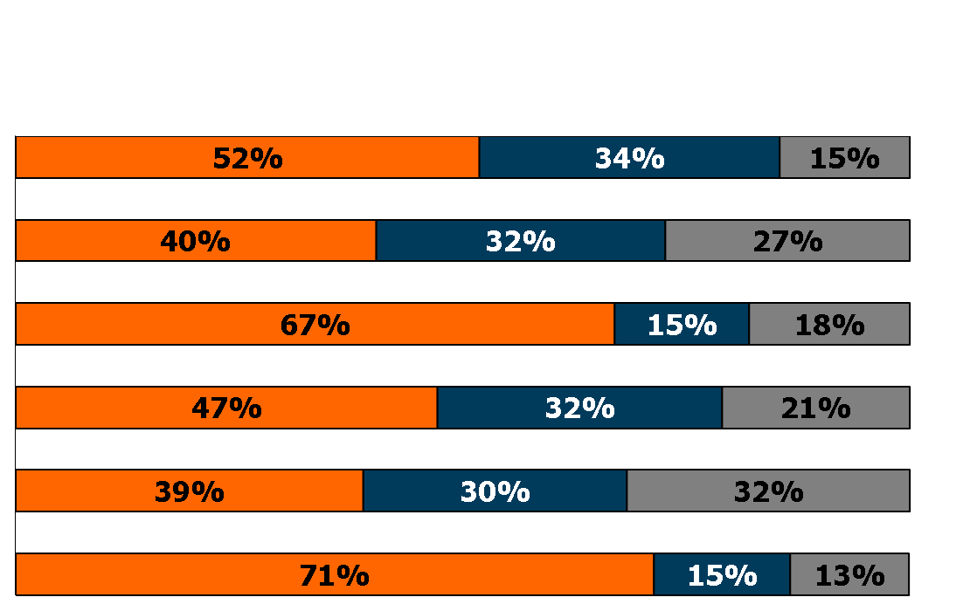
Nonelderly Health Insurance Coverage by Race and Ethnicity, 2011
Private Medicaid/Public Uninsured
Number
Multiracial
5.6 M
American Indian
1.9 M
Asian
14.7 M
Black
33.5 M
Hispanic
49.2 M
White
161.6 M
NOTES: Data may not total 100% due to rounding. American Indian category includes Aleutian Eskimos. Asian includes South Pacific Islander.
SOURCE: KCMU/Urban Institute analysis of 2012 ASEC Supplement to the CPS.

Slide 15
Uninsured Nonelderly vs. All Nonelderly, by Citizenship Status, 2011
Non-citizen
0-4 years
Non-citizen
5 or more years
U.S. citizen
47.9 Million
266.4 Million
SOURCE: Kaiser Commission on Medicaid and the Uninsured/Urban Institute analysis of 2012 ASEC Supplement to the CPS.

Slide 16
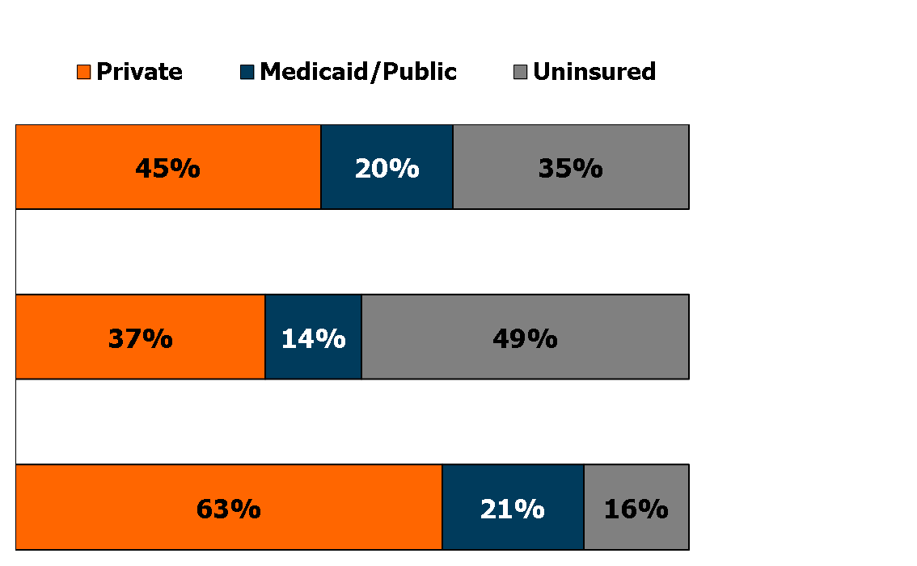
Nonelderly Health Insurance Coverage by Citizenship Status, 2011
Number
Non-citizen
0-4 years
3.9 M
Non-citizen
5 years or more
16.8 M
U.S. citizen
245.7 M
NOTES: Data may not total 100% due to rounding.
SOURCE: KCMU/Urban Institute analysis of 2012 ASEC Supplement to the CPS.

Slide 17
Uninsured Rates Among Nonelderly
by State, 2010-2011
NH
WA
VT
ME
MT
ND
OR
MN
MA
SD
WI
NY
ID
MI
RI
WY
PA
CT
NE
IA
NJ
NV
IL
IN
OH
DE
UT
CO
WV
VA
MD
CA
KS
MO
KY
NC
DC
OK
TN
SC
AZ
NM
AR
MS
AL
GA
AK
TX
LA
FL
HI
<14% Uninsured (13 states & DC)
National Average = 18.2%
14 to 18% Uninsured (20 states)
>18% Uninsured (17 states)
SOURCE: KCMU/Urban Institute analysis of 2011 and 2012 ASEC Supplement to the CPS (two-year pooled data).

Slide 18
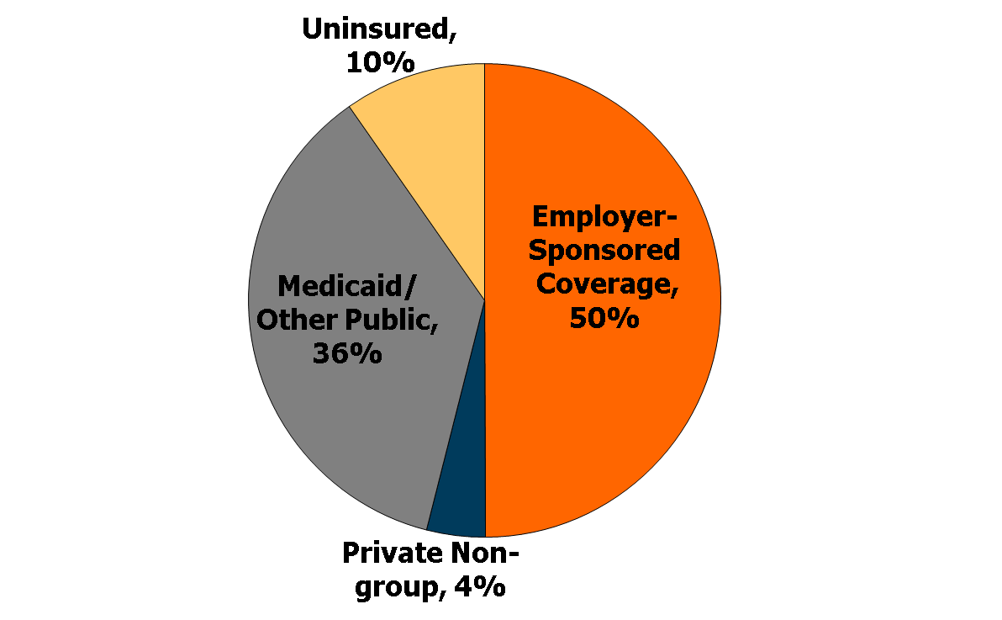
Health Insurance Coverage of
Children, 2011
78.4 Million Children
NOTES: Data may not total 100% due to rounding. Children includes all individuals under age 19.
SOURCE: KCMU/Urban Institute analysis of 2012 ASEC Supplement to the CPS.

Slide 19
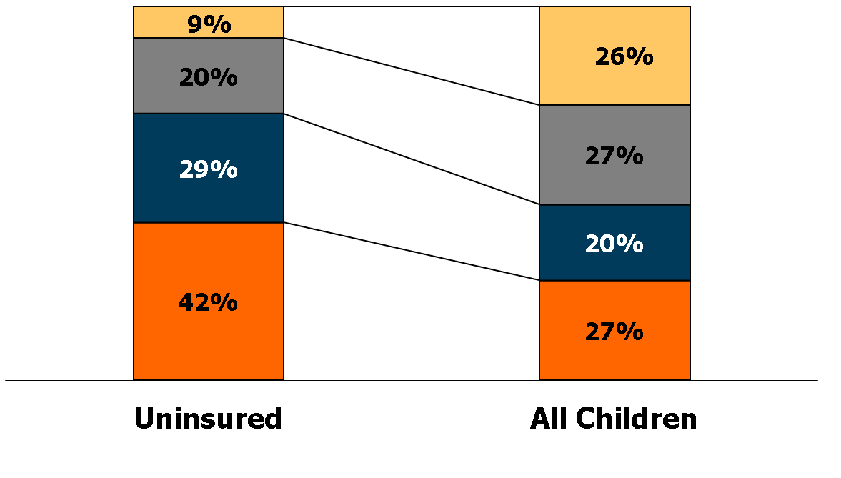
Uninsured Children vs. All Children, by Family Poverty Level, 2011
400% +
200-399%
100-199%
Under 100%
7.6 Million
78.4 Million
NOTES: The Federal Poverty Level for a family of four in 2011 was $22,350 (according to the HHS poverty threshold).
Children includes all individuals under age 19.
SOURCE: KCMU/Urban Institute analysis of 2012 ASEC Supplement to the CPS.

Slide 20
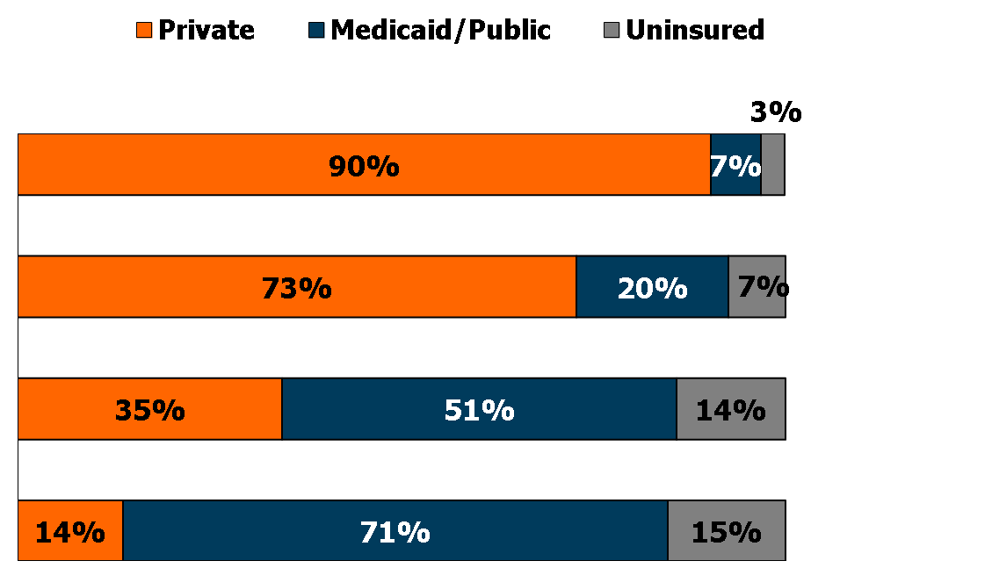
Children’s Health Insurance Coverage by Family Poverty Level, 2011
Number
400% +
20.7 M
200% - 399%
20.9 M
100% - 199%
15.8 M
Under 100%
21.0 M
NOTES: The Federal Poverty Level for a family of four in 2011 was $22,350 (according to the HHS poverty threshold).
Children includes all individuals under age 19.
SOURCE: KCMU/Urban Institute analysis of 2012 ASEC Supplement to the CPS.

Slide 21
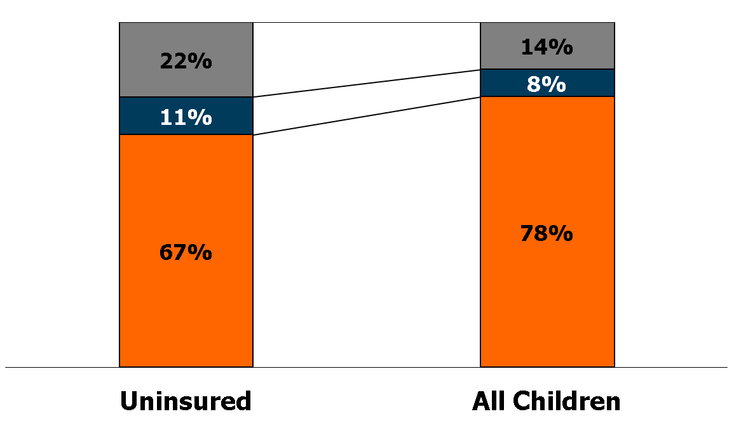
Uninsured Children vs. All Children, by Family Work Status, 2011
No workers
Only part-time
One or two full-time workers
7.6 Million
78.4 Million
NOTES: Data may not total 100% due to rounding. Children includes all individuals under age 19.
SOURCE: KCMU/Urban Institute analysis of 2012 ASEC Supplement to the CPS.

Slide 22
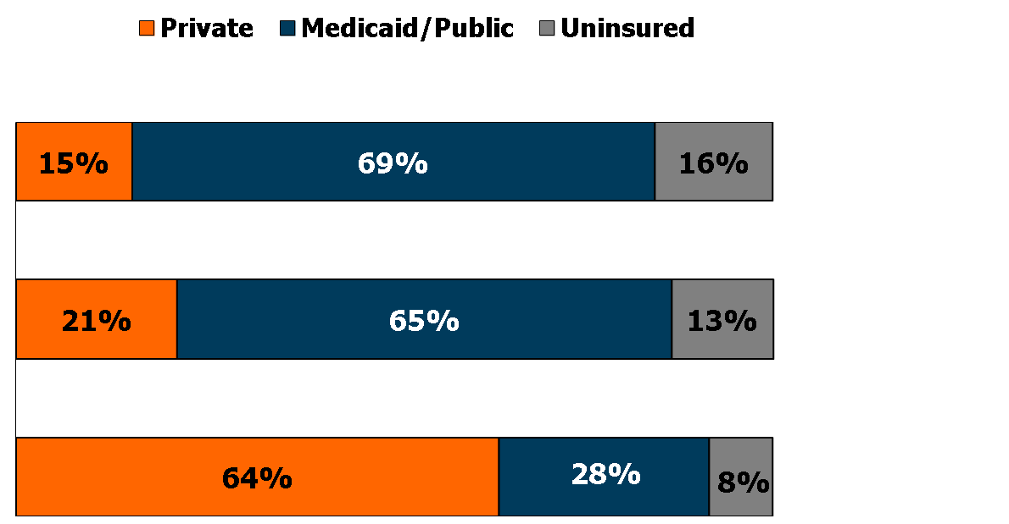
Children’s Health Insurance Coverage by Family Work Status, 2011
Number
No workers
10.7 M
Only part-time
6.2 M
One or two full-time
workers
61.5 M
NOTES: Children includes all individuals under age 19.
SOURCE: KCMU/Urban Institute analysis of 2012 ASEC Supplement to the CPS.

Slide 23
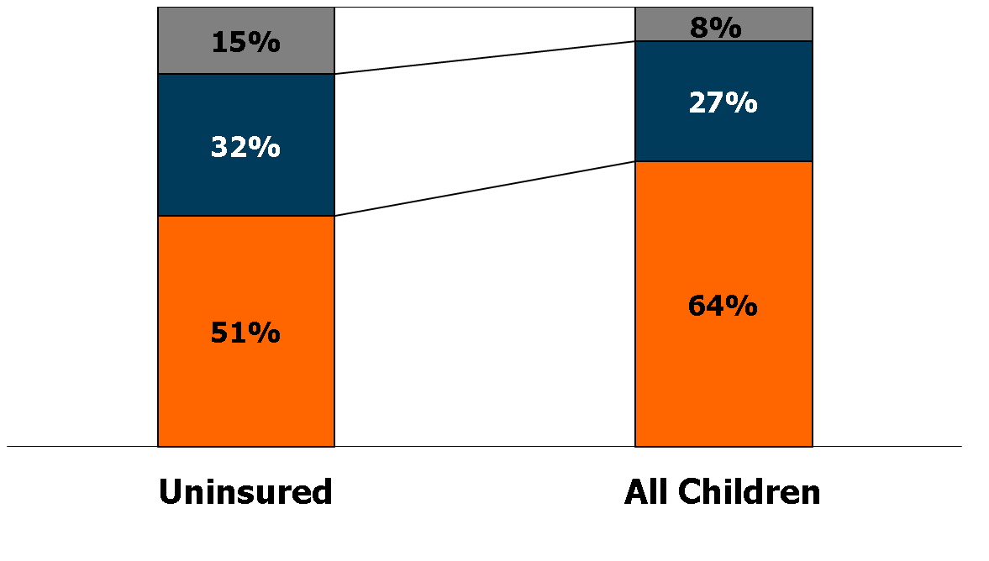
Uninsured Children vs. All Children,
by Household Type, 2011
Multigenerational/ Other
1 Parent
2 Parents
7.6 Million
78.4 Million
NOTES: Children includes all individuals under age 19. Approximately 1% of children and 3% of uninsured children live in households with no adult. These are not shown in the above chart.
SOURCE: KCMU/Urban Institute analysis of 2012 ASEC Supplement to the CPS.

Slide 24
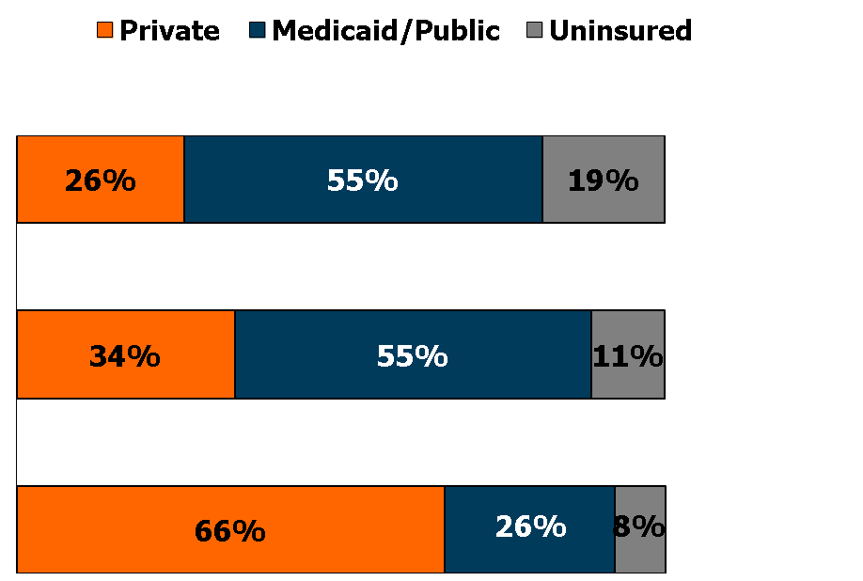
Children’s Health Insurance Coverage by
Household Type, 2011
Number
Multigenerational/ Other
6.1 M
1 Parent
21.3 M
2 Parents
50.3 M
NOTES: Data may not total 100% due to rounding. Children includes all individuals under age 19. Approximately 1% of children and 3% of uninsured children live in households with no adult. These are not shown in the above chart.
SOURCE: KCMU/Urban Institute analysis of 2012 ASEC Supplement to the CPS.

Slide 25
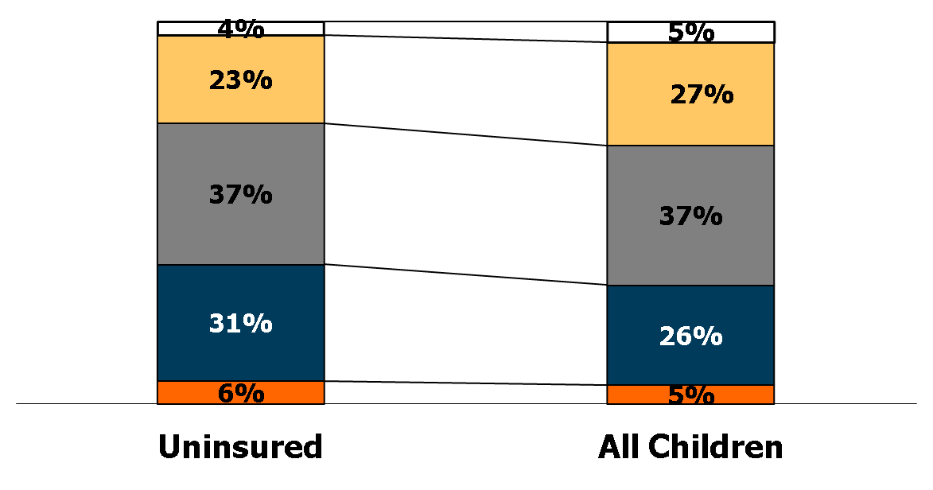
Uninsured Children vs. All Children, by Age Group, 2011
18
13 - 17
6 - 12
1 - 5
<1
7.6 Million
78.4 Million
NOTES: Data may not total 100% due to rounding. Children includes all individuals under age 19.
SOURCE: KCMU/Urban Institute analysis of 2012 ASEC Supplement to the CPS.

Slide 26
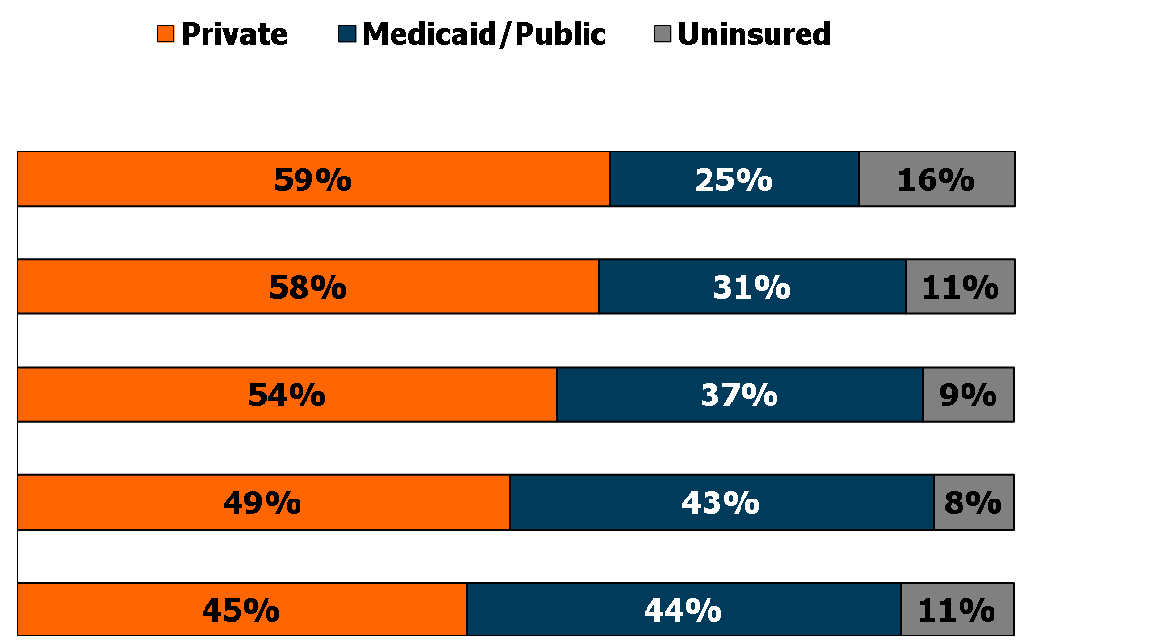
Children’s Health Insurance Coverage by Age Group, 2011
Number
18
4.3 M
13 - 17
21.2 M
6 - 12
28.6 M
1 - 5
20.4 M
<1
3.9 M
NOTES: Data may not total 100% due to rounding. Children includes all individuals under age 19.
SOURCE: KCMU/Urban Institute analysis of 2012 ASEC Supplement to the CPS.

Slide 27
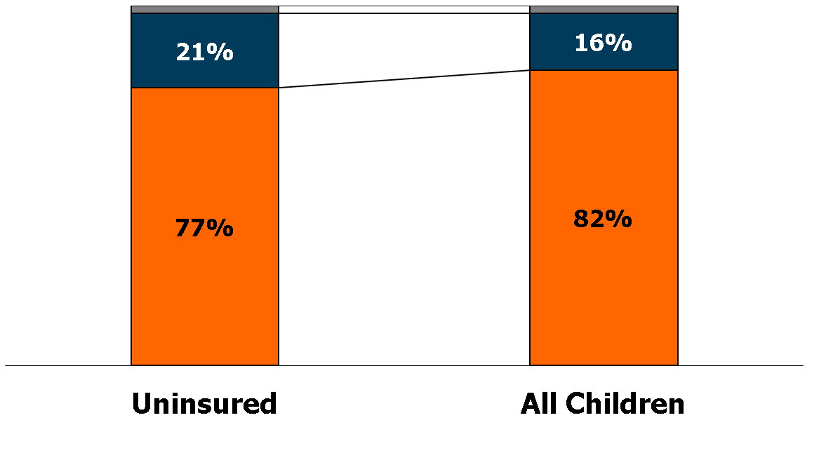
Uninsured Children vs. All Children, by Health Status, 2011
Fair or Poor (2%)
2%
Good
Excellent or
very good
7.6 Million
78.4 Million
NOTES: Children includes all individuals under age 19.
SOURCE: KCMU/Urban Institute analysis of 2012 ASEC Supplement to the CPS.

Slide 28
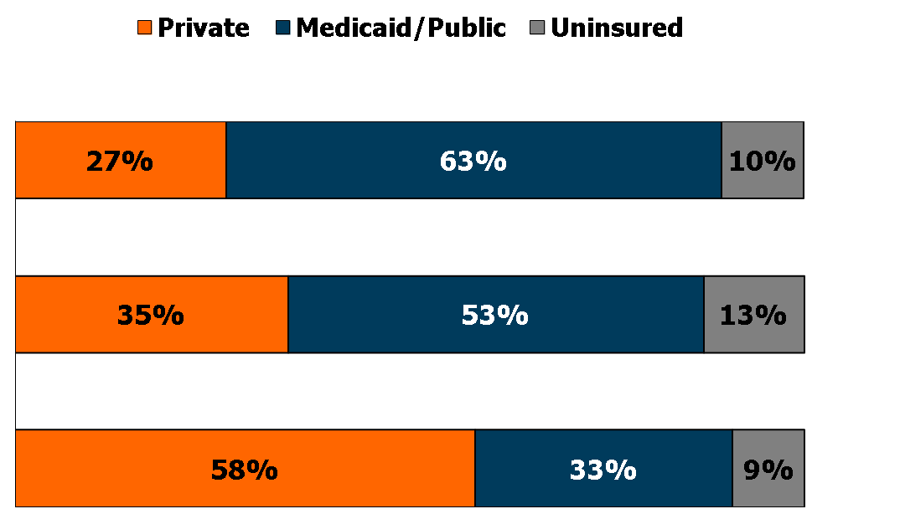
Children’s Health Insurance Coverage by Health Status, 2011
Number
Fair or poor
1.7 M
Good
12.3 M
Excellent or
very good
64.4 M
NOTES: Data may not total 100% due to rounding. Children includes all individuals under age 19.
SOURCE: KCMU/Urban Institute analysis of 2012 ASEC Supplement to the CPS.

Slide 29
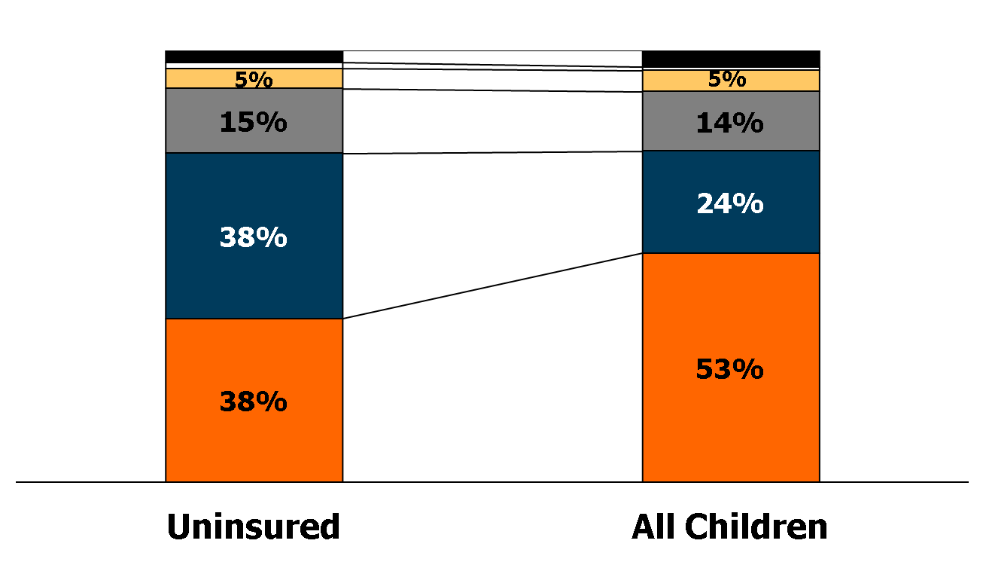
Uninsured Children vs. All Children, by Race and Ethnicity, 2011
Multiracial (3%)
4%
Am. Indian (1%)
Asian
1%
Black
Hispanic
White
7.6 Million
78.4 Million
NOTES: Children includes all individuals under age 19. American Indian category includes Aleutian Eskimos. Asian includes South Pacific Islander. Data may not total 100% due to rounding.
SOURCE: KCMU/Urban Institute analysis of 2012 ASEC Supplement to the CPS.

Slide 30
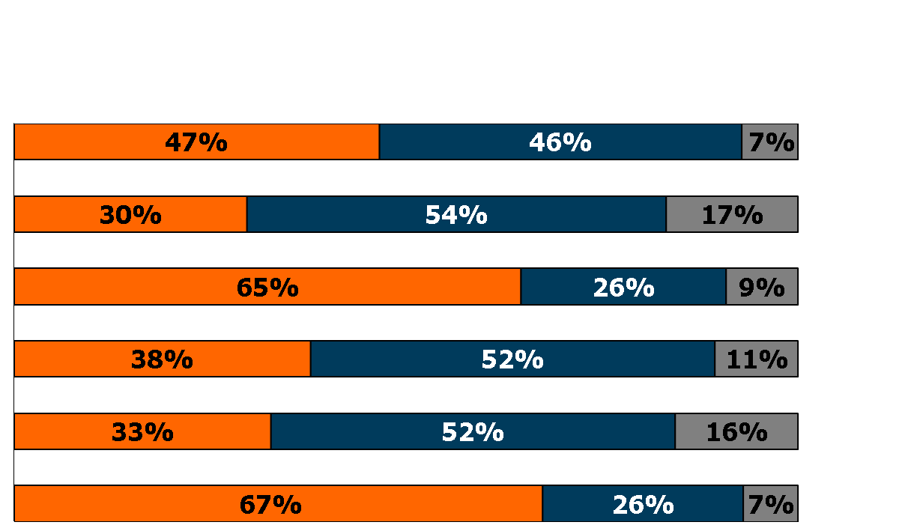
Children’s Health Insurance Coverage by Race and Ethnicity, 2011
Private Medicaid/Public Uninsured
Number
Multiracial
3.0 M
Am. Indian
0.6 M
Asian
3.9 M
Black
10.8 M
Hispanic
18.6 M
White
41.5 M
NOTES: Children includes all individuals under age 19. American Indian category includes Aleutian Eskimos. Asian includes South Pacific Islander. Data may not total 100% due to rounding.
SOURCE: KCMU/Urban Institute analysis of 2012 ASEC Supplement to the CPS.

Slide 31
Uninsured Children vs. All Children, by Citizenship Status, 2011
1%
Non-citizen
0-4 years
Non-citizen
5 or more years
U.S. citizen
7.6 Million
78.4 Million
NOTES: Children includes all individuals under age 19. Data may not total 100% due to rounding.
SOURCE: KCMU/Urban Institute analysis of 2012 ASEC Supplement to the CPS.

Slide 32
Children’s Health Insurance Coverage by Citizenship Status, 2011
Number
Non-citizen
0-4 years
0.8 M
Non-citizen
5 or more years
1.4 M
U.S. citizen
76.2 M
NOTES: Children includes all individuals under age 19. Data may not total 100% due to rounding.
SOURCE: KCMU/Urban Institute analysis of 2012 ASEC Supplement to the CPS.

Slide 33
Uninsured Rates for Children by State, 2010-2011
NH
WA
VT
ME
MT
ND
OR
MN
NY
MA
ID
SD
WI
RI
WY
MI
CT
IA
PA
NJ
NE
OH
NV
IL
IN
WV
DE
UT
CO
VA
MD
CA
KS
MO
KY
TN
NC
DC
OK
SC
AZ
NM
AR
MS
AL
GA
TX
LA
AK
FL
HI
< 9% (27 states and DC)
US Average = 9.9%
9-12% (16 states)
> 12% (7 states)
NOTES: Children includes all individuals under age 19.
SOURCE: KCMU/Urban Institute analysis of 2011 and 2012 ASEC Supplement to the CPS (two-year pooled data).

Slide 34
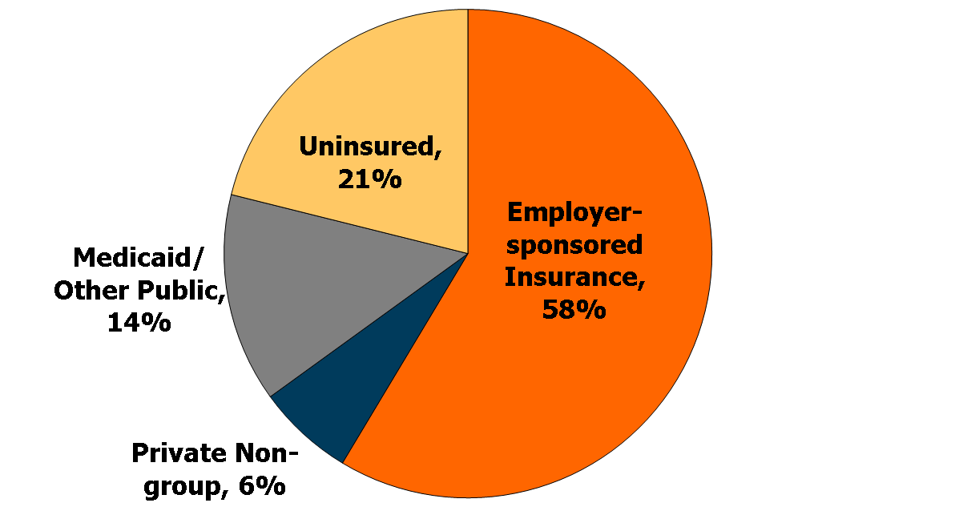
Health Insurance Coverage of
Nonelderly Adults, 2011
188.0 Million Nonelderly Adults
NOTES: Adults includes all individuals aged 19 to 64. Data may not total 100% due to rounding.
SOURCE: KCMU/Urban Institute analysis of 2012 ASEC Supplement to the CPS.

Slide 35
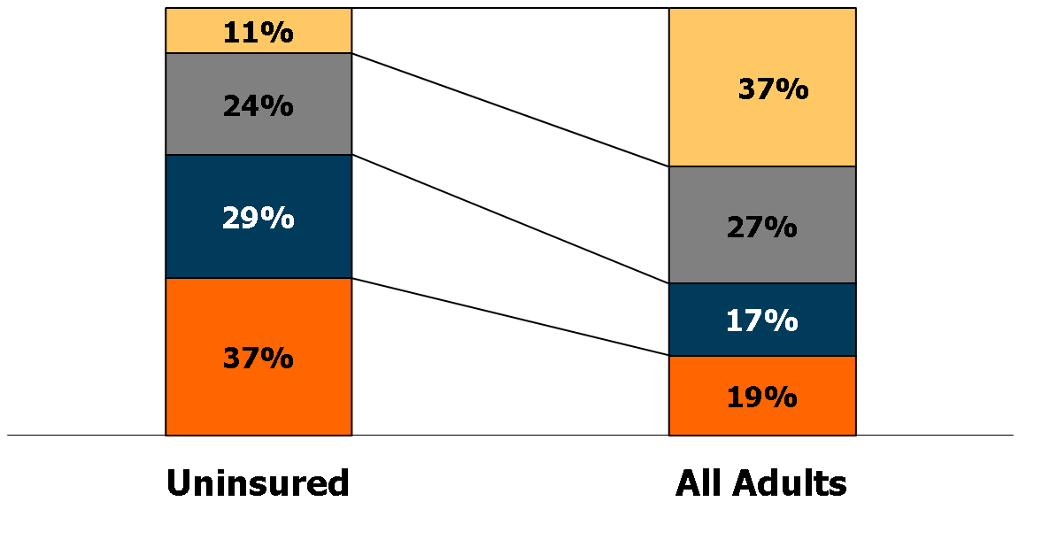
Uninsured Adults vs. All Adults, by Family Poverty Level, 2011
400% +
200-399%
100-199%
Under 100%
40.3 Million
188.0 Million
NOTES: The Federal Poverty Level for a family of four in 2011 was $22,350. Adults includes all individuals aged 19-64.
Data may not total 100% due to rounding.
SOURCE: KCMU/Urban Institute analysis of 2012 ASEC Supplement to the CPS.

Slide 36
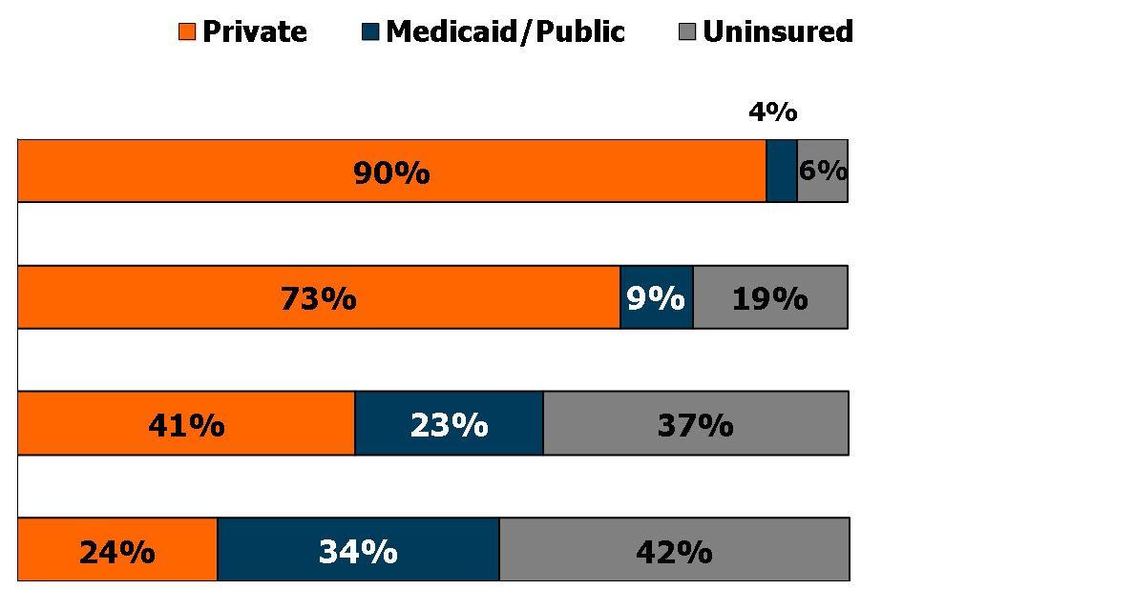
Adults’ Health Insurance Coverage by Family Poverty Level, 2011
Number
400% +
69.8 M
200-399%
51.2 M
100-199%
31.6 M
Under 100%
35.4 M
NOTES: The Federal Poverty Level for a family of four in 2011 was $22,350. Adults includes all individuals aged 19-64.
Data may not total 100% due to rounding.
SOURCE: KCMU/Urban Institute analysis of 2012 ASEC Supplement to the CPS.

Slide 37
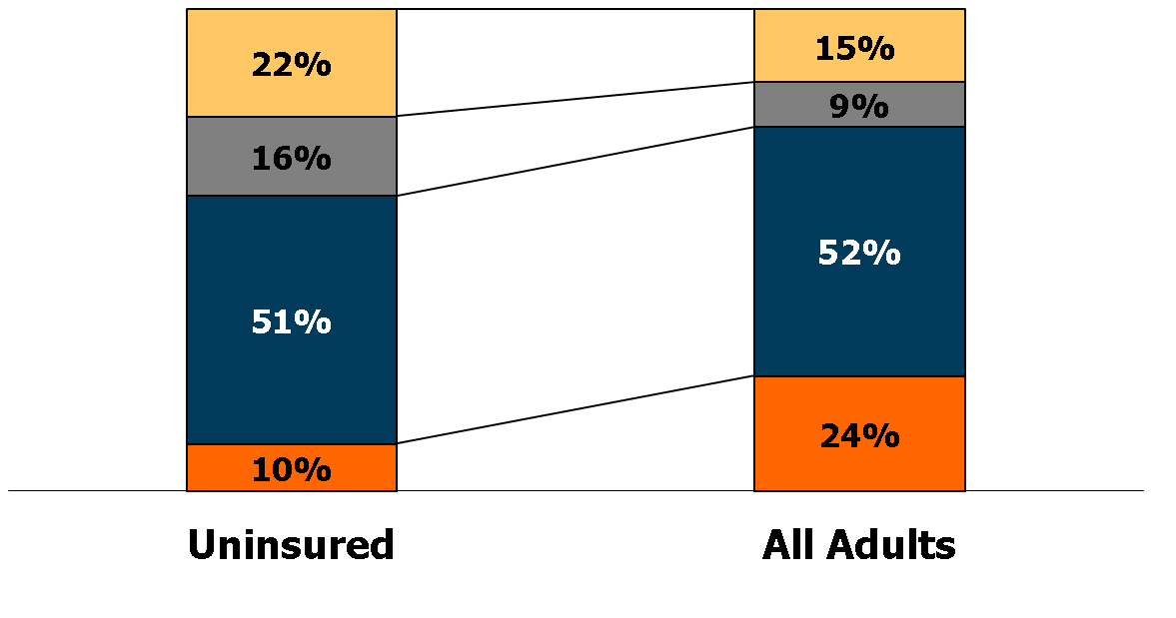
Uninsured Adults vs. All Adults, by Family Work Status, 2011
Non-workers
Only part-time
One full-time worker
Two full-time workers
40.3 Million
188.0 Million
NOTES: Adults includes all individuals aged 19 to 64. Data may not total 100% due to rounding.
SOURCE: KCMU/Urban Institute analysis of 2012 ASEC Supplement to the CPS.

Slide 38
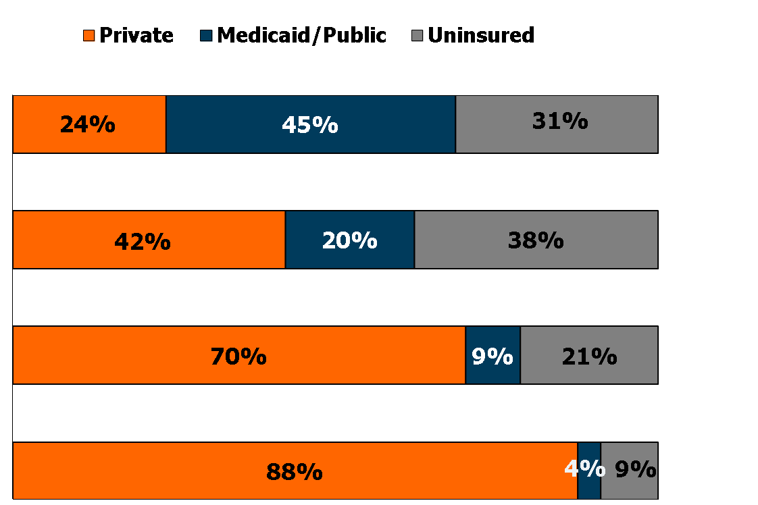
Adults' Health Insurance Coverage by Family Work Status, 2011
Number
No workers
28.6 M
Only part-time
17.5 M
One full-time
worker
97.0 M
Two full-time
workers
44.9 M
NOTES: Adults includes all individuals aged 19 to 64. Data may not total 100% due to rounding.
SOURCE: KCMU/Urban Institute analysis of 2012 ASEC Supplement to the CPS.

Slide 39
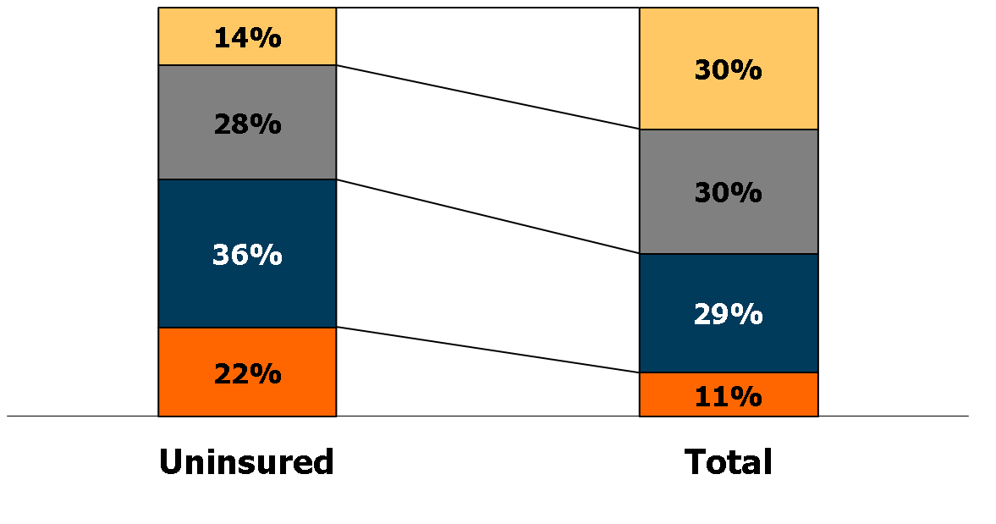
Uninsured Adults vs. All Adults, by Education, 2011
College graduate
Some college
High school graduate
Less than
high school
40.3 Million
188.0 Million
NOTES: “Some college” category includes respondents with an associate’s degree. Adults includes all individuals aged 19 to 64. Data may not total 100% due to rounding.
SOURCE: KCMU/Urban Institute analysis of 2012 ASEC Supplement to the CPS.

Slide 40
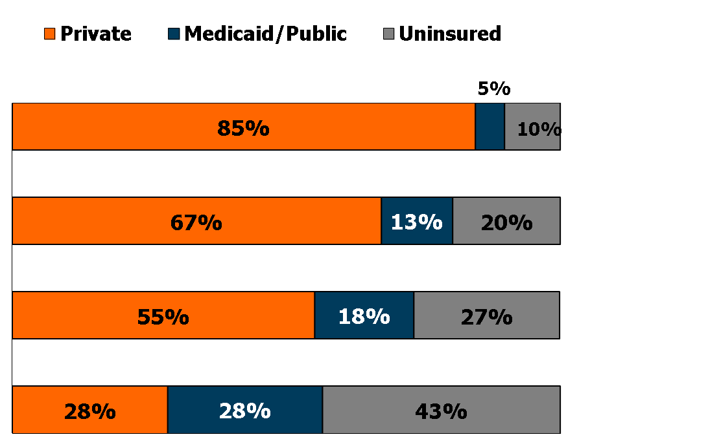
Adults' Health Insurance Coverage by Education, 2011
Number
College graduate
55.8 M
Some college
57.2 M
High school graduate
54.7 M
Less than
high school
20.4 M
NOTES: “Some college” category includes respondents with an associate’s degree. Adults includes all individuals aged 19 to 64. Data may not total 100% due to rounding.
SOURCE: KCMU/Urban Institute analysis of 2012 ASEC Supplement to the CPS.

Slide 41
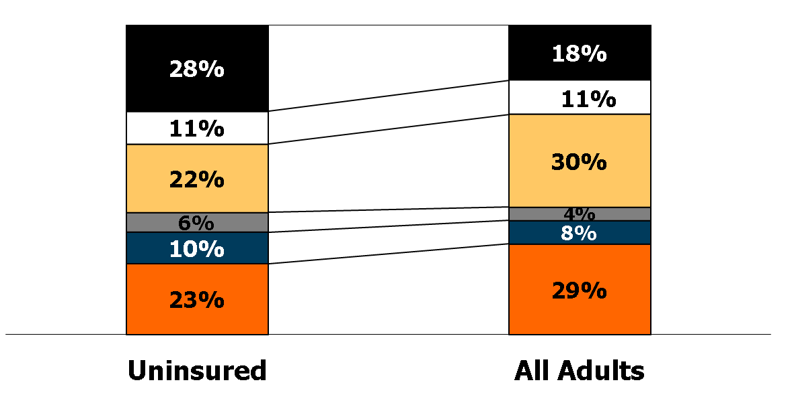
Uninsured Adults vs. All Adults, by Household Type, 2011
Adults, living together
Adults, living alone
Married, no children
Other with children
1 parent with children
2 parents with children
40.3 Million
188.0 Million
NOTES: Other households with children include families with at least three generations in a household, plus families in which adults are caring for children other than their own (e.g., a niece living with her aunt). Adults includes all individuals aged 19 to 64. Data may not total 100% due to rounding.
SOURCE: KCMU/Urban Institute analysis of 2012 ASEC Supplement to the CPS.

Slide 42
Adults' Health Insurance Coverage by Household Type, 2011
Number
33.4 M
Adults, living together
20.7 M
Adults, living alone
Married, no children
56.4 M
8.1 M
Other with children
1 parent with children
14.3 M
2 parents with children
55.1 M
NOTES: Other households with children include families with at least three generations in a household, plus families in which adults are caring for children other than their own (e.g., a niece living with her aunt). Adults includes all individuals aged 19 to 64. Data may not total 100% due to rounding.
SOURCE: KCMU/Urban Institute analysis of 2012 ASEC Supplement to the CPS.

Slide 43
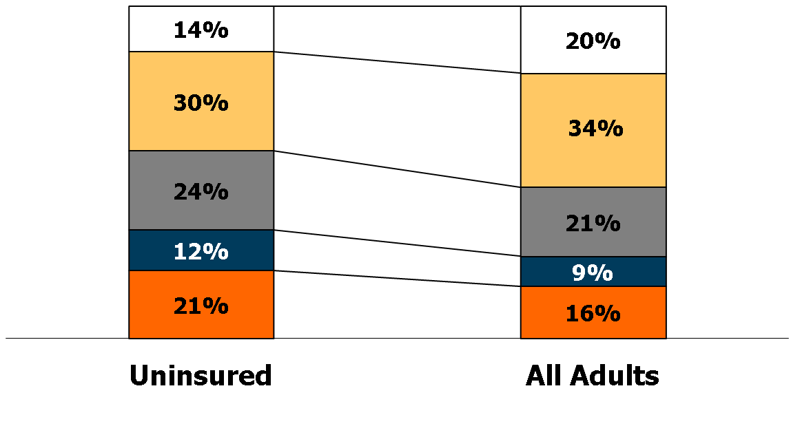
Uninsured Adults vs. All Adults, by Age Group, 2011
55 - 64
40 - 54
30 - 39
26 - 29
19 - 25
40.3 Million
188.0 Million
NOTES: Adults includes all individuals aged 19 to 64. Data may not total 100% due to rounding.
SOURCE: KCMU/Urban Institute analysis of 2012 ASEC Supplement to the CPS.

Slide 44
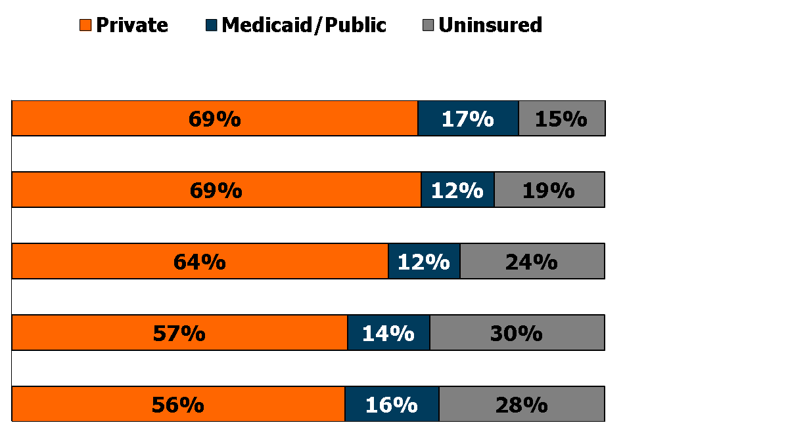
Adults' Health Insurance Coverage by Age Group, 2011
Number
55 - 64
38.0 M
40 - 54
64.5 M
30 - 39
39.2 M
26 - 29
16.7 M
19 - 25
29.7 M
NOTES: Adults includes all individuals aged 19 to 64. Data may not total 100% due to rounding.
SOURCE: KCMU/Urban Institute analysis of 2012 ASEC Supplement to the CPS.

Slide 45
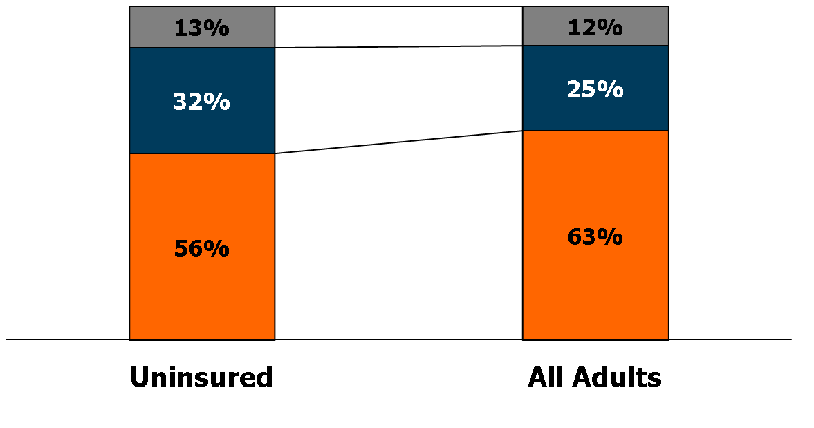
Uninsured Adults vs. All Adults, by Health Status, 2011
Fair or Poor
Good
Excellent or
very good
40.3 Million
188.0 Million
NOTES: Adults includes all individuals aged 19 to 64. Data may not total 100% due to rounding.
SOURCE: KCMU/Urban Institute analysis of 2012 ASEC Supplement to the CPS.

Slide 46
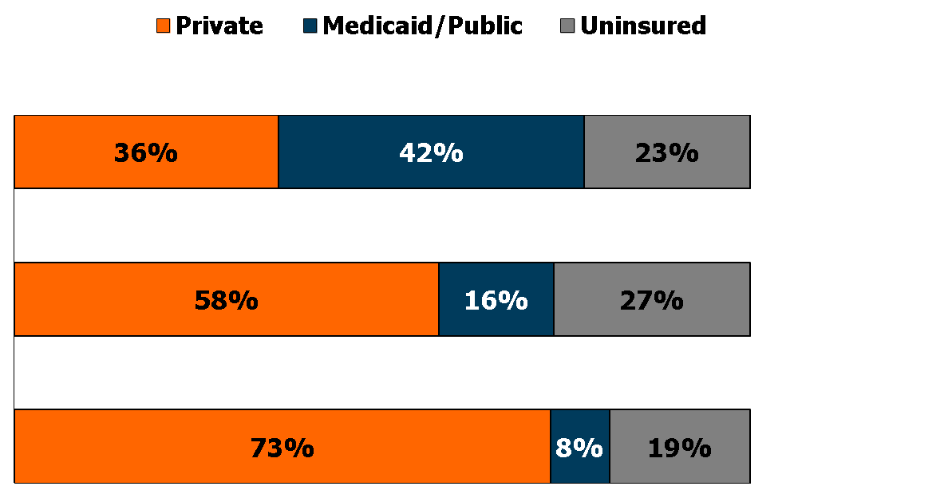
Adults' Health Insurance Coverage by Health Status, 2011
Number
Fair or poor
22.3 M
Good
47.7 M
Excellent or
very good
118.0 M
NOTES: Adults includes all individuals aged 19 to 64. Data may not total 100% due to rounding.
SOURCE: KCMU/Urban Institute analysis of 2012 ASEC Supplement to the CPS.

Slide 47
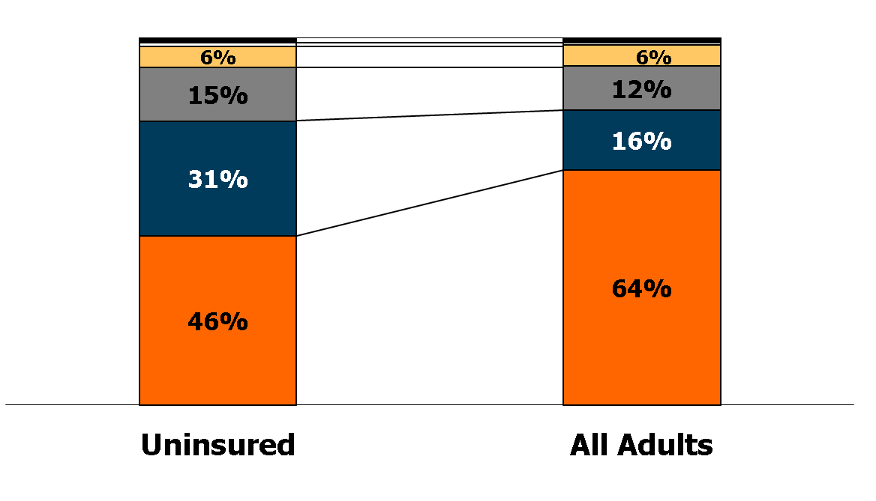
Uninsured Adults vs. All Adults, by Race and Ethnicity, 2011
Multiracial (2%)
1%
Am. Indian (1%)
Asian
1%
Black
Hispanic
White
40.3 Million
188.0 Million
NOTES: American Indian category includes Aleutian Eskimos. Adults includes all individuals aged 19 to 64.
Data may not total 100% due to rounding.
SOURCE: KCMU/Urban Institute analysis of 2012 ASEC Supplement to the CPS.

Slide 48
Adults' Health Insurance Coverage by Race and Ethnicity, 2011
Number
Multiracial
2.6 M
Am. Indian
1.3 M
Asian
10.8 M
Black
22.7 M
Hispanic
30.6 M
White
120.0 M
NOTES: American Indian category includes Aleutian Eskimos. Adults includes all individuals aged 19 to 64. Asian includes South Pacific Islander. Data may not total 100% due to rounding.
SOURCE: KCMU/Urban Institute analysis of 2012 ASEC Supplement to the CPS.

Slide 49
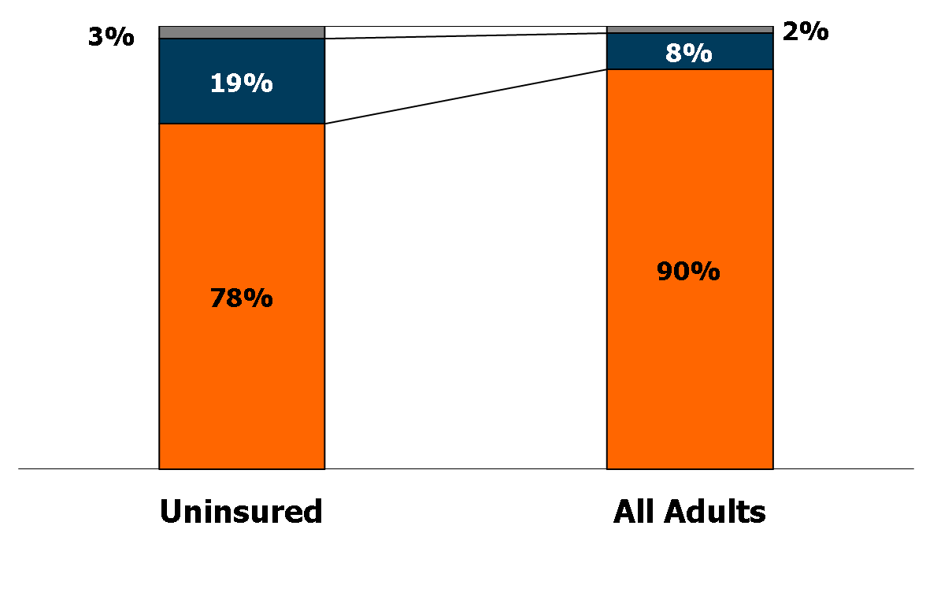
Uninsured Adults vs. All Adults, by Citizenship Status, 2011
Non-citizen
less than 5 years
Non-citizen
5 or more years
U.S. citizen
40.3 Million
188.0 Million
NOTES: Adults includes all individuals aged 19 to 64. Data may not total 100% due to rounding.
SOURCE: KCMU/Urban Institute analysis of 2012 ASEC Supplement to the CPS.

Slide 50
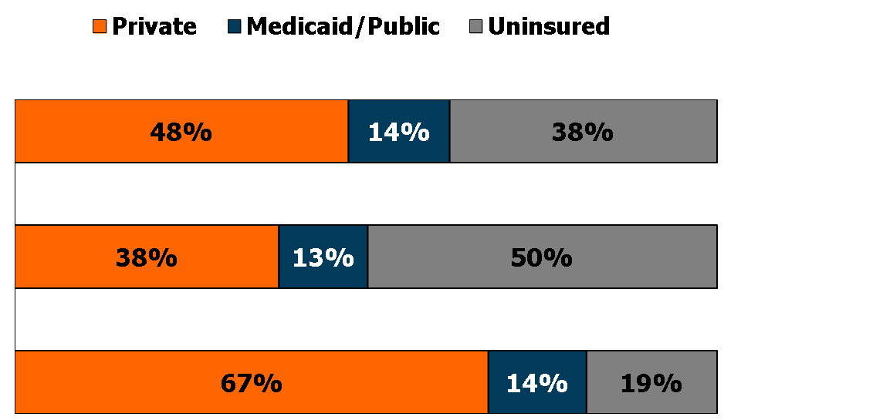
Adults' Health Insurance Coverage by Citizenship Status, 2011
Number
Non-citizen
0-4 years
3.0 M
Non-citizen
5+ years
15.4 M
U.S. citizen
169.5 M
NOTES: Adults includes all individuals aged 19 to 64. Data may not total 100% due to rounding.
SOURCE: KCMU/Urban Institute analysis of 2012 ASEC Supplement to the CPS.

Slide 51
Uninsured Rates Among Adults
by State, 2010-2011
NH
WA
VT
ME
MT
ND
OR
MN
MA
SD
WI
NY
ID
MI
RI
WY
PA
CT
IA
NJ
NV
NE
IL
IN
OH
DE
UT
CO
WV
VA
MD
CA
KS
MO
KY
NC
DC
OK
TN
SC
AZ
NM
AR
MS
AL
GA
AK
TX
LA
FL
HI
<16% Uninsured (12 states and DC)
National Average = 21.7%
16- 20% Uninsured (17 states)
>20% Uninsured (21 states)
NOTES: Adults includes all individuals aged 19 to 64.
SOURCE: KCMU/Urban Institute analysis of 2011 and 2012 ASEC Supplement to the CPS (two-year pooled data).

Slide 52
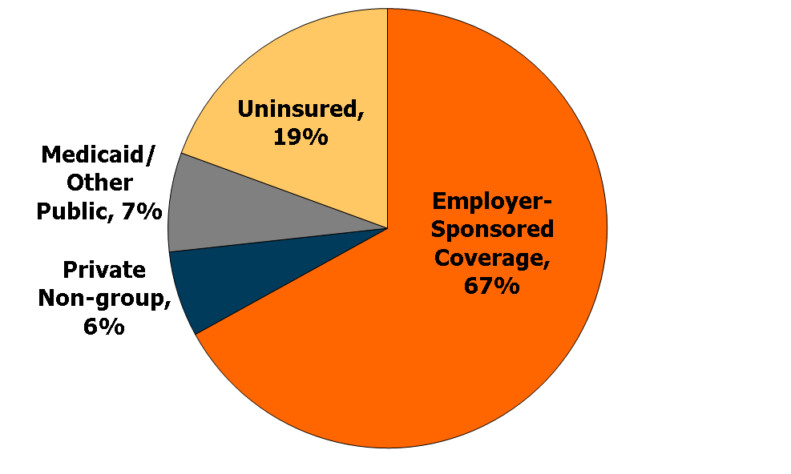
Health Insurance Coverage of
Workers, 2011
143.3 Million Workers
NOTES: Workers includes all workers aged 18-64.
SOURCE: KCMU/Urban Institute analysis of 2012 ASEC Supplement to the CPS.

Slide 53
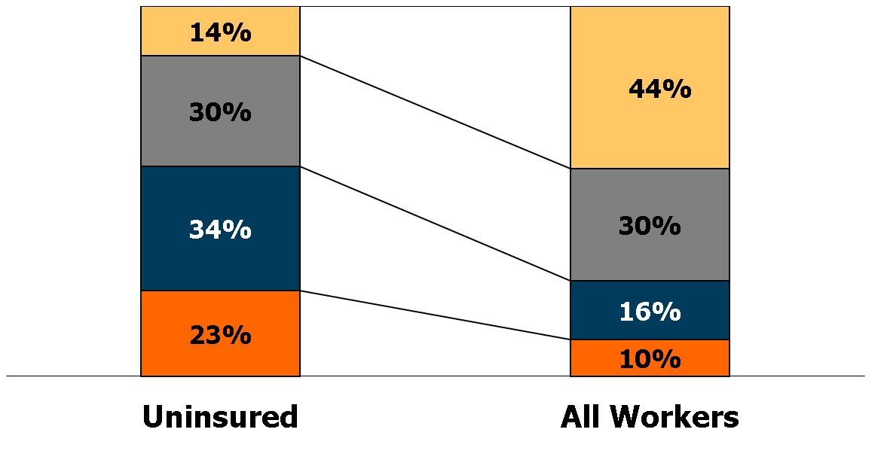
Uninsured Workers vs. All Workers, by Family Poverty Level, 2011
400% +
200% - 399%
100% - 199%
Under 100%
27.9 Million
143.3 Million
NOTES: The Federal Poverty Level for a family of four in 2011 was $22,350. Workers includes all workers aged 18-64.
Data may not total 100% due to rounding.
SOURCE: KCMU/Urban Institute analysis of 2012 ASEC Supplement to the CPS.

Slide 54
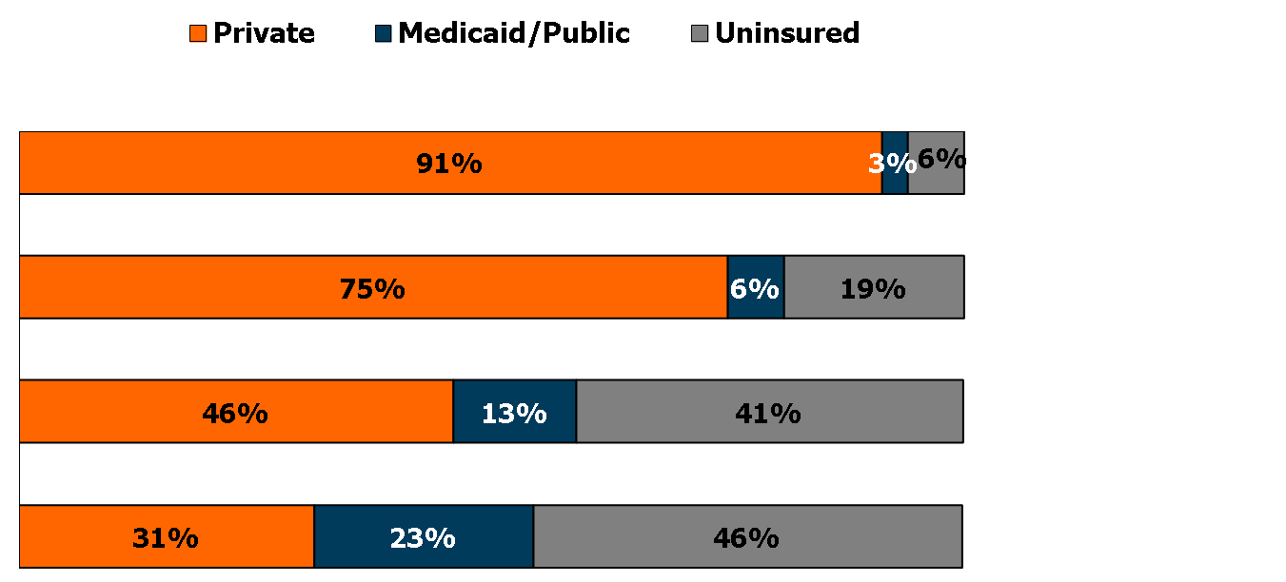
Workers’ Health Insurance Coverage by Family Poverty Level, 2011
Number
400% +
62.9 M
200% - 399%
43.4 M
100% - 199%
22.9 M
Under 100%
14.1 M
NOTES: The Federal Poverty Level for a family of four in 2011 was $22,350. Workers includes all workers aged 18-64.
SOURCE: KCMU/Urban Institute analysis of 2012 ASEC Supplement to the CPS.

Slide 55
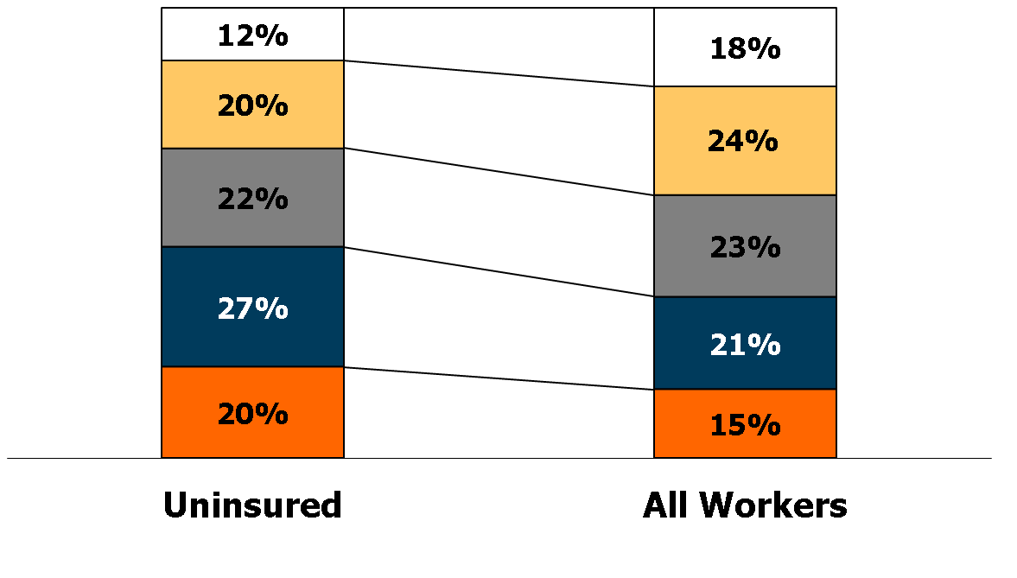
Uninsured Workers vs. All Workers, by Age Group, 2011
55 - 64
45 - 54
35 - 44
26 - 34
18 - 25
27.9 Million
143.3 Million
NOTES: Workers includes all workers aged 18-64. Data may not total 100% due to rounding.
SOURCE: KCMU/Urban Institute analysis of 2012 ASEC Supplement to the CPS.

Slide 56
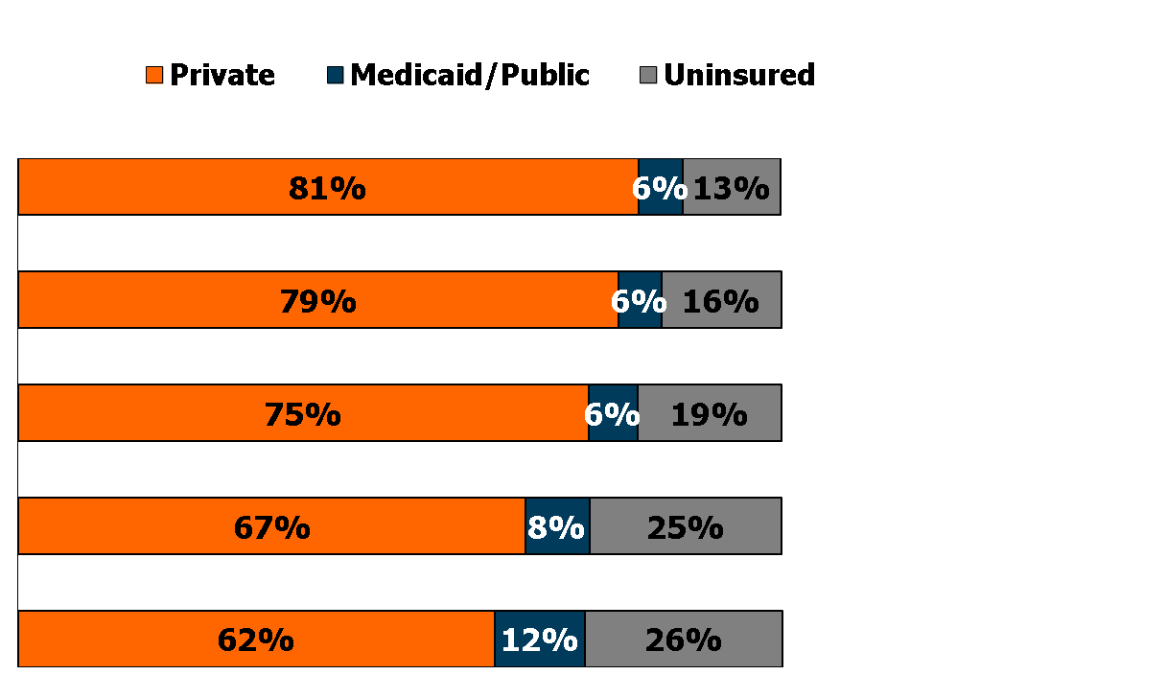
Workers' Health Insurance Coverage by Age Group, 2011
Number
55 - 64
25.1 M
45 - 54
34.6 M
35 - 44
32.2 M
26 - 34
29.5 M
18 - 25
21.9 M
NOTES: Workers includes all workers aged 18-64. Data may not total 100% due to rounding.
SOURCE: KCMU/Urban Institute analysis of 2012 ASEC Supplement to the CPS.

Slide 57
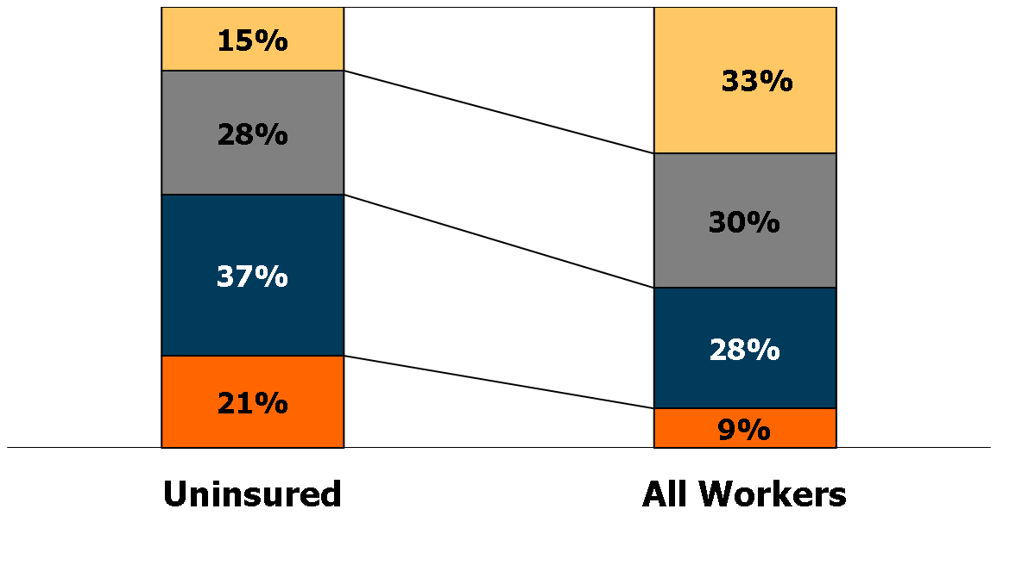
Uninsured Workers vs. All Workers, by Education, 2011
College graduate
Some college
High school graduate
Less than high school
27.9 Million
143.3 Million
NOTES: Some college category includes respondents with an associate’s degree. Workers includes all workers
aged 18-64. Data may not total 100% due to rounding.
SOURCE: KCMU/Urban Institute analysis of 2012 ASEC Supplement to the CPS.

Slide 58
Workers' Health Insurance Coverage by Education, 2011
Number
College graduate
47.5 M
Some college
43.6 M
High school graduate
39.5 M
Less than
high school
12.7 M
NOTES: Some college category includes respondents with an associate’s degree. Workers includes all workers
aged 18-64. Data may not total 100% due to rounding.
SOURCE: KCMU/Urban Institute analysis of 2012 ASEC Supplement to the CPS.

Slide 59
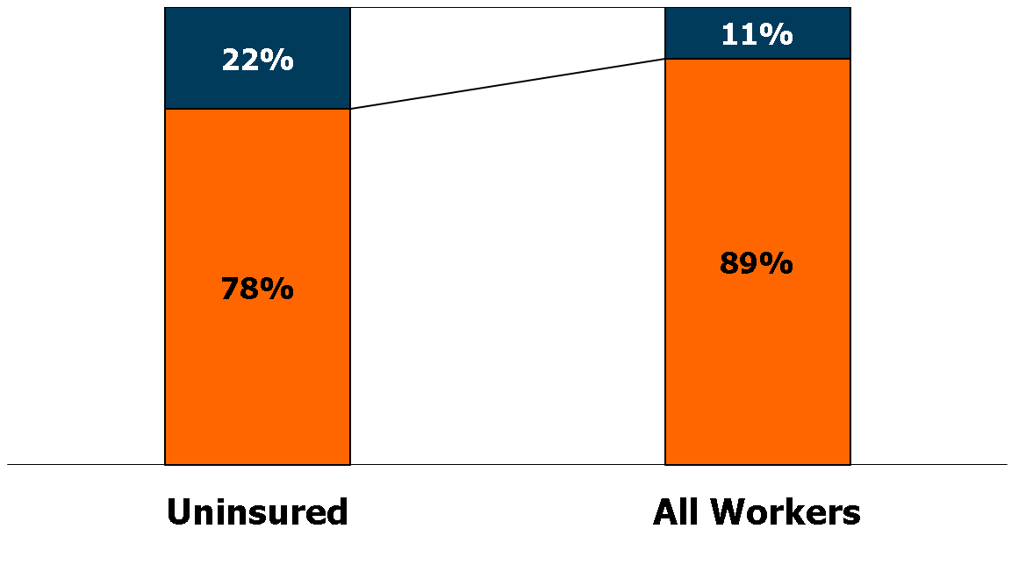
Uninsured Workers vs. All Workers, by Family Work Status, 2011
Only part-time
or no workers
One or two
full-time workers
27.9 Million
143.3 Million
NOTES: Workers includes all workers aged 18-64.
SOURCE: KCMU/Urban Institute analysis of 2012 ASEC Supplement to the CPS.

Slide 60
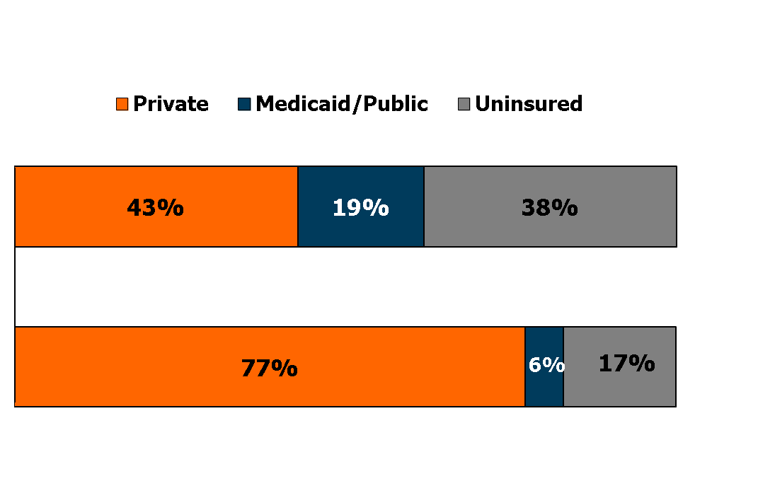
Workers' Health Insurance Coverage by Family Work Status, 2011
Number
Only
part-time
16.3 M
One or two
full-time
workers
127.0 M
NOTES: Workers includes all workers aged 18-64. Data may not total 100% due to rounding.
SOURCE: KCMU/Urban Institute analysis of 2012 ASEC Supplement to the CPS.

Slide 61

Uninsured Workers vs. All Workers, by Race and Ethnicity, 2011
Multiracial (2%)
Am. Indian (1%)
1%
Asian
1%
Black
Hispanic
White
27.9 Million
143.3 Million
NOTES: American Indian category includes Aleutian Eskimos. Asian includes South Pacific Islander. Workers includes
all workers aged 18-64.
SOURCE: KCMU/Urban Institute analysis of 2012 ASEC Supplement to the CPS.

Slide 62
Workers' Health Insurance Coverage by Race and Ethnicity, 2011
Number
Multiracial
2.0 M
Am. Indian
0.8 M
Asian
7.8 M
Black
15.5 M
Hispanic
22.4 M
White
94.8 M
NOTES: American Indian category includes Aleutian Eskimos. Asian includes South Pacific Islander. Workers includes all workers aged 18-64. Data may not total 100% due to rounding.
SOURCE: KCMU/Urban Institute analysis of 2012 ASEC Supplement to the CPS.

Slide 63

Uninsured Workers vs. All Workers, by Citizenship Status, 2011
Non-citizen
in US for 0-4 years
Non-citizen
in US for 5 or
more years
U.S. citizen
27.9 Million
143.3 Million
NOTES: Workers includes all workers aged 18-64. Data may not total 100% due to rounding.
SOURCE: KCMU/Urban Institute analysis of 2012 ASEC Supplement to the CPS.

Slide 64

Workers' Health Insurance Coverage by Citizenship Status, 2011
Number
Non-citizen in US
for 5 years or more
11.4 M
Non-citizen in US
for 0-4 years
1.8 M
U.S. citizen
130.1 M
NOTES: Workers includes all workers aged 18-64.
SOURCE: KCMU/Urban Institute analysis of 2012 ASEC Supplement to the CPS.

Slide 65
Uninsured Workers vs. All Workers, by Firm Size, 2011
Firm Size
Public Sector
1,000 +
500 - 999
100 - 499
25-99
Self-employed
27.9 Million
143.3 Million
NOTES: Workers includes all workers aged 18-64. Self-employed includes only self-employed in firms with less than 25
workers. Of the self-employed with private coverage, approximately 90% work in firms with less than 10 employees.
SOURCE: KCMU/Urban Institute analysis of 2012 ASEC Supplement to the CPS.

Slide 66

Workers' Health Insurance Coverage by Firm Size, 2011
Firm Size
Number
Public Sector
20.8 M
1,000 +
43.1 M
500 - 999
6.0 M
100 - 499
15.5 M
25-99
45.7 M
Self-employed
12.1 M
NOTES: Workers includes all workers aged 18-64. Self-employed includes only self-employed in firms with less than 25
workers. SOURCE: KCMU/Urban Institute analysis of 2012 ASEC Supplement to the CPS.

Slide 67

Uninsured Workers vs. All Workers, by Occupation, 2011
Blue Collar
White Collar
27.9 Million
143.3 Million
NOTES: Workers includes all workers aged 18-64.
SOURCE: KCMU/Urban Institute analysis of 2012 ASEC Supplement to the CPS.

Slide 68

Workers' Health Insurance Coverage by Occupation, 2011
Number
Blue collar
88.0 M
White collar
55.3 M
NOTES: Workers includes all workers aged 18-64.
SOURCE: KCMU/Urban Institute analysis of 2012 ASEC Supplement to the CPS.

Slide 69

Workers' Health Insurance Coverage by Industry, 2011
Number
Public admin.
6.8 M
Information/ education
16.2 M
Finance
9.4 M
Mining/
manufacturing
15.6 M
Health/
19.3 M
social services
Utilities,
7.1 M
transportation
Professional and business services
16.3 M
Wholesale and
20.1 M
retail trade
Construction
9.7 M
Services
20.8 M
Agriculture
2.0 M
NOTES: Data may not total 100% due to rounding. Workers includes all workers aged 18-64. “Information/Education” category includes communications. “Services” includes arts and entertainment.
SOURCE: KCMU/Urban Institute analysis of 2012 ASEC Supplement to the CPS.

Slide 70
Uninsured Rates Among Selected Industry Groups,
White vs. Blue Collar Jobs, 2011
Information/Education/
Communication
(11% of jobs)
Health/Soc Services
(13%)
Mining/Manufacturing
(11%)
Services/Arts
Entertainment (15%)
Wholesale/Retail
(14%)
Uninsured Rate for
All Workers = 19%
NOTES: Workers includes all workers aged 18-64. White collar workers include all professionals and managers;
all other workers classified as blue collar.
SOURCE: KCMU/Urban Institute analysis of 2012 ASEC Supplement to the CPS.

Slide 71
Uninsured Rates Among Workers
by State, 2010-2011
NH
WA
VT
ME
MT
ND
OR
MN
MA
SD
WI
NY
ID
MI
RI
WY
PA
CT
IA
NJ
NV
NE
IL
IN
OH
DE
UT
CO
WV
VA
MD
CA
KS
MO
KY
NC
DC
OK
TN
SC
AZ
NM
AR
MS
AL
GA
AK
TX
LA
FL
HI
<17% Uninsured (21 states & DC)
National Average = 20%
17 - 21% Uninsured (13 states)
> 21% Uninsured (16 states)
NOTES: Workers includes all workers aged 18-64.
SOURCE: KCMU/Urban Institute analysis of 2011 and 2012 ASEC Supplement to the CPS (two-year pooled data).

