Slide 1
What Are the Prescription Drug Provisions in the Inflation Reduction Act?
Juliette Cubanski, Meredith Freed, and Tricia Neuman
September 2022

Slide 2
Americans Are Concerned
About the Cost of Prescription Drugs
83% of adults think the cost of prescription drugs is unreasonable
29% say in the last year, they have not taken prescription medicines as directed because of costs
26% of adults say it is very difficult for them to afford to pay for their prescription drugs
SOURCE: KFF, “Public Opinion on Prescription Drugs and Their Prices,” April 2022.

Slide 3
Prescription Drug Provisions in the Inflation Reduction Act
For the first time, requires the federal government to negotiate prices for some top-selling drugs covered under Medicare
Requires drug companies to pay rebates if prices rise faster than inflation for drugs used by Medicare beneficiaries
Eliminates 5% coinsurance for catastrophic coverage in Medicare Part D in 2024, adds a $2,000 cap on Part D out-of-pocket spending in 2025, and limits annual increases in Part D premiums for 2024-2030
Limits monthly cost sharing for insulin products to $35 for people with Medicare
Expands eligibility for Medicare Part D Low-Income Subsidy full benefits
Eliminates cost sharing for adult vaccines covered under Medicare Part D and improves access to adult vaccines under Medicaid and CHIP
Further delays implementation of the Trump Administration’s drug rebate rule

Slide 4
Implementation Timeline of the Prescription Drug Provisions in the Inflation Reduction Act
2023
2024
2025
2026
2027
2028
2029
Requires drug companies to pay rebates if drug prices rise faster than inflation
Eliminates 5% coinsurance
for Part D catastrophic coverage
Adds $2,000 out-of-pocket cap in Part D and other drug benefit changes
Implements negotiated prices for certain high-cost drugs:
•10 Medicare Part D drugs
•15 Medicare Part D drugs
•15 Medicare Part B and Part D drugs
•20 Medicare Part B and Part D drugs
Limits insulin copays to $35/month in Part D
Expands
eligibility
for Part D
Low-Income Subsidy full benefits up to 150% FPL
Further delays implementation of the Trump Administration’s drug rebate rule to 2032
Reduces costs and improves coverage for
adult vaccines in Medicare Part D, Medicaid & CHIP
2024-2030: Limits Medicare Part D premium growth to no more than 6% per year

Slide 5
Requires the Secretary of HHS to Negotiate Medicare Drug Prices
Modifies the current law “non-interference” clause to require the HHS Secretary to negotiate drug price with manufacturers for some drugs covered under Medicare Part B and Part D
Which drugs qualify for negotiation?
The Secretary selects drugs to be negotiated from the 50 “negotiation-eligible” drugs with the highest total Medicare Part D spending and the 50 “negotiation-eligible” drugs with the highest total Medicare Part B spending
“Negotiation eligible drugs” include brand-name drugs or biologics and exclude the following drugs:
Drugs that have a generic or biosimilar available
Drugs less than 9 years (for small-molecule drugs) or 13 years (for biological products) from their FDA-approval or licensure date
Certain “small biotech drugs” (from 2026 to 2028)
Drugs that account for Medicare spending of less than $200 million in 2021
Drugs with an orphan designation as the only FDA-approved indication
Which drugs are excluded from negotiation?
How many drugs will be subject to negotiation?
The number of drugs subject to price negotiation will be 10 Part D drugs for 2026,
15 Part D drugs for 2027, 15 Part D and Part B drugs for 2028, and
20 Part D and Part B drugs for 2029 and later years
The number of drugs with negotiated prices available will accumulate over time

Slide 6
Establishing the Negotiated “Maximum Fair Price” for Medicare
The upper limit for the negotiated price of a drug (the “maximum fair price”) is equal to the lower of:
The drug’s enrollment-weighted negotiated price (net of all price concessions) for a Part D drug;
The average sales price for a Part B drug; or
A percentage of the non-federal average manufacturer price (i.e., the average price wholesalers pay manufacturers for drugs distributed to non-federal purchasers), depending on FDA approval date:
  75% for small-molecule drugs more than 9 years but less than 12 years beyond FDA approval;
  65% for drugs between 12 and 16 years beyond FDA approval; and
  40% for drugs more than 16 years beyond FDA approval
Financial penalties would be imposed on drug manufacturers for non-compliance
An excise tax would be imposed on prior year sales of a given drug for manufacturers that do not negotiate with the Secretary, starting at 65%, increasing by 10% every quarter up to 95%
  The excise tax would be suspended if manufacturers choose to have their drugs no longer covered by Medicare or Medicaid
A civil monetary penalty would be imposed on drug manufactures for not offering the agreed-upon maximum fair price of up to 10x difference between price charged and negotiated price

Slide 7
Requires Drug Manufacturers to Pay Rebates For Drug Price Increases Above Inflation
Requires drug manufacturers to pay a rebate if drug prices increase faster than the rate of inflation (CPI-U) for:
  Single-source drugs and biologicals covered under Medicare Part B
  All covered drugs under Medicare Part D except those where average annual cost is <$100
2021 is the base year for measuring cumulative price changes relative to inflation
The rebate amount is based on units sold in Medicare multiplied by the amount that a drug’s price in a given year exceeds the inflation-adjusted price
Price changes are measured based on the average sales price (for Part B drugs) or the average manufacturer price (for Part D); these measures include prices charged in the commercial market
Rebates paid by manufacturers would be deposited in the Medicare Supplementary Medical Insurance (SMI) trust fund
Manufacturers that do not pay the required rebate would face a penalty of at least 125% of the original rebate amount

Slide 8
Capping Medicare Part D Out-of-Pocket Spending and
Other Part D Benefit Changes
Changes would lower beneficiary spending, reduce Medicare’s liability for high drug costs, and increase Part D plan and manufacturer liability for high drug costs
Beneficiaries
Medicare
Part D Plans
Drug Companies
Eliminates 5% coinsurance for catastrophic coverage in 2024
Caps out-of-pocket drug spending at $2,000 beginning in 2025
Allows spreading out of out-of-pocket costs over the year
Limits premium growth to no more than 6% per year for 2024-2030
Lowers share of costs above the out-of-pocket spending cap (“reinsurance”)
Increases share of costs above the out-of-pocket spending cap
Modifies share of costs below the out-of-pocket spending cap
Requires a price discount on brand-name drugs above the out-of-pocket spending cap
Modifies the price discount on brands below the out-of-pocket spending cap

Slide 9
Changes to Medicare Part D for Brand-Name Drug Costs
Share of brand-name drug costs paid by: Enrollees Part D Plans Drug manufacturers Medicare
Inflation Reduction Act
Current law: 2023
2024
2025
5% enrollee
0% enrollee
0% enrollee
Catastrophic
coverage
Catastrophic
coverage
OOP spending
threshold
~$3,100
~$3,250
OOP
spending cap
Coverage
gap
$2,000
Initial
coverage
Initial
coverage
Deductible
Deductible
NOTE: OOP is out-of-pocket. The out-of-pocket spending threshold will be $7,400 in 2023 and is projected to be $7,750 in 2024 and $8,100 in 2025, including what beneficiaries pay directly out of pocket and the value of the manufacturer discount on brand-name drugs in the coverage gap phase. These amounts translate to out-of-pocket spending of approximately $3,100, $3,250, and $3,400 (based on brand-name drug use only).

Slide 10
Limits Monthly Copayments for Insulin in Medicare
Beginning in 2023, limits copayments to $35 per month per prescription for covered insulin products in Medicare Part D plans and for insulin furnished through durable medical equipment under Medicare Part B, with no deductible
For 2026 and beyond, limits monthly Part D copayments for insulin to the lesser of:
  $35
  25% of the maximum fair price (in cases where the insulin product has been selected for negotiation)
  25% of the negotiated price in Part D plans

Slide 11
Expands Eligibility for Full Benefits Under the
Medicare Part D Low-Income Subsidy Program
The Part D Low-Income Subsidy (LIS) Program helps beneficiaries with their Part D premiums, deductibles, and cost sharing. Beneficiaries qualify for full or partial benefits depending on their income and resources.
Current law:
  Beneficiaries qualify for full LIS benefits if they have income up to 135% of poverty and lower resources (up to $9,900 individual, $15,600 couple in 2022*)
  Beneficiaries qualify for partial LIS benefits if they have income between 135-150% of poverty and higher resources (up to $15,510 individual, $30,950 couple in 2022*)
Inflation Reduction Act:
  Expands eligibility for full LIS benefits to individuals with incomes between 135% and 150% of poverty and higher resources (at or below the limits for partial LIS benefits), and eliminates the partial LIS benefit
NOTE: *Includes a $1,500 per person allowance for funeral/burial expenses.

Slide 12
Eliminates Cost Sharing for Adult Vaccines in Medicare Part D and Improves Access to Adult Vaccines in Medicaid & CHIP
Medicare Part D
Eliminates cost sharing for adult vaccines covered under Medicare Part D that are recommended by the Advisory Committee on Immunization Practices (ACIP), such as for shingles
Medicaid and CHIP
Requires state Medicaid and CHIP programs to cover all approved vaccines recommended by ACIP and vaccine administration, without cost sharing

Slide 13
Delays Implementation of the Trump Administration’s Rebate Rule
What is the Rebate Rule?
It would eliminate rebates negotiated between drug manufacturers and pharmacy benefit managers (PBMs) or health plan sponsors in Medicare Part D by removing the safe harbor protection currently extended to these rebate arrangements under the federal anti-kickback statute. The rule was estimated to result in higher Medicare spending and higher Part D premiums.
2019
2020
2021
2022
Jan
Trump Administration issued proposed rule to ban rebates in Part D
July
Trump Administration issued executive order to finalize rebate rule
Mar
Biden Administration delayed implementation of rebate rule to 2023
June
Bipartisan Safer Communities Act delays implementation from 2026 to 2027
July
Trump Administration withdrew proposed rebate rule
Nov
Trump Administration issued final rule to ban rebates in Part D
Nov
Infrastructure Investment and Jobs Act delays implementation from 2023 until 2026
July
Inflation Reduction Act further delays rebate rule implementation to 2032

Slide 14
Number of Medicare Beneficiaries Potentially Affected by
Selected Provisions in the Inflation Reduction Act
Eliminating the 5% coinsurance requirement for
Medicare Part D catastrophic coverage
Capping out-of-pocket drug costs in Medicare Part D at $2,000
Eliminating cost sharing for adult vaccines covered under Medicare Part D
Expanding eligibility for full benefits for
Medicare Part D
Low-Income Subsidies up to 150% FPL
Provision
Number of Medicare Part D enrollees in 2020
1.3 million*
had spending above
the catastrophic coverage threshold
1.4 million*
had annual out-of-pocket drug spending of $2,000 or more
4.1 million
received a vaccine covered under Part D
0.4 million
received partial benefits under the Low-Income Subsidy program
NOTE: *Reflects Part D enrollees without low-income subsidies. Estimates of beneficiaries potentially affected by these provisions are likely to be conservative because they are based on 2020 data and do not reflect increases in drug spending from 2020 to the year of implementation, growth in the population, or any increase in drug use and spending attributable to reduced financial barriers.
SOURCE: KFF, “How Would the Prescription Drug Provisions in the Senate Reconciliation Proposal Affect Medicare Beneficiaries?” July 2022.

Slide 15
CBO Estimates of Prescription Drug Provisions in the Inflation Reduction Act
HHS Secretary negotiates Medicare drug prices | $98.5b savings
Drug manufacturer rebates for price increases above inflation | $63.2b savings¹
Medicare Part D benefit redesign | $30.0b spending²
Cap on Part D premium growth for 2024-2029 | Not scored separately
$35 monthly copay cap for insulin in Medicare Part D | $5.1b spending³
Expand income eligibility for Medicare Part D LIS full benefits | $2.2b spending
Eliminate cost sharing for adult vaccines in Medicare Part D | $4.4b spending
Improve adult vaccine access in Medicaid & CHIP | $2.5b spending
Delays the Trump Administration’s drug rebate rule | $122.2b savings (2027-31)
Overall Budget Effects, 2022-2031⁴ | $236.6b federal deficit reduction
CBO estimates that under the Inflation Reduction Act, the number of new drugs coming to the U.S. market would be reduced by about 1 drug between 2023-2032, about 5 drugs over the next decade, and about 7 drugs over the decade after that (of an estimated 1,300 drugs expected to be approved over the next 30 years).
NOTE: b is billion. ¹Includes $56.3b in savings and $6.9b in revenues. ²Includes $29.9b in spending for Part D benefit redesign and $0.1b for spreading out-of-pocket costs. ³Includes $4.8b in Part D insulin spending and $0.3b in Part B insulin spending. ⁴Numbers do not add to totals since not all prescription drug provisions are shown.

Slide 16
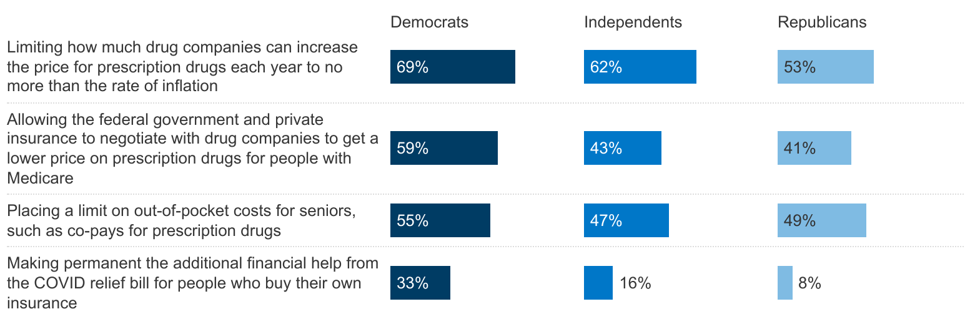
Many Democrats, Independents, and Republicans Say Prescription Drug Policies Should Be Top Priorities for Congress
Percent who say each of the following should be a top priority for Congress:
SOURCE: KFF Health Tracking Poll (March 15-22, 2022)

Slide 17
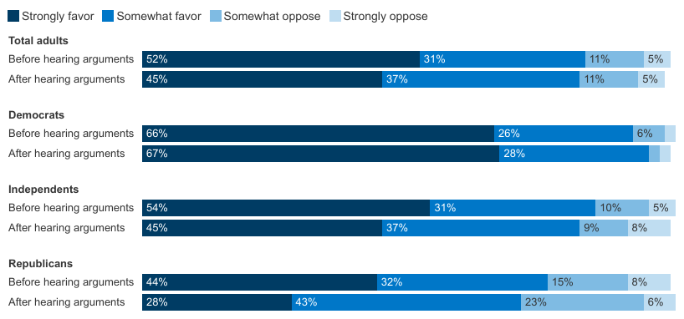
Overall Favorability Towards Drug Price Negotiation Remains Unchanged After Public Hears Arguments on Both Sides
Do you favor or oppose allowing the federal government to negotiate with drug companies to get a lower price on prescription drugs for people with Medicare and private insurance?
Argument against: This would have the government too involved and will lead to fewer new drugs being available in the future | Argument in favor: This is needed because Americans pay higher prices than people in other countries, many can’t afford their prescriptions, and drug company profits are too high
SOURCE: KFF Health Tracking Poll (Sept. 23-Oct. 4, 2021)

