Slide 1
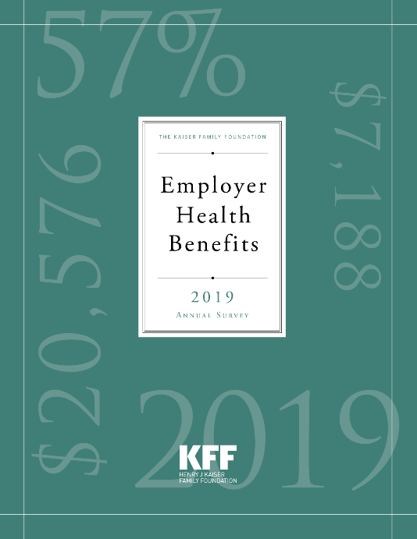
2019 KFF Employer Health Benefits Survey
September 25, 2019

Slide 2
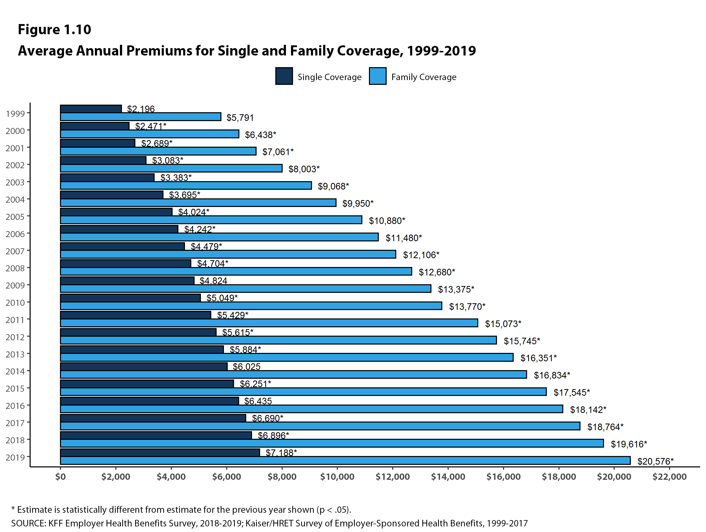
Figure 1

Slide 3
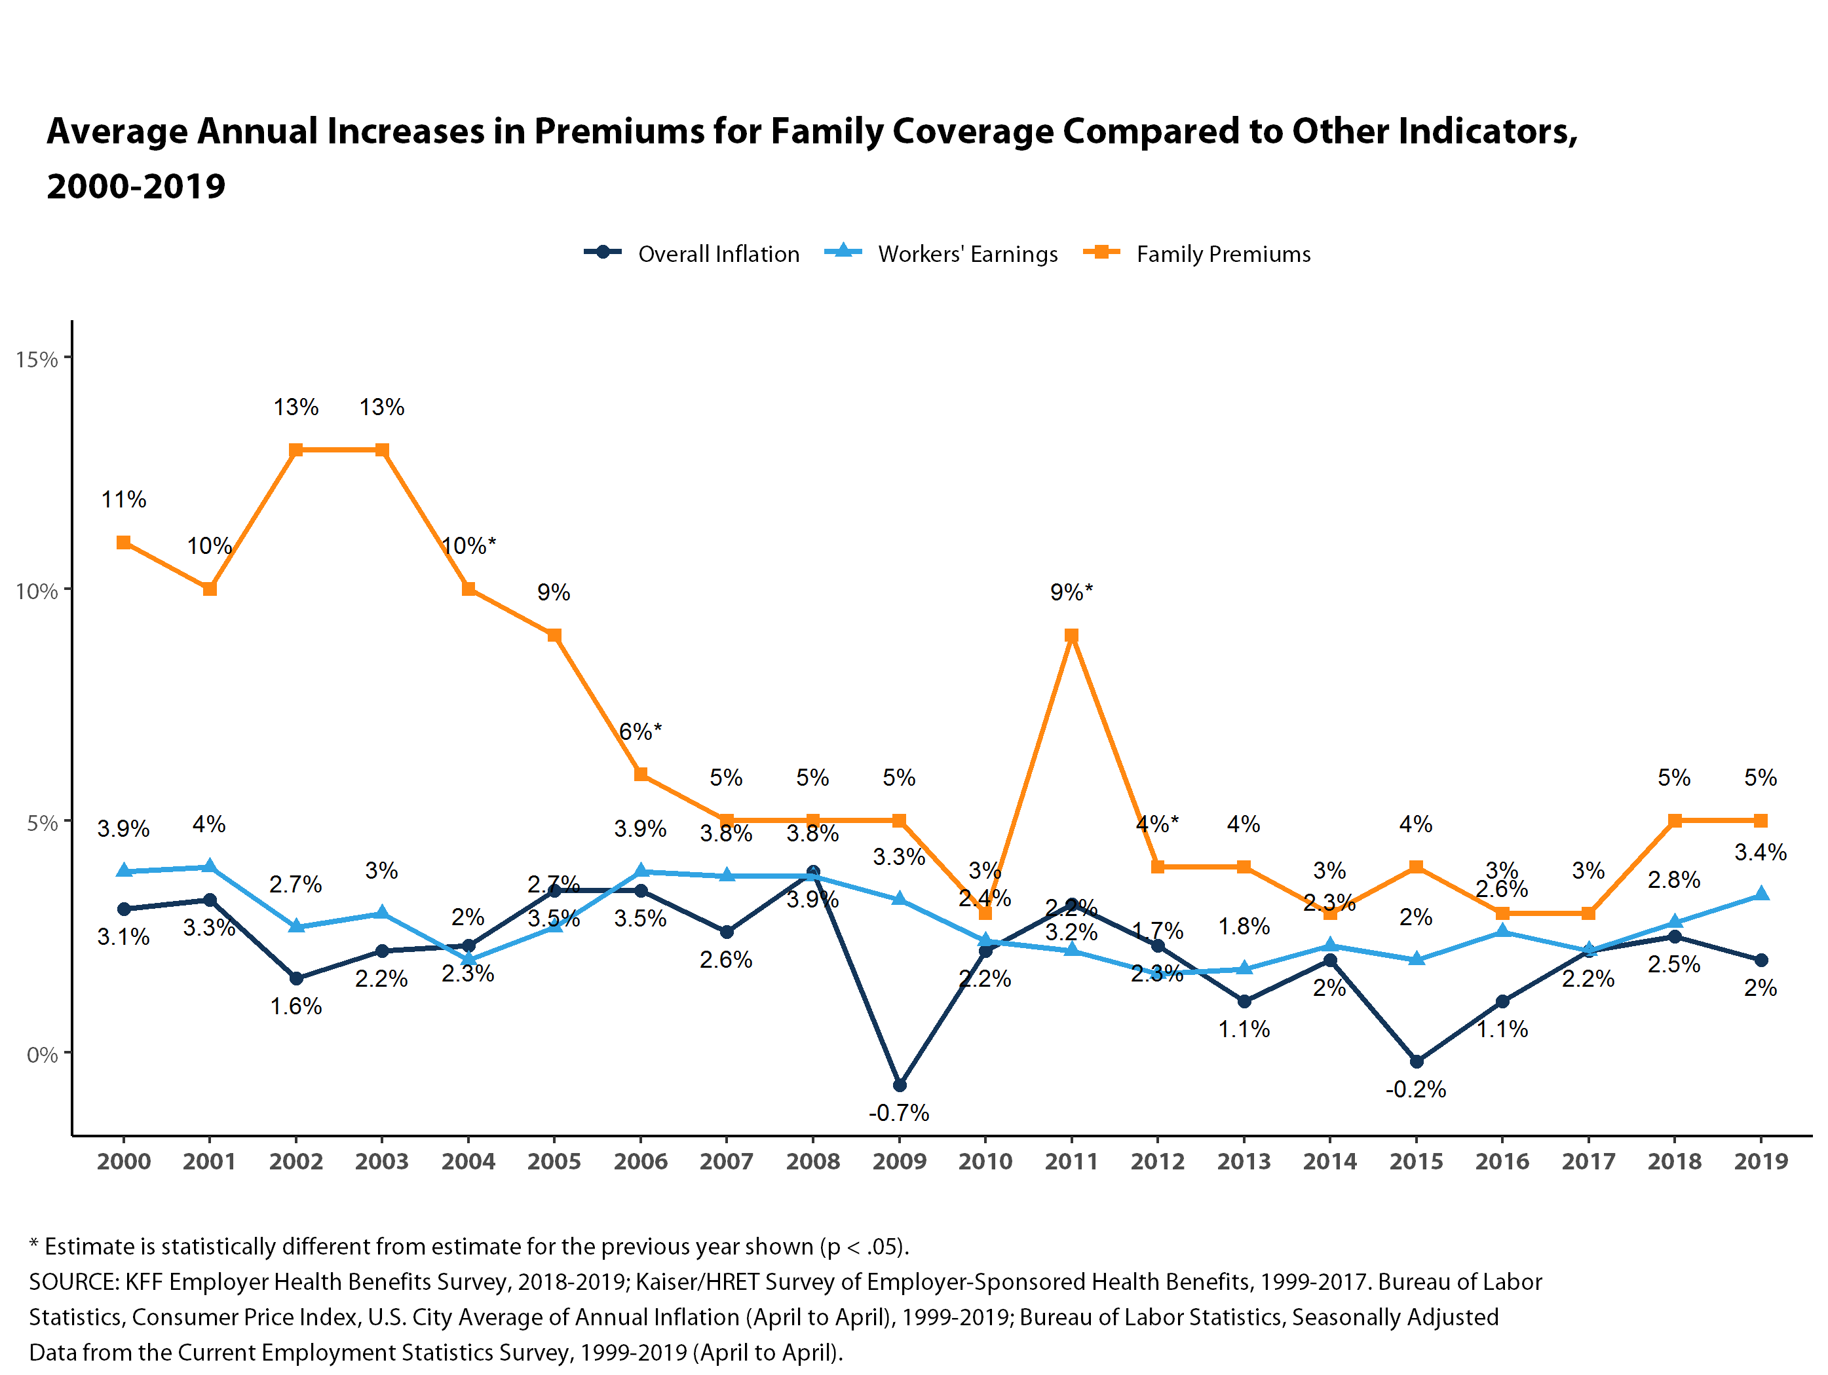
Figure 2

Slide 4
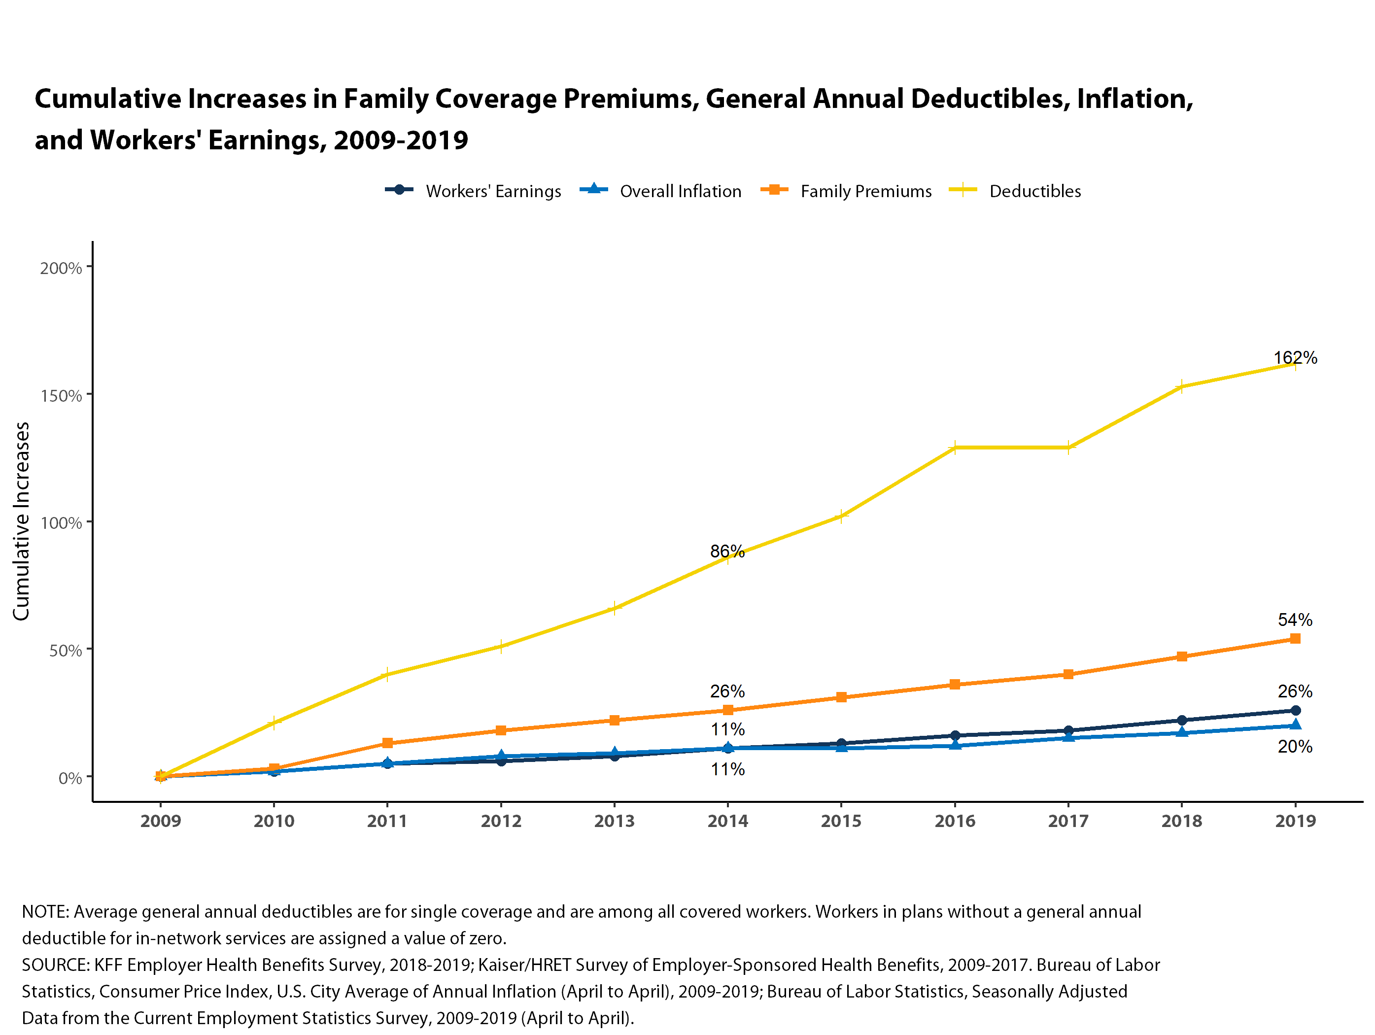
Figure 3

Slide 5
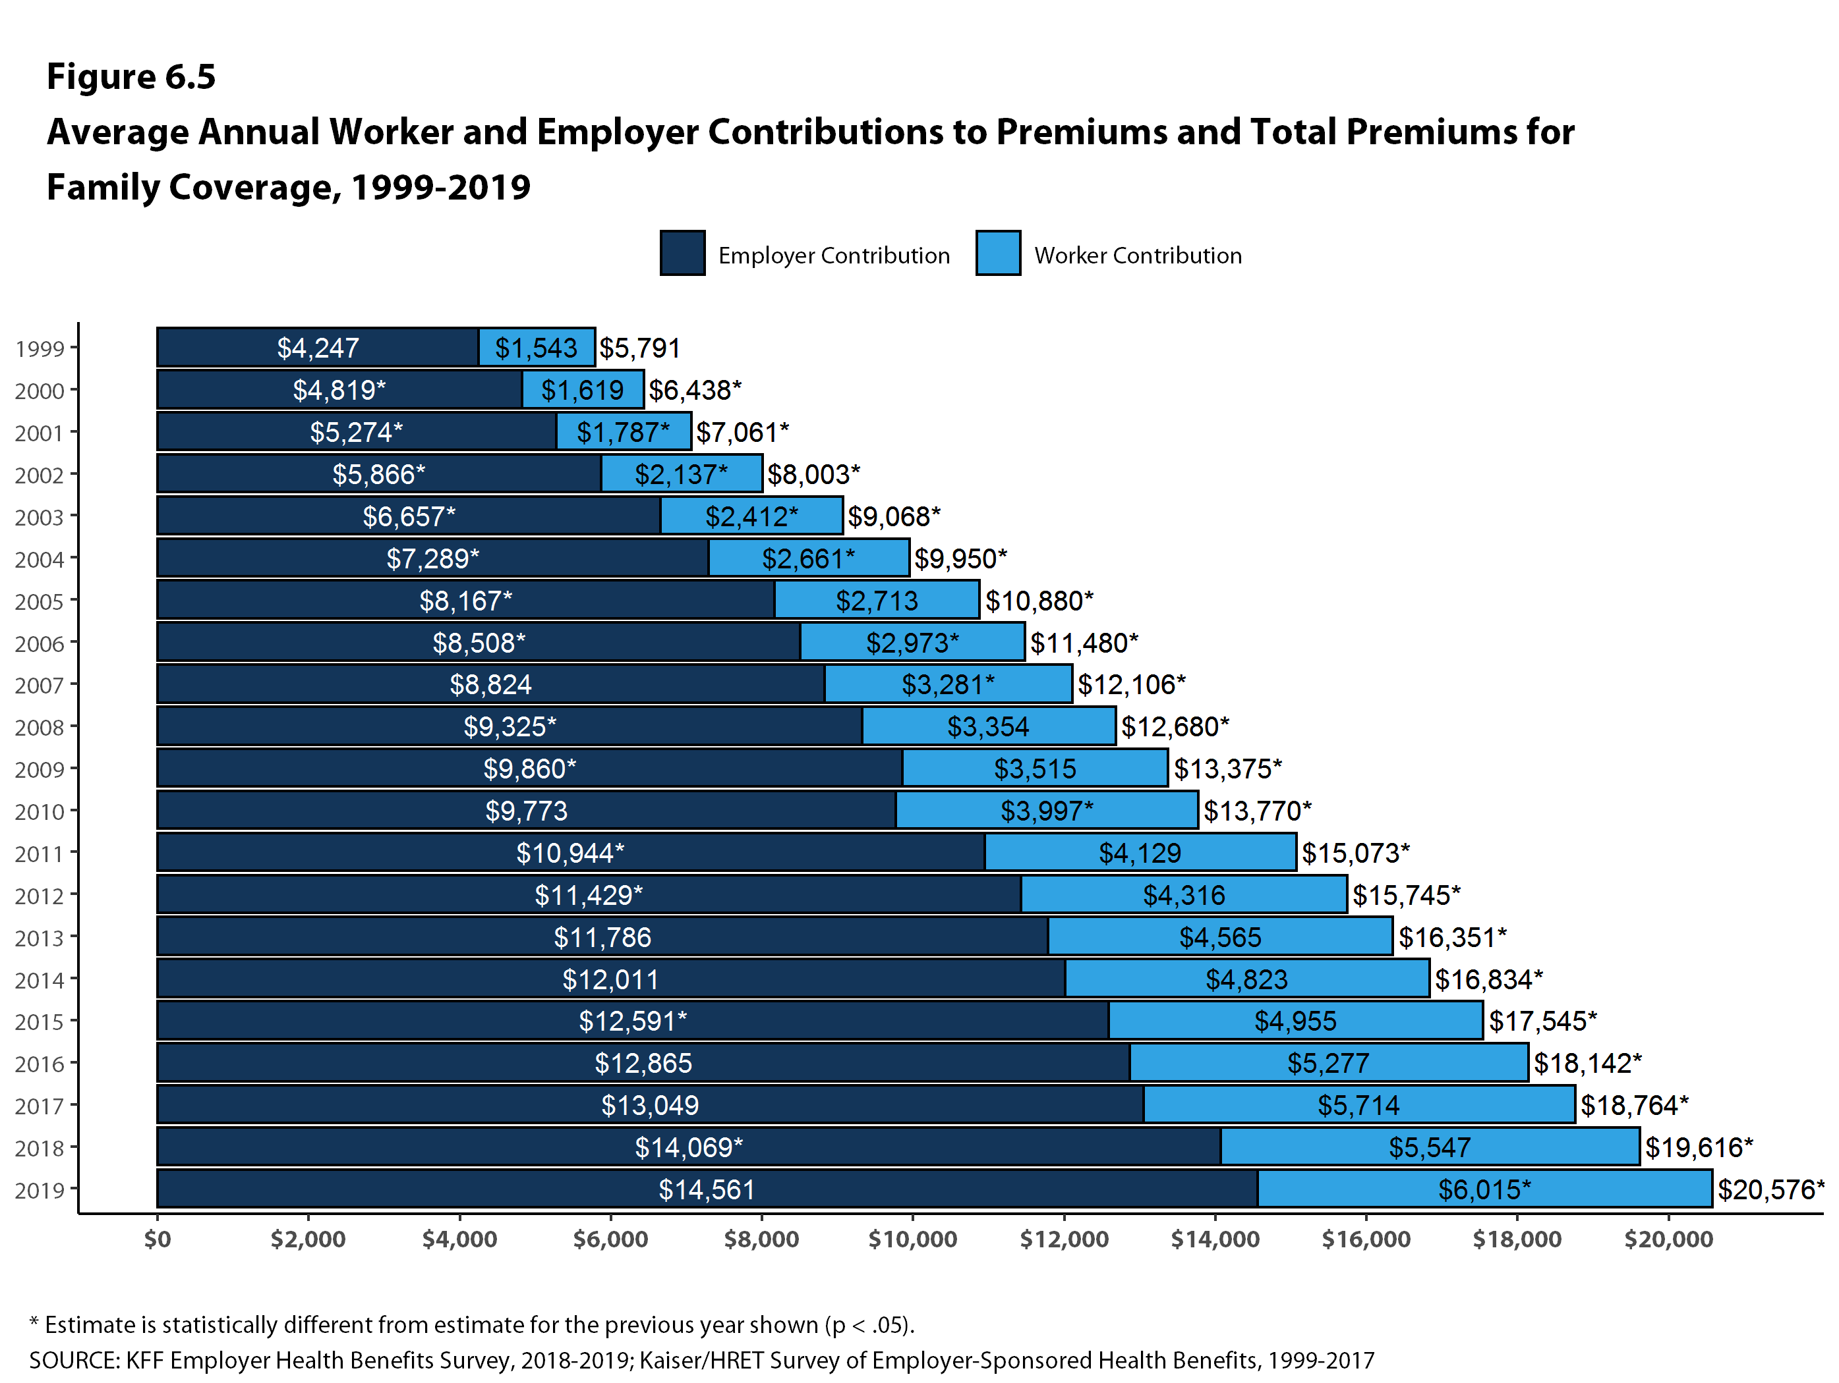
Figure 4

Slide 6
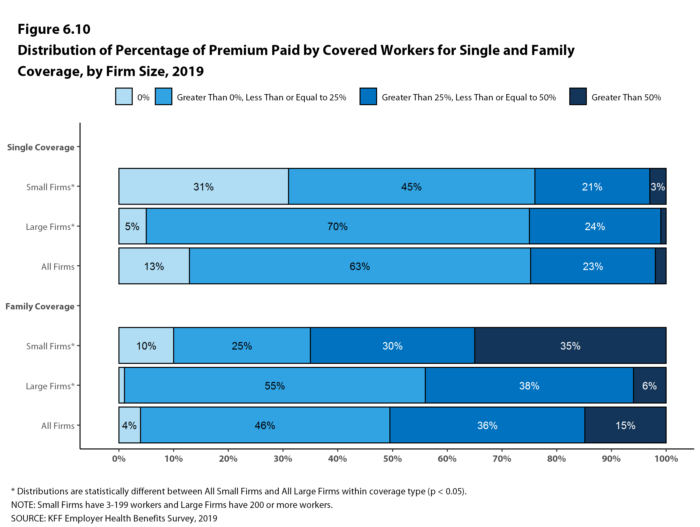
Figure 5

Slide 7
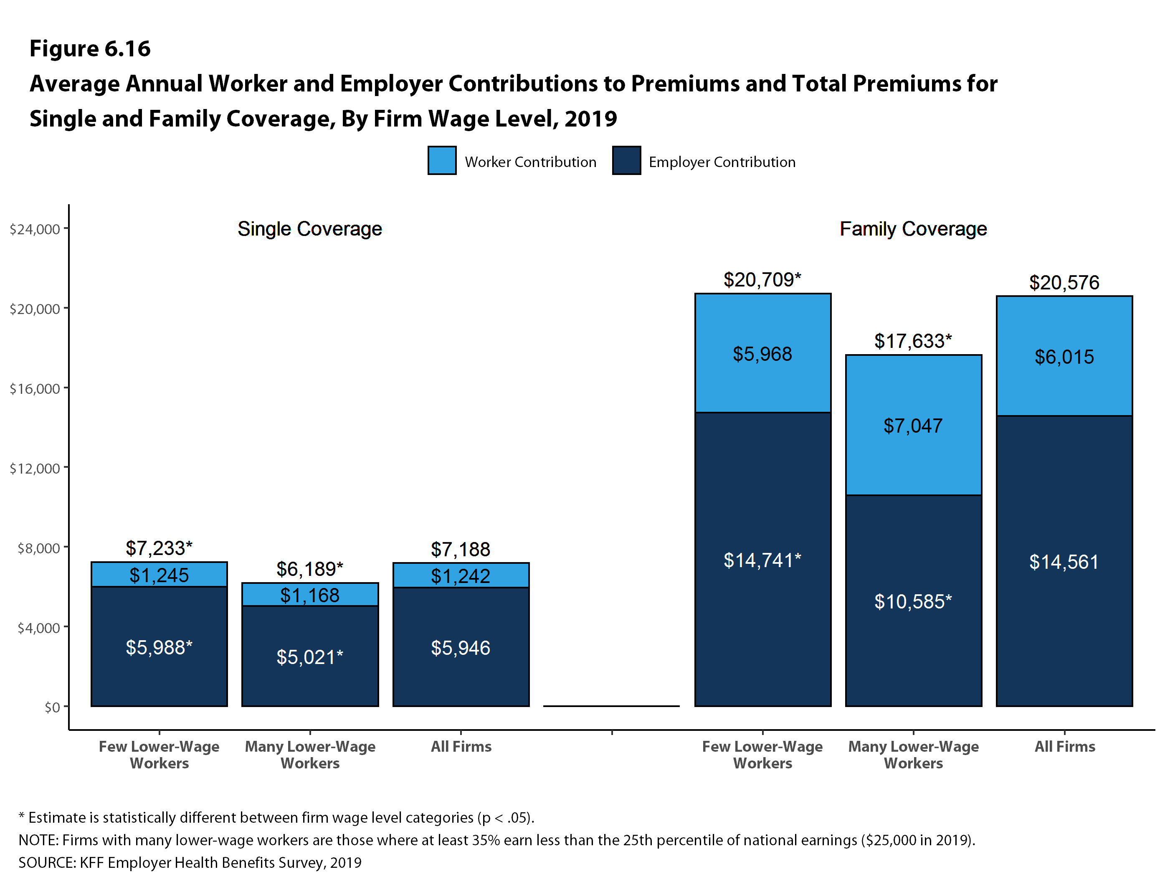
Figure 6

Slide 8
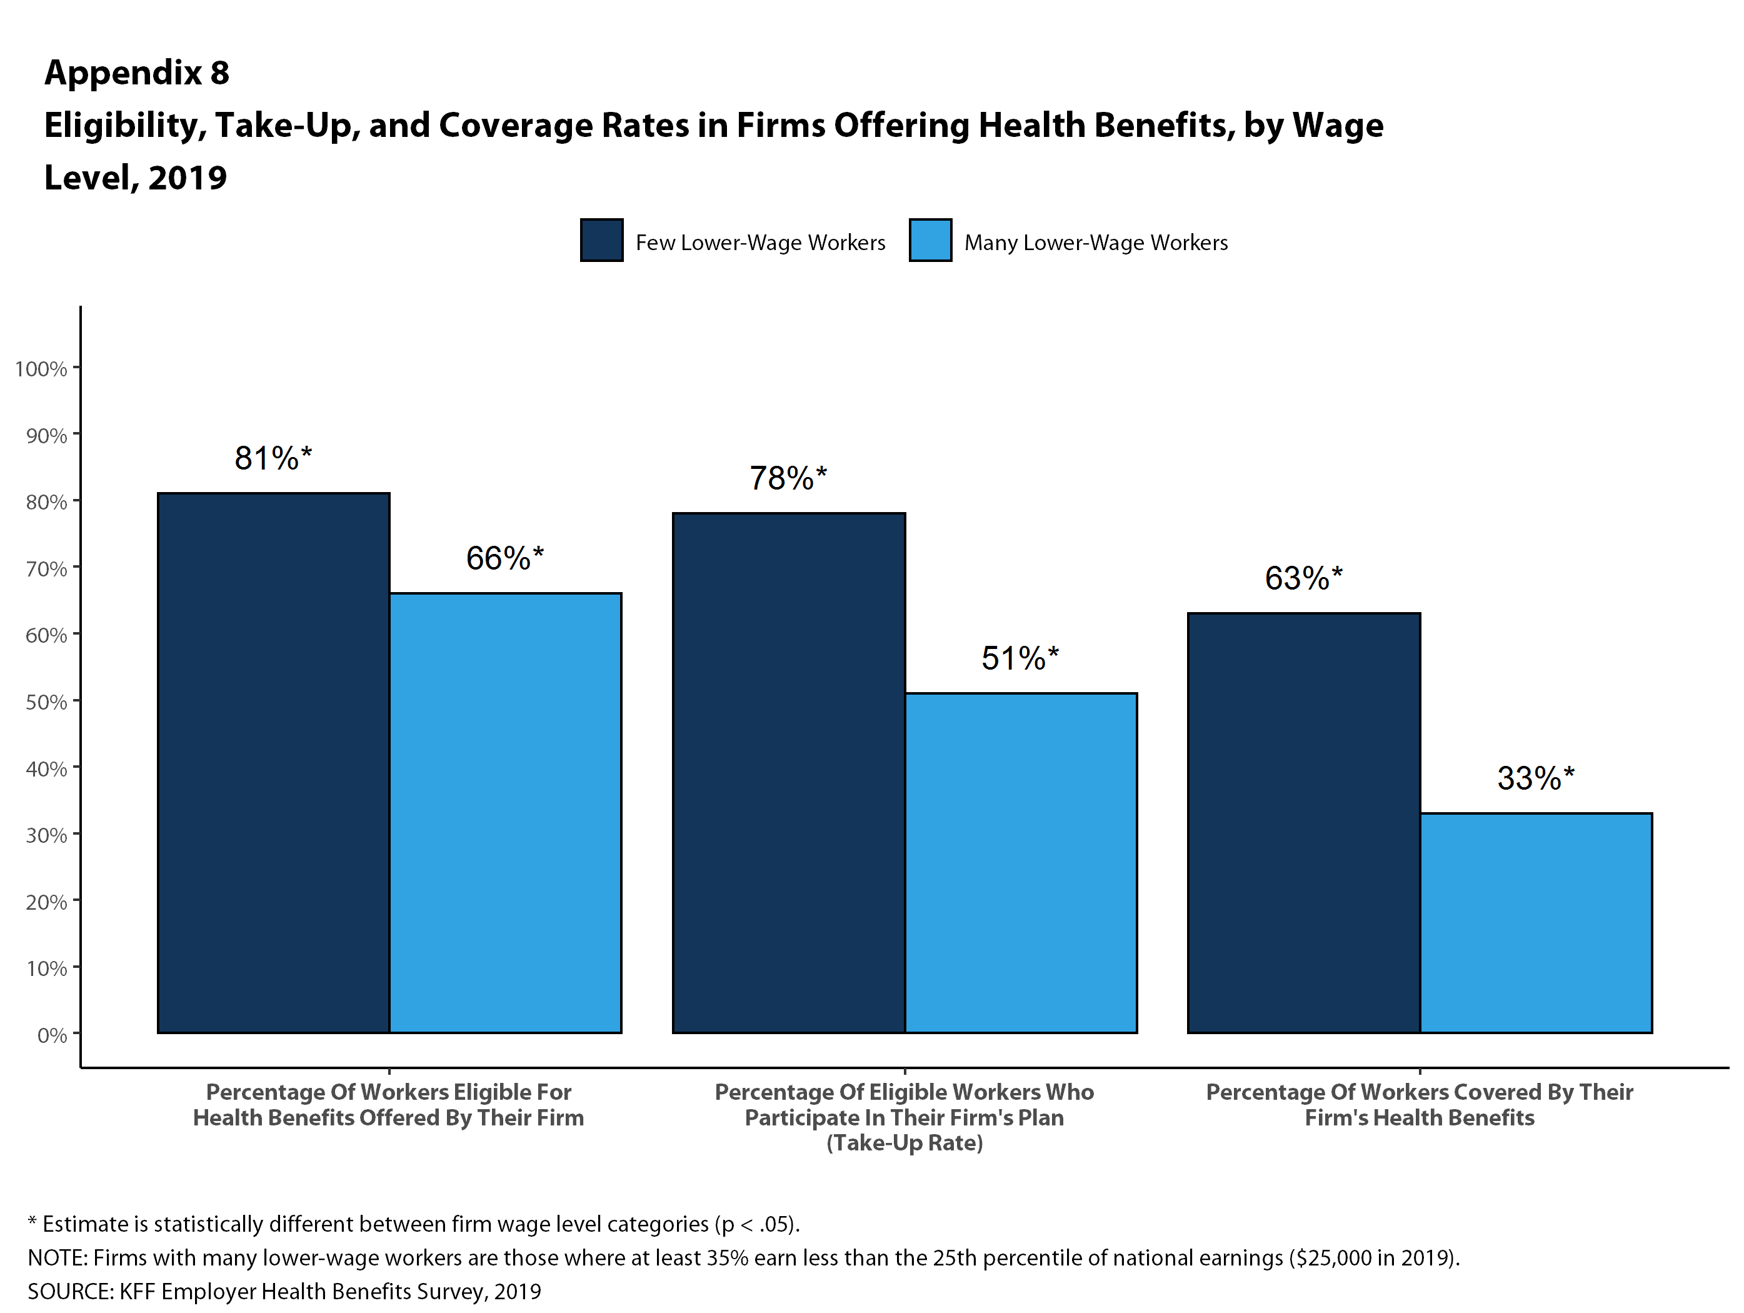
Figure 7

Slide 9
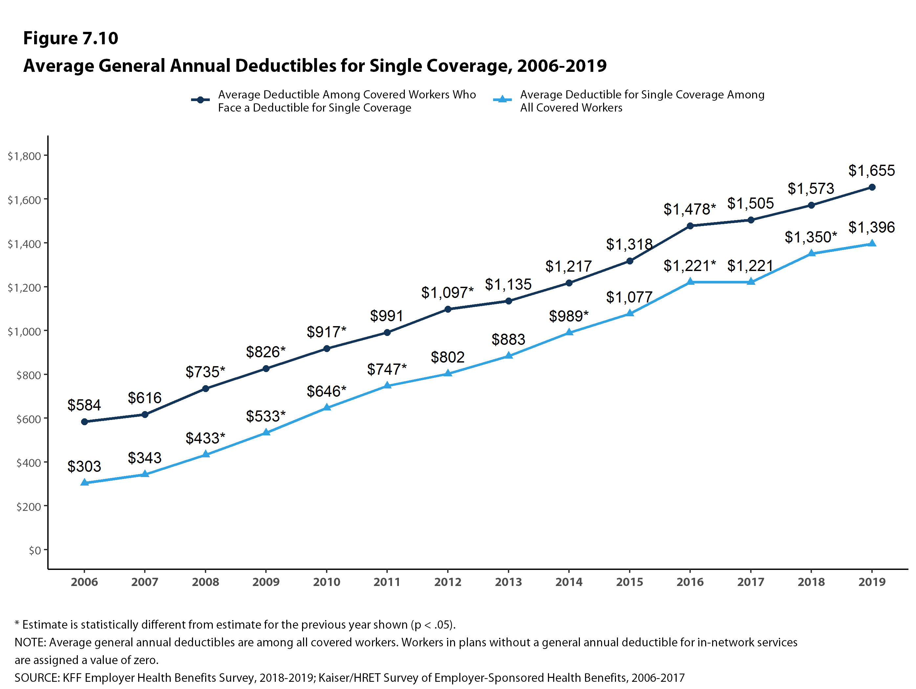
Figure 8
Notes:
Among workers with a general annual deductible for single coverage, the average deductible is just over $1,500.
Overtime both the percent of covered workers with a deductible and the average deductible have increased. We can look at these trends together by taking the average deductible for all workers – assigning a zero for workers without a deductible. Among all covered workers the average deductible is $1,221.
No matter which way you look at it, the average deductible is similar to last year but up significantly over time.

Slide 10
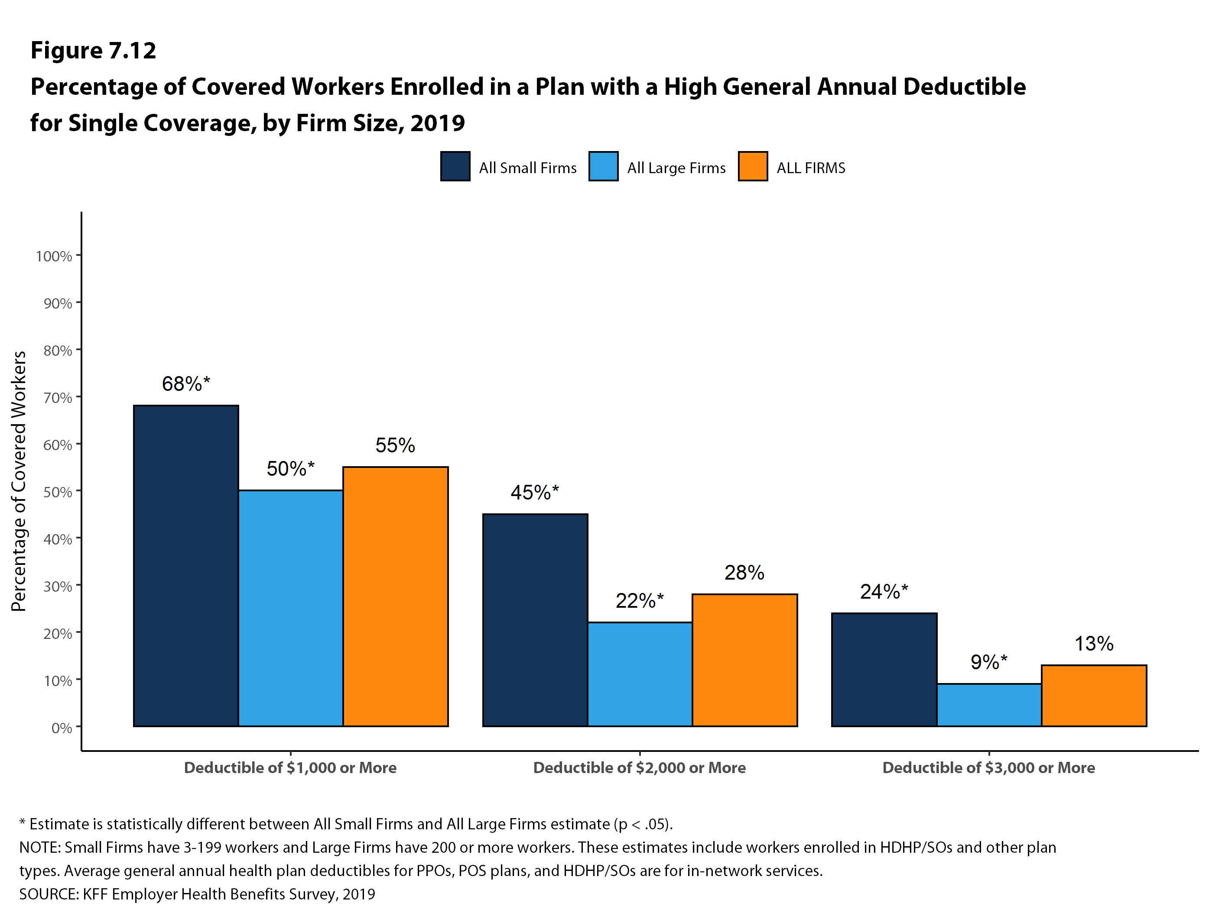
Figure 9
Notes:
Over half of covered workers have a deductible of at least a thousand dollars a year, with more than 1 in ten facing a deductible of 3000 dollars or more.

Slide 11
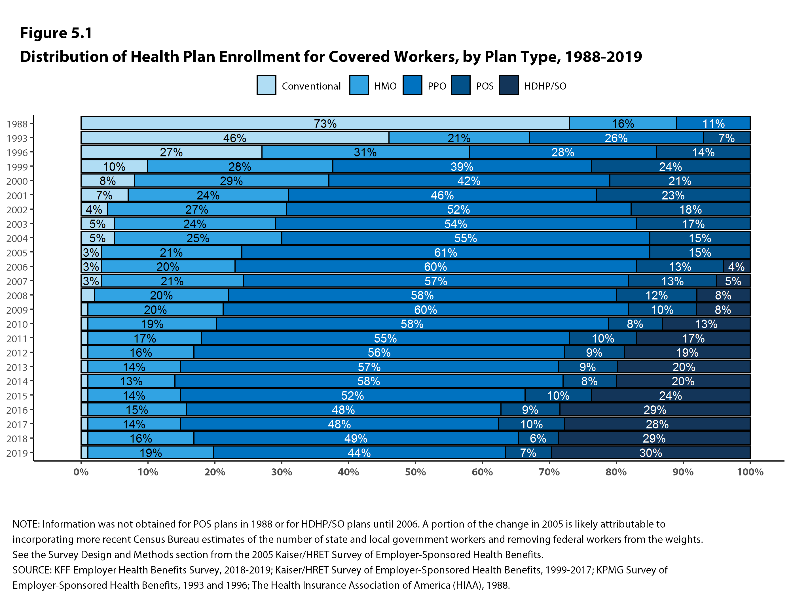
Figure 19
Figure 10
Notes:
Now looking at plan type enrollment. PPOs remain the most common health plan for covered workers at both large and small firms.
Over time HMOs have become less common although enrollment in each plan type is similar to last year.

Slide 12
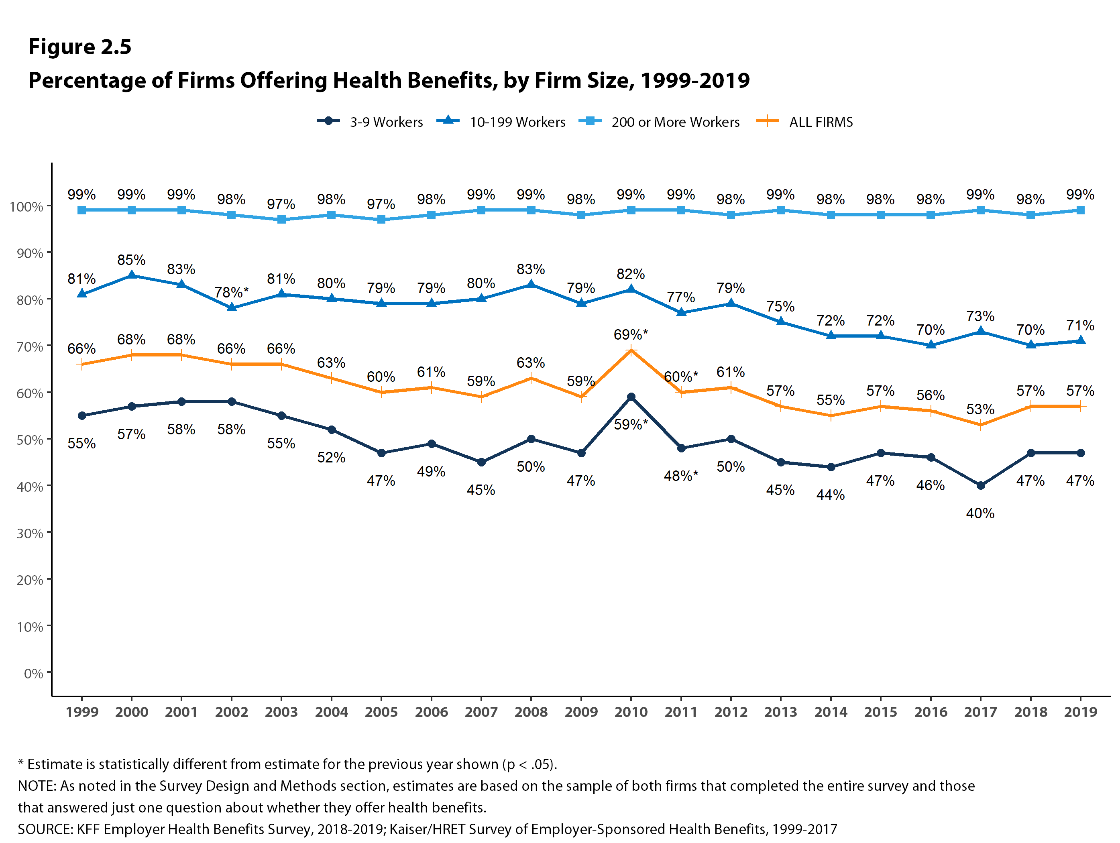
Figure 11

Slide 13
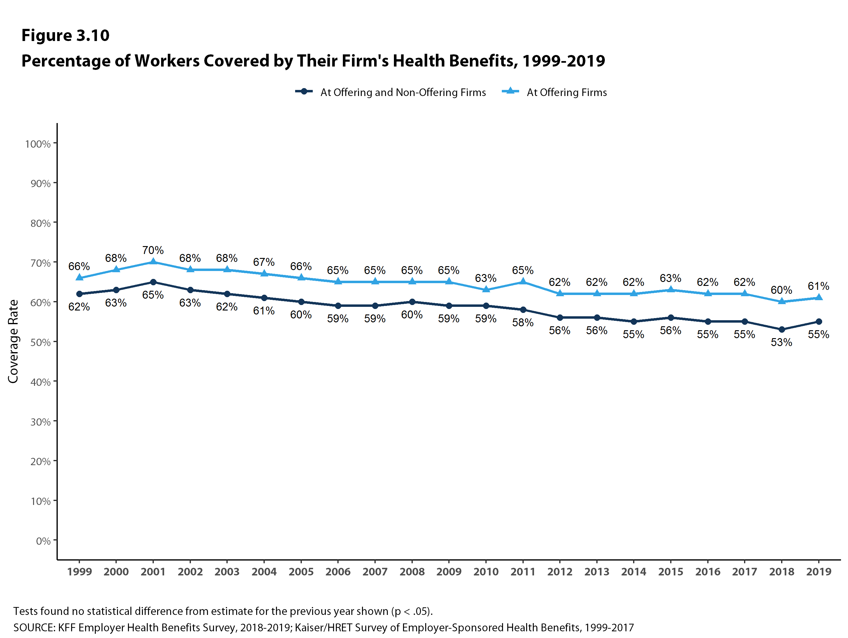
Figure 12
Notes:
While most large employers continue to offer health benefits, some have financial incentives to influence employees enrollment decision.
Fifteen percent of firms offering health benefits have incentives for workers to enroll on a spouses plan and 18% provide additional incentives for not participating in the firms health benefits at all

Slide 14
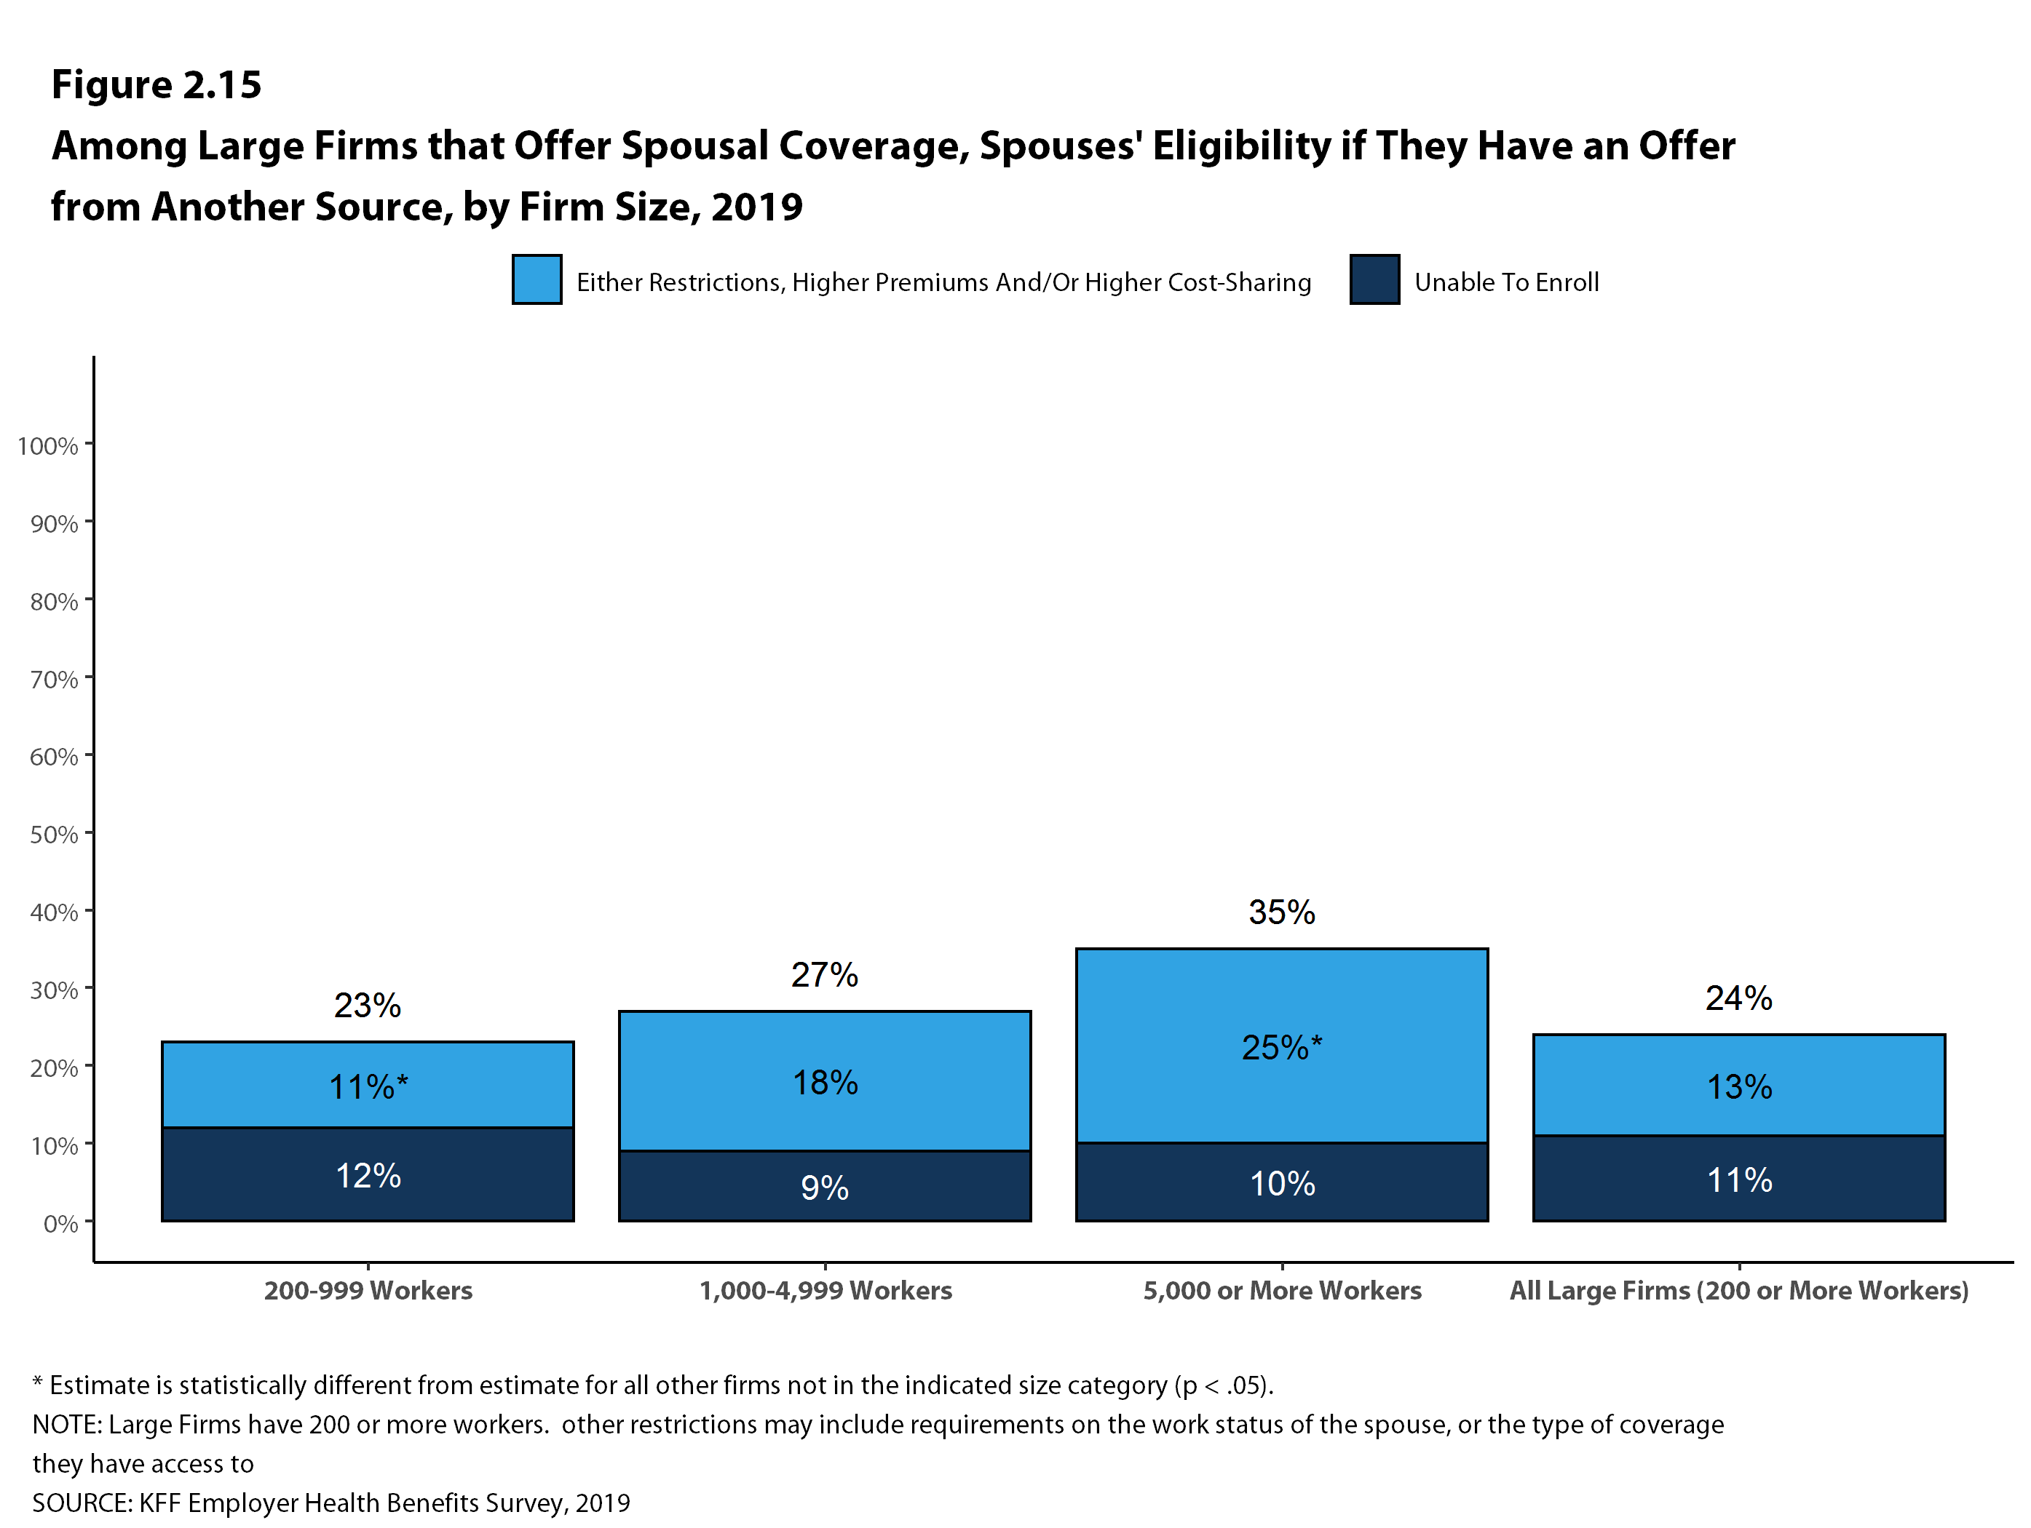
Figure 13
Notes:
While most large employers continue to offer health benefits, some have financial incentives to influence employees enrollment decision.
Fifteen percent of firms offering health benefits have incentives for workers to enroll on a spouses plan and 18% provide additional incentives for not participating in the firms health benefits at all

Slide 15
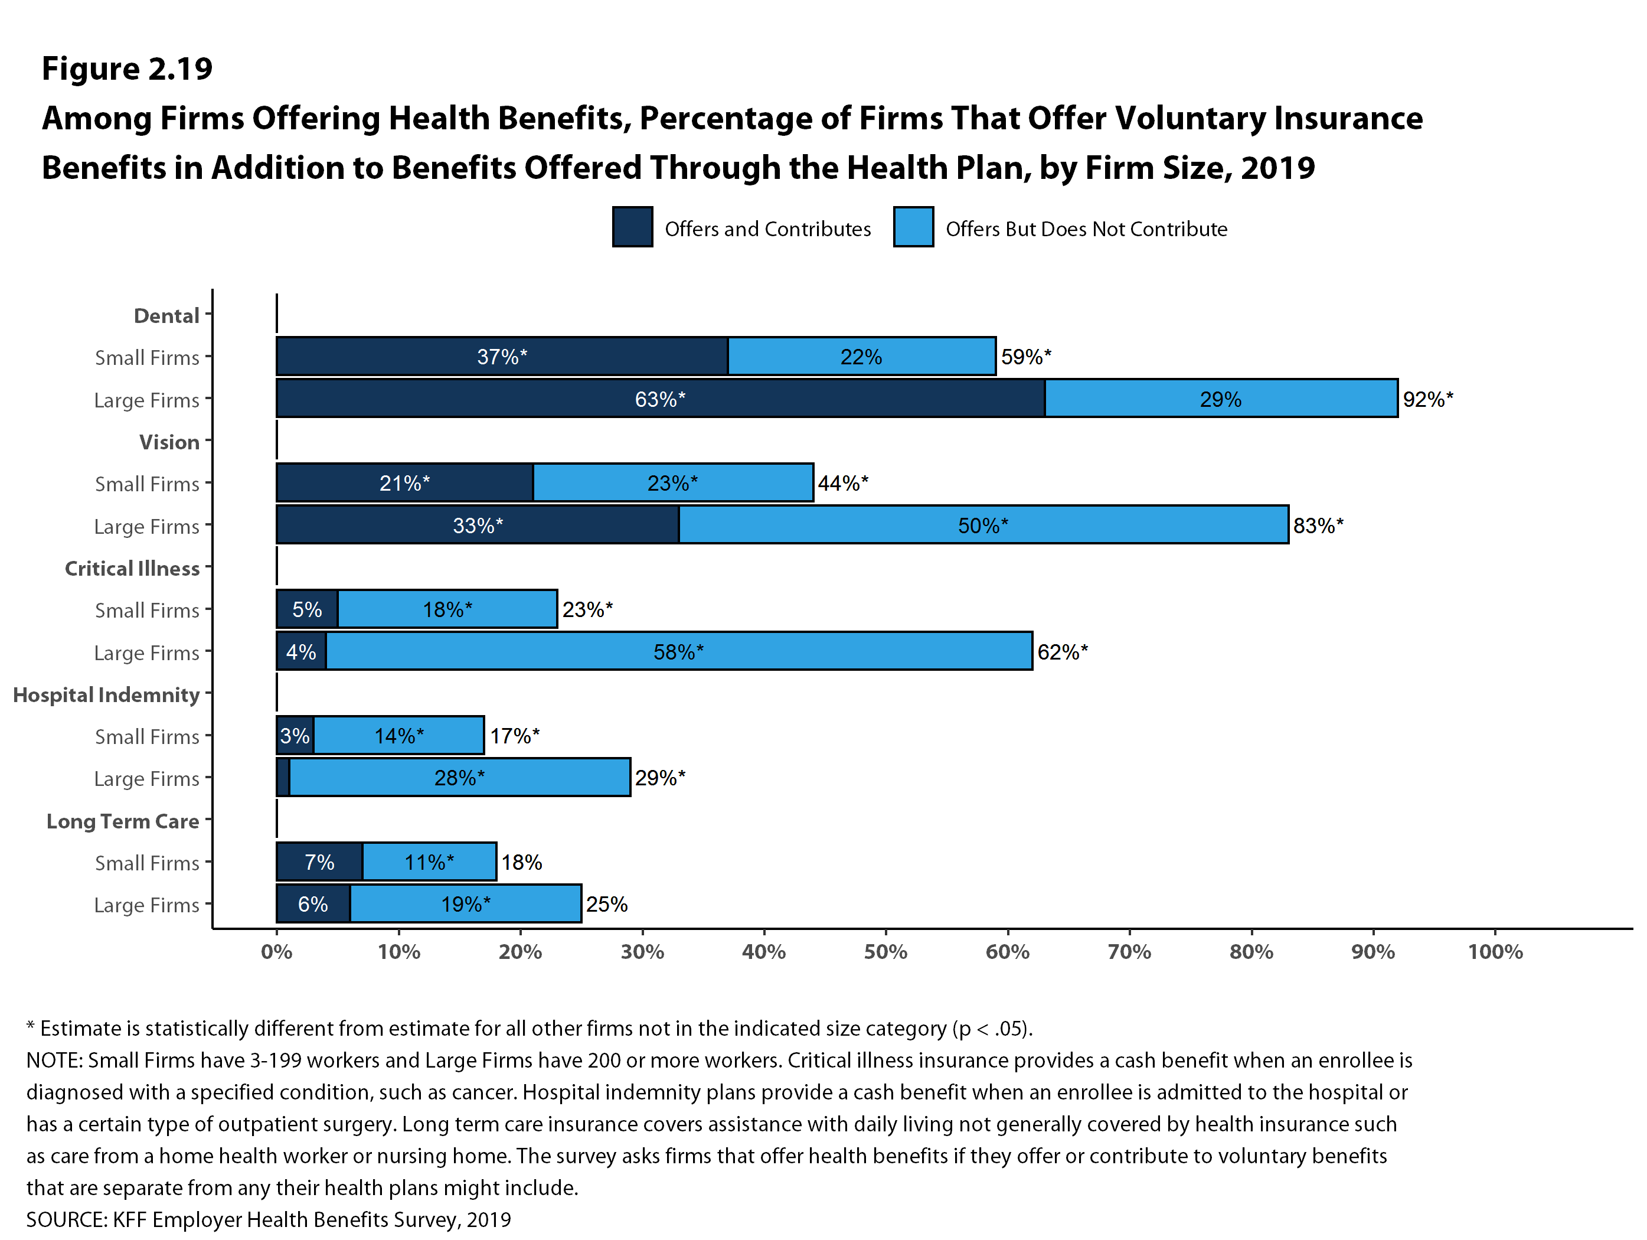
Figure 14
Notes:
While most large employers continue to offer health benefits, some have financial incentives to influence employees enrollment decision.
Fifteen percent of firms offering health benefits have incentives for workers to enroll on a spouses plan and 18% provide additional incentives for not participating in the firms health benefits at all

Slide 16
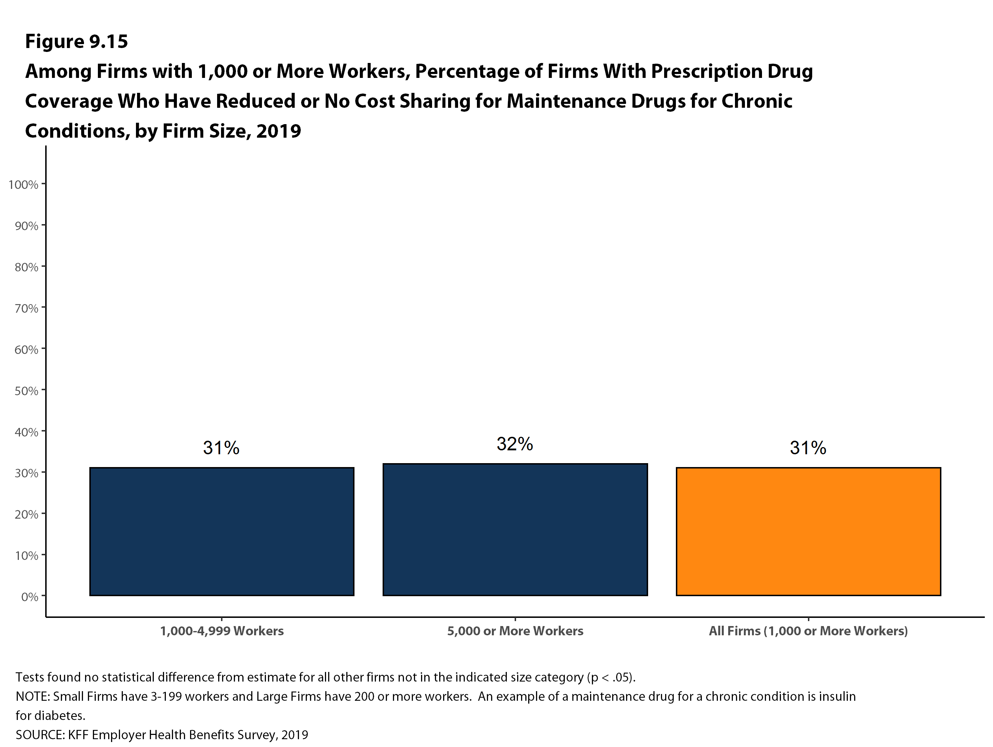
Figure 21
Figure 15
Notes:
This survey defines high-deductible health plans with a savings option as a distinct plan type.
These plans either have
1) a deductible of a $1000 for single coverage and an employer contribution towards a health reimbursement arrangement
2) or are HSA-qualified.
In 2017 almost 2 in ten covered workers are enrolled in an hsa-qualified plan and
nine percent are in enrolled a plan with a HRA.

Slide 17
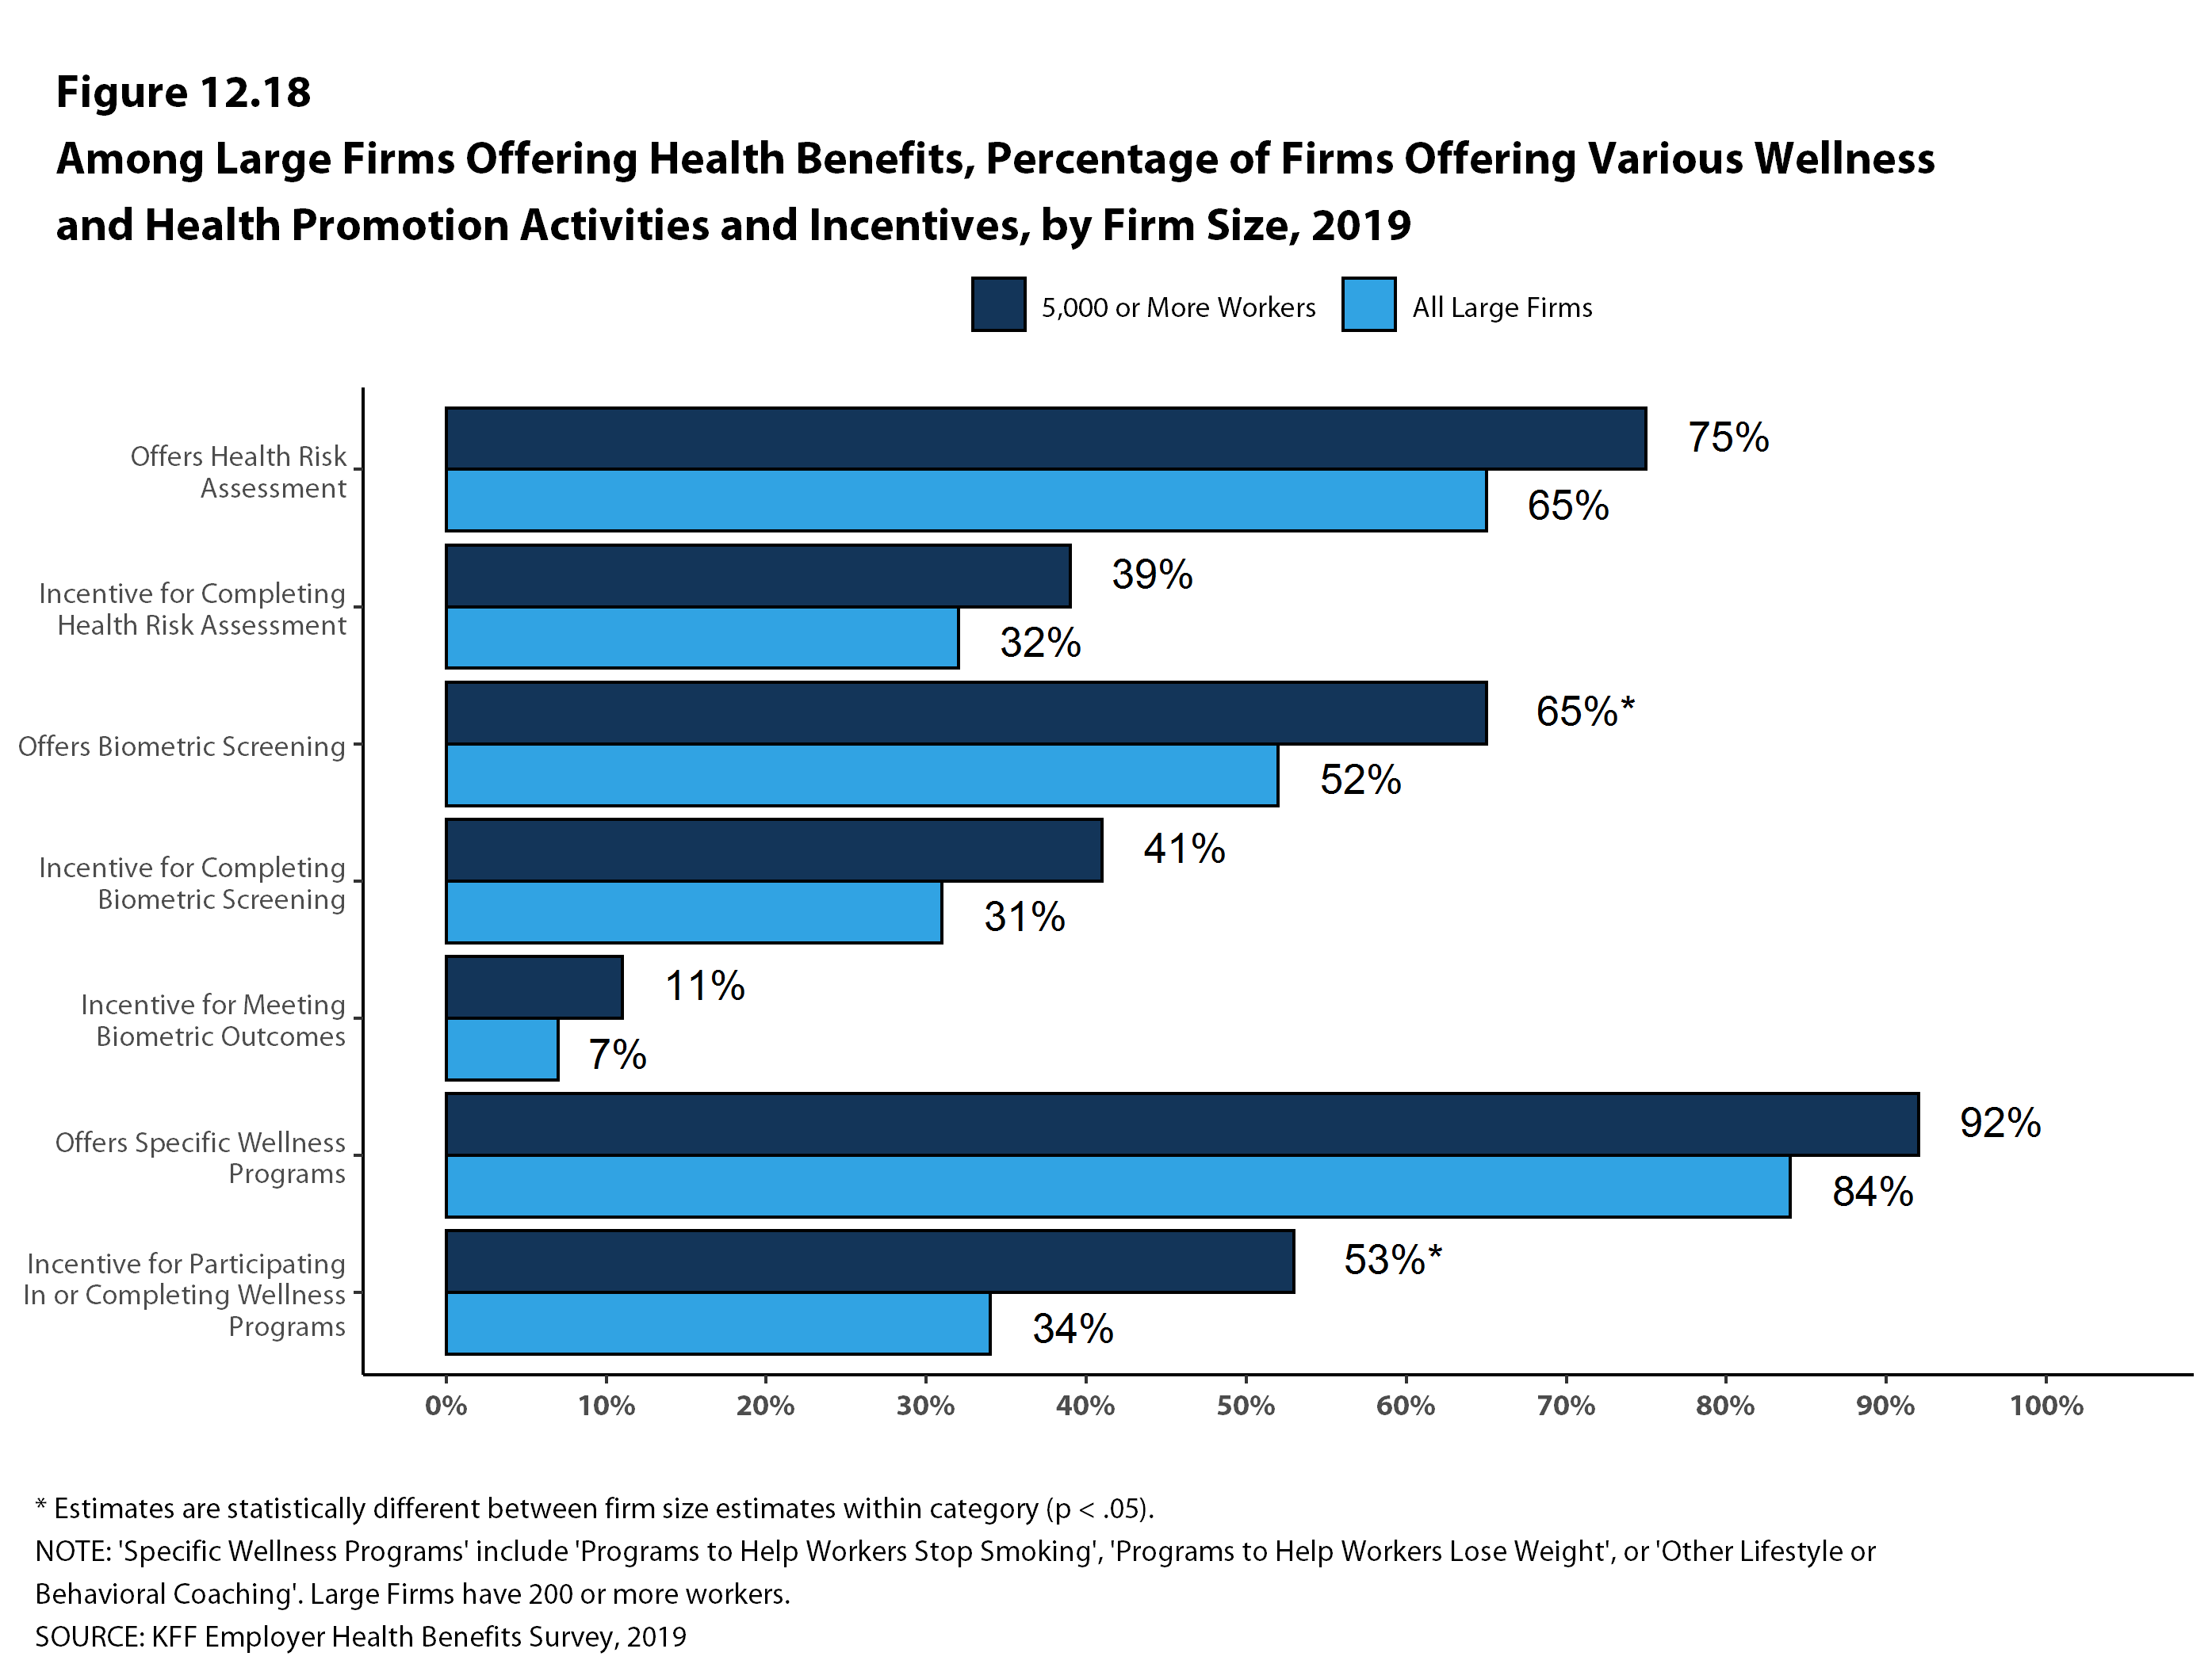
Figure 21
Figure 16
Notes:
A distinctive feature of high-deductible health plans with a savings option, is the tax-preferred savings accounts enrollees can use to defer the cost of medical expenses.
On average covered workers in HSA-qualified health plans are covered by a less expensive plan than workers in other plan types.
Almost half of covered workers in these plans receive an employer account contribution, averaging about $600 dollars for all workers with a HSA.

Slide 18
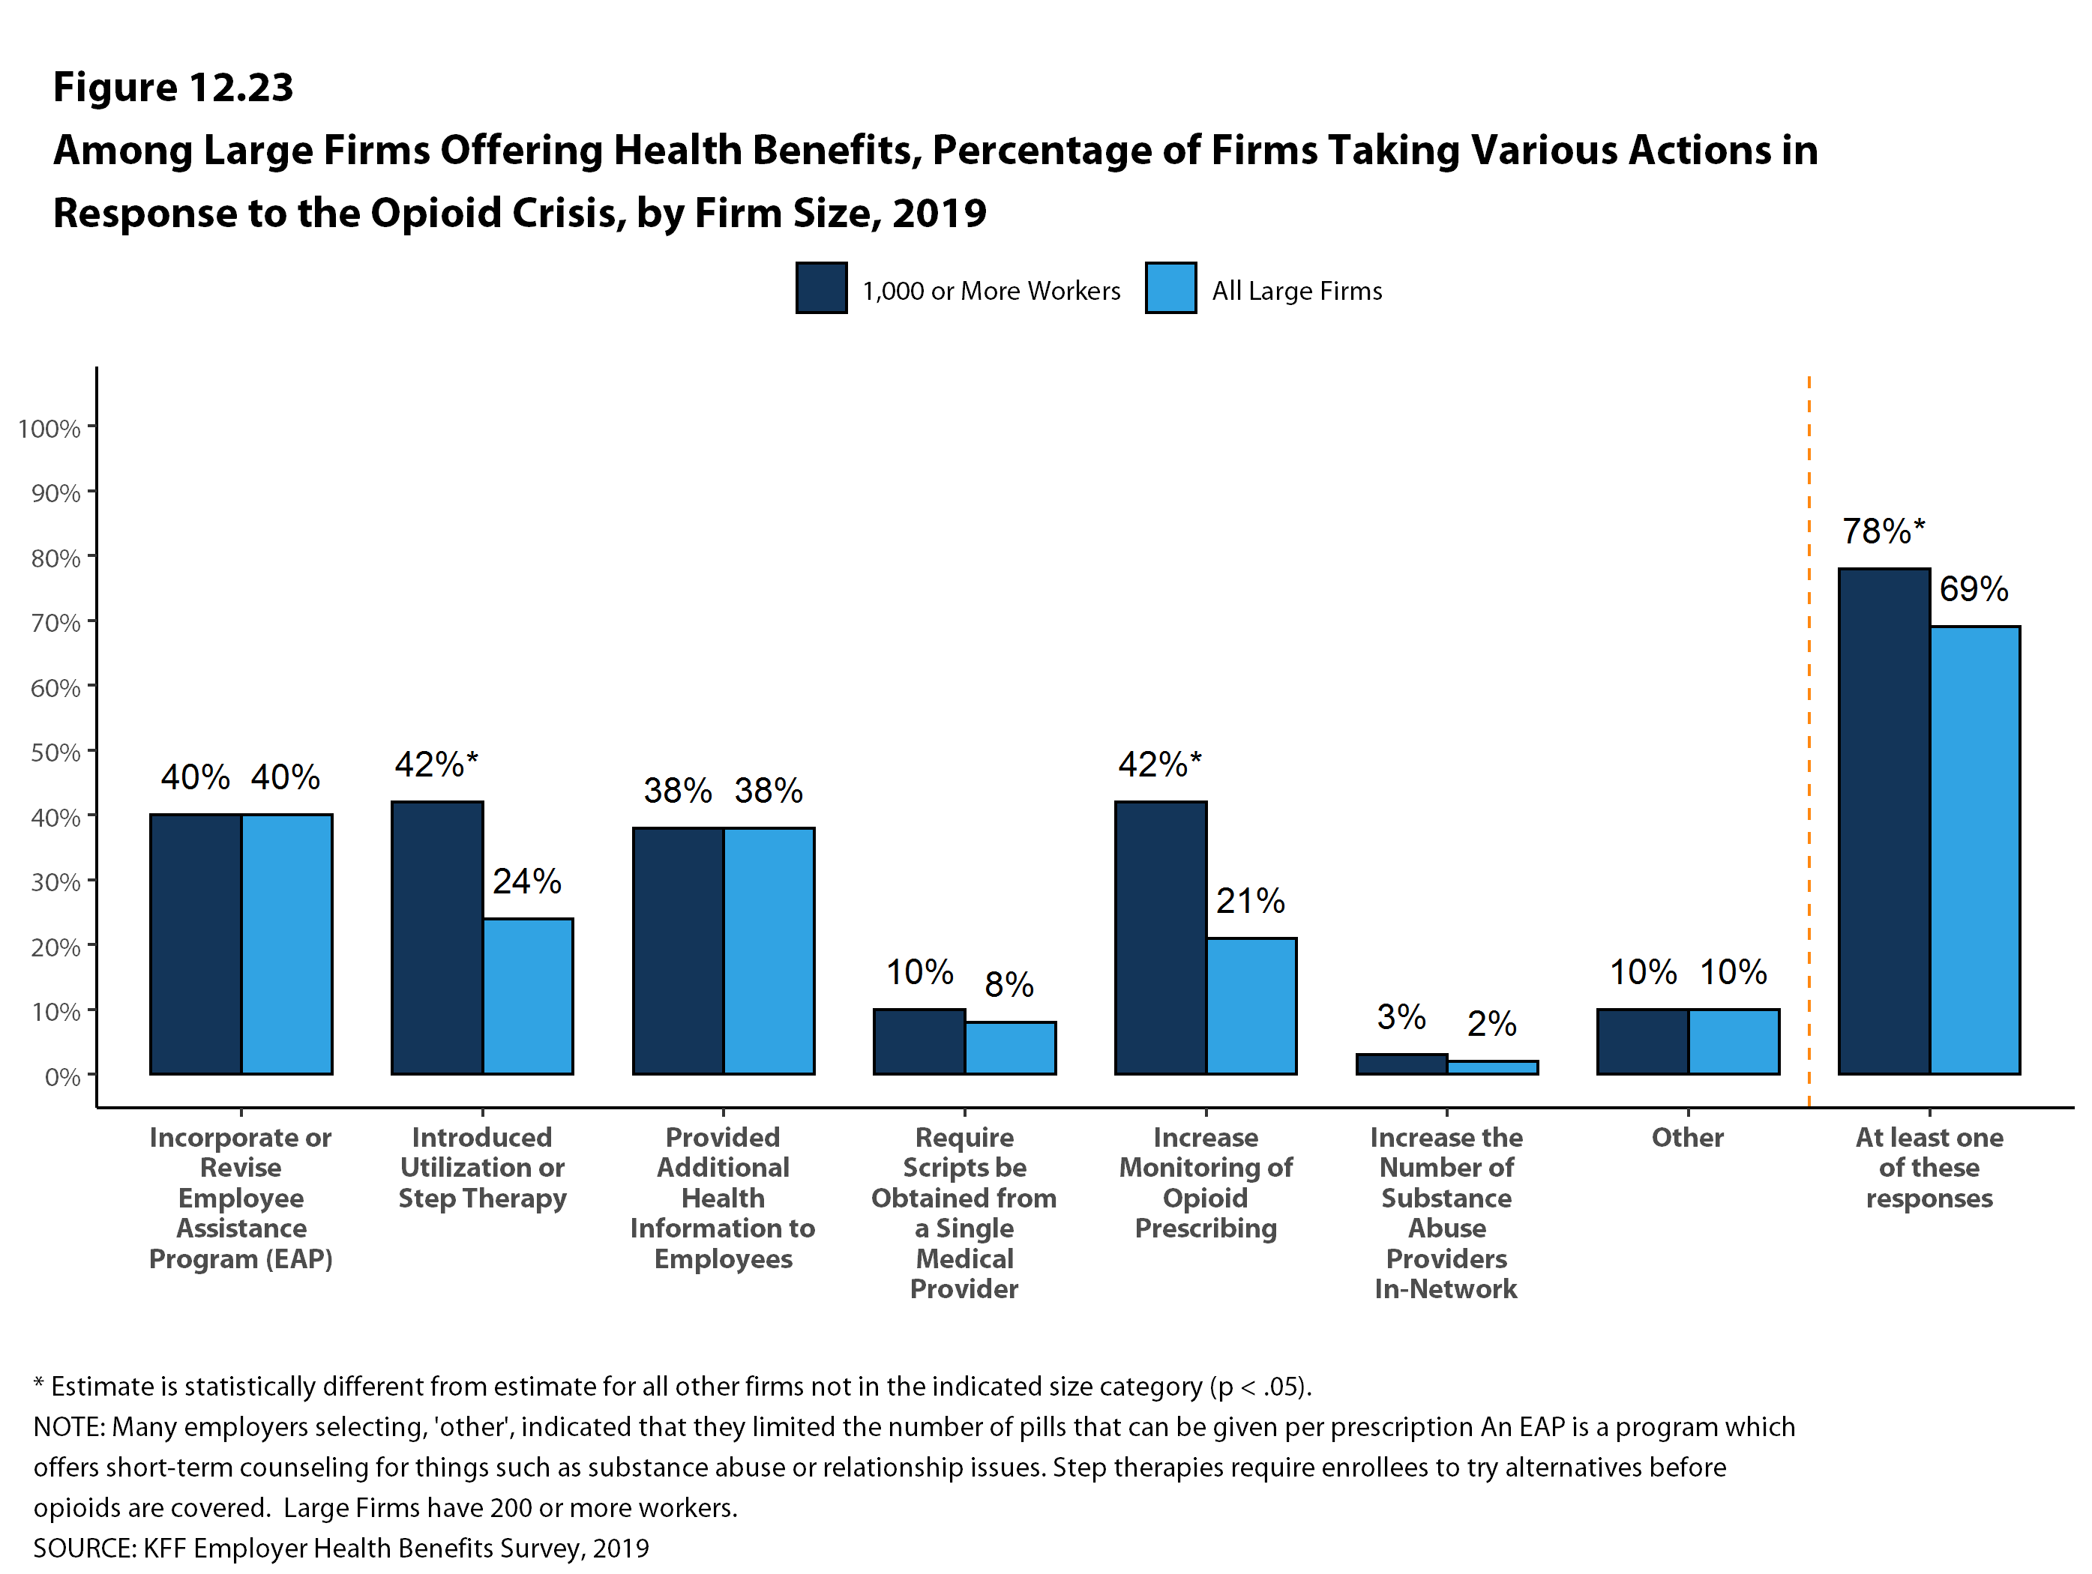
Figure 17
Notes:
Over half of covered workers have a deductible of at least a thousand dollars a year, with more than 1 in ten facing a deductible of 3000 dollars or more.

Slide 19
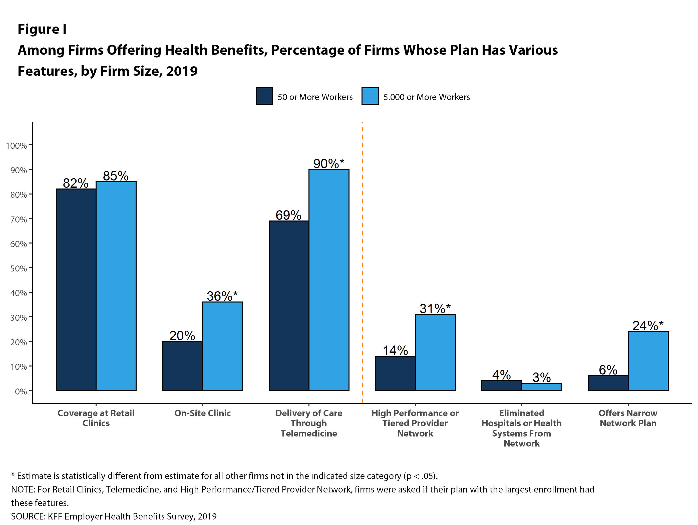
Figure 18
Alternative Sites of Care
Provider Networks
Notes:
Over half of covered workers have a deductible of at least a thousand dollars a year, with more than 1 in ten facing a deductible of 3000 dollars or more.

Slide 20
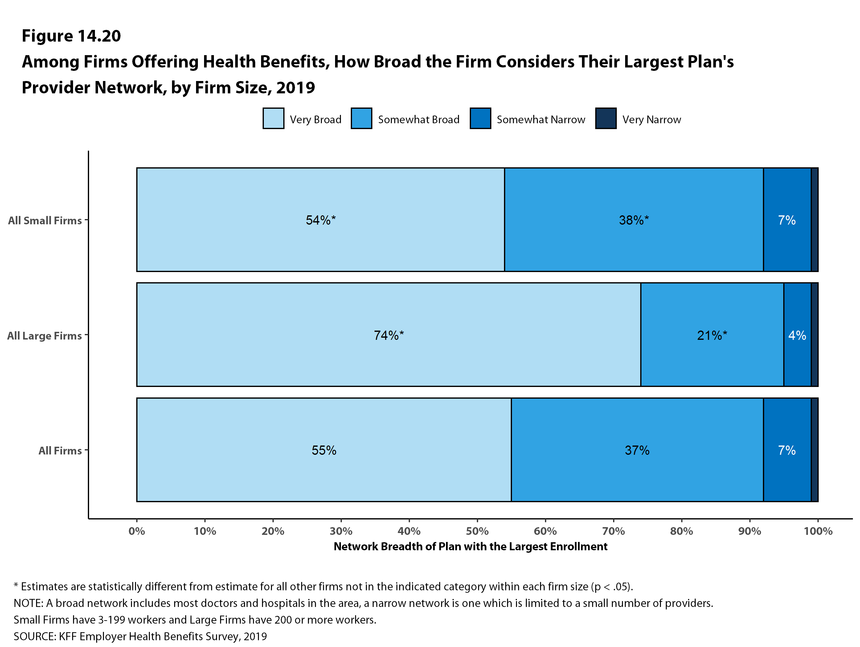
Figure 19

Slide 21
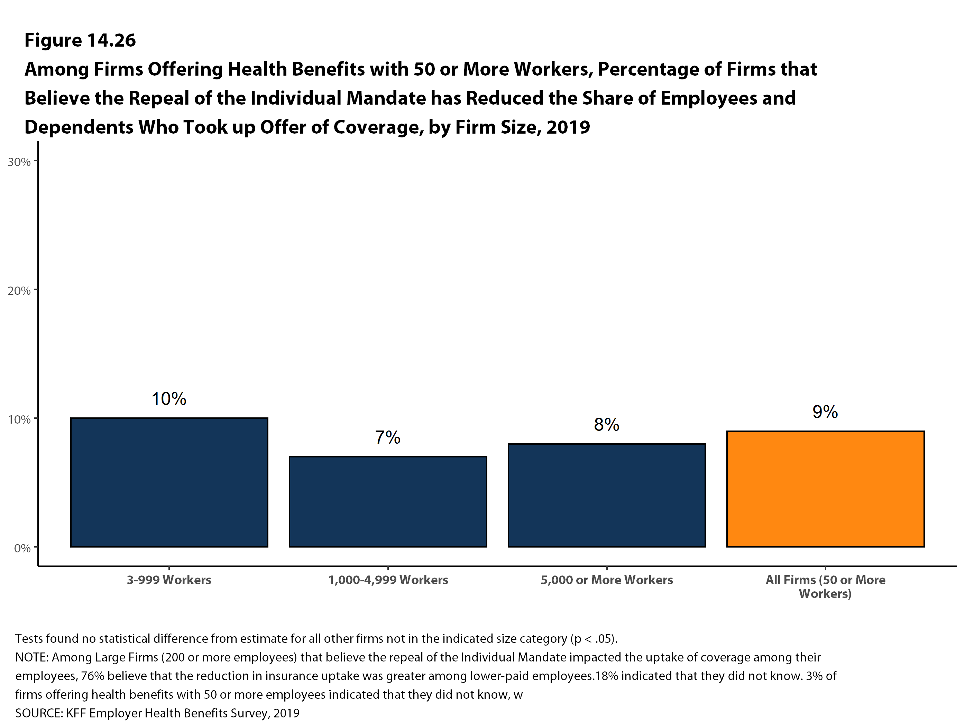
Figure 20

Slide 22
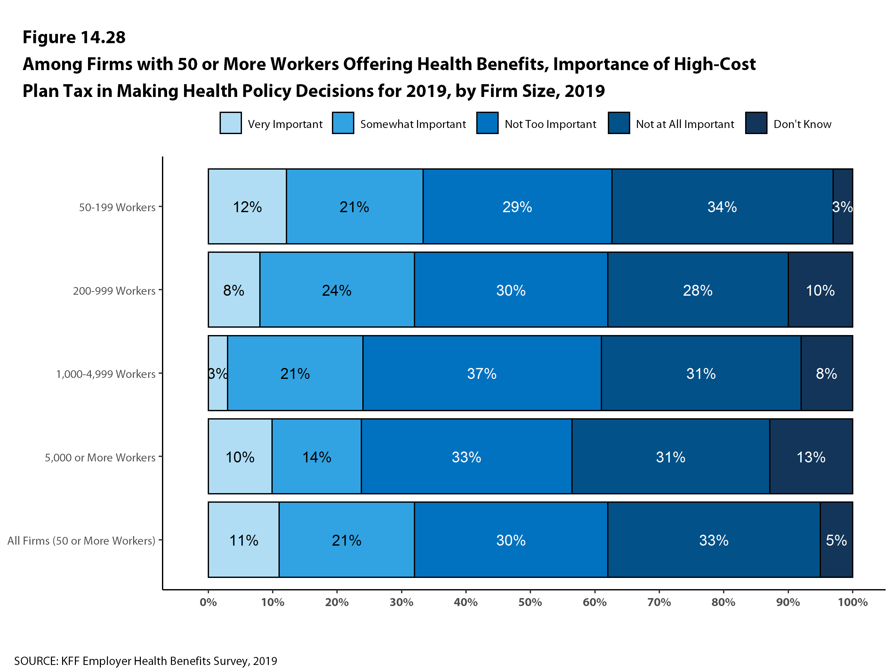
Figure 22
Figure 21

