Slide 1
What Consumers in Indiana, Ohio, and Pennsylvania
Need to Know about Open Enrollment
October 30, 2017
Karen Pollitz, Kaiser Family Foundation
Jennifer Tolbert, Kaiser Family Foundation
Julia Holloway, Director of Program Development and Navigator Services, Affiliated Service Providers of Indiana
Teresa Rios-Bishop, Outreach and Policy Manager, Ohio Association of Community Health Centers
Antoinette Kraus, Executive Director, Pennsylvania Health Access Network

Slide 2

Karen Pollitz
Senior Fellow

Slide 3

Jennifer Tolbert
Director of State Health Reform

Slide 4

Julia Holloway
Director of Program Development and Navigator Services
Affiliated Service Providers of Indiana

Slide 5

Teresa Rios-Bishop
Outreach and Policy Manager
Ohio Association of Community Health Centers

Slide 6

Antoinette Kraus
Executive Director
Pennsylvania Health Access Network

Slide 7
Events leading up to open enrollment added to uncertainty for insurers and confusion for consumers.
Debate over Affordable Care Act repeal ended with no legislation enacted
2018 Open Enrollment shortened to 6 weeks
Resources for outreach and consumer assistance have been reduced
  90% reduction in federal funding for advertising
  41% reduction in federal navigator grants; varying effects by states and programs
  Cost-sharing reduction (CSR) payments to insurers have been terminated
Bipartisan effort underway in Senate to restore CSR payments to insurers and federal funding for marketing and in-person assistance, though prospects are uncertain

Slide 8
Most are aware the individual mandate is still in effect, but four in ten uninsured are unaware or unsure.
As you may know, the health care law passed in 2010—known as the Affordable Care Act or Obamacare—required nearly all Americans to have health insurance, or else pay a fine. As far as you know, is this requirement still in effect, or not?
Total public
Uninsured ages 18-64
All non-group enrollees ages 18-64
Marketplace enrollees ages 18-64
NOTE: Refused responses not shown.
SOURCE: Kaiser Family Foundation Health Tracking Polls (pooled interviews from September and October 2017)

Slide 9
The Affordable Care Act is still the law.
The law has not been repealed or replaced
Individuals must have health insurance in 2018 or risk paying a tax penalty
  Penalty in 2018 is greater of:
    $695/adult ($347.50/child), up to $2,085/family; or
    2.5% of household income above the tax filing threshold, capped at the cost of national average bronze plan premium
  Exemptions for affordability (if lowest cost marketplace premium is more than 8.05% of income in 2018), poor adults in states not expanding Medicaid, hardship, others
To satisfy the individual mandate:
  Sign up for health coverage offered at work
  Apply for Medicaid/CHIP
    Over 690,000 in IN, OH, and PA are eligible for Medicaid but not enrolled
  Apply for private, non-group health insurance on or off Marketplace
    Premium subsidies available in Marketplace for people with income 100%-400% FPL
Private non-group health insurance can only be purchased during open enrollment or special enrollment periods (SEP) following life change events

Slide 10
Most uninsured and large shares of non-group enrollees are unaware of the timing of open enrollment.
As you may know, under the health care law there are specific open enrollment periods each year when individuals can sign up for new insurance or change their current health insurance plans.
Do you happen to know when the next open enrollment period begins?
Do you happen to know when the next open enrollment period ends?
Uninsured
ages 18-64
All non-group enrollees
ages 18-64
Marketplace enrollees
ages 18-64
NOTE: Refused responses not shown.
SOURCE: Kaiser Family Foundation Health Tracking Polls (pooled interviews from September and October 2017)

Slide 11
Open enrollment for 2018 will be shorter in most states.
November 1 – December 15, 2017 in Healthcare.gov states
  Open enrollment period will be 6 weeks, compared to 12 weeks in prior years
State run marketplaces have option to extend dates, and many have
WA
VT
ME
MT
ND
MN
NH
OR
NY
MA
ID
SD
WI
MI
RI
WY
PA
CT
NE
IA
OH
NJ
NV
IL
IN
DE
UT
WV
MD
CA
CO
KS
MO
KY
VA
DC
TN
NC
AZ
NM
OK
AR
SC
MS
AL
GA
AK
TX
LA
FL
HI
Healthcare.gov State (39 States)
State-Based Marketplace (12 States including DC)

Slide 12
Nearly one-quarter of Marketplace enrollees auto-renewed in 2017.
Auto-renewal will still be an option in 2018, but active shopping is strongly recommended
Issuer exits means auto-renewal could assign consumers to new insurer with new provider network
Unlike prior years, consumers will not have the opportunity to change plans in January if they do not like the auto-renewal results
  If 2017 plan is discontinued, consumers will be eligible for loss-of-coverage SEP
With 2018 premium changes, subsidy amounts could change substantially
Renewal notices with 2018 premium amounts that typically arrive in October will be late for many consumers

Slide 13
2018 Insurer participation changed in Indiana and Ohio, not in Pennsylvania.
State | Number of Marketplace Insurers |  | Detail
 | 2017 | 2018
Indiana | 4 | 2 | Anthem left Marketplace statewide MDwise left Marketplace statewide Caresource, no change Centene no change
Ohio | 10 | 9 | Anthem left Marketplace statewide Humana left Marketplace statewide Centene expanded Oscar entered Marketplace (Cleveland area) Aultcare, Caresource, Medical Mutual, Molina, Paramount, Premier, Summa Health: no change
Pennsylvania | 5 | 5 | Capital BCBS no change Geisinger Health Plan no change Highmark BCBS no change Independence BCBS no change UPMC no change

Slide 14
Most Marketplace enrollees worry rising deductibles, premiums will make their coverage unaffordable.
Percent who say they are “very” or “somewhat” worried that their…
…co-pays and deductibles will become so high that they won’t be able to afford to get the health care they need
…health insurance premiums will increase so much that they won’t be able to afford the plan they have now
SOURCE: Kaiser Family Foundation Health Tracking Polls (pooled interviews from September and October 2017)

Slide 15
Average medical deductibles in cost sharing reduction plans are much lower than in traditional Silver plans.
(200%-250% FPL)
(150%-200% FPL)
(100%-150% FPL)
Source: Kaiser Family Foundation analysis of Marketplace plans in the 39 states with Federally Facilitated or Partnership exchanges in 2017 (including Arkansas, Kentucky, New Mexico, Nevada, and Oregon). Data are from Healthcare.gov health plan information for individuals and families available here: https://www.healthcare.gov/health-plan-information-2017/

Slide 16
Though the President stopped reimbursement to insurers, insurers must still provide CSR to consumers.
Cost sharing reductions (CSR) are available to eligible individuals in the Marketplace with income 100%-250% FPL
  $12,060-$30,150 for individual in 2018
  $24,600 to $61,500 for family of four in 2018
Nationwide, 57% of marketplace enrollees were eligible for CSR in 2017
  47% in Indiana; 45% in Ohio; and 57% in Pennsylvania
CSR subsidies are delivered only through modified Silver plans.
  Silver plan deductibles, co-pays, and other cost sharing amounts are reduced; federal government reimburses insurers monthly for the value of added coverage
President Trump’s recent announcement ended CSR reimbursement to health insurers, but insurers are still required to offer CSR to eligible individuals
  Most important takeaway for consumers: Insurers are still required to provide reduced deductibles and copays for low-income marketplace enrollees
  Second most important takeaway for consumers: While insurers are increasing premiums to offset the loss of payments from the federal government, consumers will mostly be held harmless

Slide 17
Most insurers raised premiums to address the termination of CSR payments.
Ohio and Pennsylvania
Insurers applied an extra premium increase just to silver Marketplace plans to offset loss of CSR reimbursement from the federal government
As a result, the premium for silver plans in most areas will increase much more than will premiums for bronze or gold plans
That means the dollar value of premium tax credits will also increase substantially in 2018
Important for consumers to review plan prices during OE
  If eligible for both PTC and CSR, can avoid premium increase
  If eligible for PTC only, can avoid premium increase, possibly find other good deals
  If not eligible for PTC, can avoid premium increase
Indiana
Indiana insurers applied the extra premium increase to all metal level plans to offset loss of CSR reimbursement from the federal government
As a result, the premium for silver plans in Indiana will increase at about the same rate as premiums for bronze or gold plans
The value of premium tax credits will increase by amount of increase in benchmark silver plan
Important for consumers to review plan prices during OE
  If eligible for both PTC and CSR, can avoid premium increase
  If eligible for PTC only, can avoid premium increase
  If not eligible for PTC, will see higher premiums on all plans

Slide 18
2018 premiums in Indiana are increasing, but subsidy-eligible consumers will pay about the same for Silver plans.
Advance premium tax credit amounts and consumer share of premiums for 30-year old in Indianapolis, IN with income at 200% FPL ($24,120 in 2018)
$445
$324
$325
$287
$254
2017 Monthly Premiums
2018 Monthly Premiums
SOURCE: HealthCare.gov for 2017 and 2018 monthly premiums and premium tax credits.

Slide 19
2018 premiums in Ohio are increasing, but subsidy-eligible consumers will pay the same or less.
Advance premium tax credit amounts and consumer share of premiums for 30-year old in Cleveland, OH with income at 200% FPL ($24,120 in 2018)
$334
$277
$283
$203
2017 Monthly Premiums
2018 Monthly Premiums
SOURCE: HealthCare.gov for 2017 and 2018 monthly premiums and premium tax credits.

Slide 20
2018 premiums in Pennsylvania are increasing, but subsidy-eligible consumers will pay the same or less.
Advance premium tax credit amounts and consumer share of premiums for 30-year old in Philadelphia, PA with income at 200% FPL ($24,120 in 2018)
$564
$479
$425
$371
2017 Monthly Premiums
2018 Monthly Premiums
SOURCE: HealthCare.gov for 2017 and 2018 monthly premiums and premium tax credits.

Slide 21
New enrollment rules may add to confusion.
Failure to reconcile
  Consumers who received advanced premium tax credits (APTCs) in 2016 and who have not yet filed their 2016 federal income tax return with Form 8962 may be denied APTCs in 2018
  Marketplace eligibility determination notice won’t specify this reason
  Consumers can regain eligibility for APTC by filing 2016 federal return with Form 8962
Insurers can require repayment of 2017 unpaid premium debt
  Insurers can require payment of back due premiums from prior 12 months before issuing new coverage for 2018
  New rule, effective June 19, 2017, applies to premium debt after that date
  Prior notice required in 2017
  Appeals process not yet clearly defined
  Contact marketplace, state insurance regulator, in-person assister for help

Slide 22
Start early. Waiting to the last minute risks delays.
“Surge” signups as deadline approaches may increase with shorter Open Enrollment period
  Healthcare.gov slowdowns, call center waits are possible
  Unclear whether “in-line” enrollment will be permitted for those who are unable to complete their enrollment by Dec. 15 deadline
Planned maintenance on HealthCare.gov during Open Enrollment
Navigator funding reduced 41%, on average, in federal marketplace states
  Reductions vary by state: 35% in PA, 82% in IN, 96% in OH*
  Response to funding reductions will vary: Staff layoffs, reduced service areas, reduced service hours expected in some areas/programs**
Demand for in-person help can exceed capacity in final weeks of Open Enrollment
* Initially Ohio Navigator funding was reduced 71%, but only statewide program subsequently terminated, further reducing funds for Ohio
**Kaiser Family Foundation, “Data Note: Changes in 2017 Federal Navigator Funding,” October 2017, https://www.kff.org/health-reform/issue-brief/data-note-changes-in-2017-federal-navigator-funding/

Slide 23
Medicaid coverage is available for low-income adults in Indiana, Ohio, and Pennsylvania throughout the year.
WA
VT
ME
MT*
ND
MN
NH*
OR
MA
SD
WI*
NY
ID
MI*
CT
RI
WY
PA
IA*
NJ
NE
OH
DE
NV
IL
IN*
MD
CA
UT
CO
WV
VA
KS
MO
KY
DC
NC
1.8 million adults
were enrolled in the expansion group in IN, OH, and PA in FY 2016
TN
AZ*
NM
OK
AR*
SC
MS
AL
GA
AK
TX
LA
FL
HI
Adopted the Medicaid Expansion (32 States including DC)
Has Not Adopted the Medicaid Expansion (19 States)
NOTES: Current status for each state is based on KCMU tracking and analysis of state executive activity. *AR, AZ, IA, IN, MI, MT, and NH have approved Section 1115 waivers. WI covers adults up to 100% FPL in Medicaid, but did not adopt the ACA expansion.
SOURCE: “Status of State Action on the Medicaid Expansion Decision,” KFF State Health Facts, updated January 1, 2017.
http://kff.org/health-reform/state-indicator/state-activity-around-expanding-medicaid-under-the-affordable-care-act/

Slide 24
KFF Resources on Open Enrollment
Health Reform Frequently Asked Questions https://www.kff.org/health-reform/faq/health-reform-frequently-asked-questions/
Marketplace Subsidy Calculator (2018 updates pending) https://www.kff.org/interactive/subsidy-calculator/
Penalty calculator (pending)
ACA and You Explainers https://www.kff.org/understanding-health-insurance/
State Health Facts https://www.kff.org/statedata

Slide 25














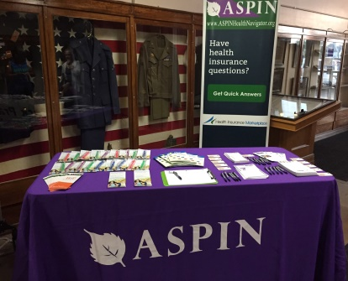

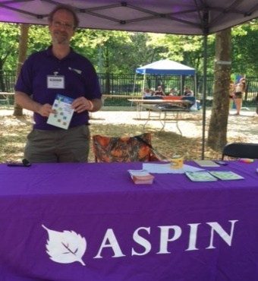
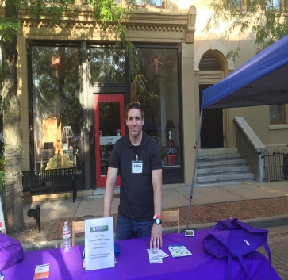
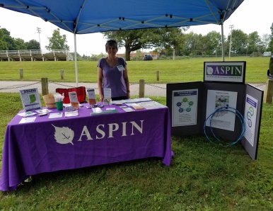
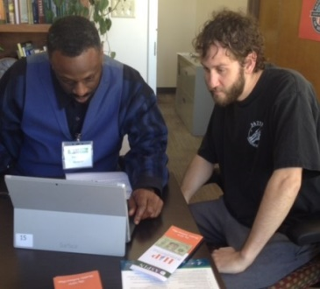


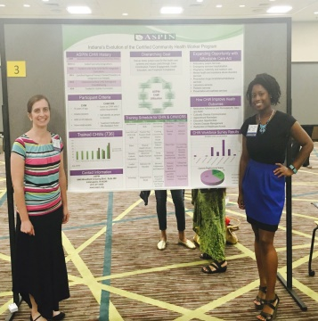
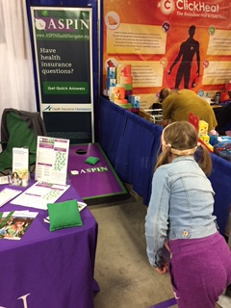
ASPIN Navigators in Action

Slide 26


Call Center
Call:
1-877-313-7215
Website:
www.aspinhealthnavigator.org

Slide 27
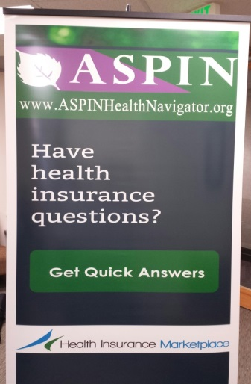

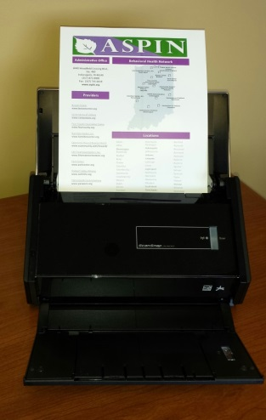

Mobile Office

Slide 28
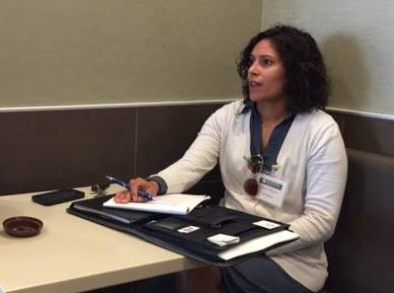
Consumer Surveys

Slide 29
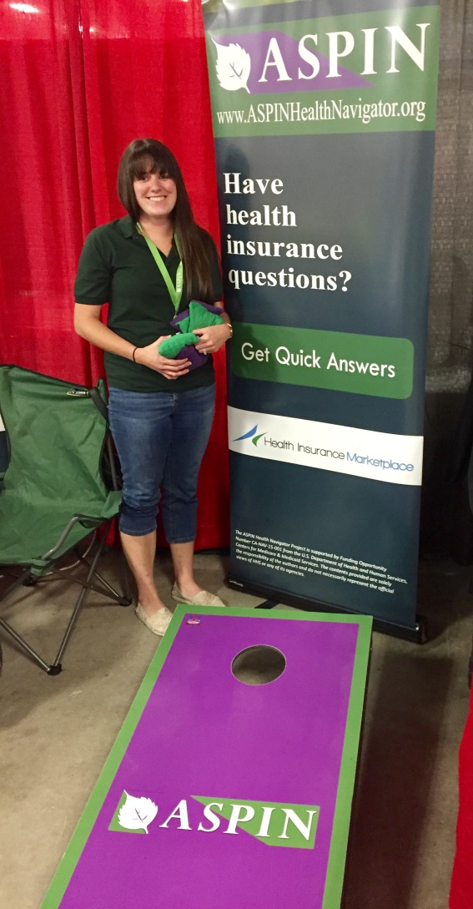

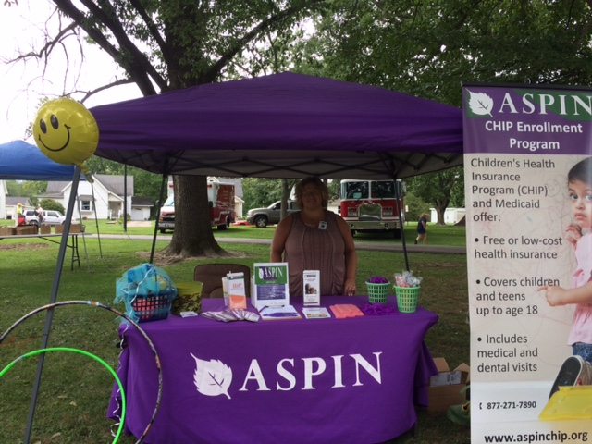
Community Partners
ASPIN Navigators in Action

Slide 30
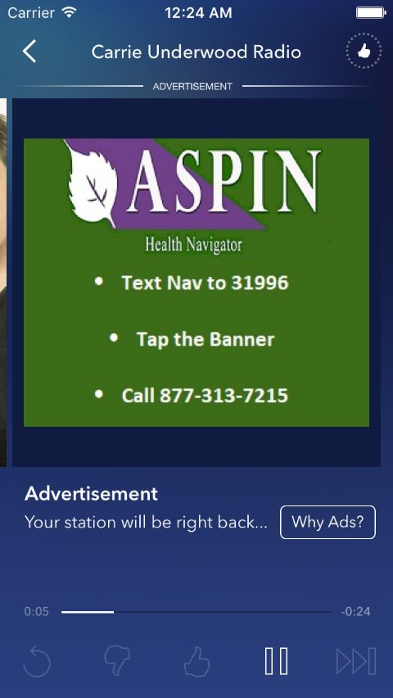
Pandora Radio Campaign

Slide 31



















ASPIN Navigators Here to Help
ASPIN Navigators Here to Help

Slide 32
Julia
Julia Holloway, MBA
Director of Program Development and Navigator Services
ASPIN
Indianapolis, Indiana
jholloway@aspin.org
877-313-7215
www.aspin.org
www.aspinhealthnavigators.org

Slide 33
Ohio Association of Community Health Centers (OACHC)
Professional organization representing Ohio’s Federally Qualified Health Center (FQHC) & Look-Alike (FQHC-LA) health centers
Also referred to as Community Health Centers
50 Community Health Center networks in Ohio
  280 locations statewide | 65 of Ohio’s 88 counties
  At least one Certified Application Counselor (CAC) for each network
Healthcare home and family doctor for more than 670,000 Ohioans annually (2016 data)

Slide 34
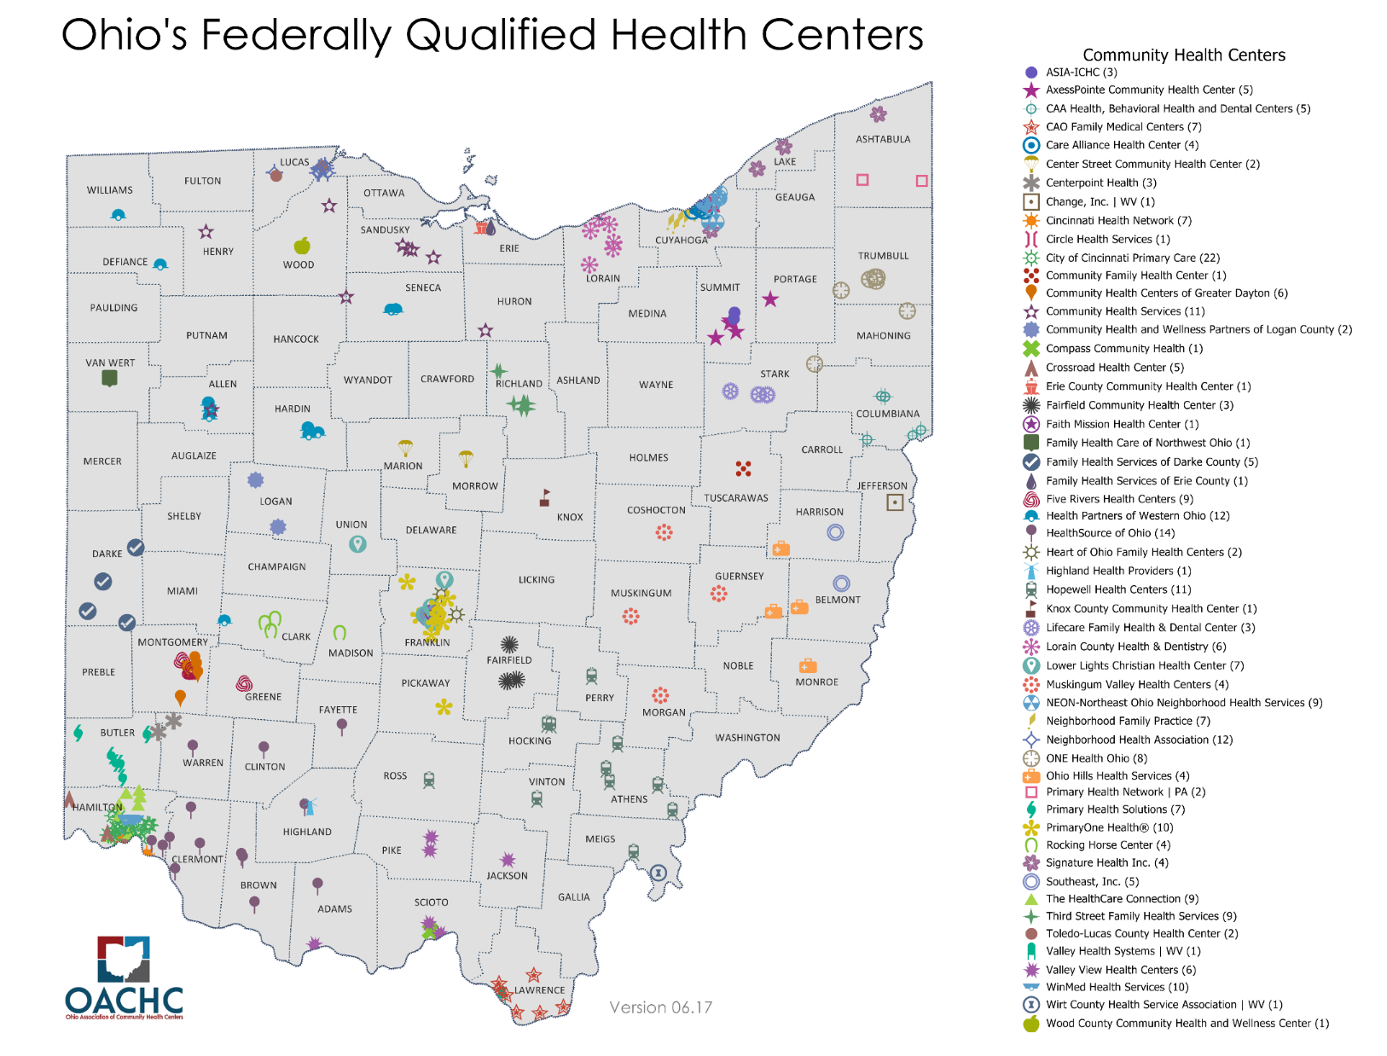

Slide 35
Ohio Assistance: OE5
FQHCs
Nonprofit Certified Application Counselor Organizations
Resolute (Navigator grantee)
Agents and Brokers
GetCovered Connector
2-1-1 (United Way)
Legal Aid

Slide 36

Connecting with Consumers:
Getting Ready for Open Enrollment
Antoinette Kraus, Executive Director

Slide 37
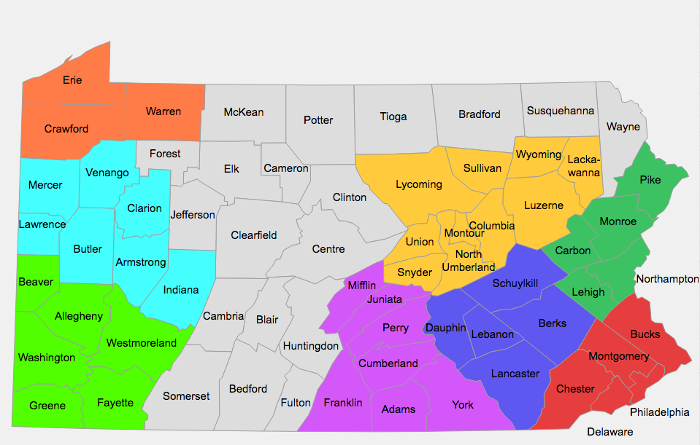

PHAN Helpline:
877-570-3642 pahealthaccess.org/gethelp

Slide 38

Robust Outreach Campaign
Teletown halls
Volunteer outreach capacity
Phone banking
Community events
Enrollment Coordination

Slide 39
Important Contact Info
PHAN Helpline 877-570-3642
helpline@pahealthaccess.org
www.pahealthaccess.org/gethelp
http://www.insurance.pa.gov/Coverage/Pages/2018-Open-Enrollment.aspx
Consumers Checkbook

Slide 40
Today’s Web Briefing Will Be Recorded
The archived web briefing will be available later today.
Slides are available for download.
https://www.kff.org/health-reform/event/web-briefing-what-should-consumers-know-about-aca-open-enrollment-in-indiana-ohio-and-pennsylvania/

Slide 41
Questions About Open Enrollment
Karen Pollitz, Senior Fellow,
Kaiser Family Foundation
Email: kpollitz@kff.org
Phone: (202) 347-5270
Jennifer Tolbert, Director of State Health Reform, Kaiser Family Foundation
Email: jtolbert@kff.org
Phone: (202) 347-5270
Julia Holloway, Director of Program Development and Navigator Services,
Affiliated Service Providers of Indiana
Email: jholloway@aspin.org
Phone: (877) 313-7215
Teresa Rios-Bishop, Outreach and Policy Manager, Ohio Association of Community Health Centers
  Email: tbishop@ohiochc.org
  Phone: (614) 884-3101
Antoinette Kraus, Executive Director, Pennsylvania Health Access Network
Email: akraus@pahealthaccess.org
Phone: (267) 971-1680

Slide 42
Contact Information
    Katie H. Smith, Communications Associate
    Kaiser Family Foundation
    Email: ksmith@kff.org
    Phone: (202) 347-5270
    Facebook: /KaiserFamilyFoundation
    Twitter: @KaiserFamFound
    Email alerts: kff.org/email

