Slide 1
What does the public know and think about Zika?
Poll findings from 2016 Kaiser Family Foundation’s Health Tracking Polls and 2016 Survey of Americans on the U.S. Role in Global Health

Slide 2
The Zika virus outbreak has remained high on the public’s radar since February 2016
SOURCE: Kaiser Family Foundation 2016 Survey of Americans on the U.S. Role in Global Health (conducted March 1-26, 2016)
and Kaiser Family Foundation Health Tracking Polls

Slide 3
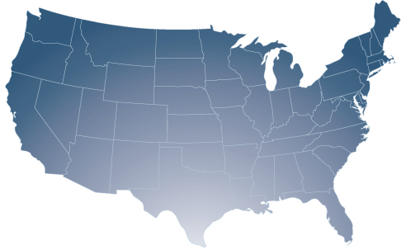
A majority of Americans know about Zika cases in the U.S.
To the best of your knowledge, have there been any cases of the Zika virus diagnosed in the United States, or not?
NOTE: Refused responses not shown.
SOURCE: Kaiser Family Foundation Health Tracking Poll (conducted June 15-21, 2016)

Slide 4
88% of Americans know Zika can be spread through the bite of a mosquito.
59% know a person can become infected with Zika through sex with an infected person.
SOURCE: Kaiser Family Foundation Health Tracking Poll (conducted August 18-24, 2016)

Slide 5
Most Americans know about Zika’s connection to birth defects
To the best of your knowledge, is the Zika virus associated with birth defects in babies born to infected mothers, is it not associated with birth defects, or have you not heard enough to say?
According to the Centers for Disease Control, the Zika virus has been linked to birth defects like microcephaly.
Microcephaly is a birth defect in which a baby’s head is smaller than expected compared to other babies. Children with microcephaly often have developmental issues.
SOURCE: Kaiser Family Foundation Health Tracking Poll (conducted June 15-21, 2016)

Slide 6
Few Americans know about the link between Zika and adult paralysis
To the best of your knowledge, is the Zika virus associated with muscle weakening and paralysis in adults, is it not associated with muscle weakening and paralysis in adults, or have you not heard enough to say?
According to the Centers for Disease Control, the Zika virus has been linked to Guillain-Barré syndrome in adults.
Guillain-Barré syndrome is an uncommon sickness of the nervous system in which a person’s immune system damages the nerve cells, causing muscle weakness and, sometimes, paralysis.
SOURCE: Kaiser Family Foundation Health Tracking Poll (conducted June 15-21, 2016)

Slide 7
Very few Americans –2%–
know someone whose health has been affected by the Zika virus
SOURCE: Kaiser Family Foundation Health Tracking Poll (conducted September 14-20, 2016)

Slide 8
Percent of the public who are worried…
…the U.S. will see a large number of cases of the Zika virus in the next 12 months
53%
…they or someone in their family will be affected by the Zika virus
34%
SOURCE: Kaiser Family Foundation Health Tracking Poll (conducted July 5-11, 2016)

Slide 9
Combating diseases like the Zika virus is seen as a top global health priority
Percent of the public who say each should be a top priority for U.S. efforts to improve health in developing countries:
NOTE: Question wording abbreviated.
SOURCE: Kaiser Family Foundation 2016 Survey of Americans on the U.S. Role in Global Health (conducted March 1-26, 2016)

Slide 10
Four in ten Americans say the U.S. government is doing enough to fight the Zika virus outbreak in the United States; an equal share say it’s not
Do you think the U.S. government is doing enough or not doing enough to fight the Zika virus outbreak in the United States?
SOURCE: Kaiser Family Foundation Health Tracking Poll (conducted August 18-24, 2016)

Slide 11
Few Americans see Zika as a personal threat, but most see it as a threat to pregnant women
Percent who say the Zika virus poses a major threat to…
…pregnant women
…you, personally
SOURCE: Kaiser Family Foundation Health Tracking Poll (conducted July 5-11, 2016)

Slide 12
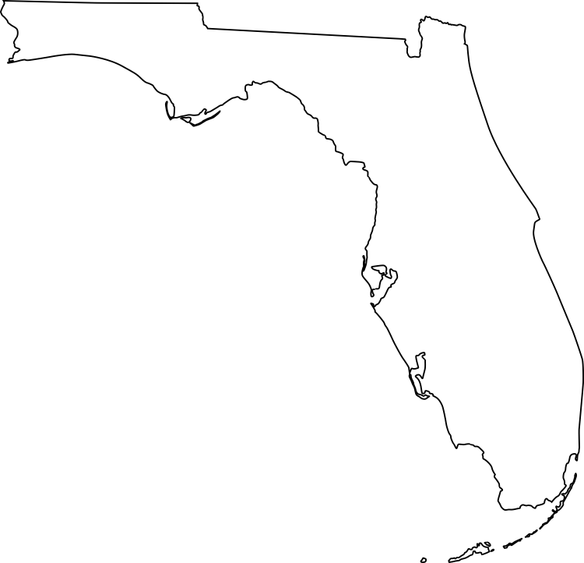
of the public is not comfortable traveling to places in the U.S., like parts of Florida, where people have been infected with Zika by mosquitoes
48%
SOURCE: Kaiser Family Foundation Health Tracking Poll (conducted August 18-24, 2016)

Slide 13
A majority of the American public thinks women in developing countries do not have adequate access to birth control
Do you think most women in developing countries affected by the Zika virus have adequate access to birth control, or not?
SOURCE: Kaiser Family Foundation 2016 Survey of Americans on the U.S. Role in Global Health (conducted March 1-26, 2016)

Slide 14
More women worry about the Zika virus than men
Percent of the public who are worried…
…the U.S. will see a large number of cases of the Zika virus in the next 12 months
…they or someone in their family will be affected by the Zika virus
SOURCE: Kaiser Family Foundation Health Tracking Poll (conducted July 5-11, 2016)

Slide 15
Percent of Americans who say they have done each of the following to protect themselves from getting Zika:
50%
46%
37%
33%
24%
Used mosquito repellent
Removed standing water around their home
Avoided activities or places where there are mosquitoes
Worn long sleeves or pants to protect against mosquito bites
Used condoms during sex
SOURCE: Kaiser Family Foundation Health Tracking Poll (conducted September 14-20, 2016)

Slide 16


A larger share of individuals in the South report taking measures to reduce the number of mosquitoes around their homes
Percent who say that to protect themselves from getting Zika, they have personally…
…removed standing water from around their home
…had a pest control company spray insecticide on their property outside their home
…had a pest control company spray insecticide on their property in their home
South
West
Midwest
Northeast
SOURCE: Kaiser Family Foundation Health Tracking Poll (conducted September 14-20, 2016)

Slide 17
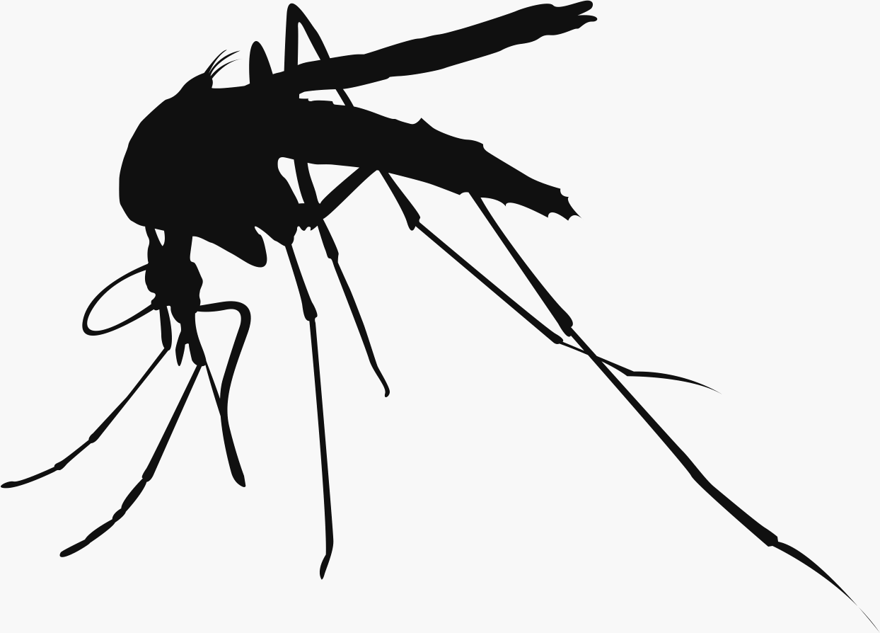
79% of the public say it is important for government funding for Zika to include money for killing mosquitoes
SOURCE: Kaiser Family Foundation Health Tracking Poll (conducted June 15-21, 2016)

Slide 18
Majorities support various actions to combat Zika at home and abroad
Percent of Americans who say that to help fight the Zika virus, the U.S. should…
NOTE: Question wording abbreviated.
SOURCE: Kaiser Family Foundation 2016 Survey of Americans on the U.S. Role in Global Health (conducted March 1-26, 2016) and Kaiser Family Foundation Health Tracking Poll (conducted June 15-21, 2016)

Slide 19
45% trust the Democratic Party
Which party do voters trust to do a better job funding efforts to limit the effects of Zika?
31%
trust the Republican Party
SOURCE: Kaiser Family Foundation Health Tracking Poll (conducted July 15-21, 2016)

Slide 20
54% trust Hillary Clinton
Which candidate do voters trust to do a better job dealing with the Zika virus outbreak?
34%
trust Donald Trump
SOURCE: Kaiser Family Foundation Health Tracking Poll (conducted August 18-24, 2016)

Slide 21
Filling the need for trusted information on national health issues, the Kaiser Family Foundation is a nonprofit organization based in Menlo Park, California.
For more information, please visit www.kff.org
Contacts:
Rakesh Singh | (650) 854-9400 | rsingh@kff.org
Craig Palosky | (202) 347-5270 | cpalosky@kff.org

