Slide 1
The Latest Trends in Income, Assets, and Personal Health Care Spending Among People on Medicare
November 2015

Slide 2
Trends in Income and Assets Among People on Medicare

Slide 3
Half of all Medicare beneficiaries had incomes below $24,150 per person in 2014
1% had incomes above $163,600
5% had incomes above $93,000
50% had incomes below $24,150
25% had incomes below $14,350
SOURCE: Urban Institute / Kaiser Family Foundation analysis of DYNASIM data 2015.

Slide 4
Median per capita income is lower for black and Hispanic beneficiaries than white beneficiaries, and declines with age among seniors, 2014
 |  | Race/ethnicity |  |  |  | Age
Total |  | White | Black | Hispanic |  | Under 65 | 65-74 | 75-84 | 85 or older
NOTE: Total household income for couples is split equally between husbands and wives to estimate income for married beneficiaries.
SOURCE: Urban Institute / Kaiser Family Foundation analysis of DYNASIM data 2015.

Slide 5
Median per capita income is lower for black and Hispanic beneficiaries than white beneficiaries with the same education levels, 2014
White
Black
Hispanic
Less than High School | High School Graduate | Some College | College Graduate
NOTE: Beneficiaries identified as “other” races not shown separately.
SOURCE: Urban Institute / Kaiser Family Foundation analysis of DYNASIM data 2015.

Slide 6
Growth in per capita income is projected to be concentrated among beneficiaries with higher incomes, 2014-2030
In 2014 dollars
95th percentile
90th percentile
75th percentile
50th percentile (Median)
25th percentile
2014 |  |  |  |  |  |  | 2020 |  |  |  |  | 2025 |  |  |  |  | 2030
Year
NOTE: All incomes are adjusted to 2014 dollars.
SOURCE: Urban Institute / Kaiser Family Foundation analysis of DYNASIM data 2015.

Slide 7
Most beneficiaries have some savings, but a larger share of black and Hispanic beneficiaries than white beneficiaries have no savings, 2014
Share of all Medicare beneficiaries with no savings = 8%
White
Black
Hispanic
No savings
5%
No savings
20%
No savings
24%
Share with savings
95%
Share with savings
80%
Share with savings
76%
41.1 million beneficiaries | 5.5 million beneficiaries | 5.1 million beneficiaries
NOTE: Beneficiaries identified as “other” races not shown separately.
SOURCE: Urban Institute / Kaiser Family Foundation analysis of DYNASIM data 2015.

Slide 8
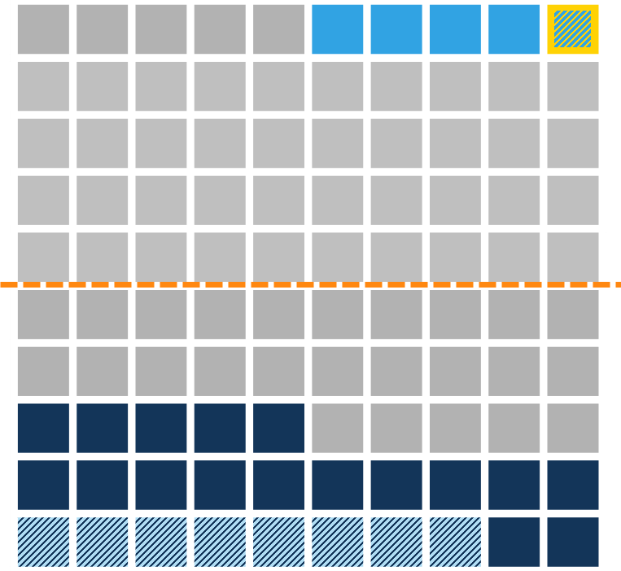
Half of all Medicare beneficiaries had savings below $63,350 per person in 2014
1% had savings above $3,585,350
5% had savings above $1,219,250
50% had savings below $63,350
25% had savings below $11,900
8% had $0 in savings
or were in debt
SOURCE: Urban Institute / Kaiser Family Foundation analysis of DYNASIM data 2015.

Slide 9
Median per capita savings is significantly lower for black and Hispanic beneficiaries than white beneficiaries, and declines with age among seniors, 2014
 |  |  | Race/ethnicity |  |  |  | Age
 | Total |  | White | Black | Hispanic |  | Under 65 | 65-74 | 75-84 | 85 or older
NOTE: Total household savings for couples is split equally between husbands and wives to estimate savings for married beneficiaries.
SOURCE: Urban Institute / Kaiser Family Foundation analysis of DYNASIM data 2015.

Slide 10
Growth in per capita savings is projected to be concentrated among beneficiaries with more savings, 2014-2030
In 2014 dollars
95th percentile
90th percentile
75th percentile
50th percentile (Median)
2014 |  |  |  |  |  |  | 2020 |  |  |  |  | 2025 |  |  |  |  | 2030
Year
NOTE: All savings are adjusted to 2014 dollars.
SOURCE: Urban Institute / Kaiser Family Foundation analysis of DYNASIM data 2015.

Slide 11
Most beneficiaries have some home equity, but a larger share of black and Hispanic beneficiaries than white beneficiaries have none
Share of all Medicare beneficiaries with no home equity = 24%
White
Black
Hispanic
No home
equity
18%
No home equity
43%
No home equity
48%
Share with home equity
82%
Share with home equity
57%
Share with home equity
52%
41.1 million beneficiaries | 5.5 million beneficiaries | 5.1 million beneficiaries
NOTE: Beneficiaries identified as “other” races not shown separately.
SOURCE: Urban Institute / Kaiser Family Foundation analysis of DYNASIM data 2015.

Slide 12
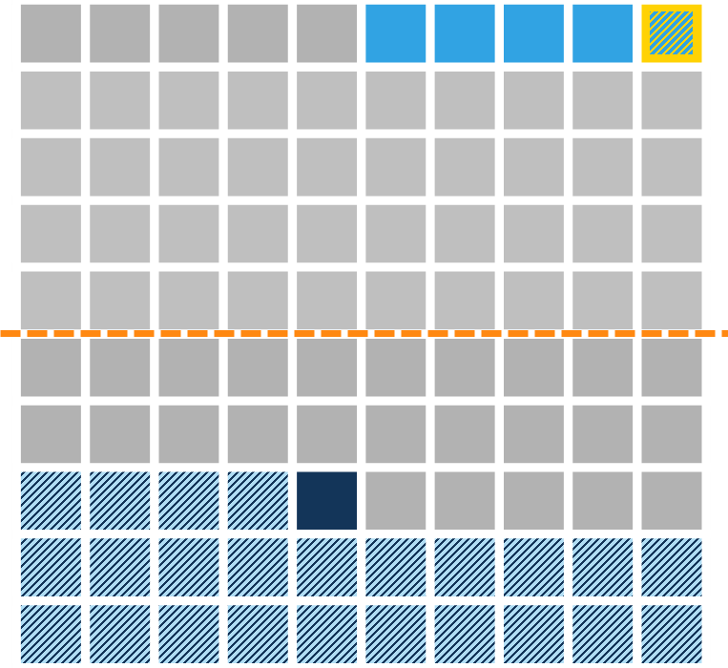
Half of all Medicare beneficiaries had home equity below $65,500 per person in 2014
1% had home equity above $773,550
5% had home equity above $418,400
50% had home equity below $65,500
25% had home equity below $5,200
24% had $0 in home equity
SOURCE: Urban Institute / Kaiser Family Foundation analysis of DYNASIM data 2015.

Slide 13
Median per capita home equity is substantially lower for black and Hispanic beneficiaries than white beneficiaries, 2014
 |  |  | Race/ethnicity |  |  |  | Age
 | Total |  | White | Black | Hispanic |  | Under 65 | 65-74 | 75-84 | 85 or older
NOTE: Total household home equity for couples is split equally between spouses to estimate home equity for married beneficiaries.
SOURCE: Urban Institute / Kaiser Family Foundation analysis of DYNASIM data 2015.

Slide 14
Growth in per capita home equity is projected to be concentrated among beneficiaries with more in home equity, 2014-2030
In 2014 dollars
95th percentile
90th percentile
75th percentile
50th percentile (Median)
2014 |  |  |  |  |  |  | 2020 |  |  |  |  | 2025 |  |  |  |  | 2030
Year
NOTE: All home equity amounts are adjusted to 2014 dollars.
SOURCE: Urban Institute / Kaiser Family Foundation analysis of DYNASIM data 2015.

Slide 15
Trends in Personal Health Care Spending Among People on Medicare

Slide 16
Medicare pays for half of beneficiaries’ total health care spending; beneficiaries pay more than one-fourth out of pocket on services and premiums
Traditional Medicare beneficiaries’ Average Total Health Care Spending, 2011 = $19,921
SOURCE: Kaiser Family Foundation analysis of the Medicare Current Beneficiary Survey 2011 Cost and Use file.

Slide 17
Premiums are nearly half of Medicare beneficiaries’ out-of-pocket health spending; LTC facility costs are the largest component of spending on services
Long-term care facility
Medical providers and supplies
Premiums
Services
Prescription drugs
Dental
Inpatient/outpatient
Post-acute care
Average Total Out-of-Pocket Spending on Services and Premiums, 2011: $5,368
NOTE: Analysis excludes beneficiaries enrolled in Medicare Advantage plans. Premiums includes Medicare Parts A, B, D, and other types of health insurance beneficiaries may have. Post-acute care includes skilled nursing facility and home health.
SOURCE: Kaiser Family Foundation analysis of the Medicare Current Beneficiary Survey 2011 Cost and Use file.

Slide 18
Average out-of-pocket spending on services is higher for women on Medicare than men and increases with age
NOTE: Analysis excludes beneficiaries enrolled in Medicare Advantage plans. Premiums includes Medicare Parts A, B, D, and other types of health insurance beneficiaries may have.
SOURCE: Kaiser Family Foundation analysis of the Medicare Current Beneficiary Survey 2011 Cost and Use file.

Slide 19
Average out-of-pocket spending on services is higher for Medicare beneficiaries in poorer self-reported health
NOTE: Analysis excludes beneficiaries enrolled in Medicare Advantage plans. Premiums includes Medicare Parts A, B, D, and other types of health insurance beneficiaries may have.
SOURCE: Kaiser Family Foundation analysis of the Medicare Current Beneficiary Survey 2011 Cost and Use file.

Slide 20
Average beneficiary out-of-pocket spending rises with the number of functional impairments and chronic conditions
# of Functional Impairments
# of Chronic Conditions
NOTE: Analysis excludes beneficiaries enrolled in Medicare Advantage plans. Premiums includes Medicare Parts A, B, D, and other types of health insurance beneficiaries may have.
SOURCE: Kaiser Family Foundation analysis of the Medicare Current Beneficiary Survey 2011 Cost and Use file.

Slide 21
Beneficiaries with incomes between $20,000-$30,000 pay somewhat more out of pocket than others; those with incomes of $20,000 or less pay less overall due to lower premiums
NOTE: Analysis excludes beneficiaries enrolled in Medicare Advantage plans. Premiums includes Medicare Parts A, B, D, and other types of health insurance beneficiaries may have.
SOURCE: Kaiser Family Foundation analysis of the Medicare Current Beneficiary Survey 2011 Cost and Use file.

Slide 22
For community-dwelling beneficiaries, providers and supplies accounts for one-third of average out-of-pocket service spending, followed by prescription drugs and dental services
Average Out-of-Pocket Service Spending among Community Residents, 2011: $1,881
NOTE: Analysis excludes beneficiaries enrolled in Medicare Advantage plans. Excludes premium spending.
SOURCE: Kaiser Family Foundation analysis of the Medicare Current Beneficiary Survey 2011 Cost and Use file.

Slide 23
For long-term care facility residents, the largest component of average out-of-pocket service spending is LTC facility costs
Average Out-of-Pocket Service Spending among Facility Residents, 2011: $18,936
NOTE: Analysis excludes beneficiaries enrolled in Medicare Advantage plans. Excludes premium spending.
SOURCE: Kaiser Family Foundation analysis of the Medicare Current Beneficiary Survey 2011 Cost and Use file.

Slide 24
One-fourth of Medicare beneficiaries spent at least $6,400 out of pocket on services and premiums in 2011; 1 in 10 spent at least $10,400
NOTE: Analysis excludes beneficiaries enrolled in Medicare Advantage plans. Premiums includes Medicare Parts A, B, D, and other types of health insurance beneficiaries may have.
SOURCE: Kaiser Family Foundation analysis of the Medicare Current Beneficiary Survey 2011 Cost and Use file.

Slide 25
Long-term care facility costs are a major component of spending for beneficiaries in the top quartile of total out-of-pocket spending
NOTE: Analysis excludes beneficiaries enrolled in Medicare Advantage plans. Premiums includes Medicare Parts A, B, D, and other types of health insurance beneficiaries may have. *Other services includes dental, home health, inpatient and outpatient hospital, medical providers/supplies, prescription drugs, and skilled nursing facility.
SOURCE: Kaiser Family Foundation analysis of the Medicare Current Beneficiary Survey 2011 Cost and Use file.

Slide 26
Beneficiaries’ out-of-pocket spending on medical and long-term care services increased at an average annual rate of 2.3% between 2000 and 2011
NOTE: Analysis excludes beneficiaries enrolled in Medicare Advantage plans. *Other services includes skilled nursing facility, home health, and inpatient and outpatient hospital services.
SOURCE: Kaiser Family Foundation analysis of the Medicare Current Beneficiary Survey 2000-2011 Cost and Use files.

Slide 27
Health insurance premiums accounts for the largest component of average health care spending by Medicare households
Health insurance
(71% of health spending)
Medical services
(16% of health spending)
Other
household spending
85.2%
Health care spending 14.8%
$3,776 10.5%
Prescription drugs
(10% of health spending)
$858 2.4%
Medical supplies
(3% of health spending)
$526 1.5%
$181 0.5%
Average Total Household Spending, 2014:
$36,080
Average Health Care Spending, 2014:
$5,342
NOTE: Numbers may not sum to total due to rounding.
SOURCE: Kaiser Family Foundation analysis of Bureau of Labor Statistics Consumer Expenditure Survey, 2014.

Slide 28
Insurance premiums have accounted for a growing share of Medicare households’ total spending since 2002; the share of spending on prescription drugs has steadily decreased
SOURCE: Kaiser Family Foundation analysis of Bureau of Labor Statistics Consumer Expenditure Survey, 2002-2014.

Slide 29
Health insurance spending by Medicare households increased nearly two-fold between 2002 and 2014; drug spending fell
SOURCE: Kaiser Family Foundation analysis of Bureau of Labor Statistics Consumer Expenditure Survey, 2002-2014.

Slide 30
Medicare households spent more on health care than non-Medicare households in 2014
Medicare households
Transportation
Total = $36,080
Transportation
$5,342
$12,468
$5,400
$5,277
$7,593
Non-Medicare households
Total = $54,232
$3,511
$17,855
$8,070
$9,479
$15,316
SOURCE: Kaiser Family Foundation analysis of Bureau of Labor Statistics Consumer Expenditure Survey, 2014.

Slide 31
Medicare households experienced a steeper drop in the average annual rate of drug spending and a smaller increase in premium spending than non-Medicare households between 2002 and 2014
SOURCE: Kaiser Family Foundation analysis of Bureau of Labor Statistics Consumer Expenditure Survey, 2002-2014.

Slide 32

Resources on Medicare Beneficiaries’ Income, Assets, and Health Care Spending at kff.org/medicare
Income and Assets of Medicare Beneficiaries, 2014-2030 Wide Disparities in the Income and Assets of People on Medicare by Race and Ethnicity: Now and in the Future How Much Is Enough? Out-of-Pocket Spending Among Medicare Beneficiaries: A Chartbook Health Care on a Budget: The Financial Burden of Health Spending by Medicare Households Medicare’s Income-Related Premiums: A Data Note

