Slide 1
Medicaid: Moving Forward
September 2015

Slide 2


The basic foundations of Medicaid are still with us today.
Enacted in 1965 as title XIX of the Social Security Act
Means-tested; originally focused on the public assistance population
Federal State
Entitlement
Eligible Individuals are entitled to a defined set of benefits
States are entitled to federal matching funds
Means-tested, with focus on welfare population:
-single parents with dependent
children
-aged, blind, and disabled
Mandatory services and populations for participating states with options for broader coverage
Sets core requirements on eligibility and benefits
Flexibility to administer the program within federal guidelines
partnership

Slide 3
But Medicaid has evolved over time to meet changing needs.
Millions of Medicaid Beneficiaries
HCBS waivers authorized
Section 1115 waivers expand Medicaid eligibility
“Katie Beckett” option
Medicaid ≠ Welfare
Implementation of the ACA Medicaid expansion
SSI
enacted
Medicaid eligibility for women
and children is expanded
SCHIP
enacted
ACA
enacted
NOTE: Data are missing for 1999, 2012 and 2013. Data for 2014 and 2015 are projections.
SOURCES: 1972-1998: Unduplicated, ever-enrolled counts as reported in the 2000 House Ways and Means Committee Green Book http://www.gpo.gov/fdsys/search/pagedetails.action?granuleId=&packageId=GPO-CPRT-106WPRT61710.
2000-2011: KCMU and Urban Institute estimates based on unduplicated, ever-enrolled data from FFY 2000-2011 MSIS.
2014-2015: Unduplicated, ever-enrolled counts as reported in the March 2015 CBO baseline.
Notes:
Updated 4/17/2015 LS

Slide 4






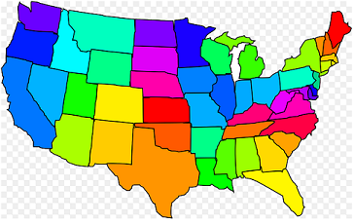

Medicaid plays a central role in our health care system
Health Insurance Coverage
Assistance to Medicare Beneficiaries
Long-Term Care Assistance
MEDICAID
Support for Health Care System and Safety-Net
State Capacity for Health Coverage
Notes:
Health Insurance Coverage:
2011 MSIS Updated 12/19/14 (KY)
Assistance to Medicare Beneficiaries:
10 million aged and disabled: MSIS 2011 Updated 12/19/14 (KY)
21% of Medicare Beneficiaries: Kaiser Family Foundation analysis of the CMS Medicare Current Beneficiary Survey Cost and Use file, 2010. Updated 8/20/14 (KY)
Long-Term Care Assistance:
MSIS 2011 data. Updated 12/19/14 (KY)
Note that this considers a Medicaid beneficiary an institutional resident if they have positive institutional spending, and a community-based resident if they have positive non-institutional spending.
Support for Health Care System and Safety-net:
KCMU estimates of CMS National Health Expenditure Accounts data for 2013, published 2014. Updated 12/19/14 (KY)
State Capacity for Health Coverage: FY 2015 FMAPs Updated 12/19/14 (KY)

Slide 5
And makes up a significant portion of total health coverage and spending.
Total = 313.4 million
Total = $2.5 trillion
NOTE: Health spending total does not include administrative spending.
SOURCE: Health insurance coverage: KCMU/Urban Institute analysis of 2013 data from 2014 ASEC Supplement to the CPS. Health expenditures: KFF calculations using 2013 NHE data from CMS, Office of the Actuary
Notes:
Notes:
Health Coverage: CHIP and individuals eligible for both Medicare and Medicaid (dual eligible enrollees) are included in Medicaid in the health coverage data. CHIP enrollees are included with “Other government programs” in the spending data.
Other Public (Federal) includes individuals covered through the military or Veterans Administration in federally-funded programs such as TRICARE (formerly CHAMPUS) as well as some non-elderly Medicare enrollees.
Updated 3/24/15 (KY)

Slide 6
Medicaid is a major financing source for health care services.
Total
National Spending
(billions)
$2,469
$937
$778
$156
$271
NOTE: Includes neither spending on CHIP nor administrative spending. Definition of nursing facility care was revised from previous years and no longer includes residential care facilities for mental retardation, mental health or substance abuse. The nursing facility category includes continuing care retirement communities.
SOURCE: CMS, Office of the Actuary, National Health Statistics Group, National Health Expenditure Accounts, 2015. Data for 2013.
Notes:
Updated 3/2/2015 (LS)
Professional services includes physician & clinical services, dental services, other professional services, and other personal health care services

Slide 7
And the primary payer for long term care.
Total National LTSS Spending
= $310 billion, 2013
Out-of-Pocket, 15%
NOTE: Total long-term care expenditures include spending on residential care facilities, nursing homes, home health services, personal care services (government-owned and private home health agencies), and § 1915(c) home and community-based waiver services (including home health). Long-term care expenditures also include spending on ambulance providers. All home and community-based waiver
services are attributed to Medicaid.
SOURCE: KCMU estimates based on CMS National Health Expenditure Accounts data for 2013.

Slide 8
Medicaid spending is mostly for the elderly and people with disabilities.
SOURCE: KCMU/Urban Institute estimates based on data from FY 2011 MSIS and CMS-64. MSIS FY 2010 data were used for FL, KS, ME, MD, MT, NM, NJ, OK, TX, and UT, but adjusted to 2011 CMS-64.
Notes:
Updated 12/22/14 (KY)
Kaiser Slides

Slide 9
Medical and long-term care needs drive Medicaid spending.
SOURCE: Kaiser Commission on Medicaid and the Uninsured and Urban Institute estimates based on data from FY 2011 MSIS and CMS-64 reports. Because 2011 data were unavailable, 2010 MSIS data were used for FL, KS, ME, MD, MT, NM, NJ, OK, TX, and UT. Data for these states were adjusted to 2010 spending levels.
Notes:
Updated 6/19/15 (KY)
NOTE: Due to data quality issues, individuals with disabilities in Maine who were enrolled in Medicaid only in Q4 of FY 2010 are not included in payment per enrollee calculations.

Slide 10
The majority of Medicaid expenditures are for acute care.
Acute
Care
71.2%
Long-Term
Care
24.9%
Total = $475.91 billion
NOTE: Excludes administrative spending, adjustments and payments to the territories.
SOURCE: Urban Institute estimates based on FY 2014 data from CMS (Form 64), prepared for the Kaiser Commission on Medicaid and the Uninsured.
Notes:
Updated 9/1/15 (KY)

Slide 11
Over half of all Medicaid beneficiaries receive their care in comprehensive risk-based MCOs.
Share of Medicaid beneficiaries enrolled
in risk-based managed care plans
VT
ME
WA
NH
MT
ND
MN
OR
MA
SD
WI
NY
ID
MI
CT
RI
WY
PA
NJ
NE
IA
OH
DE
NV
IL
IN
MD
CA
UT
CO
WV
VA
KS
MO
KY
DC
NC
AZ
TN
NM
OK
AR
SC
MS
AL
GA
TX
LA
AK
FL
HI
0% (14 states)
1-50% (11 states)
U.S. Overall = 51%
51-80% (23 states, including DC)
>80% (3 states)
SOURCE: Medicaid Managed Care Enrollment Report, Summary Statistics as of July 1, 2011, CMS, 2012.
Notes:
*Waiting for update. CMS report past due (RA)

Slide 12
Federal and state governments share Medicaid costs.
WA
VT
ME
MT
ND
MN
NH
OR
WI
NY
MA
ID
SD
MI
RI
WY
PA
CT
IA
NJ
NV
NE
IN
OH
DE
UT
CO
IL
MD
CA
KS
WV
VA
DC
MO
KY
NC
OK
TN
AZ
AR
SC
NM
MS
AL
GA
AK
LA
TX
FL
HI
FFY 2015 FMAP
50 percent (14 states)
50.1-59.9 percent (13 states)
60.0-66.9 percent (13 states)
67.0-73.1 percent (11 states, including DC)
NOTE: FMAP percentages are rounded to the nearest tenth of a percentage point. These rates are in effect Oct. 1, 2014-Sept. 30, 2015. These FMAPs reflect the state’s regular FMAP; they do not reflect the FMAP for newly eligibles in states that adopted the ACA Medicaid expansion.
SOURCE: Federal Register, January 21, 2014 (Vol. 79, No. 13), pp 3385-3388, at http://www.gpo.gov/fdsys/pkg/FR-2014-01-21/pdf/2014-00931.pdf.
Notes:
Updated 2/2013 (LS)
Source: Federal Register – updated annually (usually around November, but depends on publication.)
Note: The FMAP refers to the federal fiscal year, which doesn’t align with most state fiscal years. The most up-to-date FMAPs therefore may refer to a future time period and may not be what you need. For example, the FFY 2015 FMAPs were published in January 2014, but didn’t go into effect until October 2014.

Slide 13
Medicaid is both a spending item and a source of federal revenue in state budgets.
SOURCE: Kaiser Commission on Medicaid and the Uninsured estimates based on the NASBO’s November 2014 State Expenditure Report (data for Actual FY 2013).
Notes:
Updated 12/2014 (LS)

Slide 14
Medicaid spending and enrollment are affected by changes in economic conditions and policy.
NOTE: Enrollment percentage changes from June to June of each year. Spending growth percentages in state fiscal year.
SOURCE: Implementing the ACA: Medicaid Spending & Enrollment Growth for FY 2014 and FY 2015
Notes:
Updated by: LS 10/14/2014
Source: KCMU Annual Medicaid Budget Survey for most recent periods; HMA enrollment reports for older enrollment trends and CMS-64 data for older spending trends. This is updated once a year, usually in September or October.

Slide 15
Medicaid Helps a Range of Low-Income Individuals
Low-Income Families | Pregnant Women: Pre-natal care and delivery costs Children: Routine and specialized care for childhood development (immunizations, dental, vision, speech therapy) Families: Affordable coverage to prepare for the unexpected (emergency dental, hospitalizations, antibiotics)
Individuals with Disabilities | Autistic Child: In-home therapy, speech/occupational therapy Cerebral Palsy: Assistance to gain independence (personal care, case management and assistive technology) HIV/AIDS: Physician services, prescription drugs Mental Illness: Prescription drugs, physicians services
Elderly Individuals | Medicare beneficiary: help paying for Medicare premiums and cost sharing Community Waiver Participant: community based care and personal care Nursing Home Resident: care paid by Medicaid since Medicare does not cover institutional care

Slide 16
How Broad is Medicaid’s Reach?
Families
Elderly and People with Disabilities
NOTE: FPL-- Federal Poverty Level. The FPL was $19,530 for a family of three in 2013.
SOURCES: Kaiser Commission on Medicaid and the Uninsured (KCMU) and Urban Institute analysis of 2013 CPS/ASEC Supplement; Birth data - Maternal and Child Health Update, National Governors Association, 2012; Medicare data - Medicare Payment Advisory Commission, Data Book: Beneficiaries Dually Eligible for Medicare and Medicaid (January 2015), 2010 data; Functional Limitations - KCMU Analysis of 2012 NHIS data; Nonelderly with HIV - 2009 CDC MMP; Nursing Home Residents - 2012 OSCAR data.
Notes:
Updated 4/10/15 (VN, KY)
Sources:
< FPL, 100%FPL-199%FPL, all children, children < FPL, parents < FPL: Kaiser Commission on Medicaid and the Uninsured and Urban Institute analysis of 2013 ASEC Supplement to the CPS.
Birth data from Maternal and Child Health Update, National Governors Association, 2012.
Medicare data Medicare Payment Advisory Commission, Data Book: Beneficiaries Dually Eligible for Medicare and Medicaid (January 2015), 2010 data
Nonelderly Adults with Functional Limitations from KCMU Analysis of 2011 NHIS data
Nonelderly with HIV in regular care: 2009 MMP from “Assessing the Impact of the Affordable Care Act on Health Insurance Coverage of People with HIV,” January 2014, available at http://kaiserfamilyfoundation.files.wordpress.com/2013/12/8535-assessing-the-impact-of-the-affordable-care-act-on-health-insurance-coverage.pdf. (Possibly be unable to update in the future- only CDC analysts are allowed to work with this data. They ran it for us for the cited report.)
Nursing Home residents: March 2012 Online Survey, Certification, and Reporting system (OSCAR), Centers for Medicare and Medicaid Services, U.S. Department of Health and Human Services. Reported in “LTC Stats: Nursing Facility Patient Characteristics Report.”

Slide 17
Compared to the uninsured, Medicaid coverage increases access to care.
Children
Nonelderly Adults
NOTES: Access measures reflect experience in past 12 months. Respondents who said usual source of care was the emergency room are not counted as having a usual source of care. *Difference from ESI is statistically significant (p<.05)
SOURCE: KCMU analysis of 2014 NHIS data.
Notes:
Updated 12/22/14 (VN)

Slide 18
Top 5% of Enrollees Accounted for More than Half of Medicaid Spending, FY 2011
68.0 million
$397.6 billion
SOURCE: KCMU/Urban Institute estimates based on data from FY 2011 MSIS and CMS-64. MSIS FY 2010 data were used for FL, KS, ME, MD, MT, NM, NJ, OK, TX, and UT, but adjusted to 2011 CMS-64.
Notes:
Updated 12/19/14 (KY)

Slide 19
Dual Eligibles have significant health problems.
NOTES: Total number of dual eligibles includes beneficiaries eligible for full Medicaid benefits, along with other low-income beneficiaries eligible for assistance with Medicare premiums and cost-sharing requirements (the Medicare Savings Programs).
SOURCE: Kaiser Family Foundation analysis of the CMS Medicare Current Beneficiary Survey Cost and Use File, 2008.

Slide 20
Duals Account for 36% of Medicaid Spending, FY 2011
Dual
Spending
36%
Total = 68.0 Million
Total = $412.1 Billion
SOURCE: Kaiser Commission on Medicaid and the Uninsured and Urban Institute estimates based on data from FY 2011 MSIS and CMS-64 reports. 2010 MSIS data was used for FL, KS, MD, MT, NM, NJ, OK, TX, and UT, because 2011 data were unavailable.
Notes:
Updated 9/5/13 (KY)
Note: Total Medicaid spending excludes Disproportionate Share Hospital (DSH) and administrative spending.

Slide 21
Medicaid at 50: Moving to the future
Pre-ACA
Post-ACA
Health Insurance Coverage
for Certain Individuals
Coverage for All Adults and
Children Up to at Least
138% FPL
Antiquated
Enrollment Process
Modernized, Simplified
Enrollment Process
Shared Financing
States and Federal Govt.
Additional
Federal Financing
for New Coverage
Support for
Health Care System
Delivery System Reforms
Notes:
Updated 3/6/14 (AV)

Slide 22
Children and pregnant women had traditionally been covered at higher income levels compared to adults.
Minimum Medicaid Eligibility under Health Reform - 138% FPL
($24,344 for a family of 3 in 2012)
SOURCE: Based on the results of a national survey conducted by the Kaiser Commission on Medicaid and the Uninsured and the Georgetown University Center for Children and Families, 2013.
Notes:
Updated 1/2/2013 JS

Slide 23





The ACA Medicaid expansion fills current gaps in coverage.
Medicaid Eligibility Today
Medicaid Eligibility
in 2014
Limited to Specific Low-Income Groups
Extends to Adults ≤138% FPL*
Pregnant
Women
Extends to Adults
≤138% FPL*
Elderly &
Persons with Disabilities
Children
Parents
Adults
NOTE: The June 2012 Supreme Court decision in National Federation of Independent Business v. Sebelius maintained the Medicaid expansion, but limited the Secretary's authority to enforce it, effectively making the expansion optional for states. 138% FPL = $16,242 for an individual and $27,724 for a family of three in 2015.

Slide 24
But not all states have expanded Medicaid.
VT
ME
WA
NH*
MT**
ND
MN
OR
MA
SD
WI*
NY
ID
MI*
CT
RI
WY
PA*
NJ
NE
IA*
OH
DE
NV
IL
IN*
MD
CA
UT
CO
WV
VA
KS
MO
KY
DC
NC
AZ
TN
NM
OK
AR*
SC
MS
AL
GA
AK
TX
LA
FL
HI
Adopted (31 States including DC)
Adoption under Discussion (1 State)
Not Adopting At This Time (19 States)
NOTES: Based on KCMU analysis of state executive activity . **MT has passed legislation adopting the expansion; it requires federal waiver approval. *AR, IA, IN, MI, PA and NH have approved Section 1115 waivers. Coverage under the PA waiver went into effect 1/1/15, but it is transitioning coverage to a state plan amendment. WI covers adults up to 100% FPL in Medicaid, but did not adopt the ACA expansion.
SOURCE: “Status of State Action on the Medicaid Expansion Decision,” KFF State Health Facts, updated September 1, 2015.
http://kff.org/health-reform/state-indicator/state-activity-around-expanding-medicaid-under-the-affordable-care-act/

Slide 25
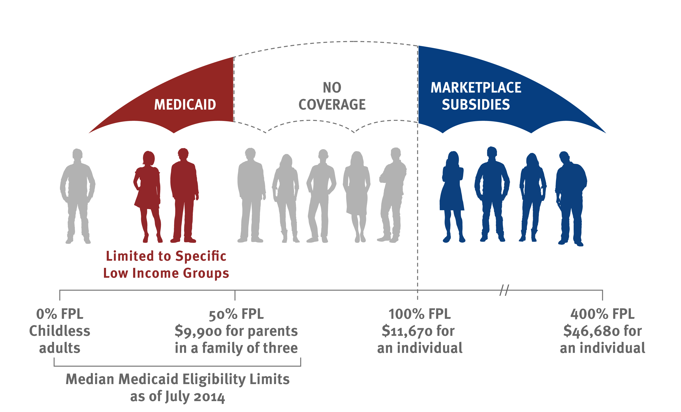
In states that have not expanded Medicaid under the ACA, there are large gaps in coverage available for adults.
44% FPL
$8,840 for parents
in a family of three
$11,770
for an individual
$47,080
for an individual
as of October 2014
as of April 2015
Notes:
Updated 4/2/2015 (AG)
Data based on CPS coverage gap runs (AD)
Next update expected in late Sept/early Oct. 2015

Slide 26
Nationwide, there are 3.7 Million low-income adults estimated to fall into the coverage gap.
Distribution By State:
Distribution By Geographic Region:
Total = 3.7 Million in the Coverage Gap
Notes: Excludes legal immigrants who have been in the country for five years or less and immigrants who are undocumented.
The poverty level for a family of three in 2015 is $20,090. Totals may not sum to 100% due to rounding.
Source: “Number of Poor Uninsured Nonelderly Adults in the ACA Coverage Gap,” KFF State Health Facts.
http://kff.org/health-reform/state-indicator/number-of-poor-uninsured-nonelderly-adults-in-the-aca-coverage-gap/#.
Notes:
Created 9/3/13 (AV)
Updated 2/13/2015 (LS)

Slide 27









The ACA modernizes the Medicaid application and enrollment experience in all states.
PAST
ACA Vision
Apply in person
Multiple options to apply
No Wrong Door to Coverage
Provide paper documentation
Electronic verification
Medicaid
CHIP
Marketplace
$
Data
Hub
#
Wait for eligibility determination
Real-time determination
Dear __,
You are
eligible for…

Slide 28

While other key reforms bolster primary care and focus on transforming care delivery and payment systems.
Increased Medicare and Medicaid payments for primary care
Investment in community health centers
Health care workforce development
Emphasis on prevention
Patient-centered medical home and accountable care models
  Health homes for Medicaid beneficiaries with chronic conditions
Shift away from fee-for-service toward value-based payment
New options for home and community-based long-term services and supports

Slide 29
Medicaid Policy Issues Going Forward
Coverage (Eligibility, Outreach and Enrollment)
  Will state decisions to implement the Medicaid expansion change?
  How will the ACA affect Medicaid enrollment? Uninsured?
  How well will new enrollment systems work and how well will systems be coordinated across health programs?
  What outreach strategies work best, least?
Financing and Fiscal Issues
  What effect will the ACA have on state and federal Medicaid spending? Will the ACA Medicaid expansion have other fiscal effects (reductions in uncompensated care or other indigent care funding, broader economic effects, effects for providers)
Access to and Delivery of Services
  How will increased Medicaid coverage affect access to health care and services - and ultimately health outcomes?
  How will delivery system changes affect access to care?
  What new innovations will be successful in integrating care for complex populations (duals demonstrations)
Notes:
2/21/14

