Slide 1
Web Briefing for Media:
Key Issues Facing the 2015 World Health Assembly -- From Ebola to WHO Reform
Thursday, May 7, 2015
Presented by the Kaiser Family Foundation

Slide 2
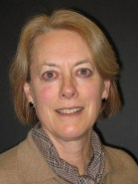
Penny Duckham (moderator)
Executive Director, Kaiser Media Fellowships Program
Kaiser Family Foundation

Slide 3
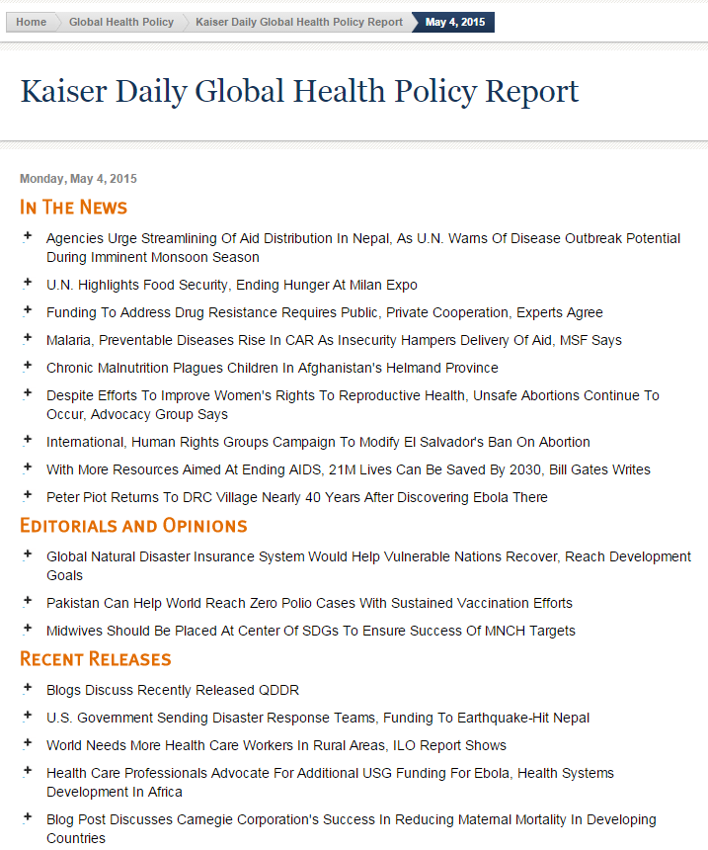

Sign up for a daily digest of global health headlines via KFF
Visit kff.org/email, enter your email address, and choose “Kaiser Global Health Policy Report.”

Slide 4
Today’s Web Briefing Will Be Recorded
All PowerPoint slides can be found at
kff.org/global-health-policy
A transcript will be available soon.

Slide 5
Q&A – You Can Ask Questions Via Chat
You can type your questions via chat at any time.
At the end of the presentations, we will begin our Q&A discussion. At that time, the speakers will answer questions that were submitted via chat.

Slide 6

Ian Smith
Executive Director, Director-General’s Office
World Health Organization (WHO)

Slide 7
The 68th World Health Assembly
Dr Ian Smith
Executive Director
Director-General's Office
May 7, 2015

Slide 8
What is WHA?
The World Health Assembly (WHA) is the largest health policy meeting in the world.
Held annually in Geneva, Switzerland, it is the supreme, decision-making body of the World Health Organization (WHO), attended by over 3,000 delegates headed by ministers of health from 194 Member States, with participants from UN agencies, civil society organizations, and other partners.
WHA is preceded by a meeting of the Programme, Budget and Administration Committee of the Executive Board. The Executive Board follows immediately after the WHA.
WHA68 Dates: May 18 – 26, 2015
Theme: Building Resilient Health Systems
Keynote: Chancellor Angela Merkel

Slide 9
How does it work?
Every year the Executive Board of WHO prepares the agenda to be discussed and the proposed decisions and resolutions.
All documents are available on the WHA website
Topics are first discussed in Committee Meetings A and B, and then brought for final decision to Plenary Meetings
Other topics are also discussed in Technical Briefings and Side Events
A daily Journal provides an update on the programme of the WHA
For the first time, all sessions will be accessible via live-stream and a mobile app.
**The Journal & WHA agenda items can be found at: http://apps.who.int/gb/e/e_wha68.html**

Slide 10
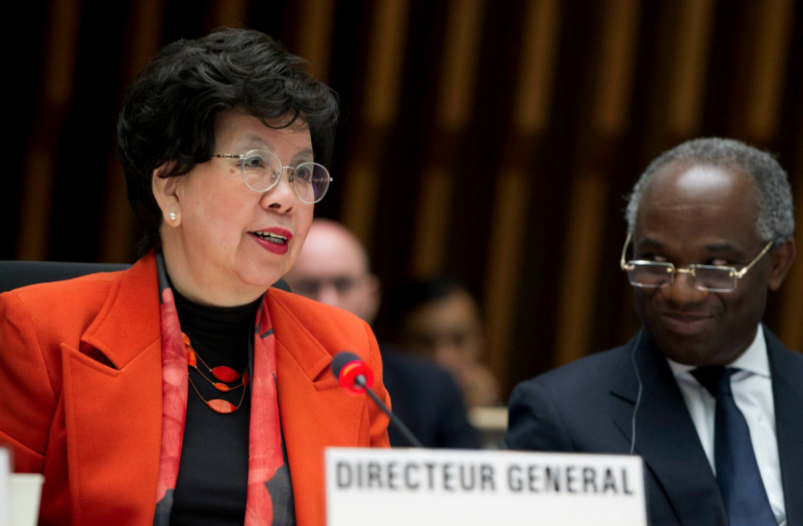
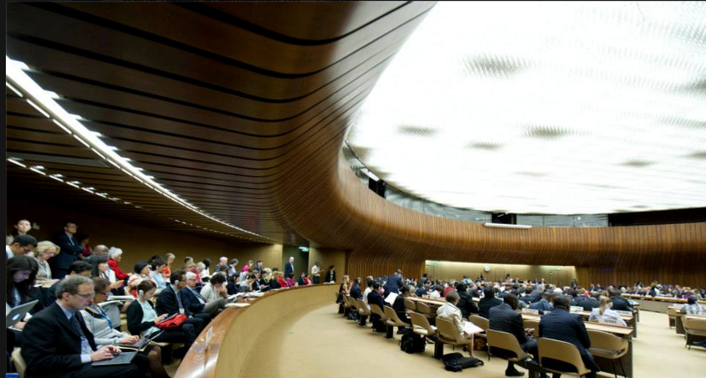
Why is it important? What does it aim to achieve?
The World Health Assembly determines the key health policies and priorities of the global community. The outcomes serve as the road map of what health decisions will be taken nationally.
This year, decision makers will approve the
biennial work programme budget for 2016 and 2017.
Topic focus areas will include: Ebola, Emergency Reform, Antimicrobial Resistance, Post-2015 Health Agenda, Climate and Health

Slide 11
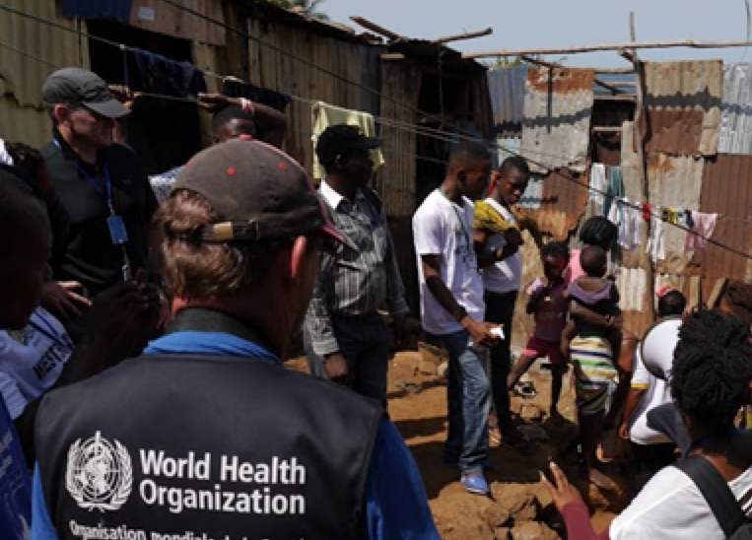
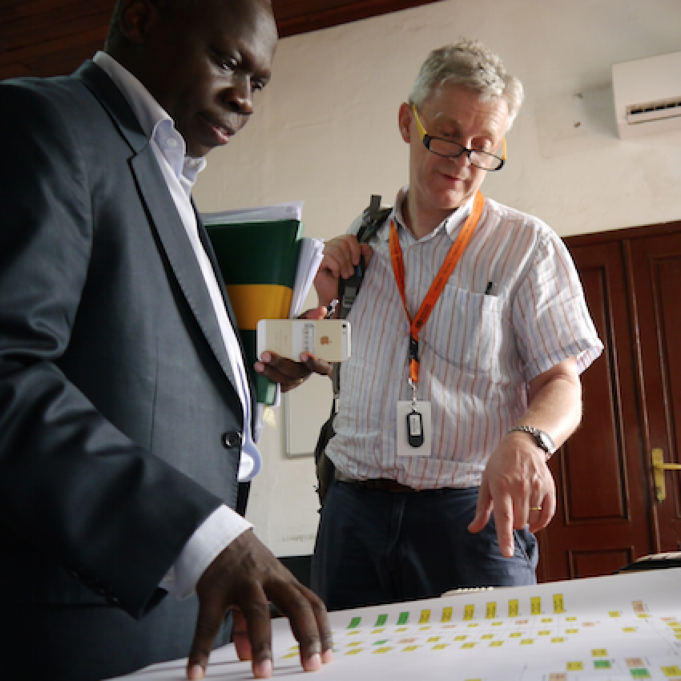
Ebola
The severity and scale of the Ebola outbreak has been unprecedented and reinforced the need for building and strengthening resilient health systems. WHA will serve as an opportunity to:
Assess the current outbreak situation.
Review and assess the response efforts.

Slide 12
Reform of WHO work in Health Emergencies
A Special Session of the Executive Board on Ebola held in January 2015 endorsed a resolution to bolster WHO’s capacity to detect and respond to disease outbreaks and other health emergencies. The WHA will review proposals for:
Strengthening WHO’s emergency response capacities under the International Health Regulations (IHR).
Planning for a global health emergency workforce.
Establishing a contingency fund that can be quickly tapped into for early rapid response.

Slide 13

Antimicrobial Resistance
Antimicrobial resistance occurs when bacteria, parasites, viruses, or fungi change in response to the use of these medications. This year decision-makers will meet to review a draft global action plan on antimicrobial resistance.

Slide 14
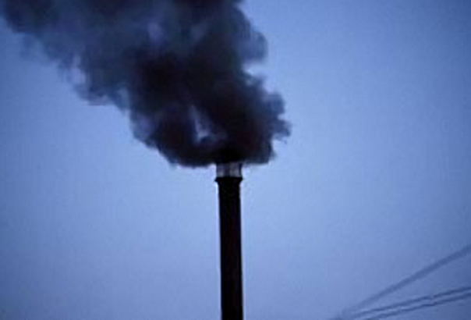
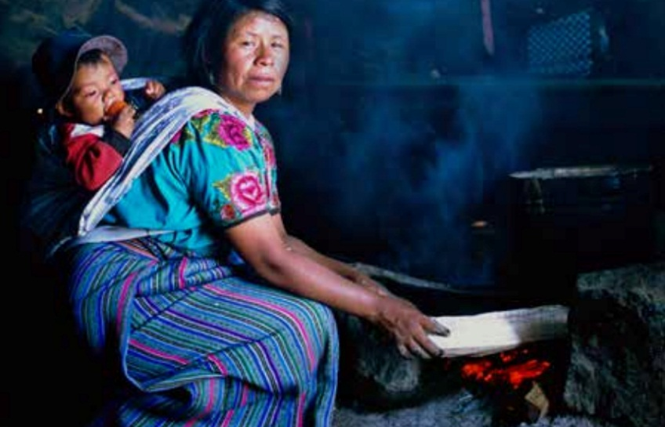
Climate and Health
Air pollution is one of the main avoidable causes of disease and death globally. To address this, decision makers will review and consider the draft resolution on prevention, control and mitigation of air pollution strategies, which include:
The use of cross-sectoral approaches to health.
Strengthening monitoring of health outcomes related to air pollution.
Connecting health statistics to data on levels and sources of air pollution.

Slide 16
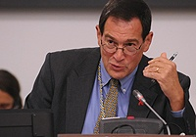
Jimmy Kolker
Assistant Secretary for Global Affairs
U.S. Department of Health and Human Services (HHS)

Slide 17
World Health Organization – General Assembly
68th World Health Assembly
Monday, May 18 to Tuesday, May 26, 2015
Geneva, Switzerland
Find the provisional agenda here: http://apps.who.int/gb/e/e_wha68.html

Slide 18
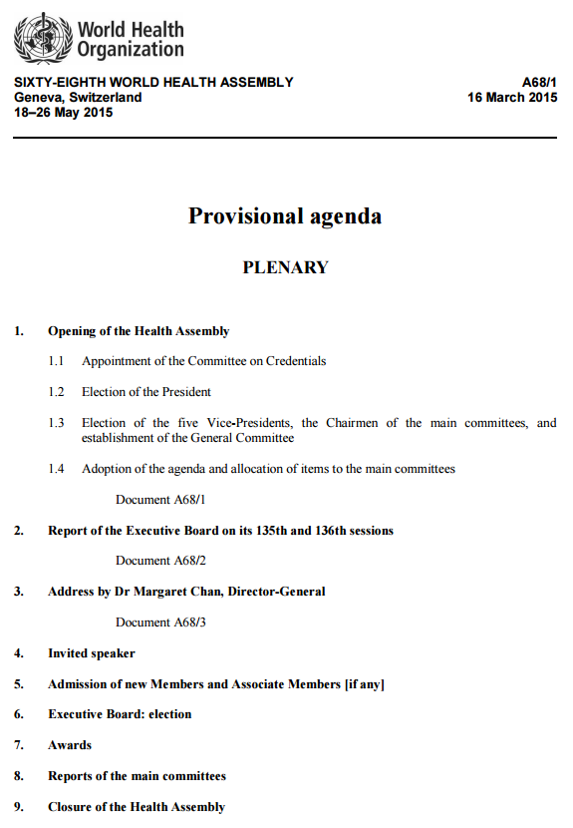
World Health Assembly Provisional Agenda
http://apps.who.int/gb/ebwha/pdf_files/WHA68/A68_1-en.pdf

Slide 19
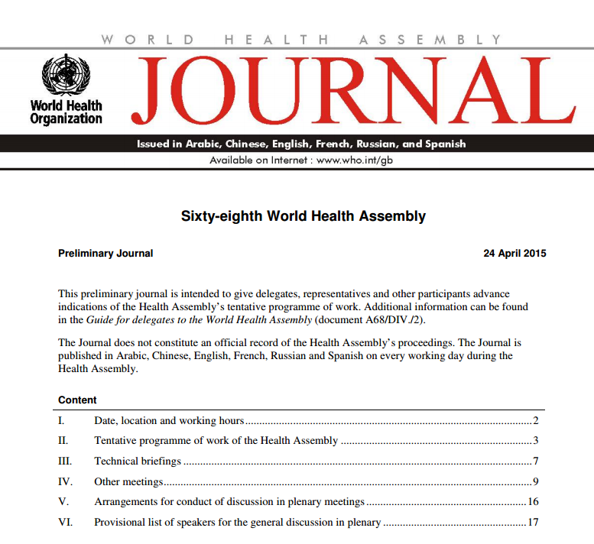
The World Health Assembly Journal
http://apps.who.int/gb/ebwha/pdf_files/WHA68/A68_JourP-en.pdf

Slide 20

Lawrence O. Gostin
Faculty Director, O’Neill Institute for National & Global Health Law
Georgetown University

Slide 21
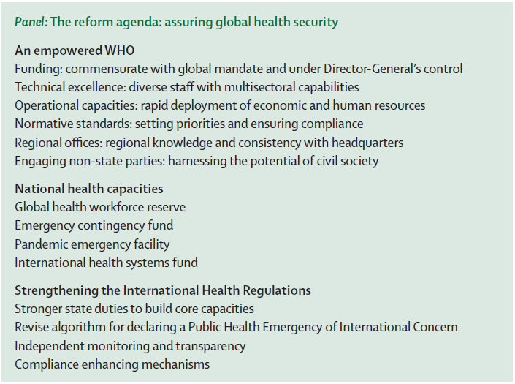
Embargoed for Release Today (1 pm ET) in The Lancet
A retrospective and prospective analysis of the west African Ebola virus disease epidemic: robust national health systems at the foundation and an empowered WHO at the apex
By Lawrence O. Gostin and Eric A. Friedman
http://www.thelancet.com/journals/lancet/article/PIIS0140-6736(15)60644-4/abstract

Slide 22

Reforming the World Health Organization After Ebola
5 reforms needed to uphold the WHO’s constitutional mandate as “the directing and coordinating authority on international health work”
Available online for free
http://jama.jamanetwork.com/Mobile/article.aspx?articleid=2247133

Slide 23

Josh Michaud
Associate Director, Global Health Policy
Kaiser Family Foundation

Slide 24
Emergency Ebola Funding, FY 2015 Omnibus
In Millions
International = $3.7 billion
Domestic = $1.7 billion
Total = $5.4 billion
NOTES: “Domestic” includes funding for the Centers for Disease Control and Prevention (CDC), National Institutes of Health (NIH), Food and Drug Administration, and the Department of Defense (DoD). It is possible that some of $1.7 billion in emergency Ebola funding for the domestic response may be used for international efforts.
SOURCE: Kaiser Family Foundation analysis of data from the “Consolidated Appropriations Act, 2015” (H.R. 83) and accompanying reports.

Slide 25
Q&A – Ask Us Questions Via Chat
We will now take questions that have been submitted via chat.
You can still ask additional questions via chat at any time.

Slide 26
Today’s Web Briefing Will Be Recorded
Today’s web briefing will be posted by or before tomorrow morning at:
kff.org/global-health-policy
The PowerPoint slides have already been posted, and a transcript will be available soon.

Slide 27
Contact Information
    Katie Smith
    Communications Associate
    Kaiser Family Foundation
    Phone: 202-347-5270
    Email: KatieS@kff.org

Slide 28
Thank you!
Until next time, keep up with the Kaiser Family Foundation online:
Twitter: @KaiserFamFound
Facebook: /KaiserFamilyFoundation
LinkedIn: /company/kaiser-family-foundation
Email Alerts: kff.org/email

