Slide 1
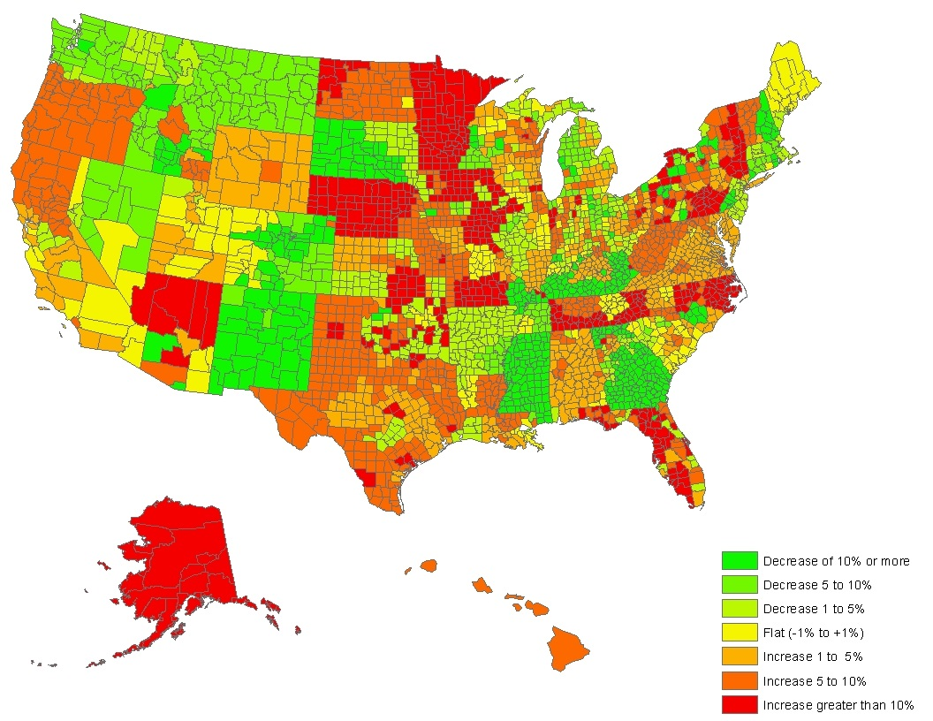
Change in Benchmark Silver Premiums, 2014 – 2015
Percent change in second-lowest silver plan, by county in 50 states and the District of Columbia
Source: Kaiser Family Foundation analysis of data from Healthcare.gov and insurer rate filings to state regulators. For more information see “Analysis of 2015 Premium Changes in the Affordable Care Act’s Health Insurance Marketplaces” Sept. 2014.

