Slide 1
Webinar for Univision: What Do Consumers Need to Know About Health Reform’s Private Coverage and Exchange Options?
Presented by the Kaiser Family Foundation
Thursday, September 5, 2013
1:30 p.m. ET
kff.org

Slide 2



Today’s Speakers from the Kaiser Family Foundation
Jennifer Tolbert
Director, State Health Reform
Karen Pollitz
Senior Fellow, Health Reform and Private Insurance
Penny Duckham
Executive Director, Media Fellowships Program

Slide 3
Promoting Health Coverage through the ACA
Universal Coverage
Medicaid Coverage For Low-Income Individuals
Marketplaces With Subsidies for Moderate Income Individuals
Individual
Mandate
Health Insurance Market Reforms
Employer-Sponsored Coverage

Slide 4
Most Uninsured Hispanics are at Income Levels that Qualify for Medicaid Expansion or Marketplace Subsidies
Health Insurance Status among the 49.2 Million Non-Elderly Hispanics in the U.S.
15.5 Million Non Elderly Uninsured Hispanics By Income Level
≥400% FPL
(5%)
139-399% FPL
Subsidies (38%)
≤138% FPL
Medicaid (57%)
Employer-Sponsored
Coverage
39%
Uninsured
Medicaid/ Other Public
30%
Data may not total 100% due to rounding.
SOURCE: KCMU/ Urban Institute analysis of 2012 ASEC Supplement to the CPS.

Slide 5





ACA Medicaid Expansion Fills Current Gaps in Coverage
Medicaid Eligibility Today
Medicaid Eligibility
in 2014
Limited to Specific Low-Income Groups
Extends to Adults ≤138% FPL*
Pregnant
Women
Extends to Adults
≤138% FPL*
Elderly &
Persons with Disabilities
Children
Parents
Adults
*138% FPL = $15,856 for an individual and $26,951 for a family of three in 2013.

Slide 6
Current Status of the Medicaid Expansion Decision, as of August 28, 2013
VT
ME
WA
NH
MT
ND
MN
OR
MA
SD
WI
NY
ID
MI*
CT
RI
WY
PA
NJ
NE
IA*
OH
DE
NV
IL
IN*
MD
CA
UT
CO
WV
VA
KS
MO
KY
DC
NC
AZ
TN*
NM
OK
AR*
SC
MS
AL
GA
AK
TX
LA
FL
HI
Moving Forward at this Time (25 States including DC)
Debate Ongoing (4 States)
Not Moving Forward at this Time (22 States)
* These states are exploring an approach to the Medicaid expansion that is likely to require waiver approval.

Slide 7
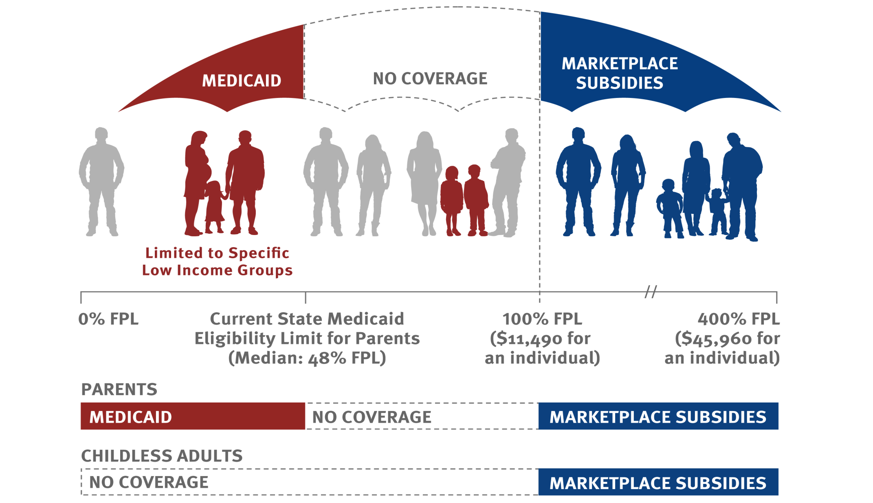
In States That Do Not Expand Medicaid, There Will Be Large Gaps in Coverage for Low-Income Adults
Current Medicaid Eligibility Limit for Parents
Median of 22 States Not Expanding:
47% FPL

Slide 8
State Have Made Their Decisions for Creating Health Insurance Marketplaces
WA
VT
ME
MT
ND
NH
OR
MN
MA
ID**
SD
WI
NY
MI
RI
WY
PA
CT
IA
NJ
NV
NE
IN
OH
DE
UT*
CO
IL
MD
CA
WV
VA
DC
KS
MO
KY
NC
OK
TN
AZ
NM**
AR
SC
MS
AL
GA
AK
TX
LA
FL
HI
State-based Marketplace (17 states including DC)
Partnership Marketplace (7 states)
Federally-facilitated Marketplace (27 states)
* In Utah, the federal government will operate the individual exchange while the state will run the SHOP exchange.
** Idaho and New Mexico received approval to operate state-based marketplaces; however, due to time constraints, the states will rely on the federal government for the IT infrastructure, but will perform most other functions.

Slide 9








The ACA Transforms the Marketplace and Medicaid Enrollment Experience for Individuals
HEALTH
INSURANCE
$
Data
Hub
Dear ______,
You are
eligible for…
Medicaid
CHIP
Exchange
#
Multiple Ways to Enroll
Single Application
for Multiple Programs
Use of Electronic
Data to Verify Eligibility
Real-Time Eligibility Determinations

Slide 10
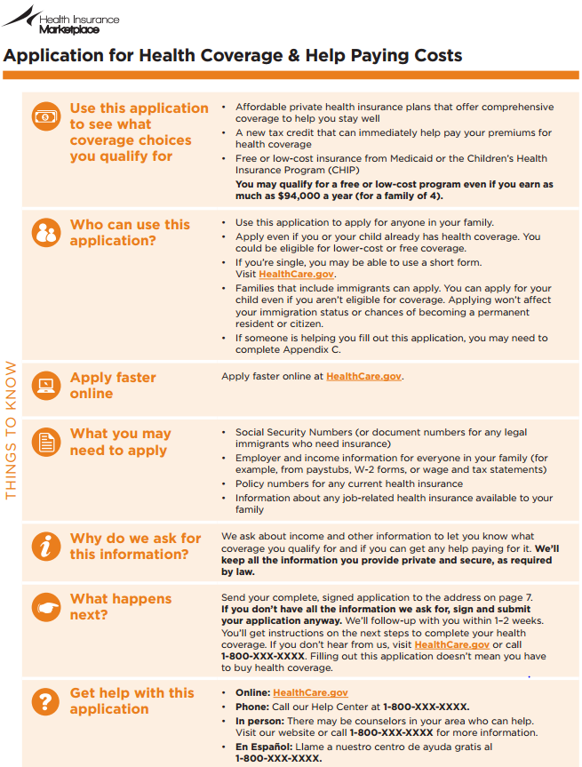
Single, Streamlined Application Will Make It Easier to Apply for Coverage
Single adults can use streamlined application
Legal immigrants are eligible for Medicaid and premium subsidies in the Marketplace.
Undocumented immigrants are barred from coverage.

Slide 11


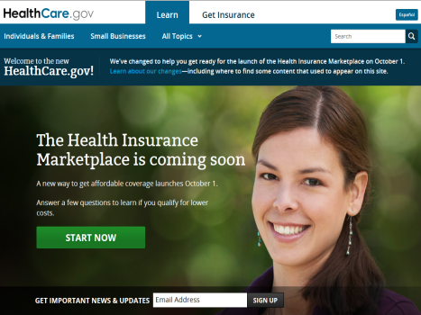
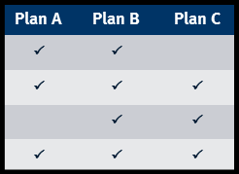
The Federal Government and States Are Developing Multiple New Avenues for Consumer Assistance
Website
  www.HealthCare.gov www.CuidadoDeSalud.gov
  Online application and renewal
  Automated eligibility determinations in real time
  Standardized information on benefits
Call Center
  Toll-free hotline
  Answer consumer questions and provide assistance with completing online application
  Provide referrals to enrollment assisters
Enrollment Assistance
  Assistance with completing applications and enrolling in coverage provided by:
  Navigators/In-Person Assisters
  Out-stationed eligibility workers
  Certified Application Counselors

Slide 12
ACA Includes New Rules for Coverage in the Non-group Market
Pre-ACA
Policies are medically underwritten
Post-ACA
Insurers are prohibited from discriminating based on health status
Policies must cover the essential health benefits
Consumer out-of-pocket spending is limited
Premium and cost-sharing subsidies are available
Policies typically have high cost sharing
Many policies exclude benefits such as prescription drugs and maternity care
Premiums are unsubsidized leaving them unaffordable for many

Slide 13
Premium Tax Credit Subsidies Will Be Available on a Sliding Scale Based on Income
Available to those with incomes from 100% to 400% FPL
  Who aren’t eligible for Medicaid, Medicare or other public coverage
  Who aren’t eligible for “affordable” job-based plans that meet other coverage standards
Individual/family required contribution for benchmark silver plan limited to lesser of % income or actual premium
  <133% FPL, maximum premium contribution = 2% income
  150% FPL, maximum premium contribution = 4% income
  200% FPL, maximum premium contribution = 6.3% income
  250% FPL, maximum premium contribution = 8.05% income
  300% - 400% FPL, maximum premium contribution = 9.5% income
Amount of federal tax credit subsidy = Benchmark Silver Plan premium minus required contribution
Tax credit subsidy amount can be applied to any plan sold through Exchange (except Catastrophic)
Subsidies can be claimed end of year, or in real time to reduce monthly premium payment
Careful estimation of income matters; excess premium subsidy claimed during a year may have to be repaid on tax return
Most who purchase non-group coverage in Exchange will receive subsidies

Slide 14
Premium Subsidies Will Lower the Cost of Coverage for Many
Single 25 year old making $20,000
  Unsubsidized silver premium = $3,030
  Individual contribution = $1,021
  Tax credit = $2,009
40 year old parents with two kids making $60,000
  Unsubsidized silver premium = $11,547
  Family contribution = $4,913
  Tax credit = $6,634
60 year old couple making $50,000
  Unsubsidized silver premium = $16,382
  Family contribution = $4,750
  Tax credit = $11,632
http://www.kff.org/interactive/subsidy-calculator

Slide 15

Some Low-Income Families Will Have Mixed Eligibility for Assistance
Sonia and Salvador Sanchez (both 40) have two children, John and Christina
Together, Sonia and Salvador earn $45,000 annually (~190% FPL)
They live in Texas where CHIP eligibility is up to 200% FPL*
When Sonia and Salvador apply for assistance through the Marketplace, they will learn their children qualify for CHIP coverage
Sonia and Salvador can buy a private health plan in Marketplace
Benchmark plan for couple their age is $7,714
However, they qualify for APTC subsidy of $5,064. This would reduce their cost for the benchmark silver plan to $2,650
* Some states charge a premium or annual enrollment fee for CHIP coverage; Texas, for example, charges a $35/child annual enrollment fee (see http://www.kff.org/other/state-indicator/premium-amounts/). This CHIP premium or fee is in addition to what families would pay for coverage for the parents through the Marketplace.

Slide 16
Cost-sharing Subsidies to Reduce Deductibles, Copays Will Also Be Available
In the Marketplace, cost sharing subsidies are also available to individuals and families with incomes 100% - 250% FPL
Unlike premium tax credit subsidies, which can be applied to any plan, cost sharing subsidies are only available through Silver plans
  Modified versions of Silver plans will have reduced deductibles, copays, out-of-pocket limits on cost sharing
  Federal government will reimburse insurers for value of cost sharing reductions
Unlike premium tax credit subsidies, cost sharing subsidies do not need to be repaid if people mis-estimate their income

Slide 17
Illustrations of Unsubsidized Cost Sharing
Plan Type | “Actuarial Value” | Typical Deductible | Typical Coinsurance | Maximum Out-of-Pocket Cost
Bronze | 60% | $5,000 | 30% | $6,350
Silver | 70% | $2,000 | 20% | $6,350
Gold | 80% | $0 | 20% | $6,350
Platinum | 90% | $0 | 10% | $6,350
Catastrophic (up to age 30) | NA | $6,350 | 0% | $6,350
All figures are for single coverage. Amounts for families would be double.
All plans must cover essential benefits: hospitalization, outpatient medical, emergency care, Rx drugs, maternity, mental health, rehab, lab tests, preventive services, pediatric dental & vision.

Slide 18
Cost Sharing Subsidies in California
Coverage Category | 94% Silver | 87% Silver | 73% Silver | 70% Silver No Cost Sharing Subsidy
Single Income Range | Up to $17, 235 (<150% FPL) | $17,236-$22,980 (>150 - 200% FPL) | $22,981-$28,725 (>200 - 250% FPL) | >$28,725 (>250% FPL)
Preventive Care Copay | $0 | $0 | $0 | $0
Primary Care Visit | $3 | $15 | $40 | $45
Specialist Visit | $5 | $20 | $50 | $65
Lab Test | $3 | $15 | $40 | $45
Generic Drugs | $3 | $5 | $19 | $19
Annual Deductible: Brand Rx | $0 | $50 | $250 | $250
Annual Deductible/ Coinsurance: Other Medical | $0/10% | $500/15% | $1500/20% | $2000/20%
Annual Out-of-Pocket Maximum | $2,250 | $2,250 | $5,200 | $6,350
Source: http://www.coveredca.com/news/PDFs/CC_Health_Plans_Booklet-rev1-8-6.pdf

Slide 19
Coming Changes to Employer-Sponsored Insurance
Large employer requirement to offer coverage or pay a penalty. Delayed to 2015
Maximum limit on annual out-of-pocket cost sharing for essential benefits limited to $6,350/person or $12,700/family. Partially delayed to 2015
No annual dollar limits on covered benefits
Small group, fully insured plans must cover essential health benefits
Already in effect: No lifetime limits on covered benefits, dependent coverage to age 26, 100% coverage for preventive services

Slide 20
Key Implementation Dates
October 1, 2013 – March 31, 2014
  Initial open enrollment period
    People can enroll after March 31st if they have a qualifying event
    Those eligible for Medicaid can enroll at any time
January 1, 2014
  Coverage through Marketplaces and expanded Medicaid coverage begins
  Insurance market rules go into effect
  Requirement to have insurance coverage takes effect
October 15, 2014 – December 15, 2014
  Marketplace open enrollment period
January 1, 2015
  Large employer requirement to offer coverage takes effect

Slide 21
Q&A
Feel free to submit questions at any time during the webinar via the chat function.
After the webinar, if you have any follow-up questions, you can contact us via email at acawebinars@kff.org.

Slide 22
ADDITIONAL RESOURCES
Throughout the Q&A discussion, we will show topic-based slides with the titles of relevant resources that can be found on our website at kff.org.
All slides will be available online after the webinar presentation is over.

Slide 23
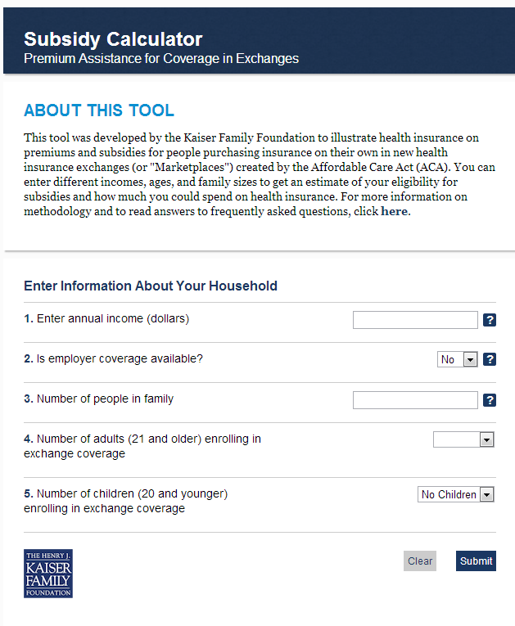

FEATURE OUR RESOURCES ON YOUR SITE FOR FREE
Health Reform Subsidy Calculator
Animated Video
kff.org/interactive/subsidy-calculator
kff.org/youtoons-obamacare-video
Examples of these embedded resources:
Kera.org: http://breakthroughs.kera.org/obamacare-101-how-the-texas-health-insurance-marketplace-will-work
CNNMoney: http://economy.money.cnn.com/2013/07/18/obamacare/

Slide 24
FOR MORE INFORMATION
Contact: Tina Hoff, Senior Vice President & Director of Health Communication and Media Partnerships
Based in Menlo Park, California headquarters
Email: THoff@kff.org
More Health Reform Information:
  kff.org/health-reform
Resources for Consumers:
  kff.org/aca-consumer-resources

Slide 25
TODAY’S WEBINAR WILL BE ARCHIVED
  kff.org/aca-univision
The full webinar presentation and PowerPoint slides will be posted by tomorrow morning.

Slide 26



SPANISH LANGUAGE RESOURCES
Now Available
  Video: La Reforma del Cuidado de la Salud Llega al Publico
Coming Soon!
  Spanish language version of the second animated YouToons video, “The YouToons Get Ready for Obamacare: Health Insurance Changes Coming Your Way Under the Affordable Care Act” – released in July 2013
  Spanish language version of our most popular resource, the Subsidy Calculator

Slide 27
RESOURCES ON HEALTH DISPARITIES
Health Coverage for the Hispanic Population Today and Under the Affordable Care Act
The Impact of Current State Medicaid Expansion Decisions on Coverage by Race and Ethnicity
Characteristics of Uninsured Low-Income Adults
The Uninsured And The Difference Health Insurance Makes
Health Coverage by Race and Ethnicity: The Potential Impact of the Affordable Care Act
Impact of the Medicaid Expansion for Low-Income Communities of Color Across States
www.kff.org/disparities-policy

Slide 28
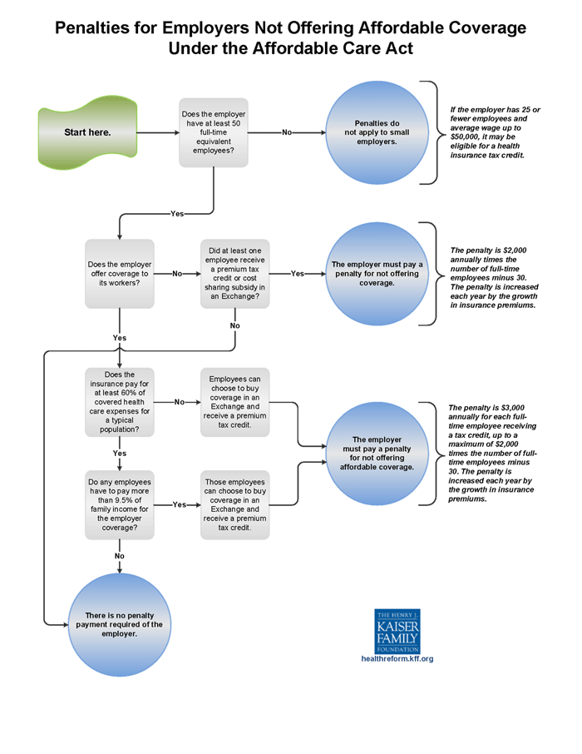
EMPLOYER MANDATE
Infographic: Employer Responsibility Under the Affordable Care Act
2013 Annual Employer Health Benefits Survey
Summary of Coverage Provisions in the Patient Protection and Affordable Care Act
www.kff.org/tag/employers

Slide 29
EXCHANGES/MARKETPLACES
State Health Insurance Marketplace Profiles
Table/Map: Status of State Action on the Medicaid Expansion Decision
Quantifying Tax Credits for People Now Buying Insurance on Their Own
Ensuring the Health Care Needs of Women: A Checklist for Health Exchanges
Navigator and In-Person Assistance Programs: A Snapshot of State Programs
Explaining Health Care Reform: Questions About Health Insurance Exchanges
Consumer Assistance in Health Reform
www.kff.org/tag/marketplaces

Slide 30
RESOURCES ON IMMIGRANTS
Health Coverage for the Hispanic Population Today and Under the Affordable Care Act
Immigration Reform and Access to Health Coverage: Key Issues to Consider
Key Facts on Health Coverage for Low-Income Immigrants Today and Under the Affordable Care Act
Overview of Health Coverage for Individuals with Limited English Proficiency
www.kff.org/tag/immigrants

Slide 31
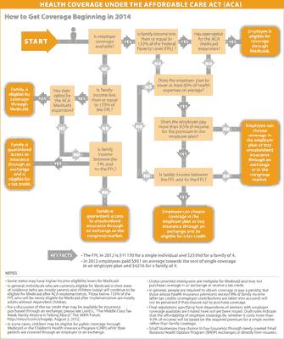
INDIVIDUAL MANDATE
Infographic: Visualizing Health Policy – Health Coverage Under the Affordable Care Act
  kff.org/infographic/visualizing-health-policy-health-coverage-under-the-affordable-care-act-aca

Slide 32
INTERACTIVE RESOURCES: Quizzes, Infographics & More
Quizzes on Women’s Health, Health Reform/ACA, Uninsured, Medicaid, Medicare
Health Reform Implementation Timeline
Health Poll Question Finder
Zooming In On Health Reform Tool
Infographic: Medicaid Spending & Enrollment
www.kff.org/graphics/search/

Slide 33
MEDICAID EXPANSION
Issue Brief: What is Medicaid’s Impact on Access to Care, Health Outcomes, and Quality of Care? Setting the Record Straight on Evidence
Issue Brief: Analyzing the Impact of State Medicaid Expansion Decisions
Report: State and Local Coverage Changes Under Full Implementation of the Affordable Care Act
Report: The Cost of Not Expanding Medicaid
Issue Brief: The Impact of Current State Medicaid Expansion Decisions on Coverage by Race and Ethnicity
Issue Brief: Key Lessons from Medicaid and CHIP for Outreach and Enrollment Under the Affordable Care Act
Fact Sheet: Medicaid and Its Role in State/Federal Budgets and Health Reform
http://www.kff.org/medicaid/

Slide 34
INDEPENDENT, TRUSTED POLLING DATA
Kaiser Health Tracking Polls
Public Opinion Polling on Raising the Age of Medicare Eligibility: Historic Trends and Current Nuances
Health Poll Question Finder
www.kff.org/polling

Slide 35
TAX CREDITS & PREMIUMS
Subsidy Calculator
An Early Look at Premiums and Insurer Participation in Health Insurance Marketplaces, 2014
Quantifying Tax Credits for People Now Buying Insurance on Their Own
Explaining Health Care Reform: Questions About Health Insurance Subsidies
The Flip Side of Higher Premiums: Better Coverage
Why Premiums Will Change for People Who Now Have Nongroup Insurance
www.kff.org/tag/subsidies

Slide 36
UPCOMING WEBINARS
The next Univision webinar will be announced soon.
To participate in other media-only webinars on the Affordable Care Act, please email ACAwebinars@kff.org.

Slide 37
KEEP IN TOUCH WITH US ONLINE
To subscribe to KFF’s email alerts, please visit http://profile.kff.org. Be sure to designate yourself as media to receive press advisories and media-only invites.
Follow us on Twitter: @KaiserFamFound
Like our Page on Facebook: facebook.com/KaiserFamilyFoundation
Watch and Embed our Videos: youtube.com/kaiserfoundation
Share via LinkedIn: linkedin.com/company/kaiser-family-foundation

