Slide 1

Dual eligible beneficiaries comprise 20% of the Medicare population and 15% of the Medicaid population in 2008
Medicare
37 million
Dual Eligible Beneficiaries
9 million
Medicaid
51 million
Total Medicare beneficiaries: 46 million
Total Medicaid beneficiaries: 60 million
SOURCE: Kaiser Family Foundation analysis of the Medicare Current Beneficiary Survey 2008, and Kaiser Commission on Medicaid and the Uninsured and Urban Institute estimates based on data from FY2008 MSIS and CMS Form-64.

Slide 2
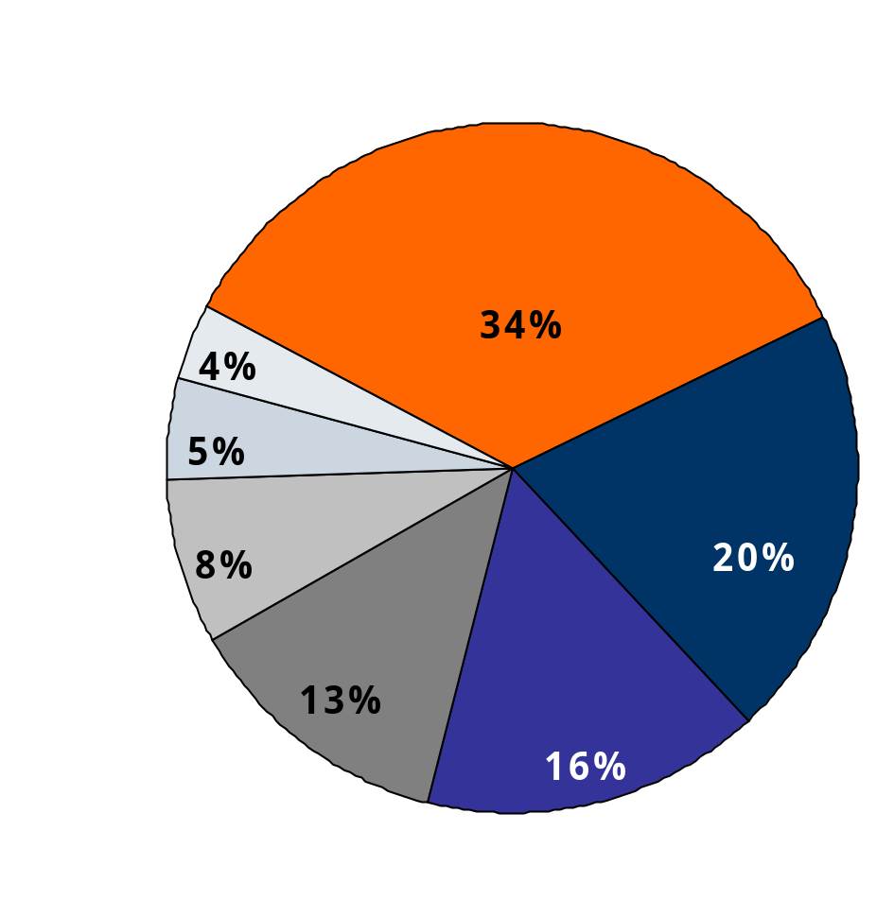
Medicare is the primary payer of medical care for dual eligible beneficiaries
Distribution of Medicare Spending for Dual Eligible Beneficiaries in Medicare FFS by Service, 2008
Medicare
National program for individuals age 65+ and younger adults with disabilities (on SSDI)
Eligibility tied to work history but not tied to income or health status
Covers medical care, prescription drugs, and is the primary source of medical insurance for dual eligible beneficiaries
Financial obligations can be steep for beneficiaries
Inpatient Hospital
Hospice
Home
Health
Providers
SNF
Drug
Subsidies
Outpatient
Average Per Capita Medicare FFS Spending: $13,805
NOTE: Medicare Advantage spending excluded from this analysis.
SOURCE: Kaiser Family Foundation analysis of the CMS Medicare Current Beneficiary Survey Cost and Use File, 2008

Slide 3
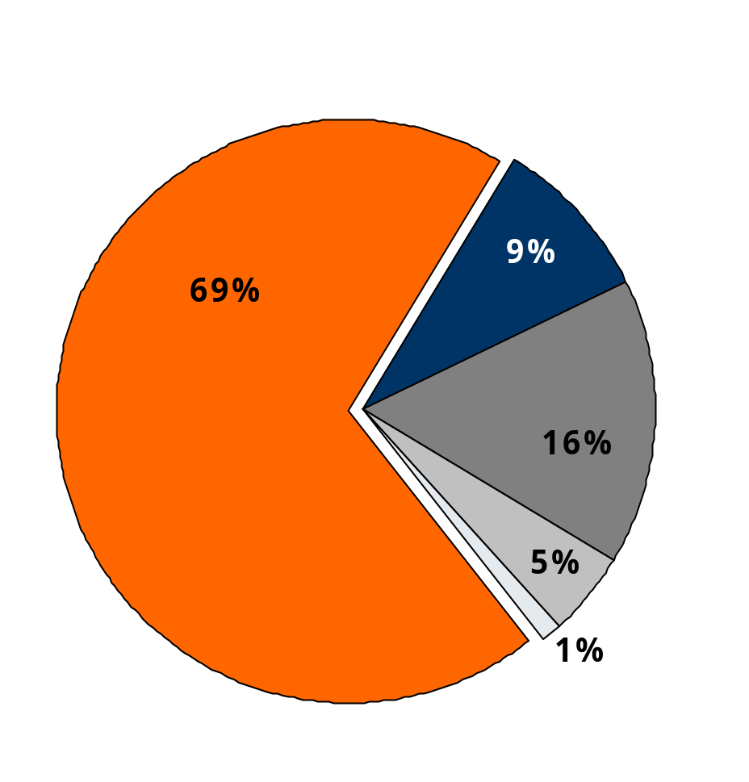
Medicaid supplements Medicare for dual eligible beneficiaries
Distribution of Medicaid Spending for Dual Eligible Beneficiaries by Service, 2008
Medicaid
Medicare premiums
Federal-state partnership with states operating programs for low-income families, disabled & elderly
Eligibility tied to income, age and disability, varies by state
Pays for Medicare premiums, cost-sharing and other benefits
Primary payer for long-term care
Long Term
Care
Medicare acute care cost-sharing
Acute care
not covered
by Medicare
Prescription Drugs
Average Per Capita Medicaid Spending: $16,087
NOTES: Home health and dental services comprise less than 1% of Medicaid spending. Medicare premiums paid by Medicaid also includes cost-sharing for Qualified Medicare Beneficiaries only.
SOURCE: Kaiser Commission on Medicaid and the Uninsured and Urban Institute estimates based on data from FY2008 MSIS and CMS Form-64.

Slide 4
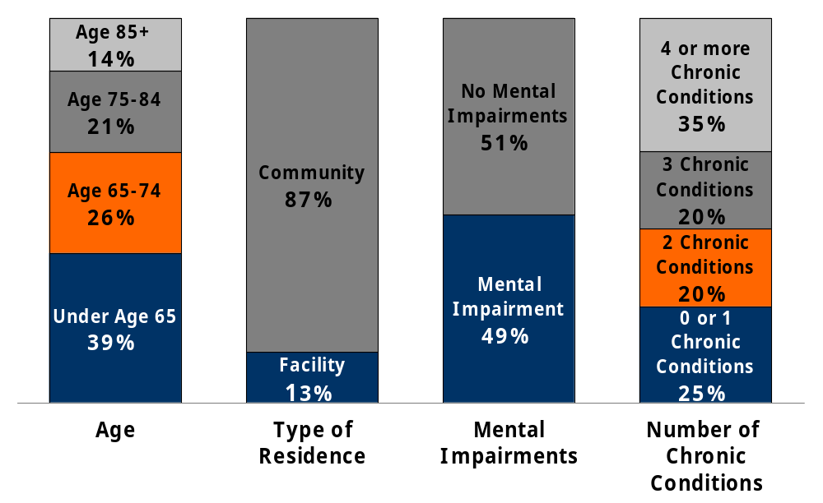
Dual eligible beneficiaries are a diverse population
NOTE: Mental impairments were defined as Alzheimer’s disease, dementia, depression, bipolar, schizophrenia, or mental retardation.
SOURCE: Kaiser Family Foundation analysis of the Medicare Current Beneficiary Survey, 2008

Slide 5
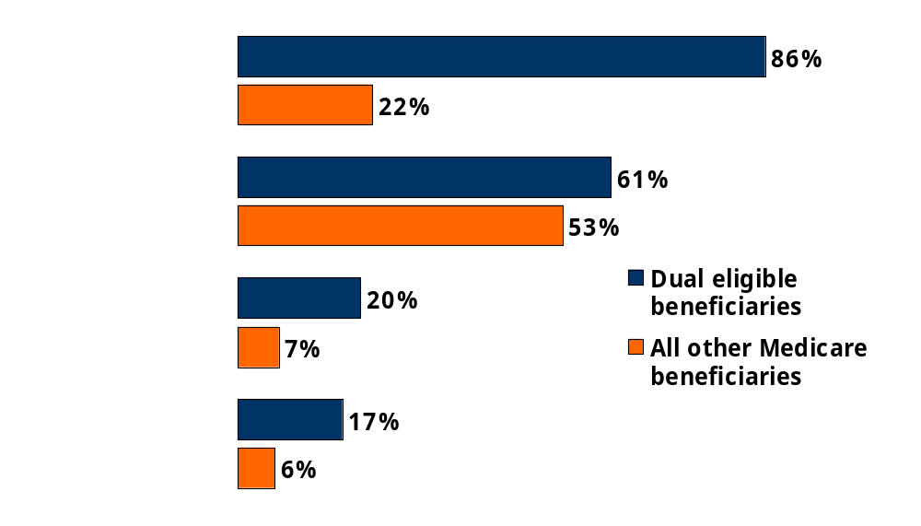
Dual eligible beneficiaries are poorer than other Medicare beneficiaries
Share of Medicare beneficiaries who are:
Income below 150% FPL (<$15,600 individuals/ <$21,000 couples)
Female
African American
Hispanic
SOURCE: Kaiser Family Foundation analysis of the Medicare Current Beneficiary Survey Cost & Use File, 2008.

Slide 6
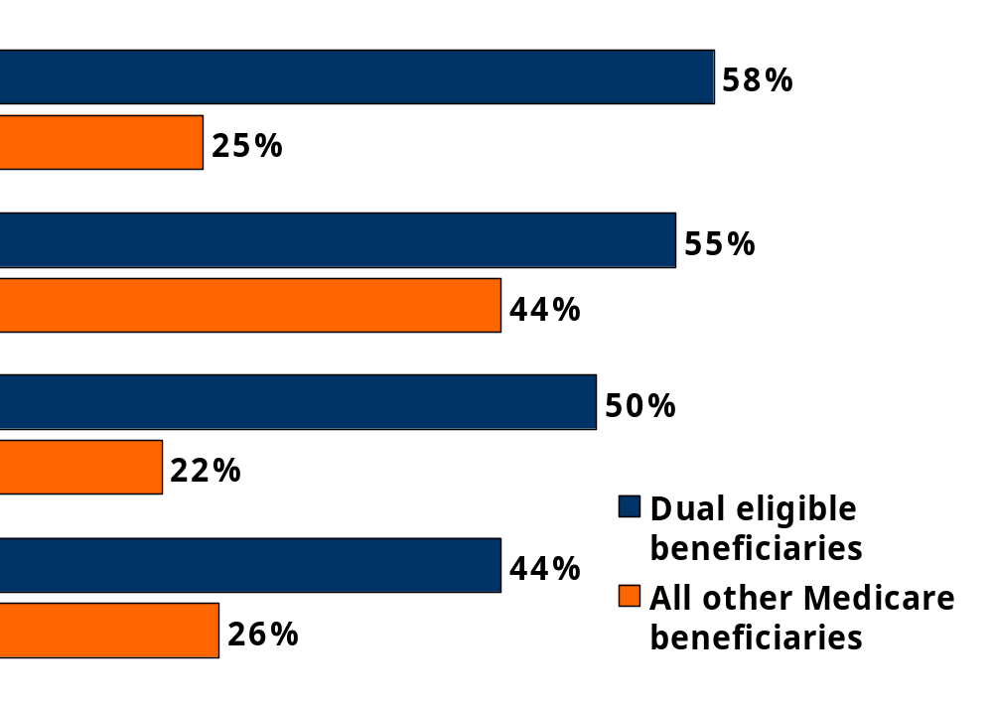
Dual eligible beneficiaries are sicker than other Medicare beneficiaries
Share of Medicare beneficiaries with:
Cognitively or Mentally Impaired
3+ Chronic Conditions
In Fair or Poor Health
Functionally Impaired
SOURCE: Kaiser Family Foundation analysis of the Medicare Current Beneficiary Survey Cost & Use File, 2008.

Slide 7
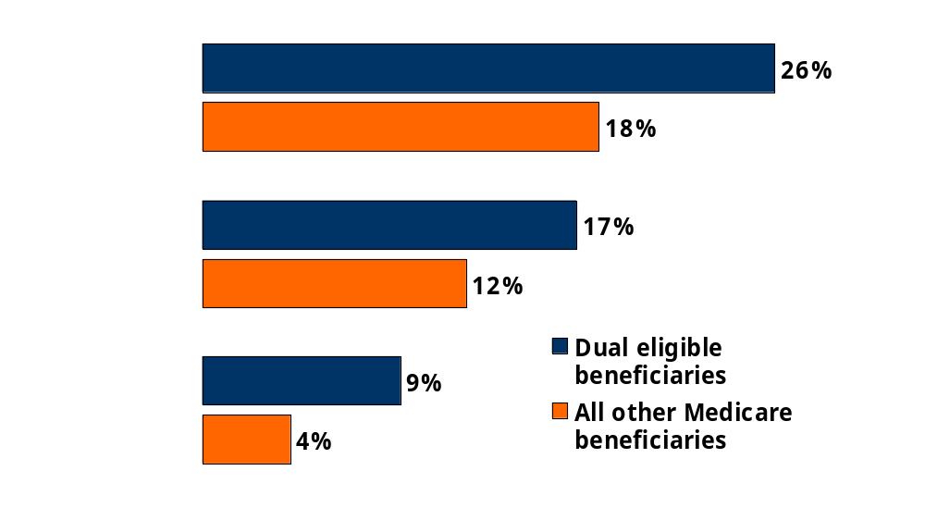
Dual eligible beneficiaries use more health services
Share of Medicare beneficiaries with:
1+ Hospital Stay
1+ Emergency
Room Visit
1+ Skilled Nursing Facility Stay
NOTE: Excludes Medicare Advantage enrollees.
SOURCE: Kaiser Family Foundation analysis of the Medicare Current Beneficiary Survey Cost & Use File, 2008.

Slide 8
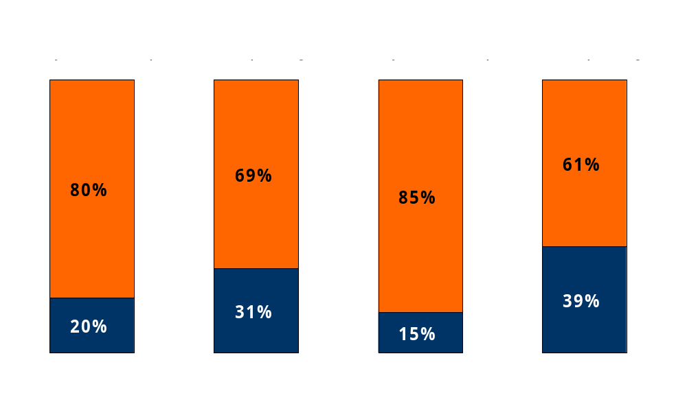
Dual eligible beneficiaries account for a disproportionate share of Medicare and Medicaid spending, 2008
Total Population:
46 Million
Total Spending:
$424 Billion
Total Population:
60 Million
Total Spending:
$330 Billion
Medicare
Medicaid
SOURCE: Kaiser Family Foundation analysis of the CMS Medicare Current Beneficiary Survey Cost and Use File, 2008, and Kaiser Commission on Medicaid and the Uninsured and Urban Institute estimates based on data from FY2008 MSIS and CMS Form-64.

Slide 9
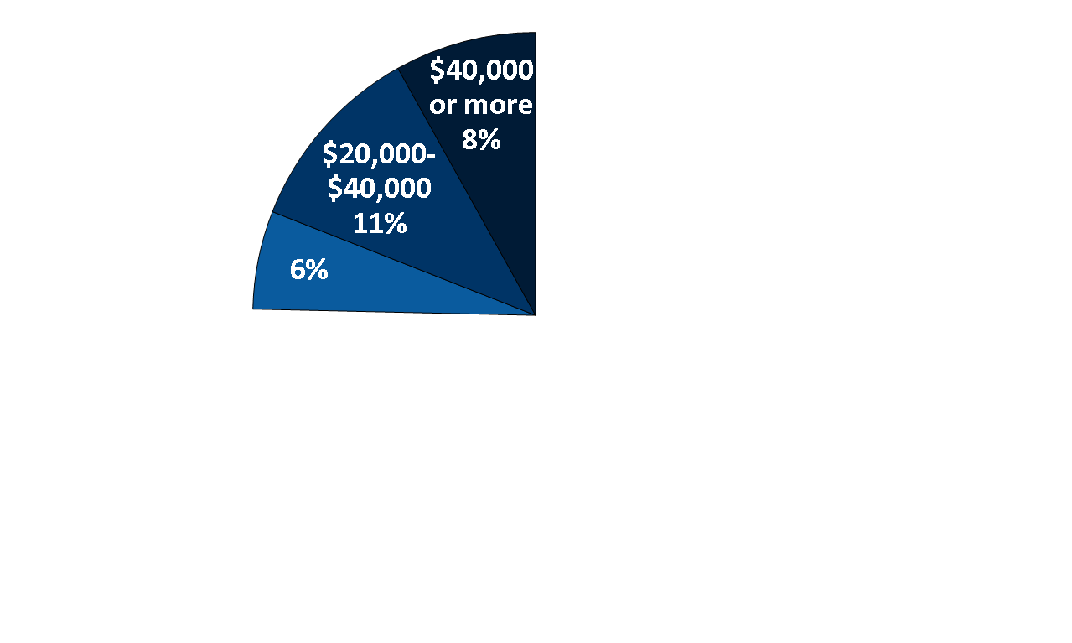
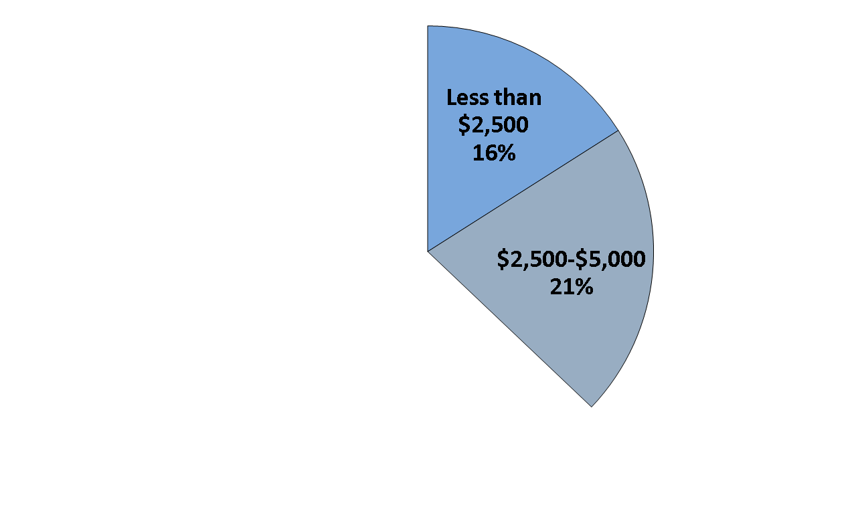
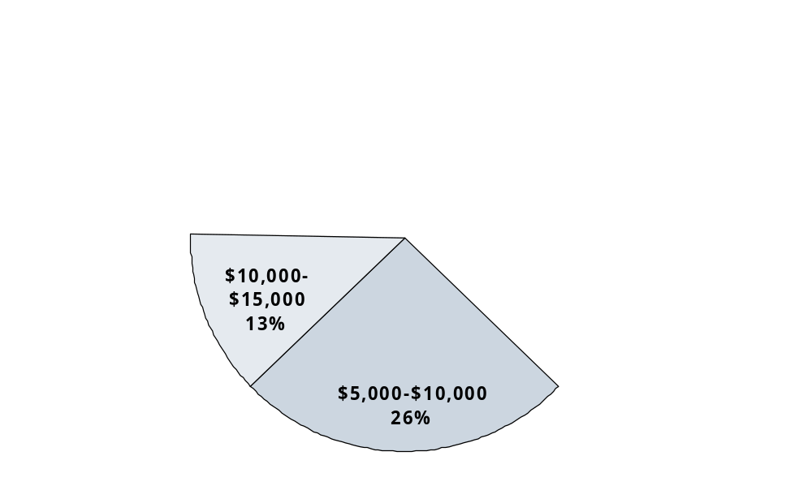
Medicare spending was more than $40,000 for 8% and less than $2,500 for 16% of the dual eligible population
Distribution of Medicare spending for Dual Eligible Beneficiaries, 2008:
$15,000-$20,000
Average Spending = $14,169
Median Spending = $7,036
SOURCE: Kaiser Family Foundation analysis of the Medicare Current Beneficiary Survey Cost & Use File, 2008.

Slide 10
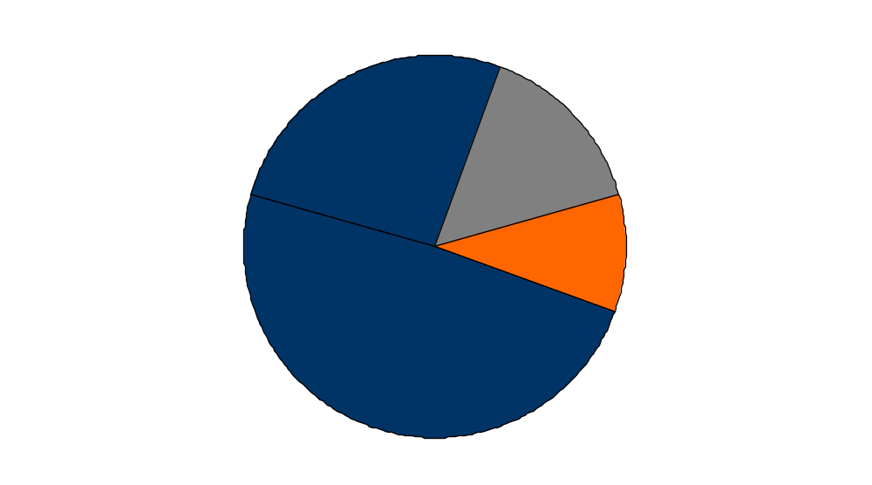
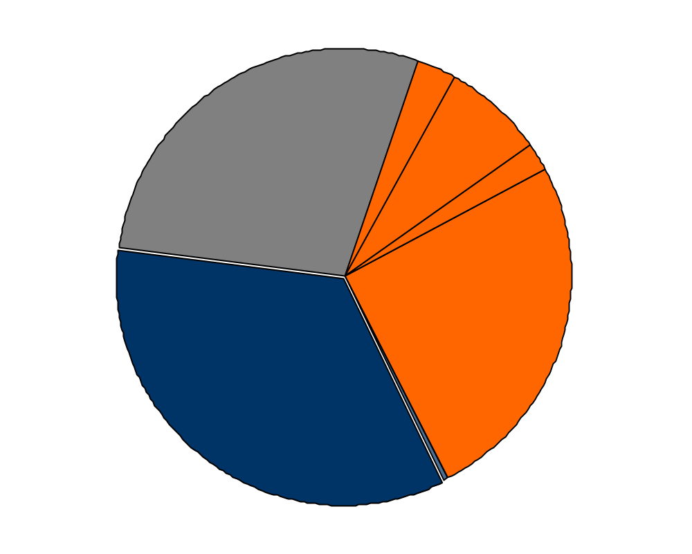
Dual eligible beneficiaries account for a
substantial share of Medicaid spending
Medicaid Enrollment, 2009
Medicaid Spending, 2009
Premiums 3%
Medicare Acute 7%
Other Aged & Disabled Spending 28%
Adults 26%
Other Acute 2%
Other Aged & Disabled 10%
Duals 15%
Duals Spending
38%
Long-Term Care 25%
Children & Adult Spending 34%
Children 49%
Prescribed Drugs 0.4%
Total = 63 Million
Total = $359 Billion
SOURCE: KCMU/Urban Institute estimates based on data from FY 2009 MSIS and CMS-64, 2012. MSIS FY 2008 data were used for MA, PA, UT, and WI, but adjusted to 2009 CMS-64.

Slide 11
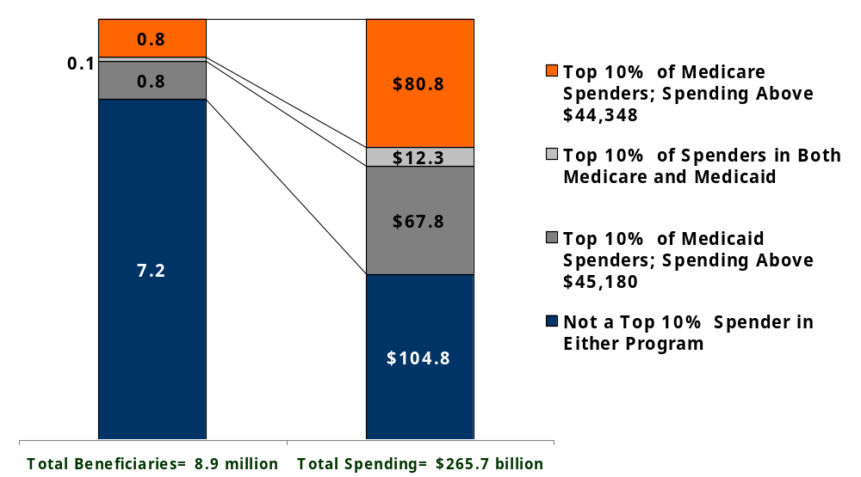
Few dual eligible beneficiaries are high spenders under both Medicare and Medicaid
SOURCE: KCMU/ Urban Institute analysis of MSIS-MCBS 2007.

Slide 12
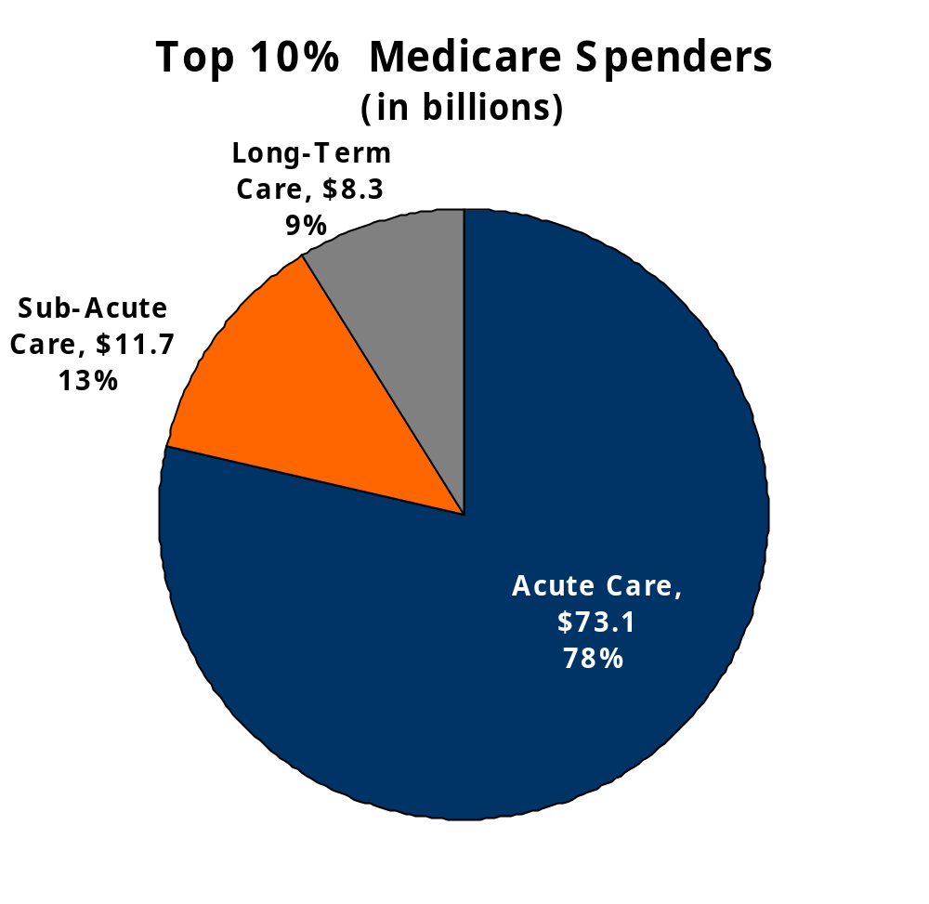
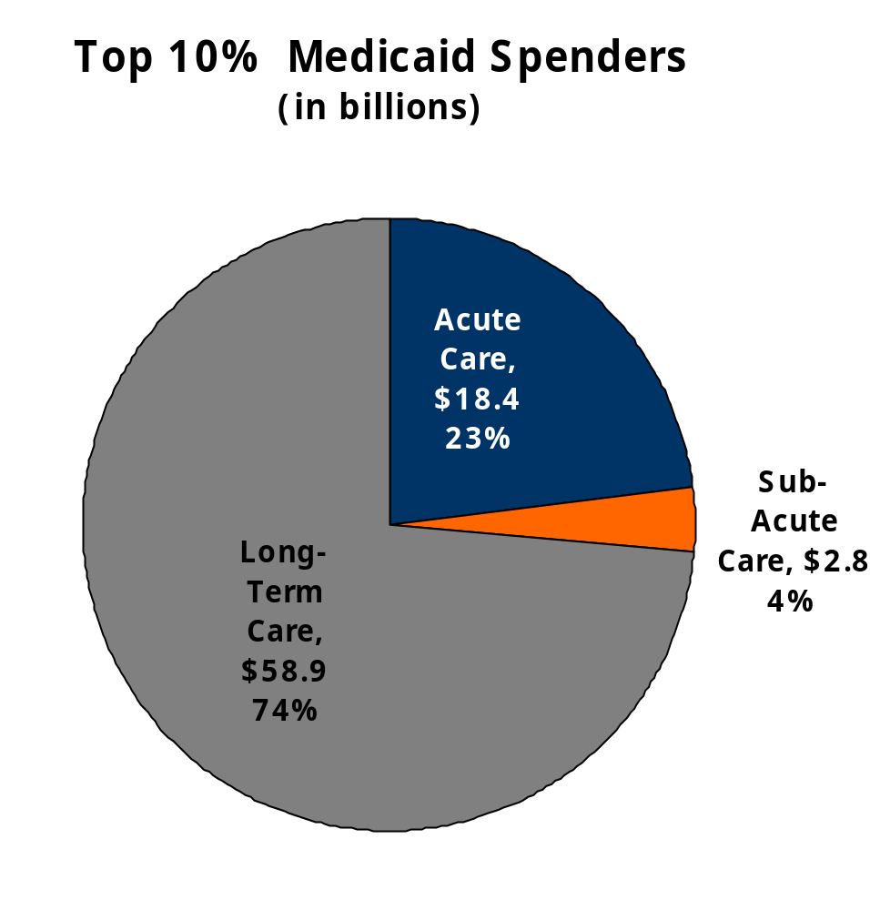
Spending by service varies among high-cost dual eligible beneficiaries by program
Total = $93.1 billion
Total = $80.1 billion
NOTE: Top 10% Medicare spenders = Medicare spending greater than $44,348, includes Medicaid spending on Medicare high-spenders.
Top 10% Medicaid spenders = Medicaid spending greater than $45,180, includes Medicare spending on Medicaid high-spenders.
SOURCE: KCMU/Urban Institute analysis of MSIS-MCBS 2007.

Slide 13
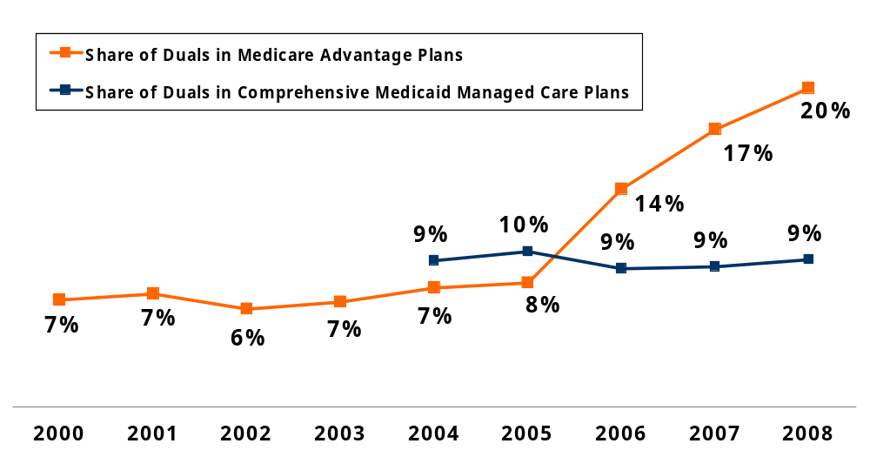
Share of Dual Eligible Beneficiaries in Medicare Advantage and Medicaid Managed Care Plans, 2000-2008
NOTES: Data exclude dual eligibles living in Puerto Rico and other territories. Medicaid manage care data include duals in commercial and Medicaid managed care organizations (comprehensive risk), health insuring organizations, and PACE plans. Information on dual enrollment in Medicaid comprehensive managed care plans was not available at the time of publication for years prior to 2004.
SOURCE: Gold M., Jacobson G, and Garfield R. analysis of the CMS MCBS Cost and Use File, 2000-2008, CMS Medicaid Managed Care Enrollment reports, 2004-2008, and Medicaid Statistical Information System 2004-2008., Health Affairs 2012.

Slide 14
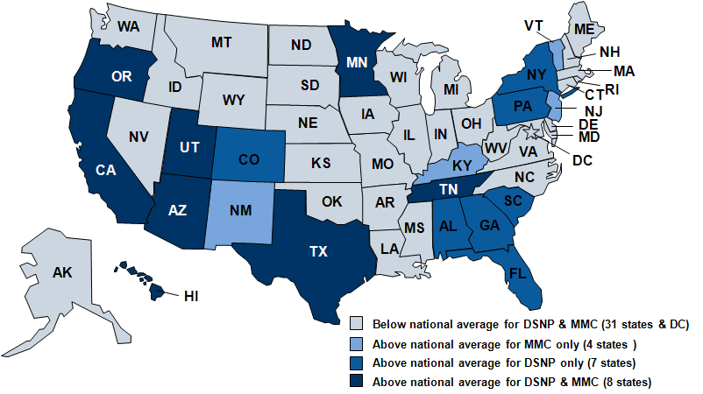
Share of Dual Eligible Beneficiaries Enrolled in Managed Care, by State, 2010
NOTE: National average was 12.0% enrolled in Medicare Dual-Special Needs Plan (DSNP )and 9.3% enrolled in comprehensive Medicaid managed care (MMC. )
SOURCE: Gold M, Jacobson G, and Garfield R. analysis of public Medicare and Medicaid data files from the Center for Medicare and Medicaid Services, Health Affairs, 2012.

Slide 15
26 states are moving forward with proposals to participate in demonstration projects, May 2012
VT
ME
WA
NH
MT
ND
MN
OR
WI
NY
MA
ID
SD
MI
CT*
RI
WY
PA
NJ
NE
IA*
OH
DE
NV
IL
IN
MD
CA
UT
CO*
WV
VA
DC
KS
MO*
KY
NC*
AZ
TN
NM
OK*
AR
SC
MS
AL
GA
TX
LA
AK
FL
HI
Proposed 2013 Start Date (14 states)
Proposed 2014 Start Date (12 states)
Not participating in demonstration (24 states and DC)
* CO, CT, IA, MO, NC, and OK are proposing managed FFS models. All others have proposed capitated models.
NOTE: MO has proposed a 2012 start date.
SOURCE: Correspondence with CMS Medicare-Medicaid Coordination Office, May 2012

Slide 16
Key considerations for testing new models of managed care for dual eligible beneficiaries
The current landscape offers room for improvement
The current system is fragmented; coordination will help to improve care
One size will not fit all
Various approaches are needed to address each subgroup’s unique needs
Building expertise and plan capacity takes time
Few health plans and states have experience managing both populations
Proceed with caution
Infrastructure needs to be in place; transitions are difficult
Don’t count your savings before they are hatched
Many are laying claim to savings, few results to date have shown cost savings
Accountability matters: who will be in charge?
Oversight needs to protect beneficiary rights and evaluation needs to be dynamic
SOURCE: Dx For A Careful Approach To Moving Dual Eligible Beneficiaries Into Managed Care Plans. Health Affairs, June 2012. http://content.healthaffairs.org/content/31/6/1186.full?ijkey=A0Vp04z5lZzbY&keytype=ref&siteid=healthaff

