Slide 1
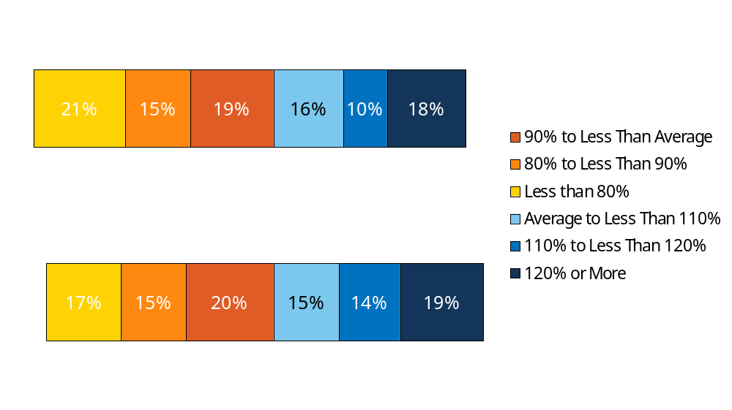
Exhibit 1.7
Distribution of Annual Premiums for Single and Family Coverage Relative to the Average Annual Single or Family Premium, 2012
<$4,492
$5,615
>=$6,738
<$12,596
$15,745
>=$18,894
NOTE: The average annual premium is $5,615 for single coverage and $15,745 for family coverage. The premium distribution is relative to the average single or family premium. For example, $4,492 is 80% of the average single premium, $5,054 is 90% of the average single premium, $6,177 is 110% of the average single premium, and $6,738 is 120% of the average single premium. The same break points relative to the average are used for the distribution for family coverage.
SOURCE: Kaiser/HRET Survey of Employer-Sponsored Health Benefits, 2012.

